Slide 1
Lab New Employee Safety Orientation
Welcome to the Lab at VMFH! This is your safety and regulatory Orientation

Slide 2
NEW EMPLOYEE LAB ORIENTATION- Welcome!!
Purpose
To provide you a standard introduction to the lab
To provide lab regulatory information related to Safety and Quality
To assure that mandatory lab general education is performed, documented, and placed in lab file
To review available intranet resources for Lab Staff

Slide 3
Housekeeping Items
Wear your badge – near your face
Log your time on the Kronos Exception Log (explanation=“education”). Punch in if possible at a Kronos time-clock.
Do you know where the closest restroom is?
COVID VACCINES – REQUIRED AT CHI-Franciscan https://vaccinelocator.doh.wa.gov

Slide 4
Documentation to be Completed
Key Elements of NELO presentation
Lab Tour
Employee Safety Product Usage Agreement
Hazardous Chemical Communication Form
Competency Quiz for Quality Plan
Techs: PT Attestation form
Medtraining Safety Modules Quizzes (pass >80%)
Notes:
-Forms are stand-alone forms that are part of the presentation and must be completed today
-medtraining is an internet based safety program for all staff. Great CE opportunities under the training library

Slide 5
Organizational Structure
Section 2

Slide 6
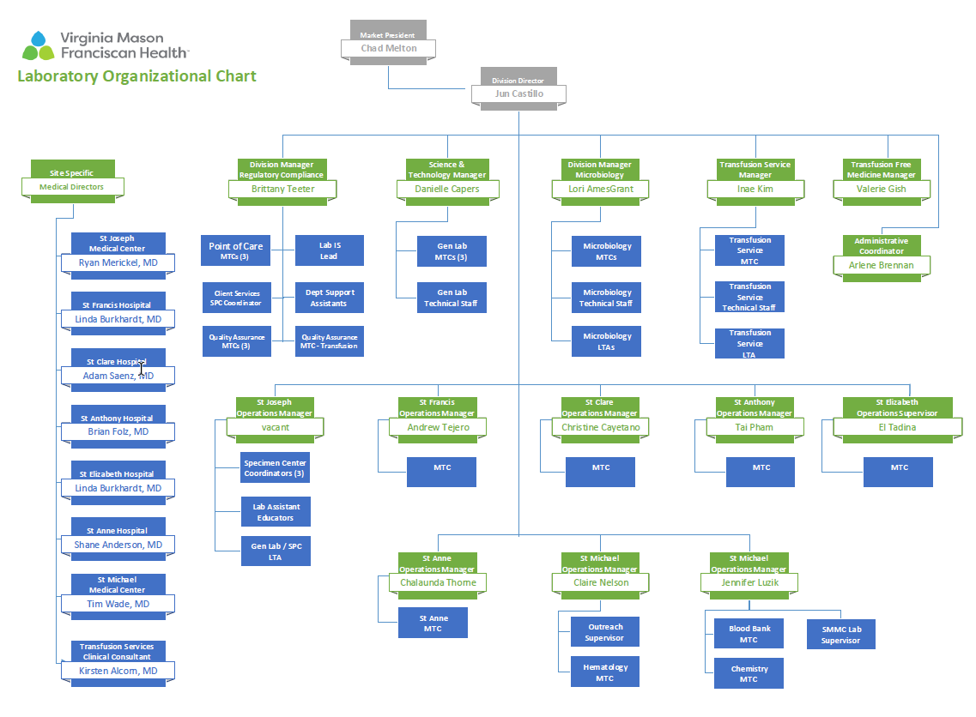

Slide 7
Laboratory Quality

Slide 8
A Culture of Consistent Quality & Safety Improvement
We strive for a Culture of Survey-Readiness and to be Excellent Everyday
We Monitor errors, audit our processes, find ways to improve!
In the LAB: We conduct ongoing Audits for compliance with:
hand washing standards
patient identification
critical values process
Safety Training
Notes:
Toyota- revolutionized how cars are made. High quality: standardized processes and efficient workflows to reduce cost. Remove wasted steps

Slide 9
How we maintain quality:
OUR METHOD
P. D. C. A .
We utilize Lean Principles
Rapid Process Improvement Projects
Standardization of processes to simplify
Waste identification and removal from the process to save time
Notes:
FHS Performance Improvement Methodology

Slide 10
The Laboratory Quality Plan
Our Lab’s Quality Plan consists of:
Plan Introduction and 12 Quality Policies (or QSE: Quality Service Essentials) which define the Lab Quality Program
In addition to Quality Plan policies: Laboratory Critical Values Policy, Records Retention, Training, Competency, and Customer Service and Safety Policies, and other high-level system lab quality policies
All found in PolicyStat
Policy Area = Lab/Quality
For the work we do, these quality standards are the backbone of our laboratory

Slide 11
What does the Laboratory Quality Plan do?
To build quality we document how things should be done in order to create a standard
We monitor our work to make sure we follow our policies
Our process is improved by documenting quality issues (w/ the Quality Form), performing self-audits, and responding to customer feedback
We hold each other accountable for producing lab test results of high quality
You are responsible for Quality in the Lab
Notes:
Techs- Read proficiency testing policy and sign attestation form for PT

Slide 12
Hospital Quality Monitoring: Incident Reporting - through IRIS
The HOSPITAL’s Incident reporting system, for:
Patient Safety, Injuries
Employee Safety, Injuries
Security (breaches in)
Find under

Slide 13
General Lab Rules

Slide 14
Dress Code and Lab Scent Policy
HR Policy takeaways: Specifics on dress are listed; badge is required, visible tattoos must be discreet and approved by your manager. Natural hair color - only.
Lab Policy for Scent discourages scents of all types: lotions, hair product, body wash, colognes.
Scent complaints are handled on a case-by-case basis.
Smell of smoke is not allowed per Dress Code
Non-smoking campus
If someone is bothered by your perfume, cologne or other smell we will bring it to your attention and we ask for your consideration and compassion.
Notes:
Even if other depts. are not enforcing the dress code, if there is an issue we will enforce what is written in that policy.

Slide 15
Dress Code and Badge Policy
Badge
Don’t add pins or stickers – unless directed by hospital authorities. (security issue)
Wear on upper half of body, near the face
If you lose or forget your badge, go to the ER security desk, and bring your ID for a temporary badge
Nails
Phlebotomists or staff with direct patient contact:
No Artificial Nails
No Very Long Nails
No Gel Nails
per Infection Prevention policy
Nothing Dangling or Long (it’s a safety issue!)

Slide 16
Cell Phone Policy
Don’t use your phone during work.
Phlebotomists: Don’t use your phone on your way to a draw, waiting for the elevator, etc.
The issue is the perception to visitors and patients of texts/calls/emails, and it’s distraction from detailed work
Listening to music/media content in off-stage areas may be acceptable in some situations.
Using your phone while on break is ok.

Slide 17
Laboratory Safety & Compliance

Slide 18
Compliance is ….
…at it’s core, following established Lab Policy and Procedure
Our Values and Ethics at Work:
Staff are audited to ensure safety and procedural standards are followed, such as:
Appropriate Use of PPE
Appropriate ID methods
Performing procedures without shortcuts
HIPAA compliance

Slide 19
Employee and Patient Safety
National Patient Safety Goals - NPSGs
Laboratory Safety Policies

Slide 20
Protected Health Information and HIPAA
What does HIPAA compliance pertain to?
Patient name, address, SSN, billing info, diagnosis info, etc. anything dealing with a patient and care
Confidential disposal of PHI
Faxing PHI with a cover sheet; verifying the fax# before sending
Documentation of release of lab results in Epic
Release of PHI over the phone
Confidentiality – Talking about a patient condition; does the person “need to know” the information to do their job
Fair Warning and username monitoring
Notes:
Pre-program faxes for frequent numbers; if manually entering a fax double check before sending; always use a cover sheet
Document your activities in Epic related to releasing records
Fair Warning- Epic monitors for inappropriate (potentially) inquiries; your manager would be notified to ask you what the business purpose was for the inquiry

Slide 21
National Patient Safety Goals [NPSG]
The Joint Commission (TJC) sets NPSGs
Each department orients staff on the NPSGs that impact their staff
Staff need to be able describe what their department does for patient safety!
3 NPSG goals apply to the LAB :
(Implemented to keep patients safe.)

Slide 22
Joint Commission NPSGs for 2023
Goal 1: Identify patients correctly
Use 2 identifiers - at least - to assure patients get the correct medicine and treatment.
Goal 2: Improve Staff Communication
Communicate test results ….
to the right staff person
on time
Goal 3: Prevent Infection
Use hand cleaning guidelines from the WHO and set goals to improve hand cleaning
Notes:
The 2 approved identifiers for use at Franciscan are: name and date of birth

Slide 23
NPSG #1 Improve Patient Identification
2 Identifiers at all times for specimen collection
Approved Identifiers are:
Patient Full Name and DOB (can count as one)
_____________
2 identifiers used when communicating about a patient: in phone calls or comparing paperwork to LIS (Beaker info) while working
Actively compare identifiers
MRN

Slide 24
NPSG#2 Effective Communication Critical Value Read-Back (Hospital Policy)
Lab Techs: Critical values must be called to specific unit staff
After giving the result, the nursing staff should Read Back what they wrote down
The Lab Tech documents the call and the read-back in LIS, along with: time/date, and who was given the result

Slide 25
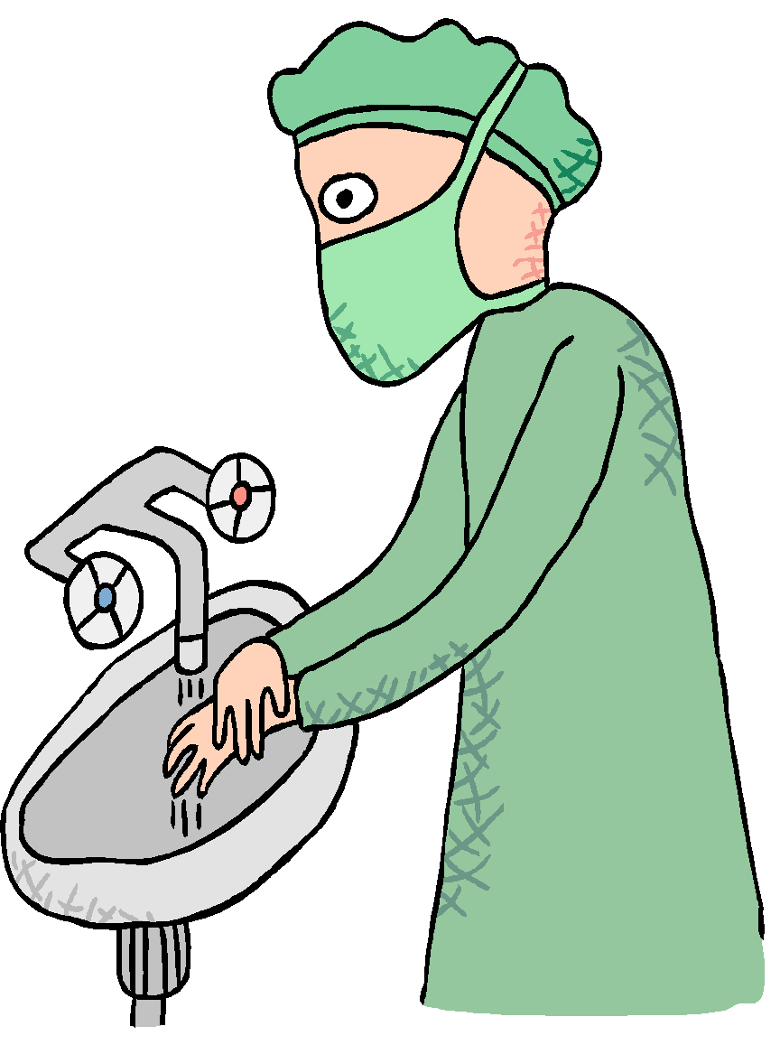
NPSG#3 Reduce Hospital Acquired Infections - by proper Hand Washing
20 seconds in warm water with soap, or with gel
When do we wash hands?
Between patients
When removing gloves
When leaving work area
(bio-hazardous)
Before eating, after restroom
When visibly soiled
TAKEAWAY: If you have patient contact, make your hand hygiene process visible to them. Our policy is to do so whenever possible.

Slide 26
Safety Training Modules Online
www.medtraining.org
Login = your work email address (first.lastname@commonspirit.org) (...@vmfh.org)
Password is password
Phlebotomists: basic phlebotomy is also on this website
Some modules can count toward Continuing Education. Check with your manager to decide on courses.

Slide 27
Laboratory Safety Policies
In Policy Stat - Find and Read these policies: (check off when done)
Chemical Hygiene Plan
Hazardous Materials Spill Response Procedure
Infectious Waste Management Plan: Storage and Disposal
Biohazard, Sharps, and Waste Designation Tool
Laboratory Infection and Exposure Control Plan
Infection and Exposure Lab Standard Operating Procedures
Bloodborne Pathogen Exposure Control Plan
Tasks Requiring Personal Protective Equipment (PPE)
Code Triage Lab Disaster Response Plan
Fire Emergency and Evacuation Policy
Incident Reporting (IRIS)/Accident Reporting for employees
Hand Hygiene Policy

Slide 28
Review Your ROLE
(by Job title) in a CODE TRIAGE
A Laboratory Manager or Supervisor will assume the role of Laboratory Unit Leader. In the absence of a Laboratory Manager or Supervisor, the Tech-in-Charge will assume the responsibility.
Specimen Coordinator has the responsibility for directing the duties of the Laboratory Assistants and/or Specimen Processors and handling all incoming phone calls to the area. At sites without a coordinator, the most senior lab assistant will assume this role.
Laboratory Assistants reporting to the Immediate treatment area /Emergency Department, have the overall responsibility of performing venipuncture as instructed on ED patients, and labeling tubes from ED triage tags or patient identification bands. Specimens must then be transported to the testing lab for the site using a "runner" or the pneumatic tube system. Manual test requisitions may need to accompany samples to lab for testing. A runner is obtained through the Labor Pool.
Lab Assistants reporting to the delayed treatment area have the responsibility of performing venipuncture as instructed. Specimens will be given to runners for delivery to the main Laboratory.
Specimen Processors/Lab Technical Assistants have the responsibility to triage samples for testing based on priority and utilize the Epic Beaker Laboratory Downtime Process if required.
Notes:
Go to PolicyStat and find your Job Title

Slide 29
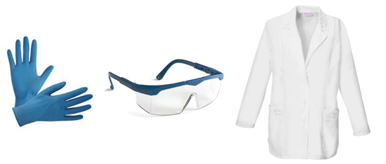
Personal Protective Equipment (PPE)
PPE needs are determined by the task being performed
Your Trainer will instruct you on the appropriate PPE to use
The basics in the Lab: Gloves and a buttoned lab coat
When indicated: Splash shields, disposable face shields, CAPR for potential infectious disease/virus transmission
Only Techs - TRAINED IN CHEMICAL SPILLS - should clean up a hazardous spill
Notes:
If you are opening a sample tube, a splash shield must be used to prevent splash to eyes, mouth, etc. Certain maintenance procedures may pose a splash hazard.

Slide 30
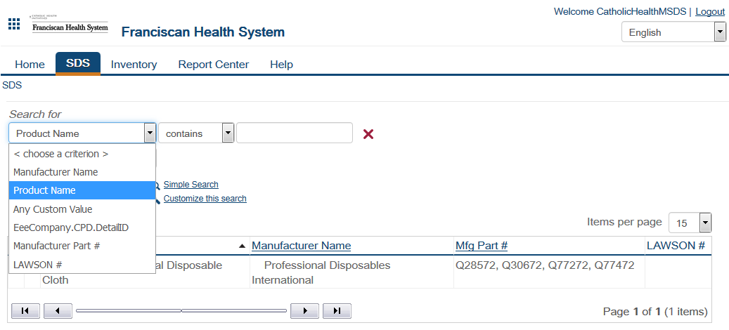
Safety Data Sheets (SDS) Review
*** the SDS Window defaults to Inventory tab. Change to the SDS tab to search for chemicals by Product Name. ***

Slide 31
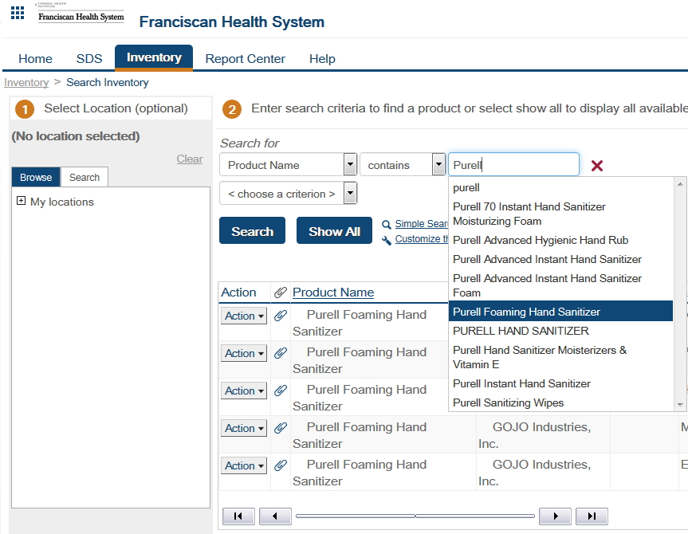
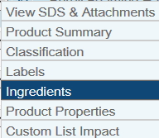
SDS Online SEARCH
Enter a chemical product name and search for results.
…or add criteria to narrow your search
Click on “Action” next to the product to list the ingredients and other useful information

Slide 32
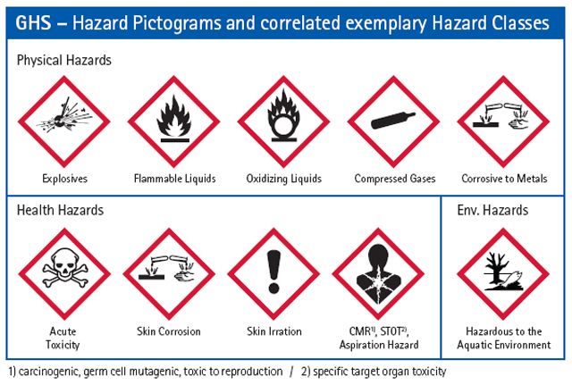
Let’s Review our Hazard Pictograms for Chemical Safety
SDS Online is the primary source of information on any chemical present in the lab. Find a pictograms chart in your Lab
They Explain:
Hazards
PPE recommended
Clean up procedures
Familiarize yourself with these signs!

Slide 33
Spill Clean-up
Locate Universal Spill Clean-Up Kit in the Lab
Bright yellow bag or bucket in safety clean-up kits area
Hazardous Spill Report required for all chemical spills
What is the Pictogram on the Spilled Substance?
Formalin, Acid, Base, and Solvent spill kits also located in the safety area or where the chemical is used

Slide 34
Employee Incident or Accidents
In the event of….
Seek First Aid treatment
Tell your immediate supervisor.
File an IRIS report:
Go to the Connect home page and log an IRIS (hospital) for employee incident
In case of Exposure:
If Bloodborne Pathogen exposure, you must
Give first aid
Notify your Supervisor/Manager
Report to the ED! The ED has a set procedure to follow.
For other exposure: Report to ED or your primary doctor ASAP
Safety issues are considered a quality issue and are investigated to prevent reoccurrence
For injuries requiring hospital/clinic treatment (Locate and file a Self Insured Injury Claim from Quick Links)
they happen!

Slide 35
Life Safety: Emergency Codes
Let’s Review:
Find and Review Emergency Codes Chart posted in Lab
Lab employees must know the required staff response
To call a Code, dial 5555 and announce your location and the Code
Codes that INVOLVE THE LAB Directly:
Code Blue- Cardiac or Respiratory Arrest
a Lab Assistant Responds
Code Red- Fire
RACE: Rescue, Alarm, Contain, Extinguish
PASS: Point, Aim, Squeeze, Sweep (the fire extinguisher )
Stop, Drop, Cover face, Roll for clothing fire
Code 5 – Shelter in Place

Slide 36
Emergency Codes cont.
Let’s Review:
Amber Alert - infant, child or vulnerable adult
Identify your lab’s assigned location in Policy 548.00
Code Orange - internal or external chemical spill
Code Triage - disaster
Know the Code Triage response, and your role
Code Gray - Patient out of control
Code 5 - shelter in place and monitor/ situation unsafe
Code Silver - weapon or hostage situation. “silent”
Code ‘Rapid Response’ – team response to safety risk situation
Call Security: (SJMC)127-4888, (SFH)125-3033, (SCH)188-2274, (SAH)130-2130, (SEH) 102-3079, SMMC-Brem x6520, SMMC-Silv x8942, SANH 106-5589

Slide 37
Emergency Contact:
Emergency Info Communication tool for STAFF
Google Hub where several RESOURCES (training sessions & support information) can be accessed at: (x)Matters GO-Live Hub
https://CommonSpirit.xmatters.com TO SIGN UP and edit your personal Info

Slide 38
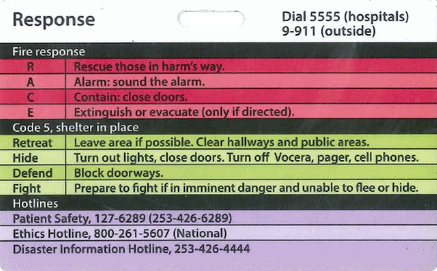
Patient and Employee Safety Signage
Patient Safety Hotline (SJMC) behind your badge
CAP hotline for test quality or employee safety issues
(866) 236-7212
Look for this Hot Line info on Bulletin Boards in the Lab
Notes:
Accreditation requires that staff can call around existing chain of command to report quality or patient safety issues that are not being responded to

Slide 39
All new hires are invited to take a MyVoice 90-Day New Hire Survey.
The survey takes about 10 minutes to complete and responses are confidential.
If employees have questions about the survey please contact employee.surveys@commonspirit.org

Slide 40
You are finished IF…
ALL forms are filled out and signed with today’s date, and related all policies have been read
Dept Orientation (tour guide): Each line item is Signed/Dated
Key Elements checklist: Each line item is Signed/Dated
Quality Competency post quiz: Passed > 80%
Employee Safety Product Usage Agreement: Completed
Hazardous Chemical Communication: Completed
Techs- PT attestation form: Read, Signed, Dated
MedTraining modules: completed and Quizzes > 80%
Turn in your documents to your trainer or manager
Notes:
Medtraining can be completed at home lab within 2 weeks

