Slide 1

New Employee Lab Orientation (NELO)
Welcome to the Lab at VMFH! This is your safety and regulatory Orientation

Slide 2
NEW EMPLOYEE LAB ORIENTATION- Welcome!!
Purpose
To provide you a standard introduction to the lab
To provide lab regulatory information related to Safety and Quality
To assure that mandatory lab general education is performed, documented, and placed in lab file
To review available intranet resources for Lab Staff

Slide 3

Mission, Vision, & Values
Mission
As CommonSpirit Health, we make the healing presence of God known in our world by improving the health of the people we serve, especially those who are vulnerable, while we advance social justice for all.
Vision
A healthier future for all, inspired by faith, driven by innovation and powered by our humanity.
Values
Compassion
Care with listening, empathy and love
Accompany and comfort those in need of healing
Inclusion
Celebrate each person’s gifts and voice
Respect the dignity of all
Integrity
Inspire trust through honesty
Demonstrate courage in the face of inequity
Excellence
Serve with fullest passion, creativity and stewardship
Exceed expectations of others and ourselves
Collaboration
Commit to the power of working together
Build and nurture meaningful relationships

Slide 4

VMFH Mission and Values

Slide 5
Hospital Orientation Review
Attendance
  VMFH provides benefits and allowances for employees' absences through Paid Time Off (PTO) and Extended Illness Bank (EIB).
  However, short notice absences from scheduled work can affect cost, efficiency, patient care, and cause hardship on both co-workers and departmental operations.
  For this reason, it is required that employees limit their short notice occurrences (SNOs) to six in a 12-month period.

Slide 6
Hospital Orientation Review
Behavior Standards
  As a minimum standard, all employees will conduct their activities in compliance with applicable laws and act in a manner consistent with our core values, standards of conduct and customer service standards. In addition, while at work employees are expected to share in the organization's core values and express them in their daily work life.
  Standards of conduct are as follows:
    Demonstrate fairness, honesty and integrity in all interactions in support of our mission.
    Uphold a high standard of skill and knowledge to deliver exceptional quality care, service and outcomes.
    Abide by the laws, regulations and policies that govern what we do.
    Maintain the integrity and protect the confidentiality of our patient, resident, client, employee and organizational information.
    Use our resources wisely to protect our assets, reduce our environmental impact and increase our public health footprint.
    Create an environment that promotes community, respects dignity and supports safety and well-being.
    Properly disclose and manage situations that pose potential or actual conflicts of interest.
    Foster a diverse and inclusive work environment in reverence to our employees, partners and those we serve.Exercise good faith and honesty in all dealings and transactions.

Slide 7

Hospital Orientation Review
Cellular Phones
  Personal cell phones and data devices have the potential to interfere with the delivery of prompt, efficient and focused patient care and customer service.
  During non-work time employees may utilize personal cell phones in the cafeteria, break rooms, private offices or on campus outside of hospital buildings.
  Non-management employees may not use cell phones or data devices, to include texting, utilizing ear buds or ear phones unless they are on a break from regular work and in a non-work area. If you are expecting an important call, excuse yourself and walk somewhere private.

Slide 8

Hospital Orientation Review
Lab Scent Policy
Lab Policy for Scent discourages scents of all types: lotions, hair product, body wash, colognes.
Scent complaints are handled on a case-by-case basis.
Smell of smoke is not allowed per Dress Code
  Non-smoking campus
If someone is bothered by your perfume, cologne or other smell we will bring it to your attention and we ask for your consideration and compassion.
Notes:
Even if other depts. are not enforcing the dress code, if there is an issue we will enforce what is written in that policy.

Slide 9

Hospital Orientation Review
ID Badge & Meal and Rest Breaks
Identification Badges
  The identification badge must be legible and worn in a visible and unobstructed location.
  Name badges must be worn between shoulder and chest level or lower if attached to a lanyard.
Meal and Rest Periods
  Each non-exempt employee shall be allowed an unpaid, uninterrupted meal period of thirty (30) minutes for each shift of more than five (5) hours. The meal period shall be taken between the second (2nd) and fifth (5th) working hour. Meal period shall not be taken at the beginning or the end of the day so as to shorten the workday.
  Non-exempt employees shall receive one fifteen (15) minute paid rest break for each four (4) hours of consecutive work. Rest breaks may be taken intermittently and need not be regularly scheduled, depending on the nature of the work.

Slide 10
Hospital Orientation Review
Vacation, Time and Tardiness
Holiday & Vacation Policy – Clinical Laboratory
  VMFH laboratories will grant vacation time off based upon staffing and operational needs.
  While management will strive to approve vacation requests at the optimum time for each employee, this is not always possible.
  A vacation request will not be granted when it will interfere with the organization's ability to provide quality care to our patients or if there are not sufficient accruals to cover the requested time off.
Timekeeping and Tardiness
  VMFH has adopted a seven minute rounding rule or grace period for pay purposes.
  If an employee clocks in within seven minutes before or after the designated start or end time, the employee will be paid as if rounded to that quarter hour even though the exact time will be recorded in the timekeeping system. Clocking in or out eight minutes before or after the designated start or end time will be paid as if rounded to the previous or next quarter hour. The seven minute rounding rule does not change the expected start and end times for any employee's work shift.
  Tardiness affects cost, efficiency, patient care, and causes disruption and hardship to both co-workers and departmental operations.
  Tardiness is defined as arriving at the workstation and/or timeclock any time after the scheduled start time. A late return from a meal or rest break will be addressed as a performance issue separate from the tardiness policy.

Slide 11
Quality Plan Introduction

Slide 12
About the Quality Plan
Quality of processes, products, and people are the cornerstones of the VMFH system. The Laboratory Quality Plan is organized to meet CAP accreditation requirements and to monitor functions and systems in the Laboratory through the performance of self-assessment audits, identification, evaluation, and correction of non-conforming events, error management, and customer feedback.
We are guided by law, conforming to the regulatory standards required by local, state, and federal government agencies.
We adhere to high standards for quality by conforming to requirements for accreditation established by the following:
  College of American Pathologists (CAP)
  The Joint Commission (TJC)
  AABB
  CLIA
  DOH

Slide 13
What does the Laboratory Quality Plan do?
To build quality we document how things should be done in order to create a standard
We monitor our work to make sure we follow our policies
Our process is improved by documenting quality issues (w/ the Quality Form), performing self-audits, and responding to customer feedback
We hold each other accountable for producing lab test results of high quality
You are responsible for Quality in the Lab
Notes:
Techs- Read proficiency testing policy and sign attestation form for PT

Slide 14

The Laboratory Quality Plan
Our Lab’s Quality Plan consists of:
Plan Introduction and 12 Quality Policies (or QSE: Quality Service Essentials) which define the Lab Quality Program
  In addition to Quality Plan policies: Laboratory Critical Values Policy, Records Retention, Training, Competency, and Customer Service and Safety Policies, and other high-level system lab quality policies
  All found in PolicyStat
    Policy Area = Lab/Quality
For the work we do, these quality standards are the backbone of our laboratory

Slide 15

A Culture of Consistent Quality & Safety Improvement
We strive for a Culture of Survey-Readiness and to be Excellent Everyday
We Monitor errors, audit our processes, find ways to improve!
In the LAB: We conduct ongoing Audits for compliance with:
  patient identification
  critical values process
  Safety Training
Notes:
Toyota- revolutionized how cars are made. High quality: standardized processes and efficient workflows to reduce cost. Remove wasted steps

Slide 16
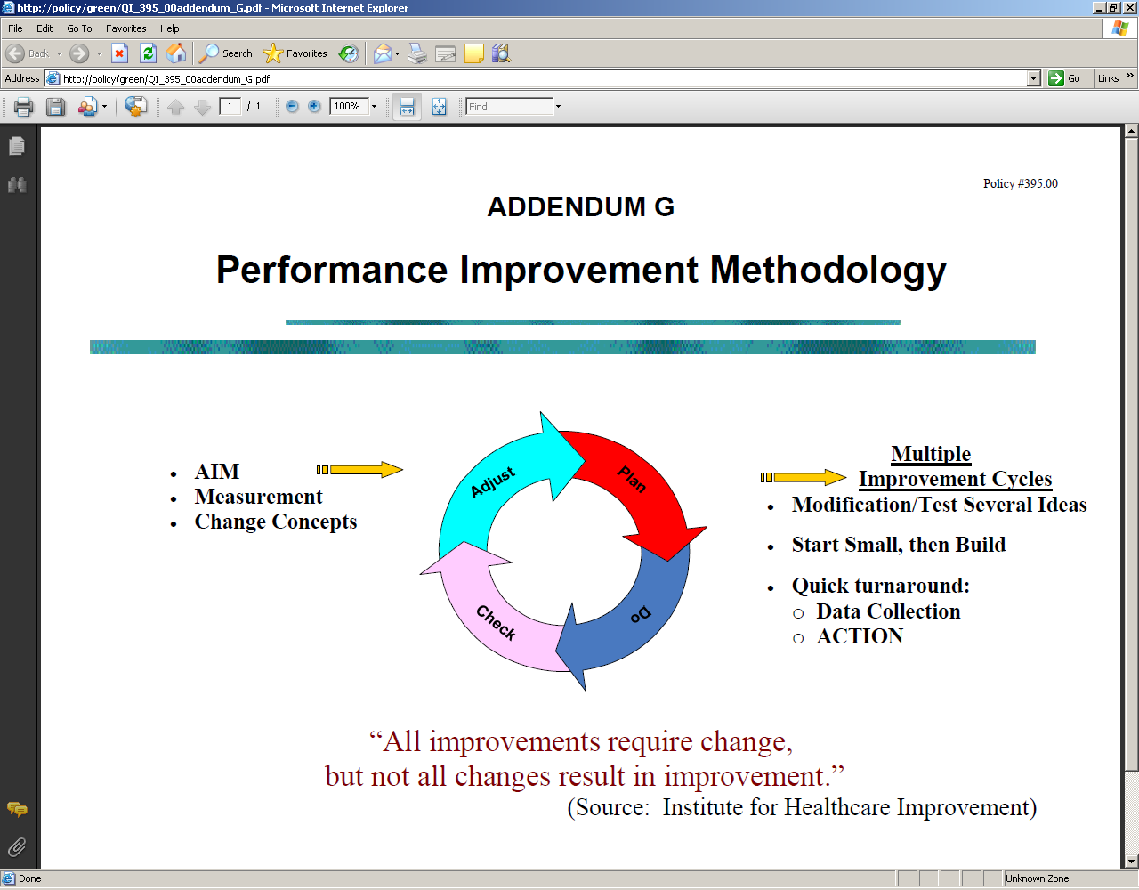

How we maintain quality:
OUR METHOD
P. D. C. A .
We utilize Lean Principles
Rapid Process Improvement Projects
Standardization of processes to simplify
Waste identification and removal from the process to save time
Notes:
FHS Performance Improvement Methodology

Slide 17
Organizational
Structure
Section 1

Slide 18
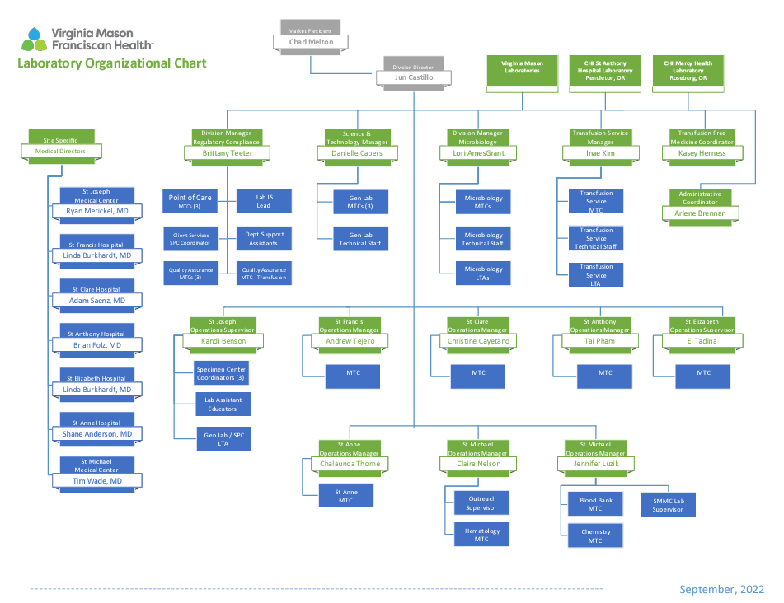

Slide 19
Personnel
Section 2

Slide 20
Quality Policy 2: Personnel
The Laboratory Medical Director is responsible for assuring there are sufficient numbers of staff with appropriate educational qualifications, documented training and experience, and adequate competency to meet the needs of the laboratory.
The CHI Franciscan Laboratory Training Process ensures the following:
  All employees receive standard training in Safety, Chemical Hygiene, Blood Borne Pathogens, Ethics, and Compliance.
  All employees receive hospital, departmental, and quality system training.
  All employees receive job-specific training (including information technology applications).
  All training processes are validated for effectiveness.
  Retraining is initiated when needed.
  All staff are evaluated for proper performance of key job functions prior to being allowed to work independently.
  Competency to perform patient testing is assessed 6 months, and annually for testing personnel. (Note: See Competency Assessment for Technical Personnel)
  All training and retraining is documented.
  All training and competency assessments are tracked and maintained.

Slide 21
Equipment
Section 3

Slide 22
Quality Policy 3: Equipment
VMFH Laboratories identify critical equipment, and in conjunction with the Clinical Engineering Department, ensures that critical equipment is checked for safety, installed, qualified, calibrated and maintained according to manufacturer's specifications.

Slide 23
Purchasing and Inventory
Section 4

Slide 24
Quality Policy 4: Purchasing and Inventory
Establishing and following specifications for suppliers of critical materials helps assure that adequate inventories and quality of supplies will be consistent.
An inventory management process ensures that incoming supplies of critical materials are received, inspected, tested when appropriate, and evaluated against acceptance criteria.

Slide 25
Process Control
Section 5

Slide 26
Quality Policy 5: Process Control
Process control within the laboratory is rooted in document control of the processes and procedures surrounding the performance and reporting of patient testing including:
  quality control programs,
  proficiency testing,
  test method validation/verification,
  defined change management processes.
Documents are developed, revised, and controlled using PolicyStat following standardized formatting protocols, collaboration methods, validation and approval processes across the system.
Validating documents ensures that the output is what it is intended to be and provides objective evidence that variables were considered and control systems evaluated before a process or work instruction is used in the live environment.
Validation of documents is performed by staff trained and knowledgeable in the subject matter.

Slide 27
Documents and Records
Section 6

Slide 28
Quality Policy 6: Documents and Records
Laboratory documents and records are managed from creation to archiving according to established processes that reflect adherence to legal and regulatory requirements, and demonstrate the organization's commitment to quality.

Slide 29
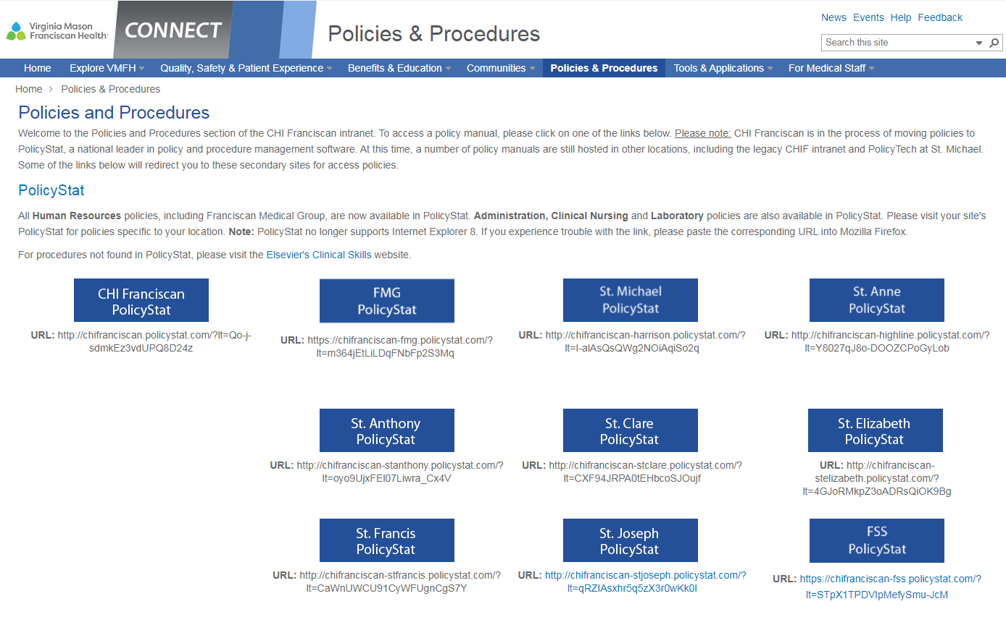

Slide 30
Occurrence Management
Section 7

Slide 31
Quality Policy 7: Occurrence Management
Occurrence Management is the process by which errors are identified, investigated, and then corrected/prevented through corrective action planning.
The Laboratory is focused on being aware of occurrences that may signal malfunctioning processes with the goal of correcting problems, improving quality and reducing risk thereby improving customer and employee satisfaction and compliance with regulations and standards.

Slide 32
Quality Policy 7: Occurrence Management
DETECTION OF OCCURRENCES
  The laboratory becomes aware of occurrences/non-conformances from a number of sources that may be logged into the hospital or lab incident reporting databases.
DOCUMENTATION AND INVESTIGATION
  The individual who detects an occurrence records the details that will facilitate the investigation and resolution.
  The Quality Form is designed and used for this purpose. After completion, each Quality Form is routed to the appropriate manager for entry into the database.
PROCESS IMPROVEMENT
  Information about the types and causes of occurrences is essential to process improvement.

Slide 33
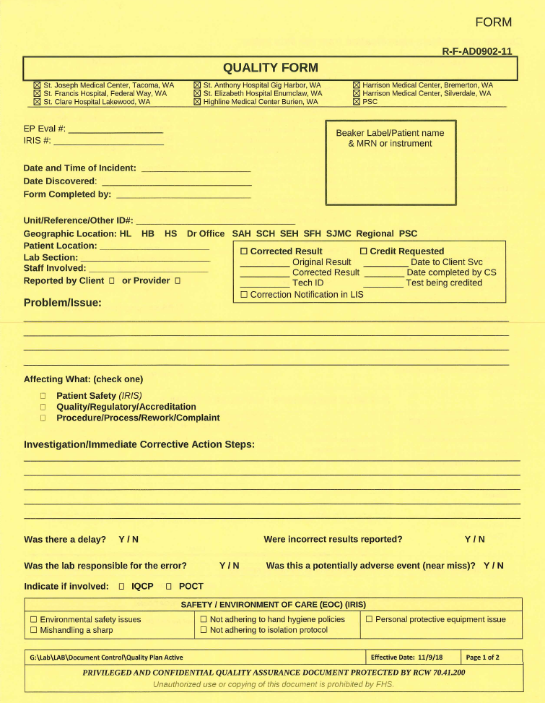
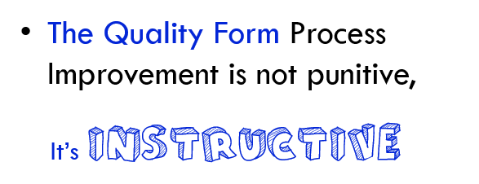
Quality Policy 7: Occurrence Management
Documenting quality occurrences helps us focus toward root-cause thinking, training shortfalls, equipment or work environment needs, and promotes a team approach to achieving excellence.

Slide 34



Hospital Quality Monitoring:
Incident Reporting - through IRIS
The HOSPITAL’s Incident reporting system, for:
Patient Safety, Injuries
Employee Safety, Injuries
Security (breaches in)
Find under

Slide 35
Assessments
Section 8

Slide 36
Quality Policy 8: Assessments
Laboratory performs or participates in audits to monitor quality, safety and regulatory performance.
Examples of audits are: hand hygiene, satellite waste accumulation, patient experience scripting compliance, and BCA computer audits.
Examples of internal assessments are: Environment of Care audits, CAP interim inspections, Code Red Fire Response.
Examples of external audits are: CAP site inspections, AABB site inspections, Department of Health site inspections, The Joint Commission inspections for accreditation.
ASSESSMENT RESULTS AND CORRECTIVE ACTION
Internal or external assessments results are analyzed and compared to requirements, desired outcomes, and goals. The summary findings are filtered through Occurrence Management, Safety, and Performance Improvement systems for corrective action, monitoring, and reassessment if the corrective actions have not been found to be effective.

Slide 37
Process Improvement
Section 9

Slide 38
Quality Policy 9: Process Improvement
CHI Franciscan Laboratory Quality Improvement efforts are supported by the hospital Risk Management Plan.
EP Evaluator provides an Incident Tracking module that is the database used to track and trend laboratory specific quality events.
These events are categorized as pre-analytical, analytical, post-analytical, and/or safety aspects of the laboratory.
The hospital Incident Reporting Information System (IRIS) is used to report all patient safety events.
Both systems provide the foundation for Laboratory process improvement opportunities.

Slide 39
Facilities and Safety
Section 10

Slide 40
Quality Policy 10: Facilities and Safety
The CHI Franciscan Laboratory adheres to institutional Facilities policies which include:
Investigation and Reporting of Medical Device Adverse Events
Indoor Air Quality Management
Smoking and Tobacco Products
Utilities Management Plan
Hazardous Materials Spill Response Policy
Ergonomic Assessment Policy
Hearing Conservation Policy
Emergency Management (disaster) Plan
Infection Prevention and Control Program
Infectious Waste Management
Access Credential Controls - Key Policy

Slide 41
Quality Policy 10: Facilities and Safety
The CHI Franciscan laboratory safety program is defined in the Safety manual. It consists of the following:
Safety orientation and training at hire
Hospital Annual update safety training with alternating competency assessment for evacuation and/or fire response technique.
Documentation of training and competency
Ready access to CHI Franciscan Safety Manual and procedures
Chemical Hygiene Plan review and Hazardous Waste/Right-to-Know Communication
Blood borne Pathogen Exposure Plan
Infection Exposure and Control Plan
Medical Consultation and Accident Reporting
All CHI Franciscan laboratory employee accidents tracked/trended to prevent recurrences (IRIS)
Laboratory Emergency fire, disaster, and evacuation plans

Slide 42
Information Management
Section 11

Slide 43
PRIVACY, CONFIDENTIALITY, DATA SECURITY
The VMFH Laboratory ensures privacy and confidentiality of all patient information by utilizing or maintaining:
  The Health Insurance Portability and Accountability Act (HIPAA) Compliance
  SECURE DATA ACCESS
  CHI FRANCISCAN IT DATA INTEGRITY AND SECURITY
All employees are required to sign Personal Accountability and Acceptable Use Agreements.

Slide 44

Protected Health Information
What does HIPAA compliance pertain to?
Patient name, address, SSN, billing info, diagnosis info, etc. anything dealing with a patient and care
Confidential disposal of PHI
Faxing PHI with a cover sheet; verifying the fax# before sending
Documentation of release of lab results in Epic
Release of PHI over the phone
Confidentiality – Talking about a patient condition; does the person “need to know” the information to do their job
Fair Warning and username monitoring
Notes:
Pre-program faxes for frequent numbers; if manually entering a fax double check before sending; always use a cover sheet
Document your activities in Epic related to releasing records
Fair Warning- Epic monitors for inappropriate (potentially) inquiries; your manager would be notified to ask you what the business purpose was for the inquiry

Slide 45
Customer Service
Section 12

Slide 46
The VMFH laboratory identifies the needs and expectations of internal and external customers, and actively seeks feedback to determine where improvements in service can be achieved to assure effective customer service practices.
The customers of CHI-FH Laboratory are made up of internal and external customers including:
  Patients
  Inpatient Providers
  Hospital Departments
  Patient Care Units
  Other laboratories in the system
  Nursing Staff
  Employees
  Outpatient Providers
  Hospital Laboratory clients

Slide 47


Quality Compliance is
…essential. By following established Lab Policy and Procedure, we are emphasizing our values and ultimately observing the mission of our company.
Staff are audited to ensure safety and procedural standards are followed, such as:
  Appropriate Use of PPE
  Appropriate ID methods
  Performing procedures without shortcuts
  HIPAA compliance

Slide 48
Safety

Slide 49


Employee and Patient Safety
National Patient Safety Goals - NPSGs
Laboratory Safety Policies

Slide 50
National Patient Safety Goals [NPSG]
The Joint Commission (TJC) sets NPSGs
Each department orients staff on the NPSGs that impact their staff
Staff need to be able describe what their department does for patient safety!
3 NPSG goals apply to the LAB :
  (Implemented to keep patients safe.)

Slide 51
Joint Commission NPSGs for 2023
Goal 1: Identify patients correctly
Use 2 identifiers - at least - to assure patients get the correct medicine and treatment.
Goal 2: Improve Staff Communication
Communicate test results ….
to the right staff person
on time
Goal 3: Prevent Infection
Use hand cleaning guidelines from the WHO and set goals to improve hand cleaning
Notes:
The 2 approved identifiers for use at Franciscan are: name and date of birth

Slide 52

NPSG #1 Improve Patient Identification
2 Identifiers at all times for specimen collection
Approved Identifiers are:
  Patient Full Name and DOB (can count as one)
  _____________
2 identifiers used when communicating about a patient: in phone calls or comparing paperwork to LIS (Beaker info) while working
Actively compare identifiers
MRN

Slide 53

NPSG#2 Effective Communication
Critical Value Read-Back (Hospital Policy)
Lab Techs: Critical values must be called to specific unit staff
After giving the result, the nursing staff should Read Back what they wrote down
The Lab Tech documents the call and the read-back in LIS, along with: time/date, and who was given the result

Slide 54
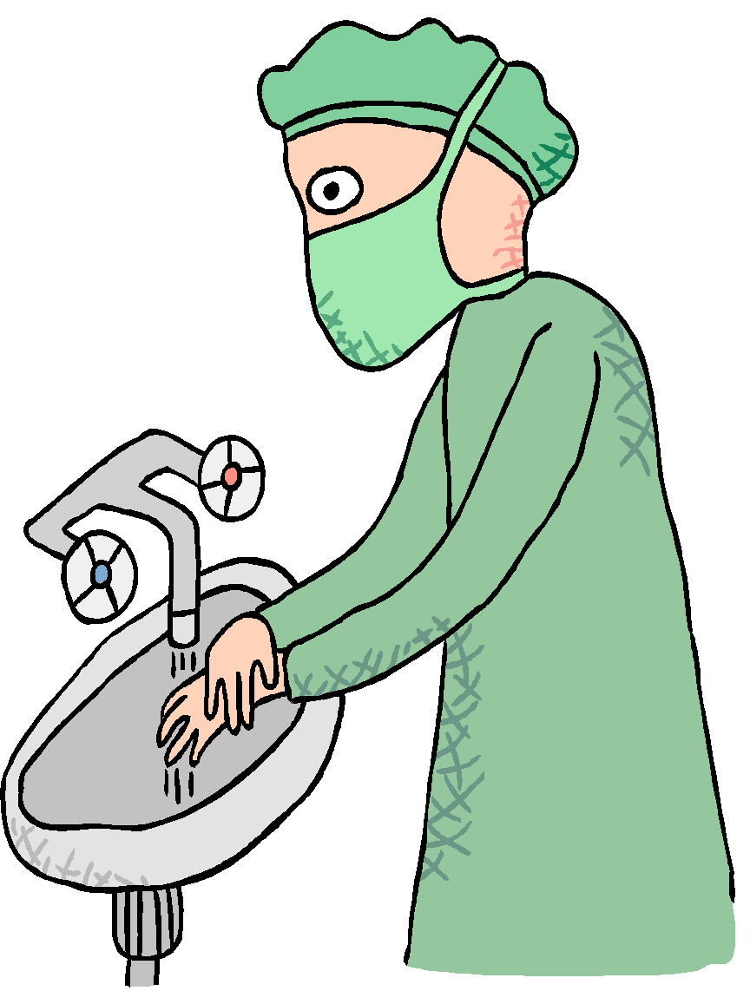
NPSG#3 Reduce Hospital Acquired Infections - by proper Hand Washing
20 seconds in warm water with soap, or with gel
When do we wash hands?
  Between patients
  When removing gloves
  When leaving work area
  (bio-hazardous)
  Before eating, after restroom
  When visibly soiled
TAKEAWAY: If you have patient contact, make your hand hygiene process visible to them. Our policy is to do so whenever possible.

Slide 55

Safety Training Modules Online
www.medtraining.org
Login = your work email address (first.lastname@commonspirit.org) (...@vmfh.org)
Password is password
Phlebotomists: basic phlebotomy is also on this website
Some modules can count toward Continuing Education. Check with your manager to decide on courses.

Slide 56

Hospital & Laboratory Safety Policies
Chemical Hygiene
  It is the responsibility of VMFH to provide a work environment that is free from recognizable hazards for its employees in accordance with the OSHA, 29 CFR, Part 1910.
  All employers with hazardous chemicals in their workplaces must have labels and safety data sheets for their exposed workers, and train them to handle the chemicals appropriately.
  A Hazardous Chemical is defined as any chemical, chemical compound, or mixture of compounds which is a physical and/or health hazard.

Slide 57
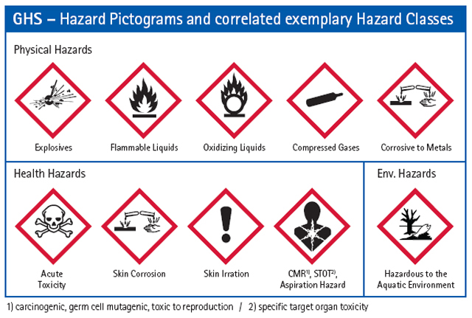

Let’s Review our Hazard Pictograms for Chemical Safety
SDS Online is the primary source of information on any chemical present in the lab. Find a pictograms chart in your Lab
They Explain:
  Hazards
  PPE recommended
  Clean up procedures
Familiarize yourself with these signs!

Slide 58




Life Safety: Emergency Codes
Let’s Review:
Find and Review Emergency Codes Chart posted in Lab
Lab employees must know the required staff response
  To call a Code, dial 5555 and announce your location and the Code
        RACE: Rescue, Alarm, Contain, Extinguish
        PASS: Point, Aim, Squeeze, Sweep (the fire extinguisher )
        Stop, Drop, Cover face, Roll for clothing fire

Slide 59
Emergency Codes cont.
Let’s Review:
Red | Fire: smoke, persistent burning smell, flames
Orange (Internal, Decon) | Hazardous materials spill/Decontamination
Amber | Infant, child, or missing adult
Grey | Combative patient
Security Stat (Hospital Only) | Disruptive visitor, team member
Silver | Weapons/Hostage
Shelter in Place | Unsafe situation/lockdown: Internal/External/Extreme Violence
Triage | Disaster Plan Activation: Internal/External
Capacity | Capacity issues: 1, 2, or Surge
Blue | Cardiac or respiratory arrest
Trauma | Trauma patient: Full/Modified/Limited
Stemi | Cardiac Emergency
Code Neuro | Stroke
Rapid Response | Activate rapid response team
Sepsis | Sepsis Emergency
External First Responder | Person needing assistance outside on hospital campus/grounds
Call Security: (SJMC)127-4888, (SFH)125-3033, (SCH)188-2274, (SAH)130-2130, (SEH) 102-3079, SMMC-Brem x6520, SMMC-Silv x8942, SANH 106-5589

Slide 60




Only we have a …
Code Lavender
Hospital Chaplains offer “Code Lavender”: counseling support for all employees who experience physical or emotional injury at work.
Chaplain – to – Staff Support
PASTORAL CARE Office: 127-4711 (located in SJMC)
PAGER: SJMC: 253-416-4588
VOCERA: “Call Chaplain”
from 9 pm to 7:30 am call the House Supervisor to call Chaplain

Slide 61
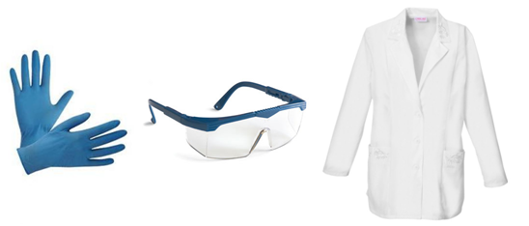
Personal Protective Equipment (PPE)
  PPE needs are determined by the task being performed
    Your Trainer will instruct you on the appropriate PPE to use
  The basics in the Lab: Gloves and a buttoned lab coat
  When indicated: Splash shields, disposable face shields, CAPR for potential infectious disease/virus transmission
  Only Techs - TRAINED IN CHEMICAL SPILLS - should clean up a hazardous spill
Notes:
If you are opening a sample tube, a splash shield must be used to prevent splash to eyes, mouth, etc. Certain maintenance procedures may pose a splash hazard.

Slide 62
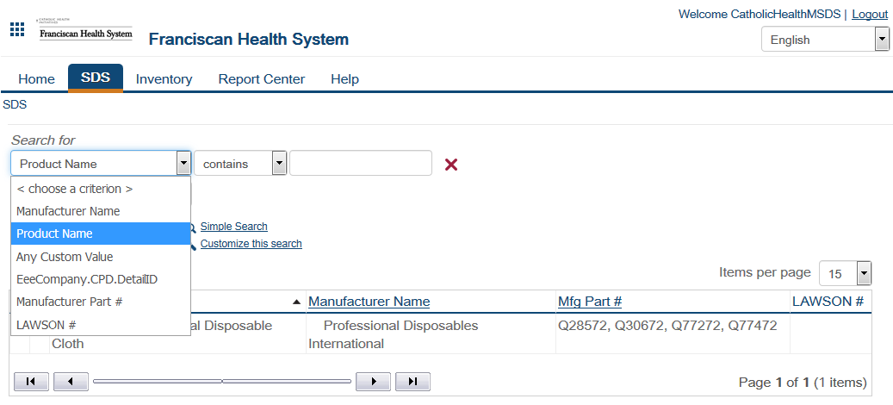

Safety Data Sheets (SDS) Review
*** the SDS Window defaults to Inventory tab. Change to the SDS tab to search for chemicals by Product Name. ***

Slide 63
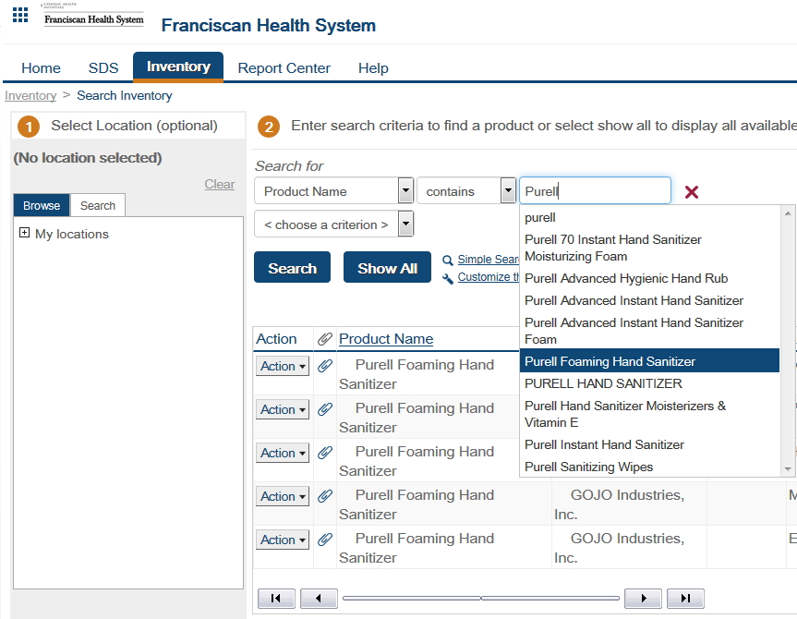
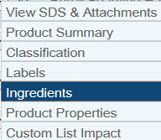
SDS Online SEARCH
Enter a chemical product name and search for results.
…or add criteria to narrow your search
Click on “Action” next to the product to list the ingredients and other useful information

Slide 64


Spill Clean-up
Locate Universal Spill Clean-Up Kit in the Lab
  Bright yellow bag or bucket in safety clean-up kits area
  Hazardous Spill Report required for all chemical spills
Formalin, Acid, Base, and Solvent spill kits also located in the safety area or where the chemical is used

Slide 65

Employee Incident or Accidents
In the event of….
When an employee receives a workplace injury such as a blood borne pathogen exposure or chemical splash.
Employees are required to report accidents and have access to medical consultation.
  In case of Blood Borne Pathogen Exposure:
    You must:
      Give first aid
      Notify your Supervisor/Manager
      Report to the ED within 1 hour of exposure!
  In case of Workplace injury
  Seek First Aid.
  Tell your immediate supervisor.
  File an IRIS report: Go to the Connect home page and log an IRIS (hospital) for employee incident
  Initiates the Employee Injury Investigation Report, completing all applicable sections and gives to their supervisor
    Report to ED or your primary doctor ASAP
  Safety issues are considered a quality issue and are investigated to prevent reoccurrence

Slide 66

Emergency Contact:
Emergency Info Communication tool for STAFF
Google Hub where several RESOURCES (training sessions & support information) can be accessed at: (x)Matters GO-Live Hub
https://CommonSpirit.xmatters.com TO SIGN UP and edit your personal Info

Slide 67
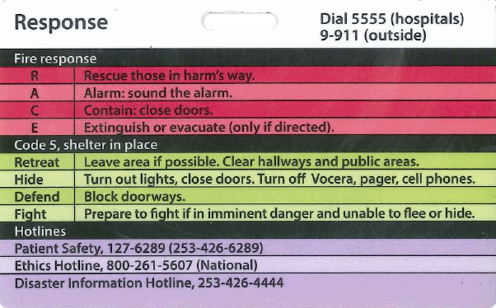


Patient and Employee Safety Signage
Patient Safety Hotline (SJMC) behind your badge
CAP hotline for test quality or employee safety issues
(866) 236-7212
Look for this Hot Line info on Bulletin Boards in the Lab
Notes:
Accreditation requires that staff can call around existing chain of command to report quality or patient safety issues that are not being responded to

Slide 68

All new hires are invited to take a MyVoice 90-Day New Hire Survey.
The survey takes about 10 minutes to complete and responses are confidential.
If employees have questions about the survey please contact employee.surveys@commonspirit.org

Slide 69

Documentation to be Completed
NELO presentation
Employee Safety Product Usage Agreement
Hazardous Chemical Communication Form
Competency Quiz for Quality Plan
Techs: PT Attestation form
Medtraining Safety Modules Quizzes (pass >80%)
Safety Tour
Notes:
-Forms are stand-alone forms that are part of the presentation and must be completed today
-medtraining is an internet based safety program for all staff. Great CE opportunities under the training library

Slide 70
You are finished IF…
All related all policies have been read and acknowledged in Policy Stat
Dept Orientation (tour guide): Signed, Dated
Employee Safety Product Usage Agreement: Signed, Dated
MedTraining modules: completed and Quizzes > 80%
Quality Competency post quiz: Passed > 80%
Hazardous Chemical Communication: Completed
Techs- PT attestation form: Read, Signed, Dated
Lab Assistant- Staff Agreement for Use of Rover Device: Read, Signed, Dated
Turn in your documents to your manager
Notes:
Medtraining can be completed at home lab within 2 weeks

