Slide 1
EMPLOYEE SAFETY TOUR
Required for all new staff and current staff annually

Slide 2
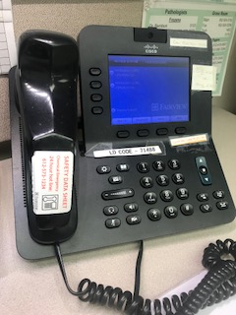
EMERGENCY PHONE NUMBERS
Location | Dial Number
Fairview Hospitals | 888
University of MN | 12345
Chemical Exposure (Also found with SDS sheets) | 612-573-1234

Slide 3
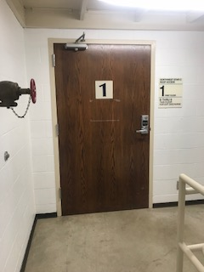
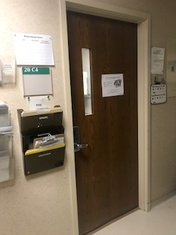
DEPARTMENT SAFETY
Locked doors key codes → 5140*
BREAK ROOM
PHLEBOTOMY STORE
ROOM

Slide 4
Electrical Safety
Cords and outlets should NOT be in the following conditions:
Tripping
Hazard
Fraying
Blocked or Overused

Slide 5
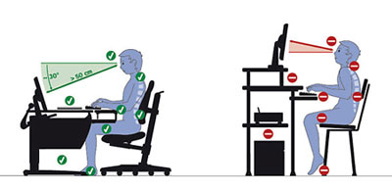

ERGONOMIC BEST PRACTICE
Adjust screen heights
Sitting posture
Lifting technique
CORRECT
CORRECT

Slide 6
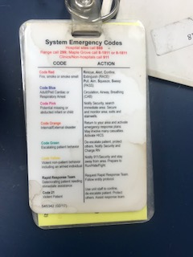
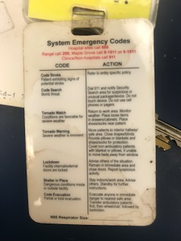
OVERHEAD CODES FOR LAB
System Emergency Codes | Action
Blue Stroke C-Section | LCT sent to draw blood
Full Trauma | Blood Bank prepares two O Neg packed cells in Igloo, LCT brings Igloo to ED
Reference badge cards for all System Emergency code descriptions

Slide 7
NEW EMPLOYEE HEALTH SCREENING
Must be completed by Employee Occupational Health Services
YES
NO
IMMUNIZATIONS
HEPATITIS VACCINE
COLOR BLINDNESS
MANTAOUX
Job Dependent

Slide 8
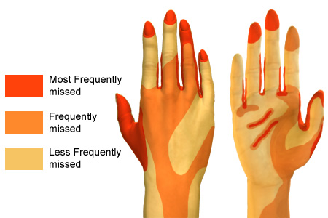
HAND HYGEINE
When?
After removing gloves
Before leaving the lab
Between patients
How?
Foam sanitizer
Soap & water
Isolation Rooms: washing with soap & water is required
REMEMBER TO NEVER TOUCH YOUR FACE WEARING GLOVES!

Slide 9
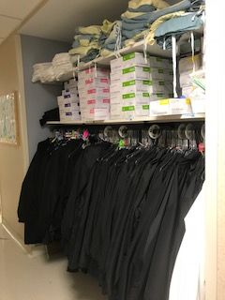
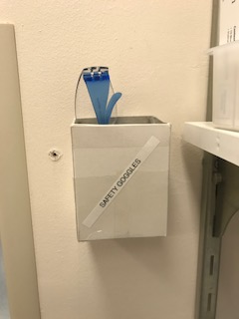
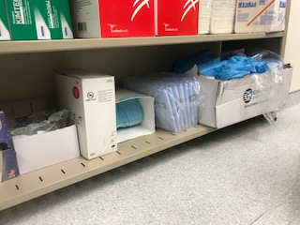
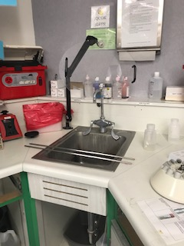
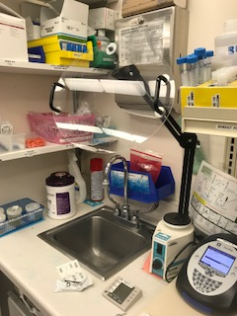
PERSONAL PROTECTIVE EQUIPMENT (PPE)
NITRILE GLOVES & LINERS
SAFETY GOGGLES:
LAB COATS
KIT BENCH
FACE
SHIELDS
PATHOLOGY
MANUAL
KIT BENCH
BOTTOM STORAGE SHELF:
Glasses, masks, aprons, protective sleeves

Slide 10
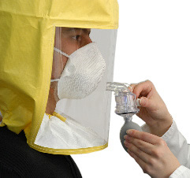
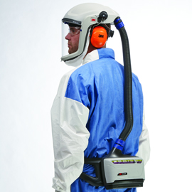
FIT TESTING
Respirator mask fitting performed annually
Certain respirators, known as tight-fitting respirators, must form a tight seal with your face or neck to work properly. If your respirator doesn't fit your face properly, contaminated air can leak into your respirator face piece, and you could breathe in hazardous substances. So before you wear a tight-fitting respirator at work, your employer must be sure that your respirator fits you. Your employer does this by performing a fit test on you while you wear the same make, model, and size of respirator that you will be using on the job. That way, you know that your respirator fits you properly and can protect you, as long as you use it correctly. – OSHA Official Website
N95 vs PAPR

Slide 11

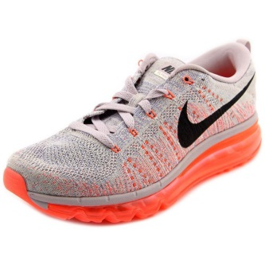
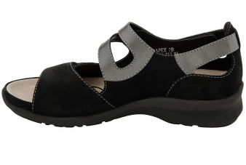
PERSONAL HYGIENE IN THE LAB
Eat, drink or chew gum
Have shoulder length hair loose
Use cell phone
Store personal belongings
Apply lip gloss or cosmetics
DO
NOT
Wear shoes without holes or cloth

Slide 12
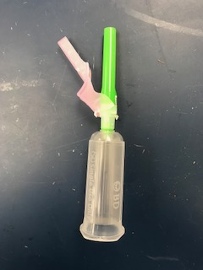
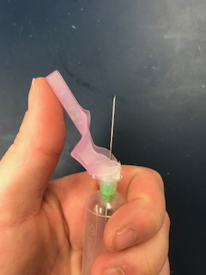
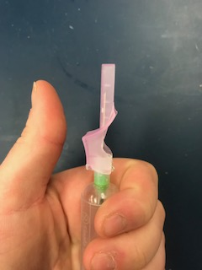
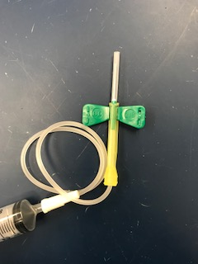
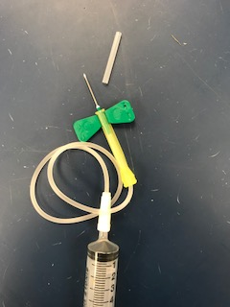
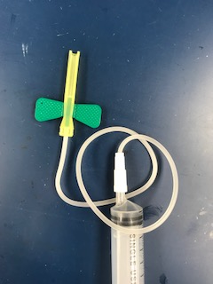
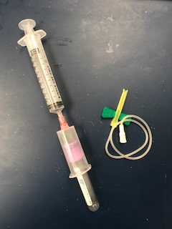
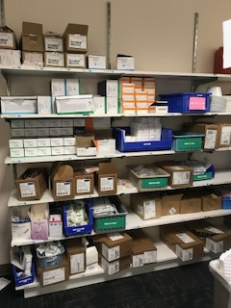
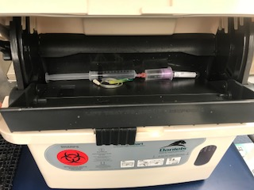
NEEDLE SAFETY
STRAIGHT NEEDLE
BUTTERFLY NEEDLE
PHLEB STORE ROOM
Activate built in safety device before disposal
Transfer blood from syringes using transfer device
Dispose all materials in designated sharps containers
Transfer Devices
Needles

Slide 13
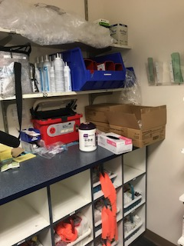
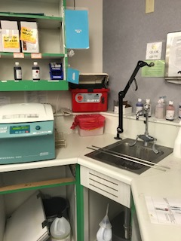
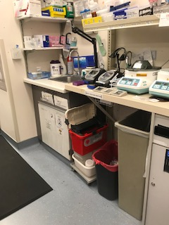
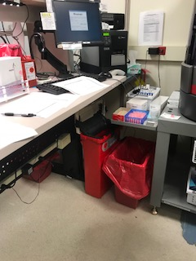
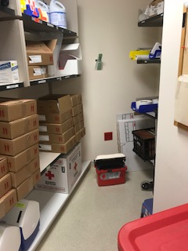
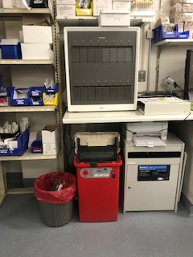
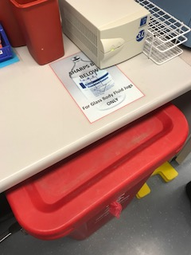
SHARPS: Needles, glass etc.
REPLACEMENTS
LOCATIONS IN MAIN LAB
Small portable sharps, place into larger sharps when full
PHLEB STOCK ROOM
MANUAL
KIT BENCH
BLOOD BANK
When large sharps are full they are placed here and replaced with empty sharps containers on Wednesdays
BLOOD BANK STORAGE
HOOD
BODY FLUIDS
Sharps containers in patient rooms are located on the wall next to the door

Slide 14
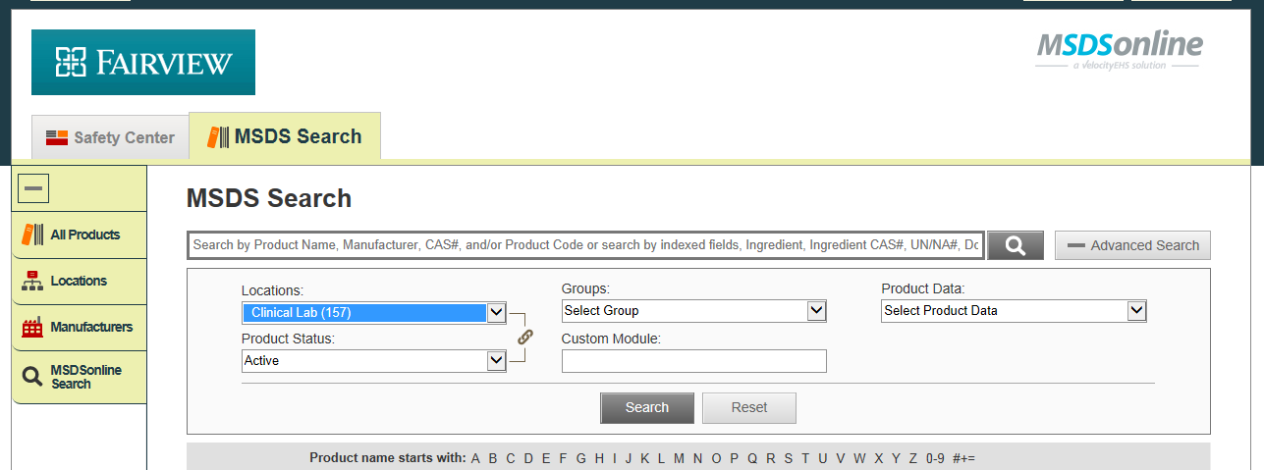
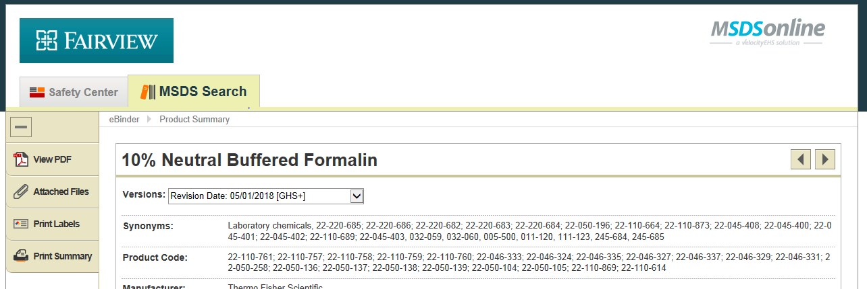
SAFETY DATA SHEETS (SDS)
Located on the Intranet
    Resources > Information > SDS
Common chemicals:
Formalin, bleach, HCL, sodium hydroxide, methanol, ascorbic acid, acetone, glacial acetic acid, perchloric acid, sulfamic acid, sodium bicarbonate powder
PDFs for chemicals used in the lab contain hazard and first aid information

Slide 15
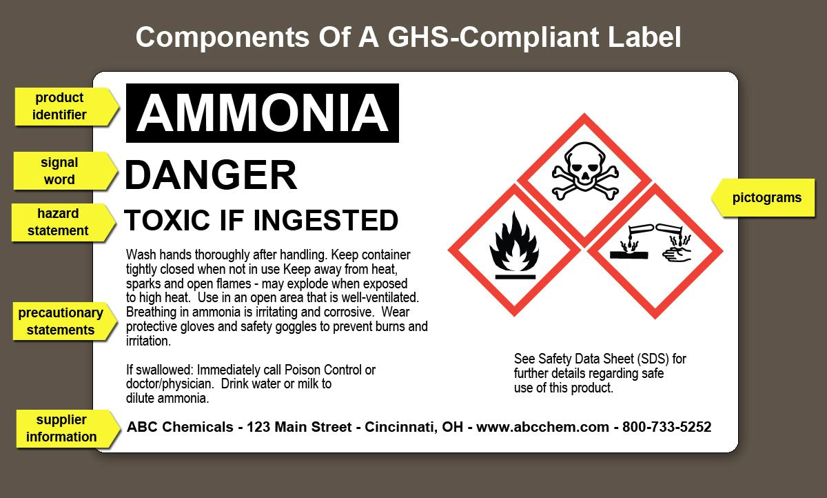
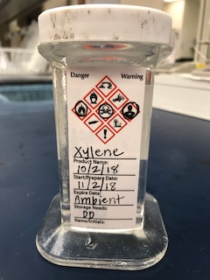
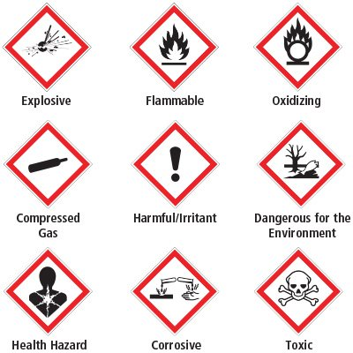
Chemical Hygiene: GHS Labeling
Labeling required for reagents with open/expire dates & aliquoted chemicals
Example
Necessary symbols determined using Safety Data Sheets (SDS)

Slide 16
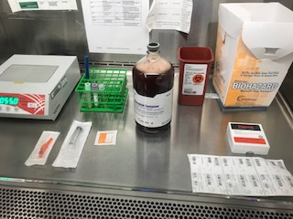
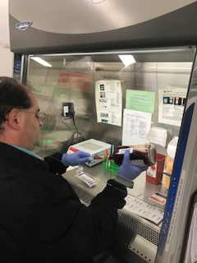
BIOLOGICAL SAFETY CABINET (BSC)
Sterile aliquoting or working with specimens that pose risk for an exposure to employee
Summary Review of Best Practices
Place chair at middle of workspace
Work at least 10cm inside BSC
Use slow, direct movements
Set up workflow from clean to dirty
Do no block front/read grills
Too many objects may disrupt airflow

Slide 17
INCIDENT REPORTING PROTOCOL
Non exposure (fall, strain) and exposure (blood or body fluids)
Non Exposure:
Seek Medical help if needed
Notify supervisor
Complete ICARE by the end of the shift
Exposure:
Wash area thoroughly
Notify supervisor
Fill out forms in the appropriate exposure folder (See next slide)
Weekdays: Report to Employee Occupational Health & Safety
Evenings/Nights/Weekends: Contact Administrative Nurse Supervisor

Slide 18
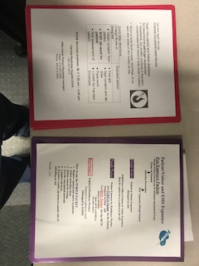
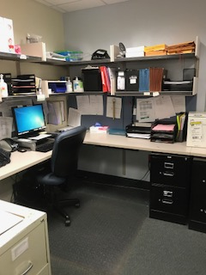
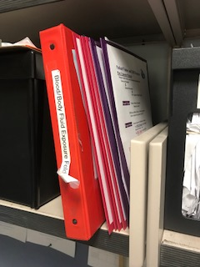
INCIDENT REPORTING PROTOCOL
EXPOSUREFOLDER LOCATION
STAFF
VISITORS/EMS
LUCs
One packet is opened per incident with the decision tree inside

Slide 19
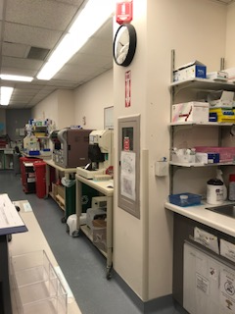
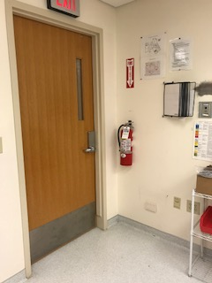
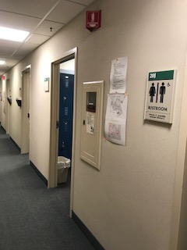
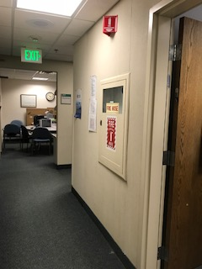
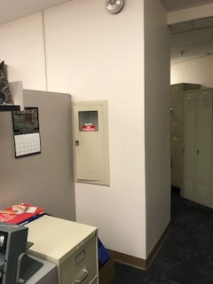
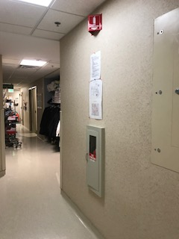
EMERGENCY: Fire Extinguishers
P-A-S-S: Pull Aim Squeeze Sweep
KIT BENCH
PATHOLOGY
HALLWAYS
Slowly walk towards fire as you sweep
CUBES

Slide 20
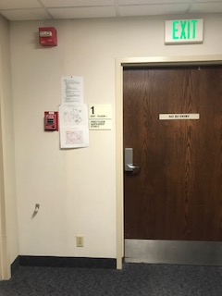
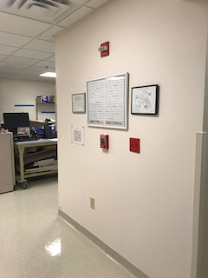
EMERGENCY: Fire Drills
Fire Pull Locations
RACE
Rescue, Alert, Confine, Extinguish, Evacuate
Smell smoke
Code RED
Dial 888 and provide location & source
Listen for instructions from Hospital Command Center, overhead, or FV Alert
Remain in place until instructed to leave
Pull fire alarm if you see fire
LOUNGE
BLOOD BANK

Slide 21

EMERGENCY: Lab Evacuation Routes
PATHOLOGY
If necessary, the lab cart may be used to transport someone or use a two-member team and lift the disabled person out of the laboratory
MAIN LAB
BREAK ROOM

Slide 22


EMERGENCY MEETING AREA
Skyway Lobby
Skyway Lobby
The courier parking lot in front of power plant (Area in yellow).
Assist in evacuating wheelchair or disabled employees/visitors/patients

Slide 23

EMERGENCY: First Aid
No first aid kit available
Phlebotomy Draw Room = 2 pull cords

Slide 24


EMERGENCY: Downtime Procedures
2. SOFT TECH
When a power outage or some other issue causes computer failure
Two places online to find logs and documents:
1. FSH LAB FOLDER
Folders, forms and procedures also found in Blood Bank
CLINICAL LAB
PATHOLOGY

Slide 25

EMERGENCY: Tool Kit
Will provide supplies necessary in a disaster situation to employees
Kit includes:
Head lamps for phlebotomists
Emergency radio
Magnetic flashlights
Copy of FSH emergency protocols
Updates list of staff directory
Extension cords
Batteries
Spill kit
Dry erase board for emergency planning
LOCATION:
Kit is not yet finalized, this is suggested content & location for future use!

Slide 26







EMERGENCY: Power Lighting, Outlets & Phones
Red Outlets = Emergency power
If there is a power failure, back up emergency generators will supply electricity to the lab
Red Phones in Main Lab:
Phone operation instructions found on each phone
Emergency number list
BLOOD BANK
CORE
LCT DISPATCH

Slide 27


CHEMICAL HYGIENE: Safety Manual & Chemical Hygiene Plan
Documentation of contents in LMS
Module assigned & completed annually by all employees

Slide 28




CHEMICAL HYGIENE: Eye Wash & Shower
SAFETY SHOWER:
EYE WASHES:
PATHOLOGY
MAIN LAB
MANAGER’S OFFICE
PATHOLOGY
USE:
USE:
Pull triangle to release water
Remove covers & push pedal foreword to begin stream
Hold eyes open to wash away chemical
Rinse for a minimum of 15 minutes

Slide 29





CHEMICAL HYGIENE: Chemical Spill Supplies
Refer to flow chart for proper spill response
Near block cabinets
PATHOLOGY
Near backup Stago
Kits Include: absorbent powder, goggles and scoops
Instructions are posted on the wall next to each kit
Large formalin spill kit located in pathology in formalin recycling room
MAIN LAB

Slide 30




CHEMICAL HYGIENE: Disinfectants & Wipes
MAIN LAB
PATHOLOGY
Blood spills → spray with bleach spray and wipe up with paper towel
Blood drops & basic cleaning → use purple wipes
WIPES: Area must be wet for 3 min for proper disinfection
BLEACH SPRAY: Area must be wet for 1 min for proper disinfection

Slide 31


Chemical Hygiene: Hazardous Waste
Material with properties that make it dangerous or capable of having a harmful effect on human health or the environment
LOADING DOCK
Containers must be labeled with hazardous waste sticker
Containers taken to waste disposal room for professional dumping

Slide 32




Chemical Hygiene: Hazardous Waste
EXAMPLES:
MAIN LAB
PATHOLOGY
Methanol
Gram Stain
Sysmex Stain
Certain Vista cartridges
Formalin
Xylene
Wright’s stain
Methanol
Left over tissue containing formalin in morgue
These materials cannot be thrown in biohazard trash or put down the drain!

Slide 33

Chemical Hygiene: Dry Ice & Liquid Nitrogen
Only Blood Bank
Plasma delivered with dry ice from the Red Cross
Do not touch with
bare hands!
Boxes of dry ice stored and picked up from here by the Red Cross
BLOOD BANK

Slide 34
WASTE DISPOSAL: Biohazard (Red Bags)
What constitutes biohazard waste?
Biohazard symbol in tact
Gauze & wipes saturated with blood/body fluid
Gloves dripping with blood/body fluid
Paper towels with significant blood/fluids
YES
Biohazard symbol torn in half
Paper towels without blood/body fluid
Used gloves with little blood/fluid
Gauze & wipes without blood/fluid
NO
Fairview pays for biohazard waste, we can help to control our costs!

Slide 35









WASTE DISPOSAL: Shredding Containers
Any paper or label with patient identifiers goes into these bins
MANUAL
MEETING TABLE
BLOOD BANK
PATHOLOGY
LUCS x 2
SEND OUTS
CUBES

Slide 36
WASTE DISPOSAL: Batteries
Batteries used in the lab are all disposable in the regular trash except for rechargeable batteries
Standard Batteries
Trash
Alkaline
Rechargeable
Lithium
Special Disposal

Slide 37


RADIATION TRAINING
Pathology
LCT also get training
entering radiation rooms
Radiation seeds come in breast tissue from OR
Annual training in LMS
Geiger counter detects radioactive seed in tissue
Lead storage container protects workers from radiation after seed removal

Slide 38
THE END
Thank you! You have completed this training.

