Slide 1
TEMPTRAK
Basics of the TempTrak System

Slide 2
TempTrak Overview
24/7 temperature monitoring for appliances
Wirelessly transmits real-time data to on-site and/or remote PC
User-friendly software applications for regultory compliance
Instantaneous alerts and paperless reports for trend analysis, corrective actions, and historical data files
Verification report print outs on demand for regulatory agencies.

Slide 3
ALERTS - There are 3 types of Alerts: Temperature, Battery, and Communication
Temperature Alerts are generated whenever a sensor transmits a temperature that does not meet the valid temperature range set up within an assigned Alarm profile
Battery Alerts are generated whenever a battery is low on voltage or has been fully drained (These don’t send alerts since you don’t have to act right away.)
Communication Alerts are generated whenever a sensor does not send information at the expected intraval. (These send an alert to security pager only)

Slide 4
Symbols for Alerts types
Active Alerts Show in upper right hand corner. The Communication Alert sends a page to security and POM monitors the Battery Alert. The Transmitter alerts are what shows when the temp is out of range on an appliance.

Slide 5
Types of Alerts Notifications: EMAIL
The Sensor Name, Date/Time of alarm, Current Temp, Alarm Range, and time out of range are all sent via email.

Slide 6
POP-UP on Designated PC
When this pop-up appears there is also a audible alarm that sounds if the volume is up on the PC. You can open TempTrak by clicking on Open Alert Window Icon. Pop-Up alerts will not happen unless someone is logged onto the computer.

Slide 7
Pager
TempTrak can page a digital pager. The number that will appear to call is #1827. When you call this number you will hear a message that informs you that there is a temperature out of range and to, log into the system, located the appliance, and document corrective measures.

Slide 8
Alert processes and Department Responsibilites

Slide 9
Fairview Range Medical Center; Mesaba Clinics, Plaza;(During operating Hours)
Units That Are Open 24 Hours A Day & Weekday Hours:
Departmental Popup alerts and/or Manager email. 1st Alert: Respond to appliance with alarm, document action taken, and clear alarm. If alarm is not responded to within 30 minutes the alarm will escalate to level 2.
Departmental PopUp alert & Manager email 2nd Alert: Respond to appliance with alarm, document action taken, and clear alarm. If alarm is not responded to within 30 minutes the alarm will escalate to level 3.
Security Pager 3rd Alert: Notify department of alarm on monitored item located in the specified unit. If not responded to within the next 30 minutes, alarm escalates to Failsafe (Switchboard).
Switchboard Failsafe Alert: Page and notify security of appliance alarm that has not been answered. Also notify specified unit of alarm.

Slide 10
Fairview Range Medical Center, Mesaba Clinics Hibbing/ Nashwauk/Mt. Iron & Plaza
Units that are not open 24 hours – after hours and weekends (specified by each department)
Security page: Onsite appliances; Check appliance with the alarm (Is the unit repairable? Is the door closed properly? Is it plugged in?) and notify department manager or POM.
Switchboard Failsafe: Page security and alert them to an alarm.
Security or switchboard operators may have to clear, document and notify department managers for alerts in areas that are closed evenings and weekends. Also contact POM for alerts on all offsite appliances. See list of phone numbers in policy for manager contacts.

Slide 11
Department Responsibilities
Each department manager utilizing the Temp Trak system is responsible for tracking temperatures on a daily basis. This is for the purpose of monitoring appliances that may need repair or attention (ie. Defrosting) before an alarm situation arises.
Department managers (or a designee) are also responsible for clearing their department’s ended alerts from the system every shift. This includes addressing any alerts that have been acknowledged, and clearing them if appropriate.
Pharmacy manager, will monitor all medication appliances.
Nutrition Services manager, will monitor all food appliances.
Any ongoing compliance issues will be reported to the EOC Committee.

Slide 12
Log in Screen for TempTrak (If you don’t have TempTrak on your pc you can find it by going to the intranet→Systems→TempTrak) Insert Login ID and Password

Slide 13
To view/take action on the current alerts: Go to Alerts→TempTrak→Sensor Readings or Double click the Red bell in right corner

Slide 14
Alerts Screen: Displays current and recently cleared temp alerts.

Slide 15
Current Alerts are events that have not yet been responded to.
Cleared Alerts are events that have been responded to and action has been taken
NOTE: When an alert is generated for a sensor and has went through the escalation of notifications, NO further alert notifications will be sent out for that sensor unless it has been CLEARED from alert status

Slide 16
When action has been documented on a alert the Notes icon will appear (see arrow below). When you double click to open this up you can see the details like shown in the box below.

Slide 17
To clear an alert: Double click the Acknowledge/Clear Alert Box Note: Pink = Temp to warm Blue = Temp to cold
Double click the Acknowledge/Clear Alert box

Slide 18
TempTrak Clear Alert Box opens: Document Corrective Action/Notes →You can free text or select a standard action to add to the note→Click Clear Alert

Slide 19
Additional Info
Multiple actions may be selected
After clearing alert it can be viewed in the Recently Cleared Alert conditions. You can view date and time of action and what notes were documented.
If additional notes/Acknowledgments are needed for the alert, click Add Note/Acknowledge BE AWARE: This will not clear the alert; only update the Temperature Alert with new notes. The alert remains open and all notifications STOP.

Slide 20
Current Sensor Readings: Go to Reports→TempTrak→Current Sensor Readings

Slide 21
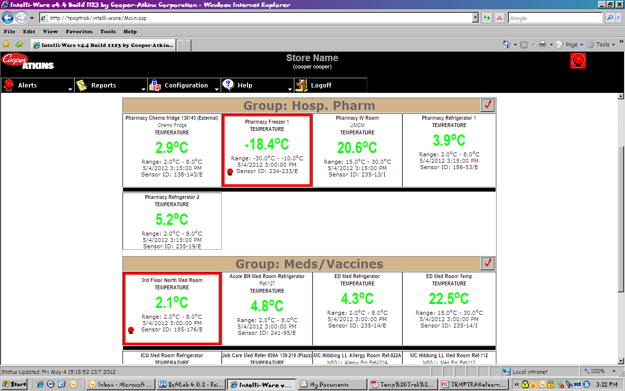
Current Sensor Readings can be viewed by group or by all group details.
To change view click on the All Group Details/All Group Summary icon.

Slide 22
Features
You will only have alerts/access for sensors that you use in your work areas
Temperature condition is indication by color:
Green = Temperature within range
Red = Temperature too hot
Blue = Temperature too cold
The Display also indicates:
-Sensor name
- Type of Sensor (Temperature, Contact, Humidity, CO2)
- Specified Temperature range
- Date/Time of last Temperature collected
- Sensor ID

Slide 23
Temp History Graph
This graph can be found by double clicking on a sensor on either the current sensor readings page or current alert page. You can use this to view the previous recordings to help with troubleshooting/monitoring.

