Slide 1
Fairview Laboratories: Specimen Tracking and Transport
Clinical and Reference Laboratory
(Non-Anatomic Pathology) Specimens

Slide 2
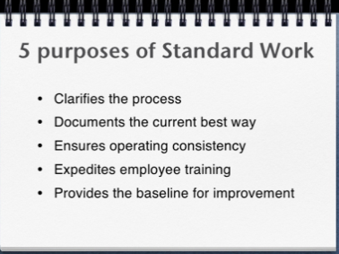
The Purpose of These Changes:
To implement tracking for all specimens moved on behalf of Fairview Laboratories for processing and testing
To implement an audit system and standard work
https://sites.google.com/site/fvlabresources/home/files
HyperLink to Cathy's Website
HyperLink to a document on the Intranet

Slide 3
Why Is This Important?
Lost specimens and/or specimens lost to testing affect:
Quality of patient care affected
RCA (Root Cause Analysis) events put us at legal risk
Brand Reputation
Avoidable(?) cost to lab(s) for investigation/re-work, etc.
MDH now mandates that certain lost specimens are considered reportable events (i.e. irretrievable, irreplaceable specimen(s)).

Slide 4
Objectives
Following this presentation, you will be able to:
Describe the sending and receiving standard work for clinical and reference laboratory specimens.
Prepare specimens for transport with courier according to the “Packaging and Labeling Specimens for Shipping and Transport” procedure.
Demonstrate understanding of standard packaging and labeling of clinical and reference specimens

Slide 5
Who to contact with questions
The following individuals are site representatives:
Cytology: Jana Holler
FMG Clinics: Lisa Karnik & Michelle Stevens-Brioschi
Lakes: Helen Brenny
Northland: Tonya Kindseth
Outreach: Joy Case
Pathology: Brooke Eguia
Southdale: Mila Montemurro-Healy
Specimen Management: Karri Cargill & Sherry Davis
UMMC East Bank: Brad Lemke
UMMC West Bank: Tami Alpaugh

Slide 6
Procedure
Please read the procedure that outlines the changes and requirements that are highlighted in this module.
Location on the Fairview Intranet:
Hyperlink here

Slide 7
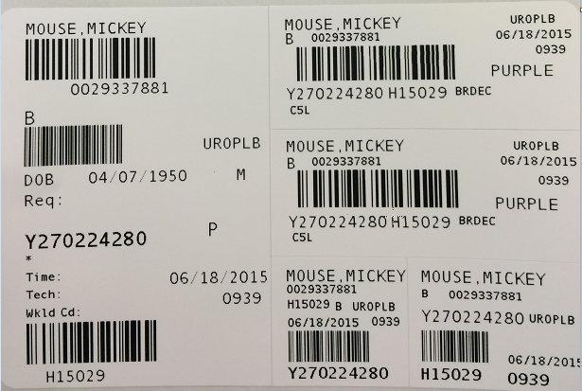
Sunquest Label Refresher
Accession number (Starts with letter for day of the week)
Hospital ID (HID)
Sunquest test code
Container ID (CID- unique number that starts with Y and is followed by a 9 digit number)

Slide 8
Lab Guide Refresher
Lab Guide is on the Fairview Intranet
Intranet location: Laboratory Services→ Find a Test
Each test should be looked up in Lab Guide to determine:
  Processing instructions
  Testing location
Process to review test in Lab Guide:
Look up test in Lab Guide
Review specimen requirements and processing instructions
Determine where specimen needs to be sent for testing

Slide 9
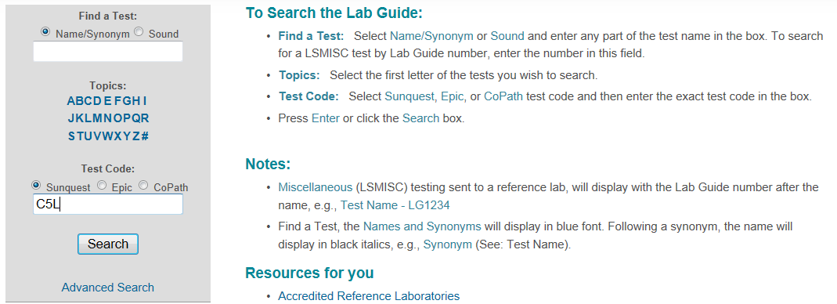
Lab Guide Refresher example:
Sunquest Test Code= C5L
Look up test in lab guide

Slide 10
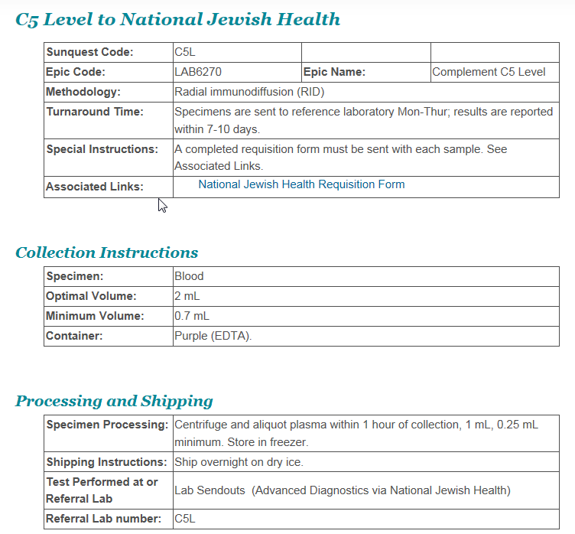
Lab Guide Refresher example:
Review specimen requirements and processing instructions
3. Determine where specimen needs to be sent for testing

Slide 11
Processing a Specimen Sent to Another Laboratory
Refer to the Fairview Lab Guide to review test requirements and processing instructions.
Mandatory:
All clinical laboratory specimens(s) must be ready for testing prior to packaging and transport/shipment according to Lab Guide instructions.
All clinical laboratory specimens must be labeled with Sunquest CID label prior to batching.

Slide 12
Generate a Batch
Clinical (Non-Anatomic Pathology) Specimens:
ROB (Reference Outbound Batch) if necessary (used by sites where no direct pick-up to reference lab is available) Reference Outbound Batches (ROB)
Miscellaneous test (XMISC) order steps must be completed in Sunquest LSMISC LAB4909 Order Workaid
Generate a batch in Sunquest by scanning individual specimen CID barcode(s) and obtain a batch label Processing a Transport Batch

Slide 13
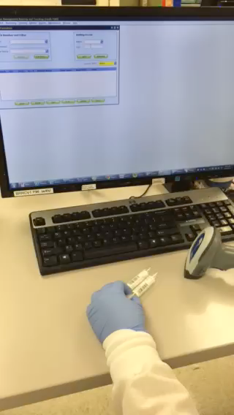
Video: Generate a batch
  Generate a batch in Sunquest by scanning individual specimen CID barcode(s) and obtain a batch label
  Processing a Transport Batch

Slide 14
Specimen Send Out Process
Non-UMMC East Bank specimens: specimens must be batched together according to test location in Lab Guide for that specific test code(s)
UMMC East Bank specimens: specimens must be batched to Specimen Management or IDDL only (unless sending lab has a direct courier route or using on-demand courier).
Pull a batch filter at least once per shift
  Review any unaccounted for specimens on filter and investigate
  Do not save this filter because it will create a batch. Processing a Transport Batch
Place specimen(s) in a Fairview Medical Laboratory custom color-coded (temperature specific) shipping biohazard bag

Slide 15
Specimen send out process, continued
Pull a batch filter at least once per shift
  Review any unaccounted for specimens on filter and investigate
  Do not save this filter because it will create a batch. Processing a Transport Batch
Place specimen(s) in a Fairview Medical Laboratory custom color-coded (temperature specific) shipping biohazard bag

Slide 16
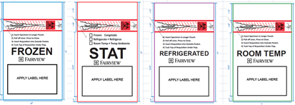
New Specimen Packaging
Custom specimen bags will now be used at all laboratory sites to package specimen(s) being sent to another Fairview lab
They come in 2 sizes (6x9” and 12x15”) and will be color coded and printed to indicate shipping temperature
    Blue=Frozen
    Red=STAT
    Purple=Refrigerated
    Green=Room Temp
  Note: Shipping temperature must be checked with Sharpie on red STAT specimen bag

Slide 17
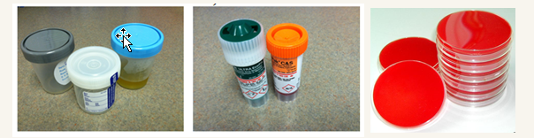
Packaging Specimens: Guidelines
Include any necessary paperwork in the external document pocket.
Note: All clinical specimen types can be mixed at appropriate temperature with the exception of sterile screw-top containers and culture plates (see images below).
Tightly seal any sterile screw-top (i.e. urine, body fluids, stool) containers
Batch culture plates, sterile screw-top containers, and blood tubes or aliquots separately.

Slide 18
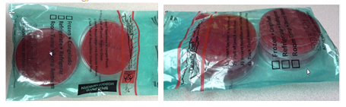
Packaging Specimens: Culture Plates
IDDL culture plates can be stacked 2 plates high with no more than 4 plates per bio-hazard bag
Note: Do NOT use tape of any kind to secure culture plates

Slide 19
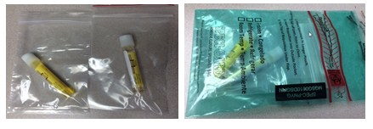
Packaging Specimens: GCPCR & CHPCR
Package all GCPCR & CHPCR containers individually (urine or swab Genprobe) into single small zip lock plastic bags.
Individual zip lock bag(s) containing GCPCR & CHPCR will be batched and placed in one biohazard bag and sent to IDDL
Insert disclaimer if unable to obtain custom specimen bags

Slide 20
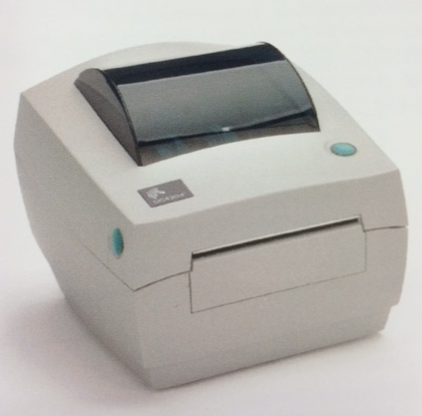
Standard Specimen Bag Labeling
Obtain an on-demand shipping label by scanning the appropriate barcode for the receiving laboratory from the standard spreadsheet (printer image below).
Note: Refer to XXXX Workaid for on-demand shipping label printing instructions and guidelines.

Slide 21
Labeling Specimens Bag(s) for Transport
All shipping labels must include the “Destination Name”, “Address”, and “Phone Number” according to the following format:
      Deliver to: [Official Laboratory Name]
      [Street Address]
      [Building, Level, Room/Suite Number]
      [City, State, Zip code]
      Phone: [Contact phone number including area code]
Shipping information must never be covered on the biohazard bag. This includes the biohazard logo, shipping temperature, the destination address, and/or batch label.

Slide 22
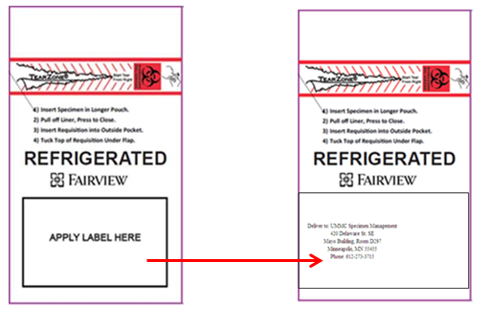
Labeling Specimens Bag(s) for Transport
Place the transport shipping label onto the designated area on the bottom portion of the specimen bag over the black-outlined box that states “Label here”.

Slide 23
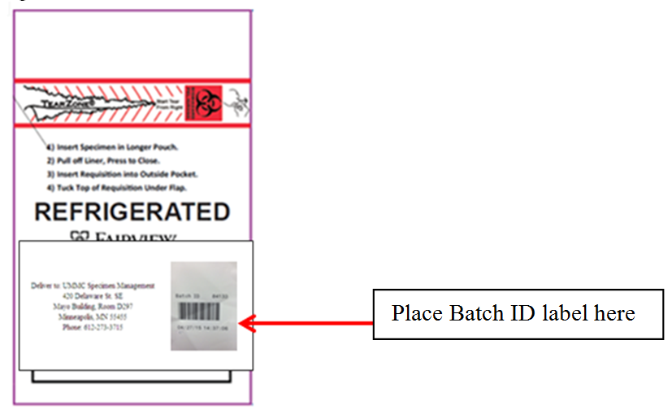
Labeling Specimens Bag(s) for Transport
Place the Sunquest batch label on top of the on-demand shipping destination label on the right.
Note: Placing the batch label on top of the affixed on-demand shipping label will prevent any adherence issues at various temperatures preventing batch labels from falling off.

Slide 24
Print-on-Demand Printer Issues?
Each site will have at least one back-up printer available.
Do NOT contact TSC/Fairview IT for print-on-demand printer issues.
Corridian customer service should be contacted for printer issues:?? Might need to explain
  Monday through Friday XXAM to XXPM
  Phone number: XXX-XXX-XXXX
If print-on-demand printer is unavailable, address labels must be hand written using the standard format from the standard spreadsheet.

Slide 25
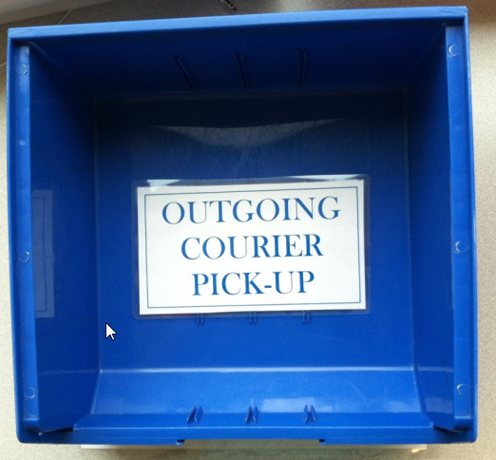
Outgoing Specimen(s): Courier Pick-Up
All outgoing specimens ready for testing and courier pick-up must be placed in the appropriate BLUE outgoing courier pick-up bin.
Note: There will be a BLUE outgoing courier pick-up bin available for all shipping temperatures.

Slide 26

Incoming Specimen(s): Courier Drop-Off
All incoming specimens will be dropped off in the designated RED courier drop-off bin.

Slide 27
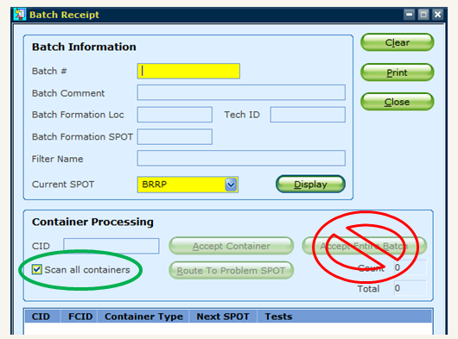
Receiving Laboratory Responsibilities:
Disband all batched specimens using Sunquest SMART by scanning the CID label on each specimen(s) individually
  Do NOT accept the entire batch

Slide 28
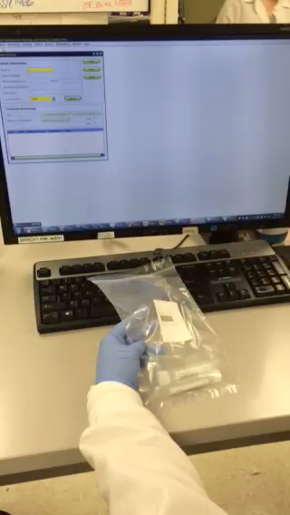
Video: Disbanding a Sunquest Batch
Receiving Laboratory Responsibilities:
  Disband a batch in Sunquest by scanning individual specimen CID barcode(s)
  Processing a Transport Batch

Slide 29
Receiving Laboratory Responsibilities:
Any CID(s) left on the batch must be investigated immediately
  Discard biohazard bag into an appropriate biohazard disposal bin. Specimen bags must NOT be re-used for any reason
  Do NOT put biohazard bags into the regular trash

Slide 30
Receiving Location Responsibilities:
If specimen is at final testing location, proceed with testing
If specimen is not at final testing location, disband batch and re-batch specimen(s) by scanning CID label(s) to the new location

Slide 31
Fairview Laboratories: Specimen Tracking and Transport
Anatomic Pathology Specimens

Slide 32
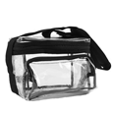
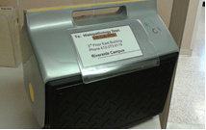
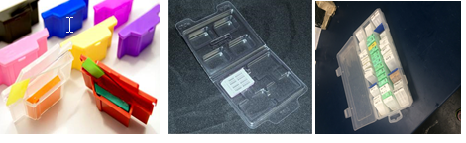
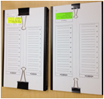
Packaging: AP Specimens
All Anatomic Pathology (AP) specimens being transported by Fairview Pathology laboratories must be packaged appropriately.
Cardboard folder with black clips
Transparent reusable totes
Black cooler for immunofluorescence slides
Hard-sided tissue block cases
using the cardboard folders with black clips, transparent reusable totes/large bags/small bags, hard-sided tissue block cases, or the black reusable transport cooler for immunofluorescence slides.
Notes:
Put pictures in same order they are listed in bullet point & put name of each item under corresponding picture

Slide 33
Tracking & Batching: AP Specimens
Generate Sunquest CID label for each specimen by one of the following ways:
  Release the order in Epic and receive it in Sunquest.
  Order the correct Sunquest tracking code per Epic/Paper Order on the appropriate CSN/Account.
  Receive the appropriate AP tracking code in Sunquest.
Generate a batch in Sunquest by scanning individual specimen CID barcode(s) and obtain a batch label.

