Slide 1

MHealth Fairview Laboratories
Specimen Transport and Tracking
2024 Annual Required Learning

Slide 2
Objectives:
Describe
Describe the sending and receiving standard workflow for laboratory specimens.
Prepare and label
Prepare and label specimens for transport according to procedure
Define
Define Lost and Mishandled Specimens
Report
Use Compass to report Lost or Mishandled Specimen(s)
Locate
Locate instructions in Test Menu

Slide 3
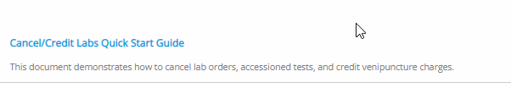
System Procedures:
Please read Specimen Packaging and Labeling for Shipping & Transport
Please access the Epic Learning Library to review cancel/credit workflow.

Slide 4

A standard workflow for packaging, labeling, shipping, tracking, and processing specimens:
Reduces the potential for lost or mishandled specimens
Creates reliable results and high-quality patient care
Protects our brand reputation.

Slide 5
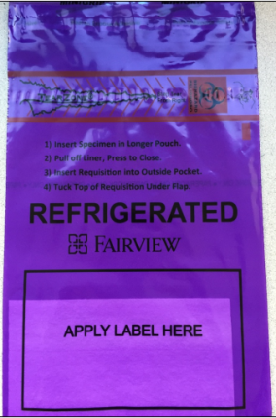
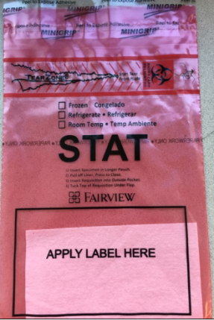
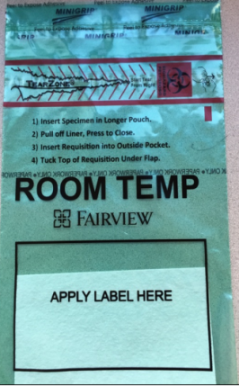
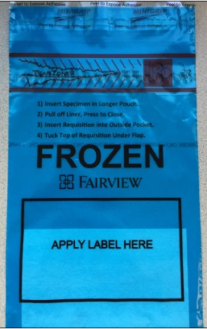
MHealth Fairview Custom Specimen Packaging
Lab custom specimen bags are used by all labs to package specimen(s) being sent to an external MH Fairview lab.
The custom bags are 6x9” and 12x15”.
    Blue=Frozen
    Red=STAT
    Purple=Refrigerated
    Green=Room Temp
Indicate specific shipping temperature on any Red STAT specimen bag with a sharpie.

Slide 6
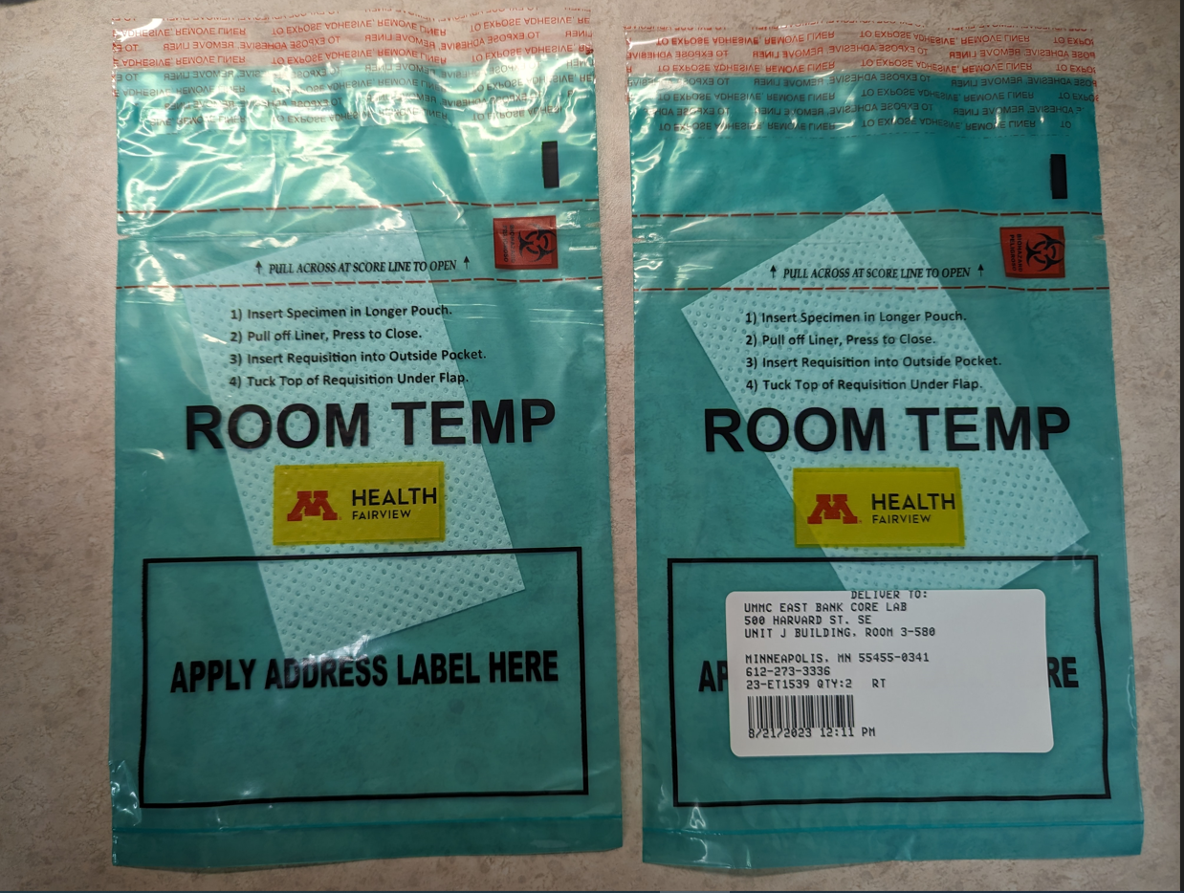
Labeling specimen bags for transport
Place the transport shipping label onto the designated area on the bottom portion of the specimen bag over the black-outlined box that states “Apply Label Here”.

Slide 7
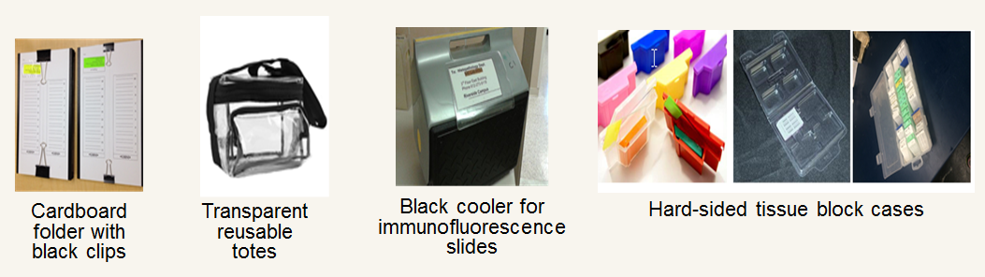
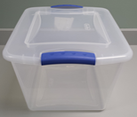
AP Specimen Packaging:
Anatomic Pathology Laboratories will use the following resources to send specimens between their sites:
Clear plastic tote

Slide 8
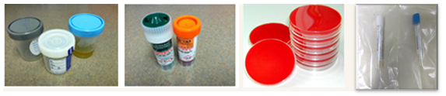
Specimen Packaging Guidelines
Clinical Pathology Limit of 20 specimens per 6x10 bag and no more than 30 blood specimens per 12 x 15 bag
IDDL transport bags are restricted to no more than 10 specimens per bag (any size).
  Note one exception:
    1. Outreach Covid specimens can be packed up to 50 specimens/bag.
Include any necessary paperwork in the external document pocket.
Tightly seal any sterile screw-top (i.g. urine, body fluids, stool) containers.
Package sterile screw-top containers (i.g. urine, eswab, PCR, and Aptima) and culture plates separate from all other specimen types in a single small ziplock plastic bag. See separate procedure for amniotic fluid/CVS processing.
  All other clinical specimen types can be packaged together at appropriate temperature.

Slide 9
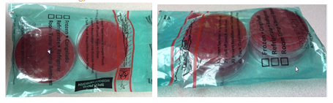
Packaging Culture Plates
IDDL culture plates can be stacked 2 plates high with no more than 4 plates total per bio-hazard bag.
Note: Do not use tape of any kind to secure culture plates.

Slide 10
Where to Send Specimens:
Place specimen(s) in a MHealth Fairview custom color-coded (temperature specific) shipping biohazard bag or other approved clear biohazard bag.
Specimens must be sent to UMMC East Bank Core Lab, IDDL or Pathology (unless sending lab has a direct courier route, an on-demand/stat courier is requested). Some sites also send directly to ARUP, Medtox, and Mayo.
For all laboratories that have a direct courier route to another MHFV Fairview laboratory, all specimen(s) must be put on a Beaker packing list.
Click Packing List Quick Start Guide in the EPIC Learning Library to review expectations.
Note: Quantiferon Gold TB Samples not incubated or centrifuged must be sent to UMMC East Bank Core Lab for processing steps.

Slide 11
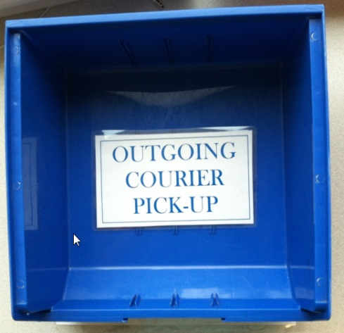
Outgoing Specimen(s): Courier Pick-up
All outgoing specimens ready for testing and courier pick-up must be placed in the appropriate BLUE outgoing courier pick-up bin. There will be a location barcode for scanning on or near the bin.
There will be a BLUE outgoing courier pick-up bin available for all shipping temperatures.

Slide 12

Incoming Specimen(s): Courier Drop-off
All incoming specimens will be dropped off in the designated RED courier drop-off bin. There is a location barcode for scanning on or near the bin.

Slide 13
Mandatory Warm Handoff at Delivery and Pickup
All Associated courier specimen deliveries/pickups must involve a direct-communication one-to-one handoff between a courier and a lab staff member.
Couriers must scan all bags in the Lab Department (not in the hallway, car, etc.).
Courier must verbally acknowledge the # of bags being directly handed to or picked up from a lab staff member in the Lab department. Couriers cannot drop and go. A lab staff member must be physically present (the only exception is if there are only supplies or racks to be picked/dropped and there are no patient samples).
Courier must scan lab employee badge as documentation of receipt of specimens.

Slide 14
Definition of Lost and Mishandled:
Specimen is Lost in lab or Lost in transit
    Specimen cannot be located.
    Testing cannot be completed.
    Start a “Missing Specimen Investigation” form. Link: Missing Specimen Form
    Enter a Compass Patient Safety Event (PSE).
    When possible, collect a new specimen.
Specimen is present, but was Mishandled or Lost to testing
    Testing cannot be completed on that specimen.
    Testing can be performed if another specimen is available
    Enter a Compass Patient Safety Event (PSE), regardless of impact to the diagnosis or patient care.
    Test must be credited and reordered on a new Specimen ID number to ensure proper documentation.

Slide 15
LOST SPECIMEN: Risk Reduction
To reduce or eliminate risk of losing a specimen, the following lab practices are required at all Sending/Receiving locations:
No garbage, recycling, laundry, hazardous waste or other receptacles can be located below the bench of the Sending or Receiving locations.
All bags must be flattened after specimen removal. This flattening process will eliminate the risk of specimens being disposed of with the bags.

Slide 16
Sending Laboratory Responsibilities:
Clinical lab specimens must be “instrument ready” or “testing ready” prior to packaging and transport according to Test Menu instructions (centrifuged, aliquoted, Beaker label, etc.).
Send out specimens follow reference laboratory’s processing and shipping instructions found on reference lab’s website (Mayo, ARUP, Medtox, etc.).
Review the Beaker Sendout Bench activity’s applicable “Specimens to Send Out” view. This is our safety net.
Ensure all specimens are accounted for. Review any unaccounted-for specimens and investigate.

Slide 17
Receiving Laboratory Responsibilities:
Review the ‘Expected’ view in the Beaker’s receiving activity at regular intervals throughout each shift, a minimum of once per shift.
Investigate any specimens on the list that should have already arrived and escalate any specimens on the list over 24 hours.
When receiving a packing list, scan each individual specimen label to receive, never receive an entire packing list without scanning.

Slide 18
Laboratory Test Directory Refresher:
Find Test Directory on the MHealth Fairview Intranet: Lab Test Directory
https://www.testmenu.com/fairview
Clinical Teams →Laboratory Services→Lab Test Directory
Each test is reviewed in Test Directory to determine:
  Specimen and/or container type
  Specimen processing requirements
  Causes for rejection
  Shipping instructions
  Performing laboratory

Slide 19

For Courier related issues, questions or assistance:
Courier Services Hotline (24/7): 612-273-4652
Option 1: On Time Delivery Service for on demand and STATs
Option 2: Associated Couriers for all scheduled routes
Call for immediate assistance with:
Locating a courier
Troubleshooting a specimen location
Courier Performance issue
Missed pickup/drop off
For non-emergent concerns, email: FairviewHealthCS@Associated-couriers.com
IMPORTANT: Never contact a courier directly, call the courier services hotline dispatcher.

Slide 20
Summary:
All specimen(s) have a Beaker specimen label and are ready for testing prior to transport/shipment.
All specimens are placed on a Beaker packing list by scanning each individual specimen label.
Specimen(s) must be packaged according the system procedure Specimen Packaging and Labeling for Shipping & Transport .
Specimen Bags are labeled with a Beaker packing list label.
Deliveries and pickups must have a warm hand off between courier and lab staff with verbal communication and badge scanning.
Lost or Lost to Testing/Mishandled specimens must be documented according to the System Missing Specimen procedure and credited according to the Cancel Credit Quick Start Guide

Slide 21
Who to contact with questions?
For questions on policies or procedures, please see your site MHFV Laboratory Transportation and Courier Committee representative.

