Slide 1

QuantiFERON-TB GOLD COLLECTION AND
PROCESSING

Slide 2
Lesson Details
Target Audience
This lesson is intended for all Fairview Employees who collect, handle, and process QTB specimens after the collection.
Author and Qualifications
Karri Schultze MLS(ASCP)^{CM}
Laura Pilcher MLS(ASCP)^{CM}
Cindy Johnson MLS(ASCP)
Patrica Larson MLS(ASCP)
Sources
Fairview Diagnostic Laboratories Lab Guide: QuantiFERON-TB Gold (QTB)
www.cellestis.com
Cellestis QuantiFERON-TB Gold Package Insert
Fairview Health Services- PATIENT IDENTIFICATION AND LABORATORY SPECIMEN LABELING - procedure # S:LM-L016
Contact Hours
0.5
Estimated Duration and Viewing Instructions
The expected time to complete this learning activity is 15 minutes and should be completed during your regularly scheduled work time. Any lessons or classes completed outside your scheduled work time must have prior approval from your supervisor and a supervisor or manager must approve any overtime.

Slide 3
Objectives
Upon completion of this lesson, learners should be able to:
Know the proper QTB collection procedure.
Describe the purpose for proper QTB handling from after collection to delivery to the testing laboratory.
Become familiar with the key factors in preanalytic processing to assure accurate results.
Perform the proper steps from the receipt of the tube set from the collection site, storage, incubation of the tube set, and transport to the testing laboratory.

Slide 4
How is This Lesson Relevant?
There are multiple steps involved with the QuantiFERION-TB Gold method that must be completed properly by Clinical Laboratory Staff to ensure accurate performance.
Accurate results require accurate pre-analytic collection and processing!

Slide 5
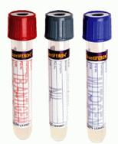
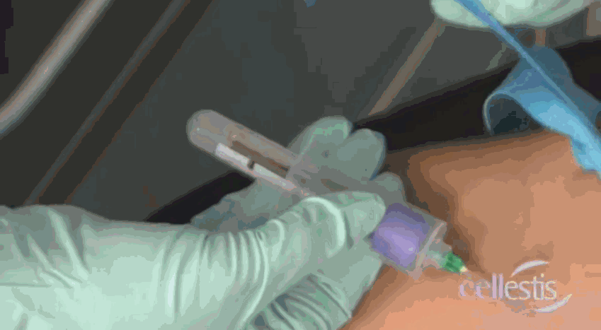
Collection and Transport
QTB sets are collected at the various clinics, outreach clients, and as inpatients.
Accurate QuantiFERON-TB Gold results require accurate collection, incubation, processing, storage, transport, and testing.

Slide 6
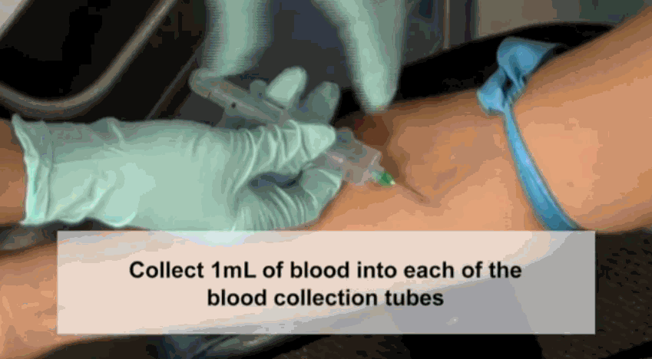
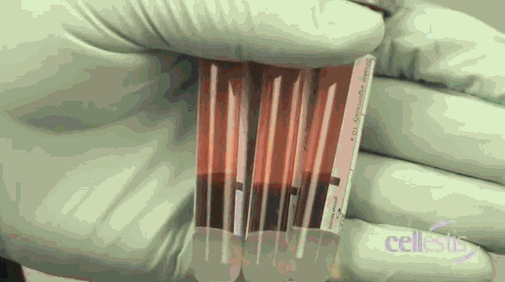
Collection and Transport
Tubes need to be at 17-27°C (63-81°F) at the time of collection
It is extremely important to draw exactly 1mL of blood into each of the 3 tubes. There’s a black mark on the side of each tube that indicates the 1mL fill line.

Slide 7
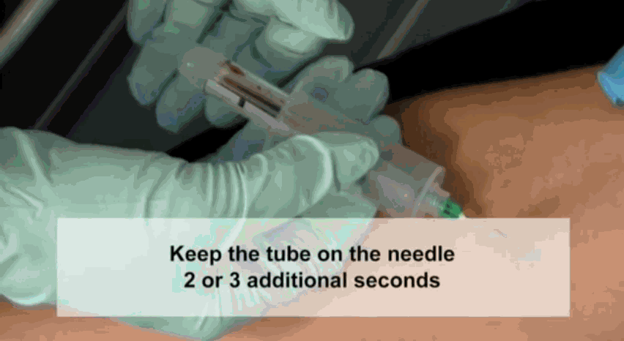
Collection and Transport
Tubes will fill slowly.
Keep each tube on the needle for 2-3 seconds after tube appears to have completed filling.

Slide 8
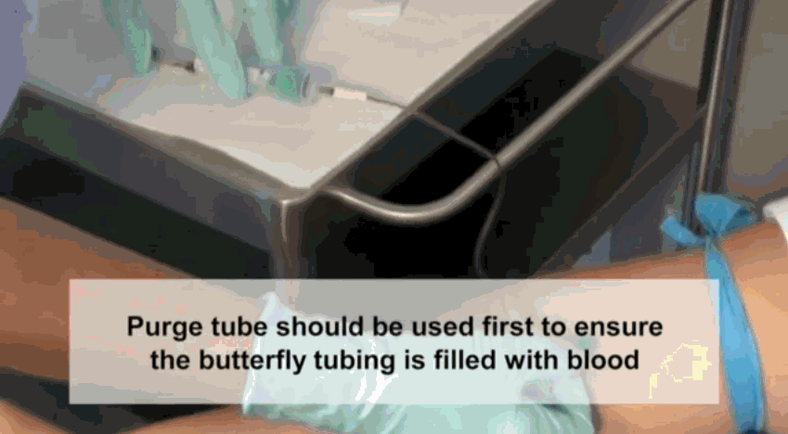
Collection and Transport
Use of a syringe may ensure correct blood volume.
If butterfly needle is used, first collect other required tubes or use a “lead discard” tube to remove the air. Then proceed with collecting the QTB tubes

Slide 9
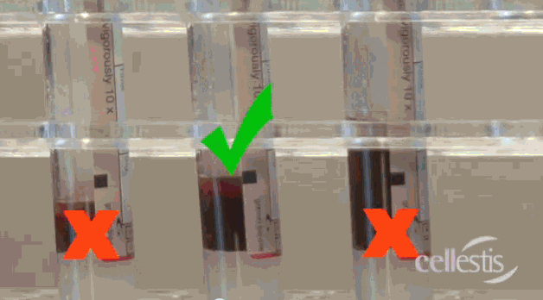
UNDER-FILLED
OVER
FILLED
GOOD TO GO!

Slide 10
Collection and Transport
Thorough mixing is required to ensure complete integration of the tube’s contents into the blood.
Immediately SHAKE the tubes firmly 10 times (5 seconds).
Entire inner surface of tube must be coated with blood.

Slide 11
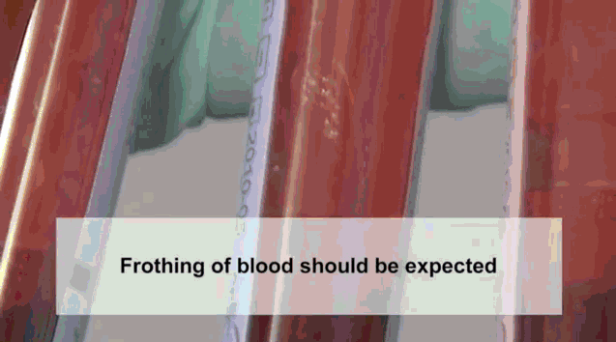
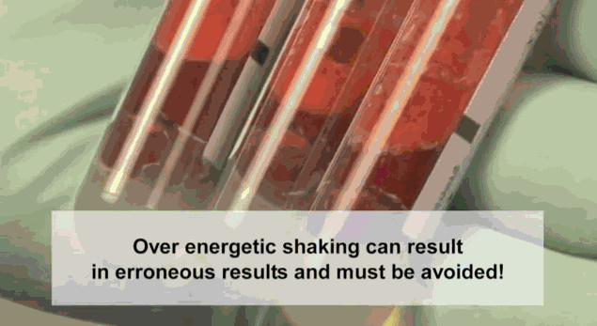
Collection and Transport
Over energetic shaking may cause gel disruption and could lead to aberrant results.
Frothy samples are acceptable but foamy samples are NOT.

Slide 12
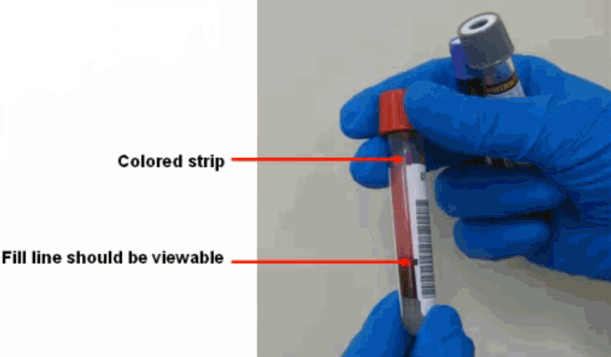
Collection and Transport
LABEL tubes appropriately. CID labels should be placed on each of the 3 tubes in the tube set so that the colored QuantiFERON strip at the top of
the tube, and the black fill line are not covered by
the label.
The back window should be visible on all 3 collection
tubes.
If possible, reprint a second
set of CID labels to make
sure all 3 tubes have the
same long CID label on them
The tubes should be labeled according to the Fairview Health Services PATIENT IDENTIFICATION AND LABORATORY SPECIMEN LABELING procedure # S:LM-L016.

Slide 13
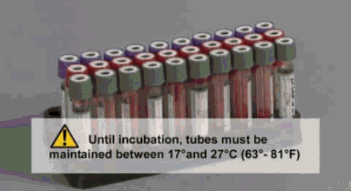
Collection and Transport
Tubes are to remain at room temperature until incubation. Specimens should not been sent refrigerated or frozen.
Tube sets will generally arrive as incubated or non-incubated and it is important to identify how they are received and how to handle appropriately.

Slide 14
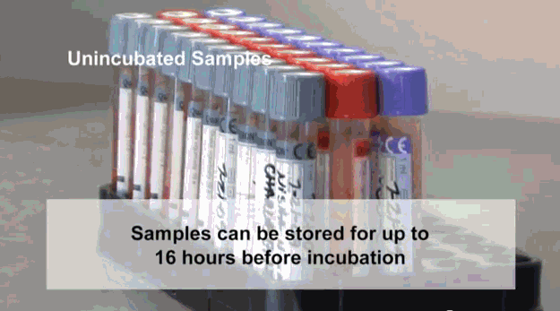
Unincubated Samples
It is recommended that incubation start as soon as possible and must be within 16 hours of collection.
Once a QTB set arrives, verify the collection time was within 16 hours.
If incubation hasn’t started before the 16 hour time limit has elapsed, the test should be canceled by the receiving laboratory, test credited, and the sending location must be contacted with an explanation.
Educational materials should be provided if necessary to correct in the future.

Slide 15
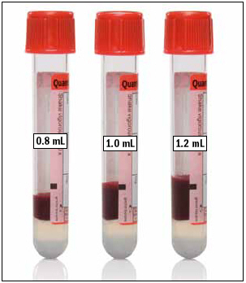
The 3 QTB tubes in the tube set are manufactured to draw 1 mL of blood and perform optimally within the range of 0.8 – 1.2 mL. Under or over-filled tubes outside of the 0.8-1.2 mL range may lead to erroneous results.
Upon receiving the tube set,
Verify each tube for proper fill levels.
If the level of blood is not close to
the BLACK INDICATOR LINE, The test
should be canceled immediately by
the receiving lab, test credited
and the sending location must be
contacted with an explanation.
If necessary, educational materials
should be provided.

Slide 16
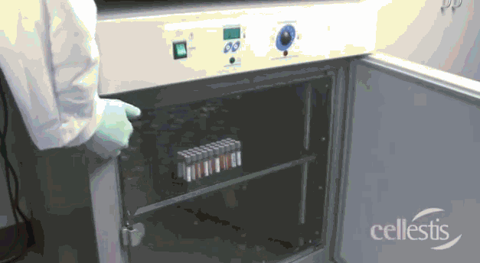
Incubation
Improper incubation will cause erroneous results.
Ensuring that the tubes are incubated at the correct temperature and for the correct amount of time is essential to the accurate performance of the test.
  The tube set should not be refrigerated or frozen prior to incubation.
  Humidity and CO2 are not required for incubation.

Slide 17
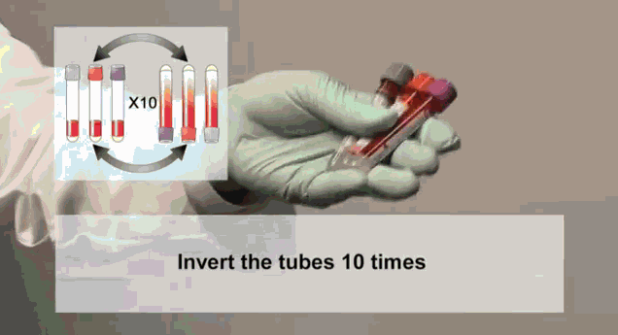

Incubation
If incubation is at all delayed from the time of collection, re-mix tubes by inverting 10 times before incubation.
Over energetic shaking may cause gel disruption and could lead to aberrant results.

Slide 18
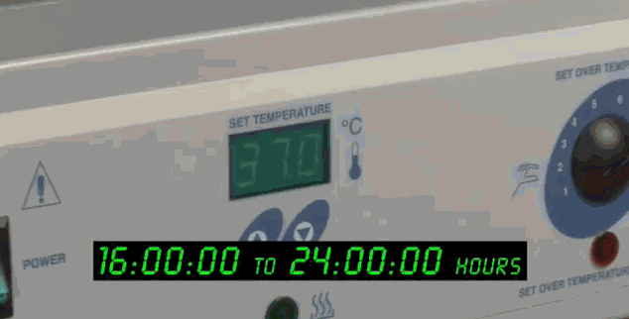
Incubation
QTB specimens should not be delayed for incubation once they are received by Specimen Management or the Acute Care Labs.
Immediately place the blood tubes within the correctly labeled rack in the incubator.
Document on the log: the time the specimens were placed into the incubator and the time frame they are to come out. Follow the guidelines on the side of the log for the times.
INCUBATE all 3 tubes upright at 37°C ± 1°C for 16-24 hours.
The tubes can not be
taken out of the incubator
and then re-incubated.

Slide 19
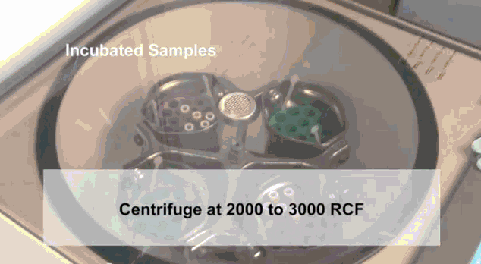
Centrifugation
After incubation, centrifuge tubes
in a swing bucket centrifuge for
15 minutes at 3000 RCF (g).
Place all 3 tubes together back in the original QTB transport bag, track through Sunquest, apply Batch label to bag, and label “incubated”.
Centrifuge at 3000 RCF for 15 minutes

Slide 20
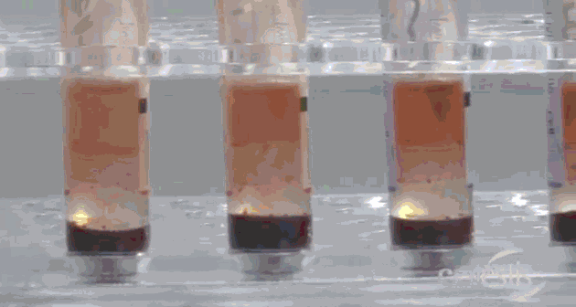
Centrifugation
After centrifuging the samples, the gel plug will separate the cells from the plasma. If this does not occur, the tubes should be re-centrifuged at a higher speed.
After centrifugation, the plasma must be stored in original collection tube at 2ºC to 8ºC for up to 28 days (8 weeks).
  Specimens should not be frozen.

Slide 21
Incubated Samples
Incubated samples that arrive also need to be verified to correct fill volumes.
Centrifuged samples need to be verified that they have been stored for less than 28 days at 2°C to 8°C.
Incubated samples that have not been centrifuged need to be verified that they have been received within 3 days of incubation and maintained at a temperature of 4°C and 27°C.

Slide 22
Delivery to Special Chemistry
    Deliver Incubated and Centrifuged Samples
    to Special Chemistry:
    Special Chemistry is open: (M-F 7:00 -16:00)
        ACL-East will PTS the processed and batched samples to Special Chemistry.
        Specimen Management will place the processed and batched samples in routing bucket for pickup.
    Special Chemistry is closed:
        ACL will store the processed and batched samples at 2ºC to 8ºC for morning delivery.
        Specimen Management will store the processed and batched samples in routing bucket at 2ºC to 8ºC for morning pickup.

Slide 23
Holidays and Weekends
    Special Chemistry is closed:
        ACL East will process, batch, and store the samples at 2ºC to 8ºC for delivery on Special Chemistry’s next working day.
        Specimen Management will need to note the received time of QTB tube set and department hours of operation to adjust the start of incubation and processing times in order to maintain the proper incubation time of 16-24 hours at 37°C ± 1°C .
        Specimen management will then process, batch and store the samples in routing bucket at 2ºC to 8ºC for delivery on Special Chemistry’s next working day.

Slide 24
Sample Rejection
Learn the QTB Sample Rejection Criteria and the 2-step process for canceling and crediting a test.
It is everyone’s job to cancel a QTB when it
does not pass the criteria. Be a team player
and cancel and credit the test at the
receiving laboratory.
Those main QTB Sample Rejection Criteria are:
  Mislabeled or unlabeled specimens
  Insufficient volume or tubes overfilled
  Samples over shaken
  Samples transported at wrong temperatures
  Samples > 16 hours old prior to incubation
  Specimens other than those collected and processed according to laboratory procedure and instructions in the QuantiFERON-TB Gold collection kit.

Slide 25
ETC Cancellation Codes
Common ETC codes to use when
cancelling QTB tests.
LABPRO - (Lab accident –specimen processed incorrectly)
USFULL - (Tube overfilled)
USUNDR - (Tube under filled)
USSTO - (Unsatisfactory specimen – too old for testing)
CANL - (Canceled – Specimen improperly labeled)

Slide 26
FAQ
Can the blood collection tubes be transported lying down?
Yes. QuantiFERON-TB Gold Blood Collection Tubes can be transported lying down only after the tube mixing step has been done. The tubes should be re-mixed by inverting 10 times immediately prior to being placed upright in the 37ºC incubator.
What if 37ºC incubation starts more than 16 hours after the time of blood collection?
The Package Insert specifies that the 37ºC blood incubation must commence within 16 hours of collection. Delay in incubation may cause false negative or indeterminate results. The sample must then be cancelled and recollected.
Can I incubate the blood collection tubes lying down?
QuantiFERON-TB Gold Blood Collection Tubes must be kept upright during incubation at 37ºC.
The gel plug hasn't moved during centrifugation. What should I do?
After incubation of tubes at 37ºC, the plasma is separated from the cells by centrifuging for 15 minutes 3000 RCF (g). The gel plug should move to separate the cells from the plasma. If this does not occur, the tubes should be re-centrifuged at a higher speed.

Slide 27
Conclusion
Once again, it must be emphasized that accurate QuantiFERON-TB Gold results require accurate collection, incubation, processing, storage, transport, and testing.
Questions – Contact:
    Acute Care, East 612-273-3336
    Acute Care, West 612-273-6135
    Special Chemistry 612-273-4047
    Specimen Management 612-273-3714

Slide 28
Competency
After completion of this educational portion, please complete the competency test.
All employees must obtain 80% to mark the test as completed.
If the first attempt at taking the test does not result in a score of 80%, please review the material and retake the test.

