Slide 1
Fairview Laboratories: Specimen Tracking and Transport
Clinical and Reference Laboratory
(Non-Anatomic Pathology) Specimens

Slide 2
Hyperlink test
Clinical (Non-Anatomic Pathology) Specimens:
ROB (Reference Outbound Batch) if necessary (used by sites where no direct pick-up to reference lab is available) Reference Outbound Batches (ROB)
Miscellaneous test (XMISC) order steps must be completed in Sunquest LSMISC LAB4909 Order Workaid
Generate a batch in Sunquest by scanning individual specimen CID barcode(s) and obtain a batch label Processing a Transport Batch

Slide 3
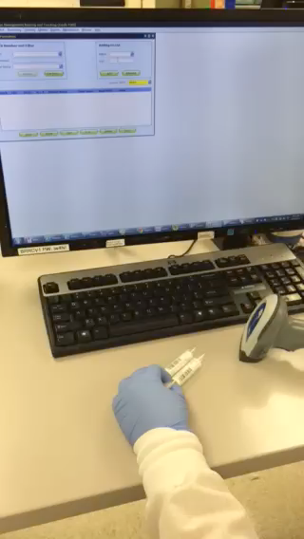
Embedded Video test
  Generate a batch in Sunquest by scanning individual specimen CID barcode(s) and obtain a batch label
  Processing a Transport Batch

