Slide 1

QuantiFERON-TB GOLD COLLECTION AND
PROCESSING

Slide 2
Lesson Details
Target Audience
This lesson is intended for all Fairview Employees who collect, handle, and process QTB specimens after the collection.
Author and Qualifications
Karri Schultze MLS(ASCP)^{CM}
Laura Pilcher MLS(ASCP)^{CM}
Cindy Johnson MLS(ASCP)
Patrica Larson MLS(ASCP)
Sources
Fairview Diagnostic Laboratories Lab Guide: QuantiFERON-TB Gold (QTB)
www.cellestis.com
Cellestis QuantiFERON-TB Gold Package Insert
Fairview Health Services- PATIENT IDENTIFICATION AND LABORATORY SPECIMEN LABELING - procedure # S:LM-L016
Contact Hours
0.5
Estimated Duration and Viewing Instructions
The expected time to complete this learning activity is 15 minutes and should be completed during your regularly scheduled work time. Any lessons or classes completed outside your scheduled work time must have prior approval from your supervisor and a supervisor or manager must approve any overtime.

Slide 3
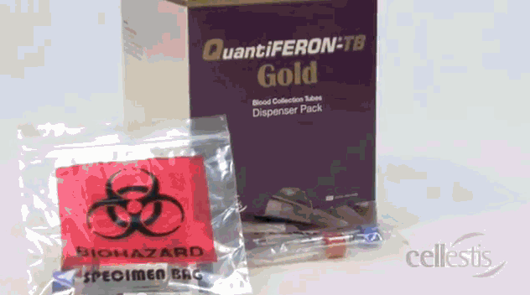
Table of Contents:
Objectives
How is this lesson relevant?
Collection and Transport
Unincubated
Incubation
Centrifugation
Incubated
Delivery
Holiday and Weekends
Sample Rejection
ETC Codes
FAQ
Conclusion

Slide 4
Objectives
Upon completion of this lesson, learners should be able to:
Know the proper QTB collection procedure.
Describe the purpose for proper QTB handling from after collection to delivery to the testing laboratory.
Become familiar with the key factors in preanalytic processing to assure accurate results.
Perform the proper steps from the receipt of the tube set from the collection site, storage, incubation of the tube set, and transport to the testing laboratory.

Slide 5
How is This Lesson Relevant?
There are multiple steps involved with the QuantiFERION-TB Gold method that must be completed properly by Clinical Laboratory Staff to ensure accurate performance.
Accurate results require accurate preanalytic processing!

Slide 6
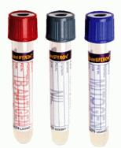
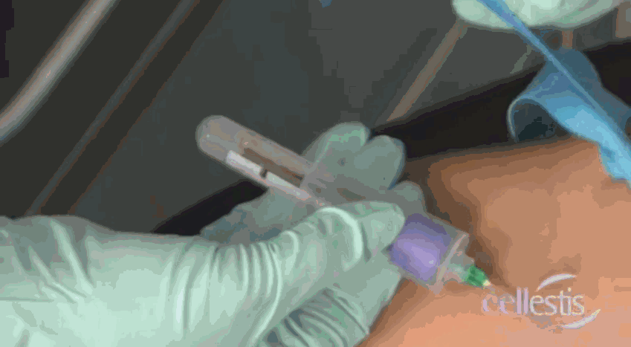
Collection and Transport
QTB sets are collected at the various clinics, outreach clients, and as inpatients.
Accurate QuantiFERON-TB Gold results require accurate collection, incubation, processing, storage, transport, and testing.

Slide 7
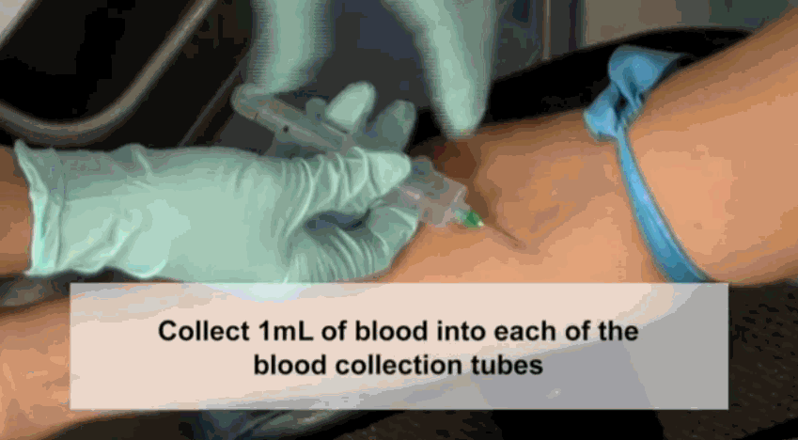
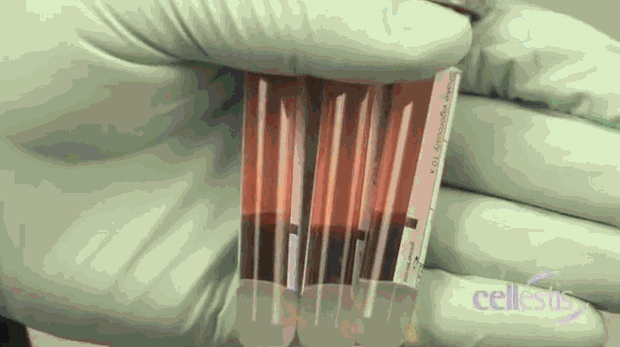
Collection
Tubes need to be at 17-27°C (63-81°F) at the time of collection
It s extremely important to draw exactly 1-mL of blood into each of the 3 tubes. There’s a black mark on the side of each tube that indicates the 1-mL fill line. TQuantiFERON®-TB Gold blood collection tubes are manufactured to draw 1mL ±10% and perform optimally within the range of 0.8 to 1.2mL. If the level of blood in any tube is not close to the indicator line, it is recommended to obtain another blood sample. Under or over-filling of the tubes outside of the 0.8 to 1.2mL range may lead to erroneous results.
QTB tubes are drawn last, after other tubes. The QTB tubes need to be collected in a certain order: Gray, Red Purple. Use GRaPe (Gray, Red, Purple) to remember what order to draw the QTB tubes in.

Slide 8
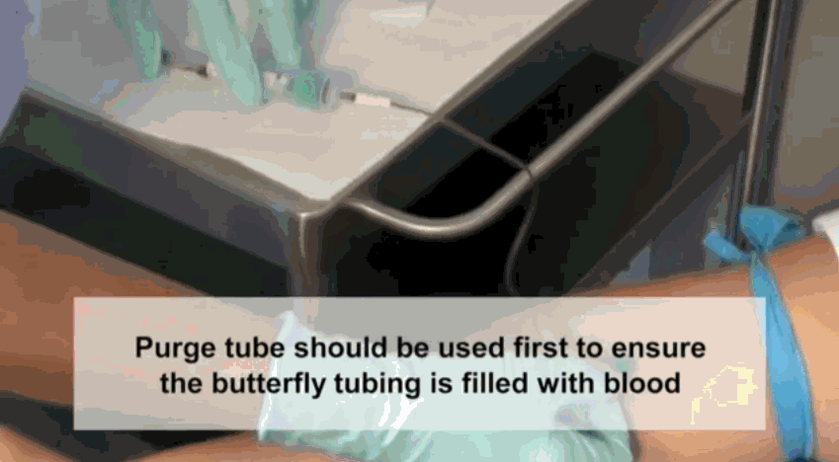
Collection and Transport
Use of a syringe may ensure correct blood volume.
If butterfly needle is used, first collect other required tubes or use a “purge” tube to remove the air. Then proceed with collecting the QTB tubes

Slide 9
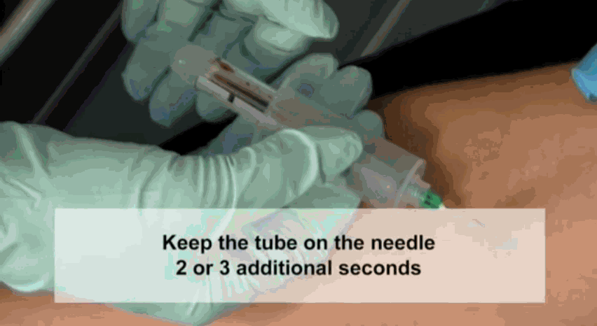
Collection
Tubes will fill slowly.
Keep each tube on the needle for 2-3 seconds after tube appears to have completed filling.

Slide 10
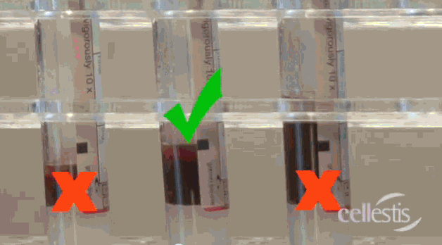
UNDER-FILLED
OVER
FILLED
GOOD TO GO!

Slide 11
Collection and Transport
Thorough mixing is required to ensure complete integration of the tube’s contents into the blood.
Immediately SHAKE the tubes firmly 10 times (5 seconds).
Entire inner surface of tube must be coated with blood.

Slide 12
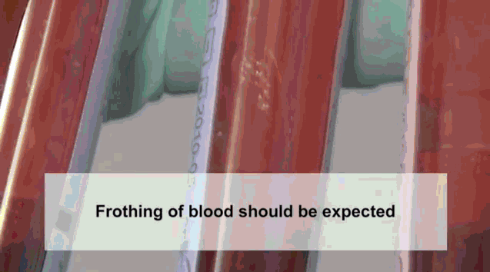
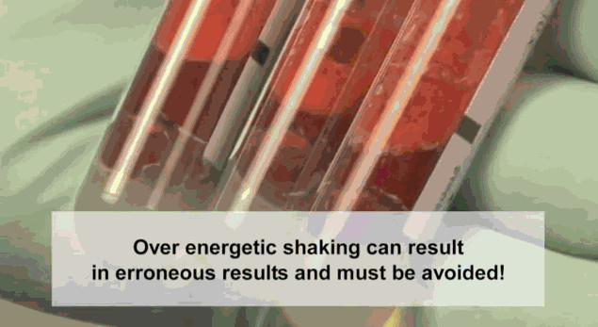
Collection and Transport
Over energetic shaking may cause gel disruption and could lead to aberrant results.
Frothy samples are acceptable but foamy samples are not.

Slide 13
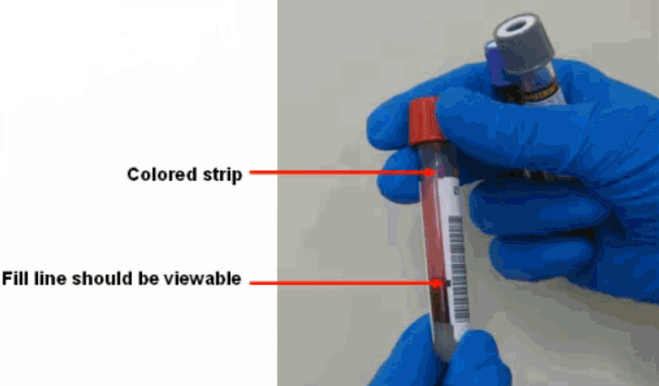
Collection and Transport
LABEL tubes appropriately—. CID labels should be placed on each of the 3 tubes in the tube set so that the colored QuantiFERON strip at the top of
the tube, and the black fill line are not covered by
the label.
The back window should be visible on all 3 collection
tubes.
If possible, reprint a second
set of CID labels to make
sure all 3 tubes have the
same long CID label on them.
The tubes should be labeled according to the Fairview Health Services- PATIENT IDENTIFICATION AND LABORATORY SPECIMEN LABELING - procedure # S:LM-L016
Send the labeled sample in the original bag to the UMMC E Core lab.

Slide 14
Receipt of QTB in UMMC-E Core Lab:
Upon receiving a QTB sample at UMMC E Core Lab, the order entry tech should be checking for:
  Correct volume
  Collect date & time (sample must be <16 hours old if not yet incubated)
  Was the sample incubated and spun at the sending site? (sticker may be present to indicate)
  If it is found that a sample needs to be cancelled at this point, the OE tech will notify the provider and perform a 2-step cancel in MECAN using the appropriate ETC code. Otherwise, send the sample to the Processing desk for processing.

Slide 15
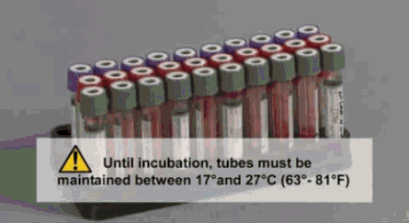
Improper incubation and storage will cause erroneous results:
CORRECT STORAGE AND PROCESSING IS CRUCIAL!
Tubes are to remain at room temperature until incubation. Specimens should not be sent refrigerated or frozen.
Tube sets will arrive as incubated or non-incubated and it is important to identify how they are received and how to handle appropriately. Sometimes a sticker is present on the sample bag to indicate status, but not always.

Slide 16
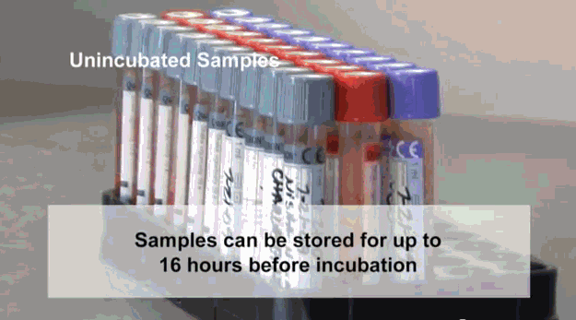
Unincubated Samples
It is recommended that incubation start as soon as possible and must be within 16 hours of collection.
Once a QTB set arrives, verify the collection time was within 16 hours.
Non-incubated samples should be kept at room temperature until incubation begins.
If incubation hasn’t started before the 16 hour time limit has elapsed, the test should be canceled by the receiving laboratory, test credited, and the sending location must be contacted with an explanation.
Educational materials should be provided if necessary to correct in the future.

Slide 17
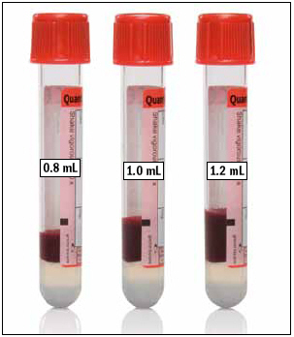
Always check for proper volume of blood:
The 3 QTB tubes in the tube set are manufactured to draw 1 mL of blood and perform optimally within the range of 0.8 – 1.2 mL. Under or over-filled tubes outside of the 0.8-1.2 mL range may lead to erroneous results.
Upon receiving the tube set,
Verify each tube for proper fill levels.
If the level of blood is not close to
the BLACK INDICATOR LINE, The test
should be canceled immediately by
the receiving lab, test credited
and the sending location must be
contacted with an explanation.
Acceptable volume range

Slide 18
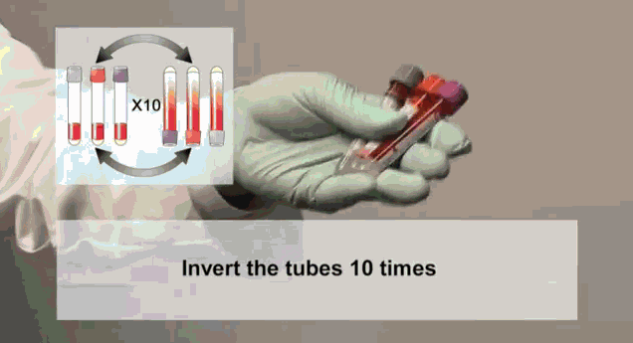

Re-mixing tubes:
If incubation is at all delayed from the time of collection, re-mix tubes by gently inverting 10 times before incubation.
CAREFUL!! Over energetic shaking may cause gel disruption and could lead to aberrant results.

Slide 19
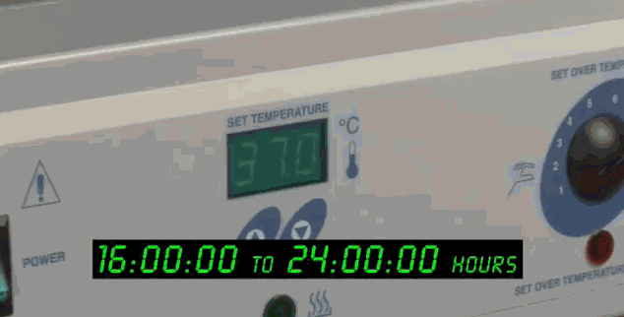
Complete log documentation and begin incubation:
Each different colored log corresponds to a different QTB time slot, which is based on the timeframe the samples started incubation, and what time they will be pulled out. Chose the correct log (time slot) for your sample(s).
Upon receipt at the Processing desk of the Core Lab:
  1. Follow the guidelines on the top of the log and document on the log:
  a) Correct volume? Y or N
b) <16 hrs old from time of collection? Y or N
(Cancel if >16 hrs old and not yet incubated)
c) Incubated by sending site? Y or N
d) Spun by sending site? Y or N
  2. Gently re-mix blood tubes by inversion and immediately place the tubes within the correctly labeled time rack in the incubator.
  3. Incubate all 3 tubes upright at 37°C ± 1°C for 16-24 hours; no more, no less.
The tubes cannot be
taken out of the incubator
and then re-incubated.

Slide 20
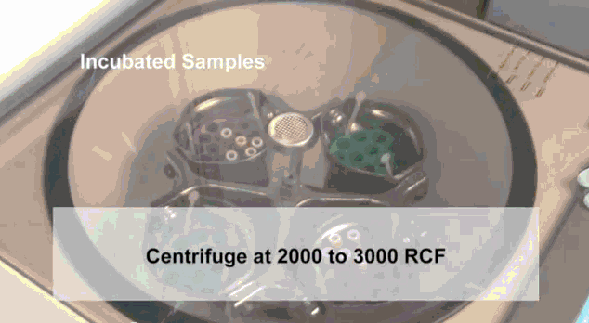
Centrifugation
After incubation, have a charge tech check your work before centrifugation.
Centrifuge tubes
in a swing bucket
centrifuge for
15 minutes at
3000 RCF (g).
** Be sure to double check that the centrifuge speed is set to RCF (g) and not RPM (see next slide for more detail).
Centrifuge at 3000 RCF for 15 minutes

Slide 21
Centrifugation (a little background)
Difference Between RCF and RPM in Centrifugation:
Revolutions Per Minute (RPM)
Revolutions Per Minute (RPM) in regards to centrifugation is simply a measurement of how many full rotations the rotor does in one minute. Basically, it is telling us how fast the rotor is spinning. Centrifuges will have a speed range that they are capable of achieving and will vary depending on the centrifuge. A low speed centrifuge might spin at as low as 300 RPM, whilst a high speed centrifuge could spin up to 15000 RPM. Ultracentrifuges are also available and are the most powerful type of centrifuge, they can spin in excess of 150,000 RPM.
Relative Centrifugal Force (RCF)
Relative Centrifugal Force (RCF) or g-force (both are the same, RCF is expressed as units of gravity) is a measurement of the gravitational force that a sample is subject to. The force applied to the contents varies by the size of the centrifuge rotor. The force is generated from the spinning of the rotor which, in turn, exerts this force outward on the centrifuge tube. Not only does RCF take into account the speed of rotation, it also measures the distance from the center of rotation to give us a g-force measurement. RCF is the preferred method of measurement as it will remain the same even if you are using a different centrifuge with a different rotor size.

Slide 22
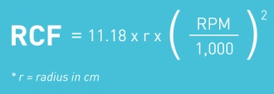
Centrifugation (a little background)
What’s the difference between RPM and RCF?
Both RPM and RCF(g-force) can be measured in centrifugation, but as we have just explored, the two are very different. RPM simply measures how fast the rotor is spinning, and while this information is helpful, it is lacking the ability to truly measure the g-forces the sample is subject to. A centrifuge spinning at 5000 RPM, for example, will spin at 5000 RPM regardless of the centrifuge being used, or the size of the rotor. The g-force applied to the specimen contents varies by the size of the centrifuge rotor. RCF accommodates the rotor size into its measurement so we can determine the gravitational force being applied to the specimen.

Slide 23
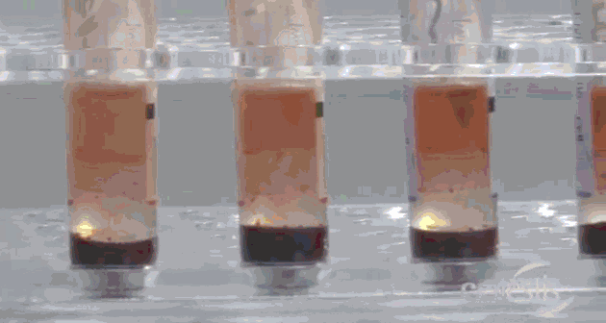
After centrifugation, processing and storage:
After centrifuging the samples, the gel plug will separate the cells from the plasma. If this does not occur, the tubes should be re-centrifuged at a higher speed.
After centrifugation, the plasma must be stored in original collection tube at refrigerated (2ºC to 8ºC) temp. for up to 28 days (8 weeks) unless transported to UENDO same day.
  Specimens should never be frozen.

Slide 24
After centrifugation, batching:
After centrifugation is complete, place the samples on a batch and in a rack (with each patient’s tubes next to each other, in GRaPe order) together to go on the transport cart for delivery to UENDO during business hours, or to be stored at refrigerated temperature (2℃-8℃) after hours.

Slide 25
Incubated Samples:
Incubated samples that arrive also need to be verified to correct fill volumes.
Incubated samples that have been centrifuged: need to be verified that they have been stored for less than 28 days at 2°C to 8°C.
Incubated samples that have not been centrifuged: need to be verified that they have been received within 3 days of incubation and maintained at a temperature between 4°C (refrigerated) and 27°C (room temp) before centrifugation.

Slide 26
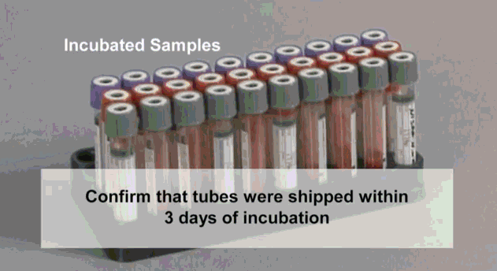
Incubated, Un-centrifuged Samples:
Incubated samples that have not been centrifuged need to be verified that they have been received within 3 days of collecting and maintained at a temperature between 4°C (refrig.) and 27°C (room temp) before centrifuging.
Document sample info on appropriate colored QTB log.
Centrifuge tubes in a swing bucket centrifuge for 15 minutes at 3000 RCF (g).
Place all 3 tubes together back in a QTB transport rack, track through Sunquest by placing on a batch, place batch label in rack pouch, and label “incubated”. Send to UENDO during business hours or store refrigerated in the Core lab after hours.

Slide 27
Delivery to Special Chemistry, weekdays
    Delivering Incubated and Centrifuged Samples
    to Special Chemistry/UENDO:
    Special Chemistry is open: (M-F 7:00 -16:00, Sat-Sun 0800-1500)
        Core Lab (ACL) will transport the correctly processed and batched QTB samples to Special Chemistry via the specimen transport cart.
    Special Chemistry is closed:
        Core Lab (ACL) will store the processed and batched samples in a rack at 2ºC to 8ºC for morning delivery via the specimen transport cart.

Slide 28
Sample Rejection
Learn the QTB Sample Rejection Criteria and the 2-step process for canceling and crediting a test.
It is everyone’s job to cancel a QTB when it
does not pass the acceptable specimen
criteria! Be a team player and cancel and
credit the test (2 step) at the receiving laboratory.
Re-cap: The main QTB Sample Rejection Criteria are:
  Mislabeled or unlabeled specimens
  Insufficient volume or tubes overfilled
  Samples over shaken
  Samples transported at wrong temperatures
  Samples > 16 hours old prior to incubation
  Specimens other than those collected and processed according to laboratory procedure and instructions in the QuantiFERON-TB Gold collection kit.

Slide 29
ETC Cancellation Codes
Common ETC codes to use when
cancelling QTB tests.
LABPRO - (Lab accident –specimen processed incorrectly)
USFULL - (Tube overfilled)
USUNDR - (Tube under filled)
USSTO - (Unsatisfactory specimen – too old for testing)
CANL - (Canceled – Specimen improperly labeled)

Slide 30
FAQ
Can the blood collection tubes be transported lying down?
Yes. QuantiFERON-TB Gold Blood Collection Tubes can be transported lying down only after the tube mixing step has been done. The tubes should be re-mixed by inverting 10 times immediately prior to being placed upright in the 37ºC incubator.
What if 37ºC incubation starts more than 16 hours after the time of blood collection?
The Package Insert specifies that the 37ºC blood incubation must commence within 16 hours of collection. Delay in incubation may cause false negative or indeterminate results. The sample must then be cancelled and recollected.
Can I incubate the blood collection tubes lying down?
QuantiFERON-TB Gold Blood Collection Tubes must be kept upright during incubation at 37ºC.
The gel plug hasn't moved during centrifugation. What should I do?
After incubation of tubes at 37ºC, the plasma is separated from the cells by centrifuging for 15 minutes 3000 RCF (g). The gel plug should move to separate the cells from the plasma. If this does not occur, the tubes should be re-centrifuged at a higher speed.

Slide 31
Conclusion
Once again, it must be emphasized that accurate QuantiFERON-TB Gold results require accurate collection, incubation, processing, storage, transport, and testing.
Questions – Contact:
    UMMC East Core Laboratory 612-273-3336
    Special Chemistry 612-273-4047

