Slide 1

Fairview Laboratories:
Specimen Transport and Tracking
Annual Required Learning for 2020
INSTRUCTIONS for PowerPoint:
To view all links, go to “Slideshow” at top of this page
and select “From Beginning.”

Slide 2
Objectives:
Following this presentation, you will be able to:
Describe the sending and receiving standard workflow for laboratory specimens.
Prepare specimens for transport according to the “Packaging and Labeling Specimens for Shipping and Transport” procedure.
Demonstrate an understanding of standard packaging and labeling of laboratory specimens.
Define Lost/Mishandled Specimen(s)
Report/Document Lost/Mishandled Specimen(s)
DESIGN NOTE
Content should stay at least ½” above the logo and NOT fall in the space between the logo and slide number.

Slide 3
Purpose:
Standardizing Tracking and Processing
To implement a standard workflow for packaging, labeling, shipping for tracking and processing of all specimens transported on behalf of M Health Fairview and Fairview Laboratories.
To implement standard audit to verify compliance with standard work and comply with System Risk Management.
Patient Care and Brand Reputation

Slide 4
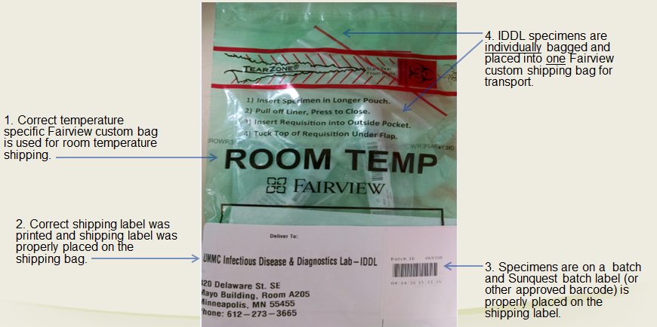
Standard packaging, labeling, and shipping:

Slide 5
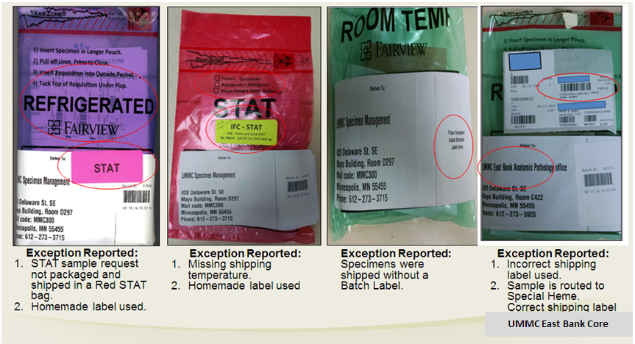
What is wrong with these pictures?
Remember:
Do NOT handwrite on label anywhere….

Slide 6
Why is this important?
Lost and Lost to Testing/Mishandled specimens:
In the event of a missing specimen, use the “Missing Specimen Investigation” form. Link: Missing Specimen Form
Quality of patient care can be effected which could lead to additional procedures or testing for the patient.
Reportable (lost specimen) events are reported to CMS (Center for Medicare and Medicaid Services). CMS mandates that lost specimens that are considered irretrievable or irreplaceable must be reported.

Slide 7
Definition of LOST and LTEST:
Cancel, Credit, and Reporting in Compass
DEL-LOST = Specimen is Lost
    Specimen cannot be located and testing cannot be completed. A Compass Patient Safety Event (PSE) needs to be completed (If possible, a new specimen will need to be collected)
DEL-LTEST = Specimen was Mishandled
    Testing can be performed if another draw/specimen is available (regardless of impact to the diagnosis, a Compass Patient Safety Event (PSE) must be completed). Test must be credited and reordered on a new accession number to ensure proper documentation.

Slide 8
System Procedures:
Please read the procedure that outlines the changes and requirements that are highlighted in this module.
Specimen Packaging and Labeling for Shipping & Transport
Workaid: Pathology Specimen Tracking
Canceling and Crediting Orders and Results

Slide 9
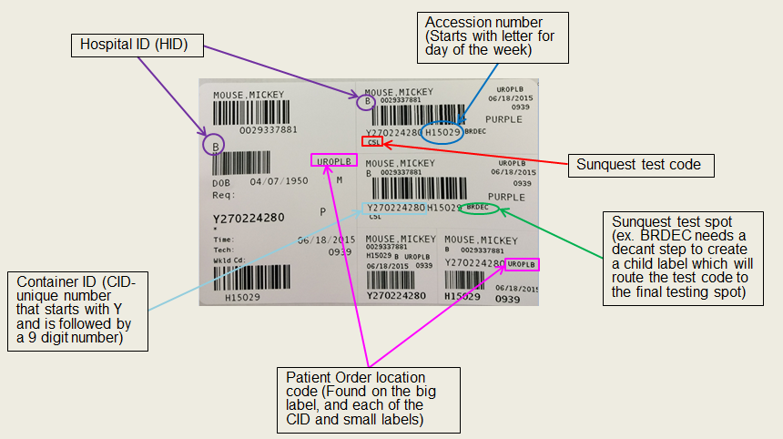
Sunquest Label Refresher:

Slide 10
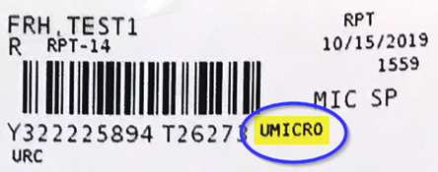
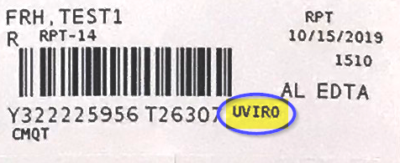
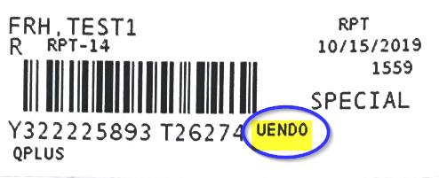
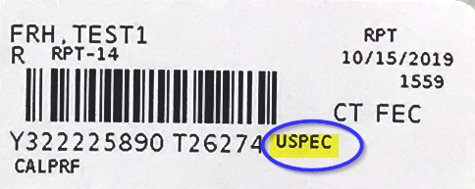
Common Shipping Errors:
Does it go to IDDL or NOT?? Look at the SPOT on the SQ label and in Lab Guide.
YES!
NO!
UMICRO and UVIRO
Just because it’s TB testing doesn’t mean it goes to IDDL!
UENDO ships to UMMC East Core
Not all stool testing is routed to IDDL!
USPEC ships to UMMC East Core

Slide 11
Lab Guide Refresher:
Lab Guide is on the Fairview Intranet.
Intranet location: Laboratory Services→ Lab Guide Test Catalog
Each test should be looked up in Lab Guide to determine:
  Collection, Processing, & shipping instructions
  Testing location

Slide 12
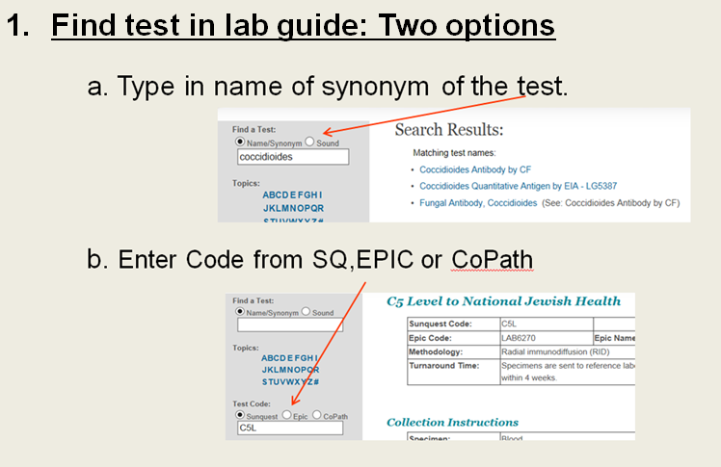
Lab Guide Refresher example:

Slide 13
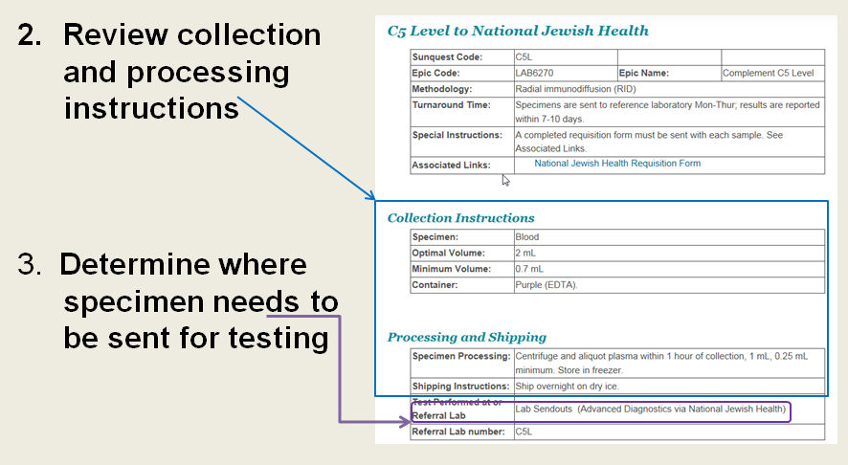
Lab Guide Refresher Example:

Slide 14
Sending Laboratory Responsibilities:
Refer to the Fairview Lab Guide to review test requirements and processing instructions.
Mandatory:
All clinical laboratory specimens must be “instrument ready” or “testing ready” prior to packaging and transport according to Lab Guide instructions (Decant, ROB, and XMISC completed according to procedure). Examples: Centrifuged, Decanted, Aliquoted, Labeled with correct CID, etc.
Note: If test is not in Lab Guide, follow the reference laboratory’s processing and shipping instructions found on Reference Lab’s website (ex. Mayo, ARUP, Medtox, etc.).

Slide 15
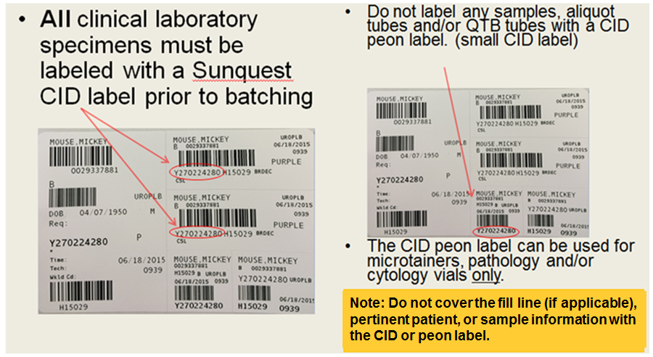
Specimen CID Labeling:

Slide 16
Tracking in Sunquest: Obtain a CID Label
Generate Sunquest CID label for each specimen by one of the following ways:
  Release the order in Epic or Atlas and receive it in Sunquest.
  Order the correct Sunquest test code(s) and/or routing code(s) per Epic/Paper Order on the appropriate CSN/Account.
  Receive the appropriate test code(s) and/or routing code(s) in Sunquest.

Slide 17
Tracking in Sunquest: Generate a Batch
Generate a batch in Sunquest by scanning individual specimen CID barcode(s) and obtain a batch label. Click here to view procedure: Processing a transport Batch
  Miscellaneous test (XMISC) order steps must be completed in Sunquest. Click here to view procedure: Miscellaneous (LAB4909) Order Workaid.
  ROB (Reference Outbound Batch) if necessary. Click here to view procedure: Reference Outbound Batches (ROB) .

Slide 18
Where to Send Specimens:
Place specimen(s) in a Fairview custom color-coded (temperature specific) shipping biohazard bag or other approved clear biohazard bag.
Specimens must be batched to UMMC East Bank Core Lab, IDDL or Pathology (unless sending lab has a direct courier route or an on-demand/stat courier is requested).
For all laboratories that have a direct courier route to another Fairview laboratory, all specimen(s) must be put on a Sunquest transport batch.

Slide 19
Sending Laboratory Responsibilities:
Pull a transport batch filter at least once per shift. This is our “safety net” to catch specimens that have been unaccounted for.
  Review any unaccounted for specimens on filter and investigate.
  Do not save this filter because it will create a batch of specimens not ready/available for transport. Click here to view procedure: Processing a Transport Batch.

Slide 20
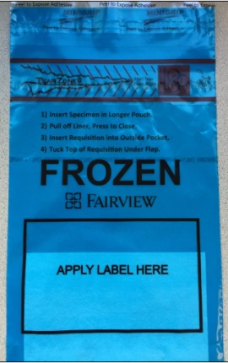
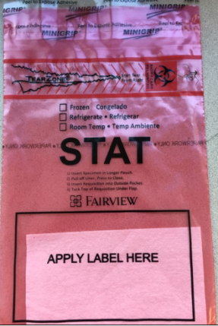
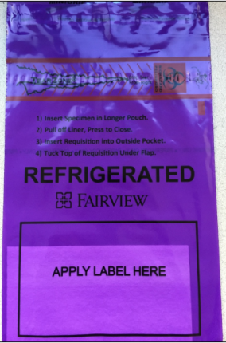
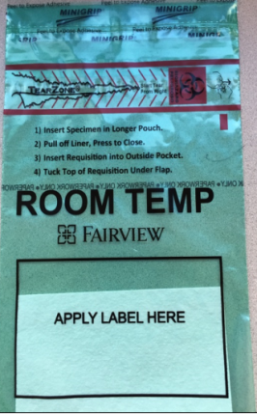
Fairview Custom Specimen Packaging
Fairview custom specimen bags are used at all laboratory sites to package specimen(s) being sent to an external Fairview location.
Fairview custom specimen bags are available in 2 sizes (6x9” and 12x15”).
    Blue=Frozen
    Red=STAT
    Purple=Refrigerated
    Green=Room Temp
Note: Indicate specific shipping temperature on any Red STAT specimen bag with a sharpie.

Slide 21
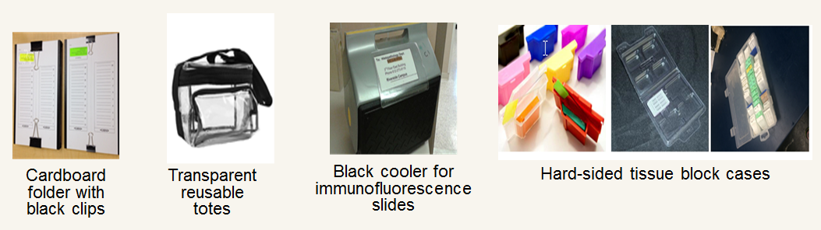
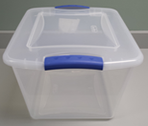
Specimen Packaging:
Anatomic Pathology Laboratories will use the following resources to send specimens between their sites:
Clear plastic tote

Slide 22
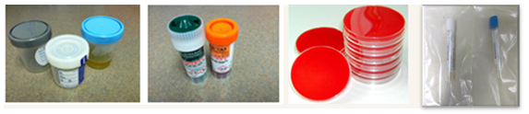
Packaging Specimens: Guidelines
NEW: A limit of 10 specimens (CIDs) per bag (regardless of specimen type/test ordered). The only exception to this limit are for clinic sites that ship the blue chemistry racks.
Include any necessary paperwork in the external document pocket.
Tightly seal any sterile screw-top (i.e. urine, body fluids, stool) containers.
Package sterile screw-top containers, urine, GCPCR/CHPCR, eSwab and culture plates separate from all other specimen types.
  Note: All clinical specimen types can be packaged together at appropriate temperature with the exception of sterile screw-top containers, urine, GCPCR/CHPCR, eSwab and culture plates (images above).

Slide 23
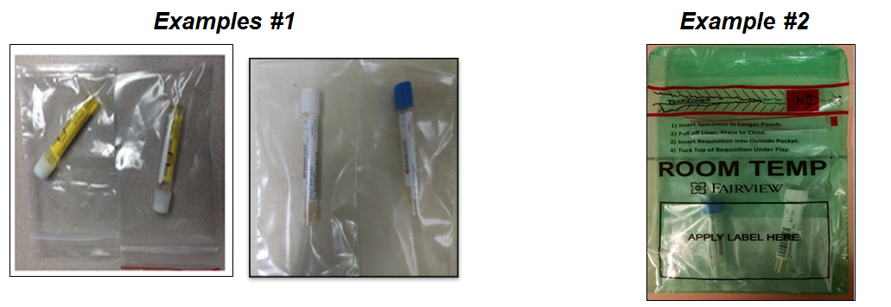
Packaging Specimens:
GCPCR/CHPCR & eSwab
Package all GCPCR, CHPCR & eSwab containers individually (urine or swab Genprobe) into single small zip lock plastic bags. Example 1.
Individual zip lock bag(s) containing GCPCR, CHPCR & eSwab will be batched and placed in one biohazard bag and sent to IDDL. Example 2.

Slide 24
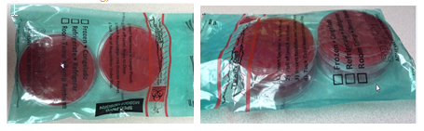
Packaging Specimens: Culture Plates
IDDL culture plates can be stacked 2 plates high with no more than 4 plates total per bio-hazard bag.
Note: Do not use tape of any kind to secure culture plates.

Slide 25

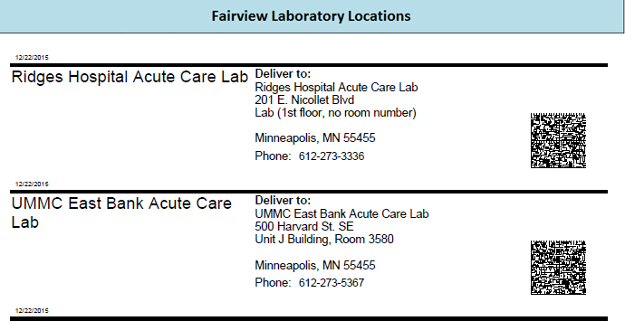

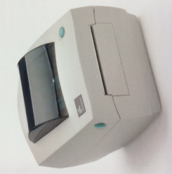
Standard Specimen Bag Labeling
Obtain an on-demand shipping label by scanning the appropriate barcode for the receiving laboratory from the standard spreadsheet.
All bags must be labeled with standard shipping label.
A master barcode shipping label list can be found on the Fairview Intranet:
Intranet.fairview.org/Clinical/Services/Lab/Procedures for Lab Staff/System Policies and Procedures/Packaging and Shipping by Courier/Barcode List for Shipping Address Labels.
Link to Address Barcode Sheets: https://fls.labqms.com/sthDMSTOC.asp?TD=246&DC=T&LD=996&ID=1098

Slide 26
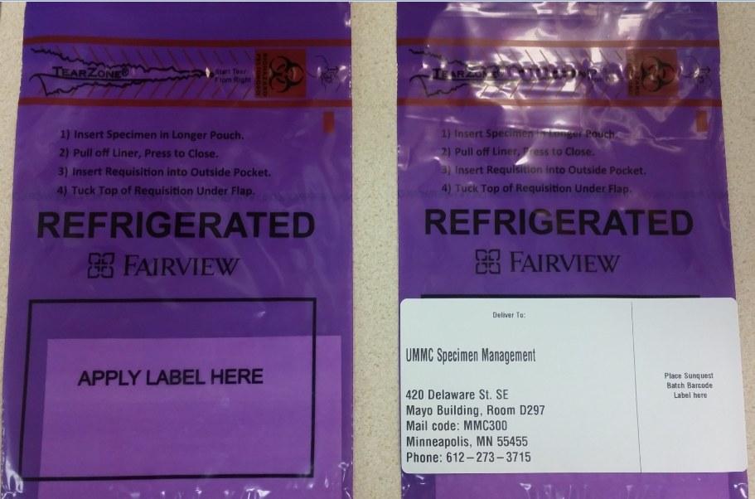
Labeling specimens Bag(s) for Transport
Place the transport shipping label onto the designated area on the bottom portion of the specimen bag over the black-outlined box that states “Apply Label Here”.

Slide 27
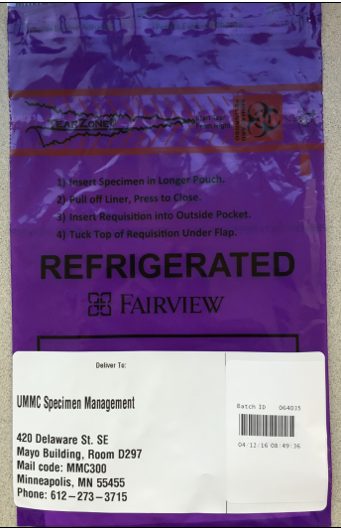
Labeling Specimens Bag(s) for Transport
Place the Sunquest batch label on top of the print-on-demand shipping destination label on the right.
Note: Placing the batch label on top of the on-demand shipping label will prevent batch labels from falling off at various temperature ranges.
Insert Sunquest batch label (or other approved barcode) here

Slide 28
Delivery/Pickup REQUIREMENT: WARM HANDOFF
All HealthEx courier specimen deliveries/pickups must involve a direct-communication one-to-one handoff between a courier and a lab staff member.
Couriers must scan all bags in the Lab Department (not in the hallway, car, etc.).
Courier must verbally acknowledge the # of bags being directly handed to or picked up from a lab staff member in the Lab department. Couriers can not drop and go. A lab staff member must be physically present.
Courier must scan lab employee badge as documentation of receipt of specimens. If an lab employee does not have their badge, they must find another lab member to accept the warm handoff and claim responsibility for the specimen receipt.

Slide 29
LOST SPECIMEN: Risk Reduction
To reduce or eliminate risk of losing a specimen, the following lab practices are required at all Sending/Receiving locations:
1. No garbage, recycling, laundry, hazardous waste or other receptacles can be located below the bench of the Sending or Receiving locations.
2. All bags must be flattened after specimen removal. This flattening process will eliminate the risk of specimens being disposed of with the bags.

Slide 30
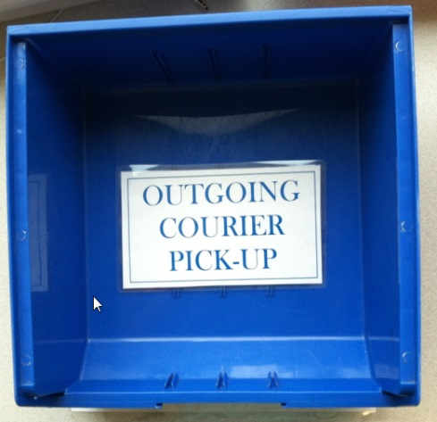
Outgoing Specimen(s): Courier Pick-up
All outgoing specimens ready for testing and courier pick-up must be placed in the appropriate BLUE outgoing courier pick-up bin. The courier bins will have a location barcode for scanning.
Note: There will be a BLUE outgoing courier pick-up bin available for all shipping temperatures.

Slide 31
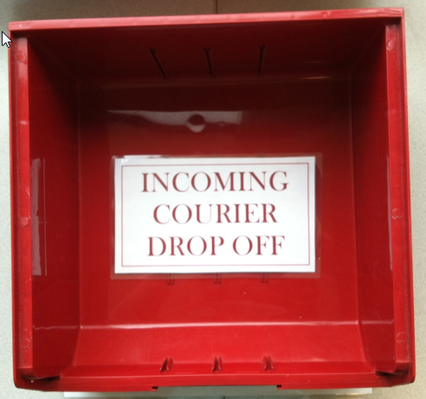
Incoming Specimen(s): Courier Drop-off
All incoming specimens will be dropped off in the designated RED courier drop-off bin. The courier bins will have a location barcode for scanning.

Slide 32
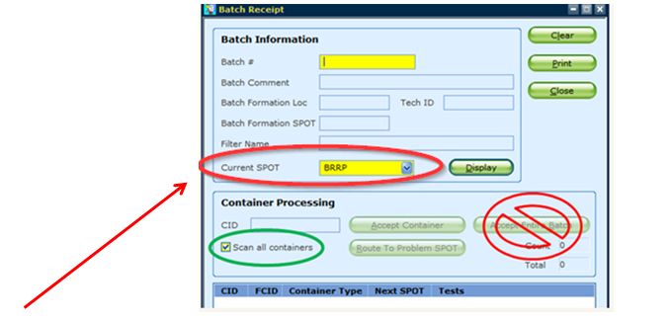
Receiving Laboratory Responsibilities:
Disband all batched specimens using Sunquest SMART by scanning the individual CID label on each specimen.
Never accept the entire batch
Note: Verify the “Current spot” is correct for your receiving location.

Slide 33

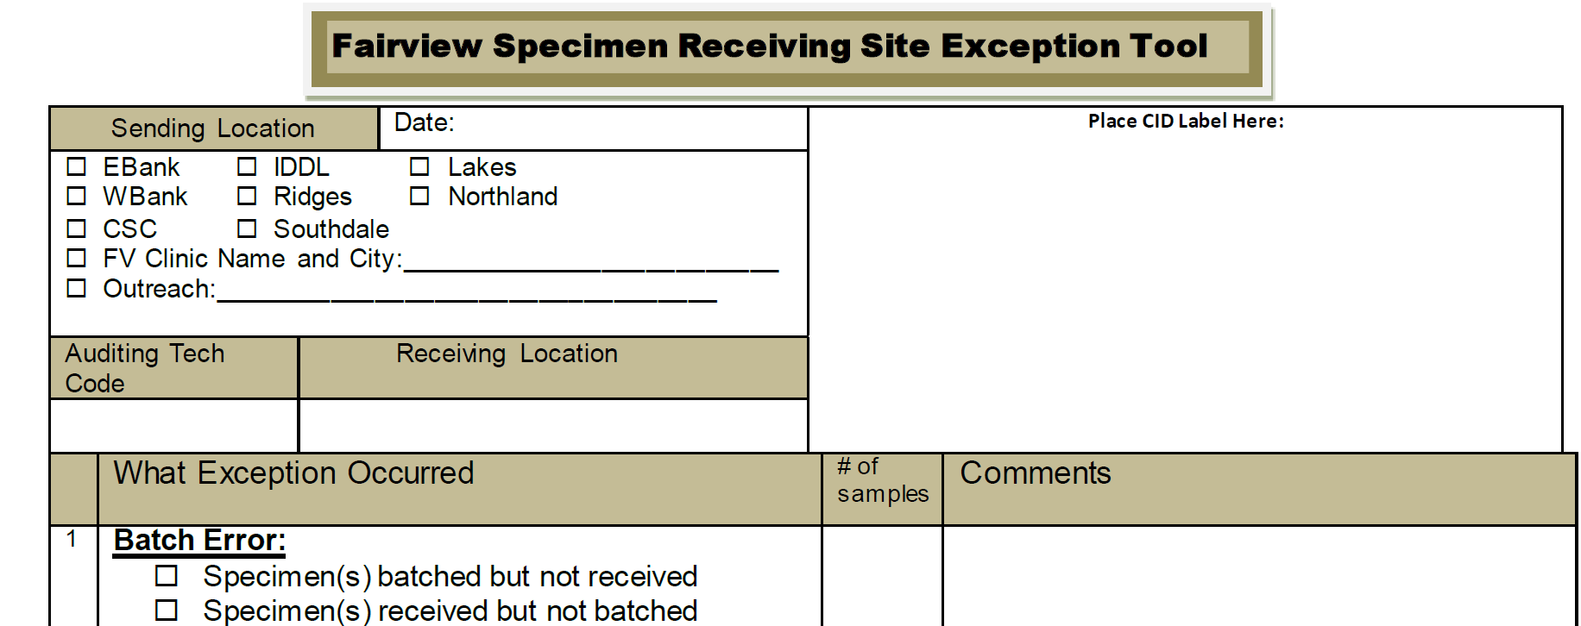
Receiving Lab Responsibilities
Any CID(s) left on the batch must be investigated immediately.
Utilize the Exception Tool to document and report any issues pertaining to samples and/or batches. Fairview Specimen Receiving Site Exception Tool.
Reporting examples:
    Report issues to sending labs about specimen issue or transport batch issues.
    Report issues w/ couriers (ex., thawed in route, in a room temp bag, but arrived frozen, etc.)

Slide 34
Receiving Location Responsibilities:
If specimen is at final testing location, proceed with testing.
If specimen is not at final testing location and needs to be re-batched to new testing location:
  Disband batch by scanning each individual CID label(s)
  Re-batch specimen(s) by scanning the individual CID label(s)
  Package and label for transport or shipment

Slide 35
Compliance and Education:
All receiving locations will complete the “Exception Tool” as part of their daily work flow when issues are identified.
Exception(s) results are shared with the System Transportation & Courier committee and with the Laboratory Leadership team.
Link: Fairview Specimen Receiving Site Exception Tool.
A quality review is done monthly to identify trends in exception errors across the MHealth Fairview Lab System. Managers and site representatives will follow up with staff on identified errors.

Slide 36

For 24/7 Courier Issues, questions or assistance:
Call 612-273-4652
Courier Hotline (24/7) for scheduled or STAT pickups is: 612-273-4652.
Option 1: On Time Delivery Service for STATs
Option 2: HealthEx Couriers for all scheduled routes
Call for immediate assistance with:
Locating a courier
Troubleshooting a specimen location
Courier Performance issue
Missed pickup/drop off
For non-emergent concerns, an email can also be sent to: FairviewHealthCS@healthexcourier.com
IMPORTANT NOTE: DO NOT CONTACT A COURIER DIRECTLY. ALL CONTACT MUST BE MADE THROUGH THE COURIER HOTLINE DISPATCH.

Slide 37
Summary:
All specimen(s) must have a Sunquest CID label and be ready for testing prior to transport/shipment.
All specimens must be tracked in Sunquest by scanning each individual CID label to create and disband batches.
Specimen(s) must be packaged according the system procedure Specimen Packaging and Labeling for Shipping & Transport .
Specimen Bags must be labeled with the standard address label format.
All deliveries must have a warm hand off between courier and lab staff.
Lost or Lost to Testing/Mishandled specimens must be documented according to the System Canceling and Crediting Orders and Results in Sunquest procedure.

Slide 38
Who to contact with questions?
For questions on policies or procedures, please see your site
Transportation and Courier Committee representative.

Slide 39

Thank You!

