Slide 1

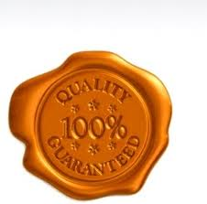
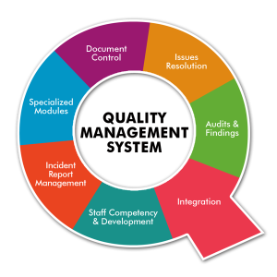
SAY what you do
DO what you say
Prove it
Improve it

Slide 2
YOUR QUALITY TEAM
Director of Laboratory Services
Tara Butler
Regional Quality Assurance Manager
Gisele Hickman
Quality & Safety Coordinator
Jennifer Blackwood
Quality & Safety Coordinator
Rebecca White

Slide 3
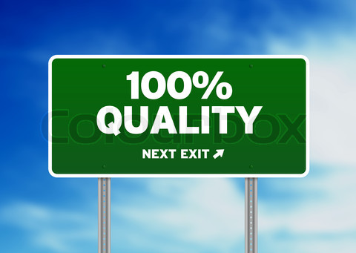
Where are we going?
Through Quality Management we will ensure that all the essentials needed to plan, control and improve processes are in place to enable us to deliver high quality results.
The ultimate end-user of our services is the patient. Our business is to ensure the best outcomes for our clients and in doing so we become a valuable contributor to the betterment of the overall health care system.

Slide 4
Quality is Everyone’s Business
HOW WELL DO WE KNOW OUR WORK PROCESSES?
Are we doing the right things?
Are we doing things right?
How safe are patients in our system?
How do we know?
How can we be certain that we do things right the first time, every time?

Slide 5
Quality is Everyone’s Business Cont’d
HOW DO WE CONTINUALLY IMPROVE OUR OUTCOMES?
Do we have a systematic process for improvements?
Do we have accountability for improvements?
How do we know we are making a difference?
Do we promote leadership by example to foster change?
Do we learn from other industries?
Do we foster sustainability, continued learning and innovation?
Quality means doing it right when no one is looking.”
― Henry Ford

Slide 6
ACCREDITATION
Laboratory accreditation is a process by which an authoritative body gives formal recognition that an organization is competent to carry out specific tasks (detailed in a scope of accreditation) in a reliable, credible, and accurate manner. Accreditation assesses both the quality system and technical competence of the organization on the basis of a pre-defined standard. For medical laboratories, the fundamental standard is ISO 15189 Medical Laboratories – Particular requirements for quality and competence.

Slide 7
What is a Quality Management System ?
Quality Management system is a system that is developed in order to provide and implement quality policies within an organization to ensure compliance with customer and regulatory requirements.

Slide 8
What makes up a QMS?
Occurrence Management
Management Reviews
Internal Audits
Training and Assessment Tools
Quality Control
Inventory Control
Document Control
Resource Allocation Guidelines
Management Commitment

Slide 9
Why do we do it?
The customers’ requirements – confidence in the ability to deliver the desired product and service consistently meeting their needs and expectations.
The organization’s requirements – both internally and externally, and at an optimum cost with efficient use of the available resources materials, human, technology and information.

Slide 10

Why do we do it?
Cont’d
A good QMS will:
Set direction and meet customers’ expectations
Improve process control
Reduce wastage
Lower costs
Facilitate training
Involve staff

Slide 11
What is the difference between Quality Improvement and Quality Assurance?
Quality Assurance (QA) is a system of quality control activities that promote the quality of higher-level processes and functions. QA is best applied to all steps in the laboratory test cycle, including integrity of the test ordering and collection process, analyses, and the reporting of results, as well as to other important variables
Quality Improvement (QI) is a separate activity that supplements Quality Assurance. QI is the effort to improve the quality of product/process beyond its current state.

Slide 12
PDSA Model for Continuous Improvement
PLAN
DO
STUDY
ACT
Measurement Analysis and
Improvement- Continual monitoring
Management
Responsibility - commit to quality and strategic planning
Resource Management - allocate and manage resources to implement plans
Service Realization -
pre-analytical/analytical/
post-analytical QA activities

Slide 13
PDSA Model for Continuous Improvement Cont’d
The PDSA cycle is a simple method of quality improvement, which involves the design of a change to improve a process (“Plan”), implementation of the change on a test basis (“Do”), evaluation of the impact of the change on process variation and bias (“Study”), and if the change is successful, implementation on an ongoing basis (“Act”).

Slide 14
Quality Manager’s
Responsibility
Oversee compliance with the requirements of the QMS
Report to the Director of Laboratory Services
Ensure promotion of customer awareness
Ensure the voice of the customer is heard

Slide 15
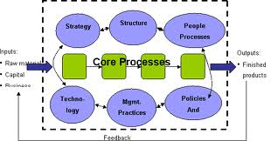
Document Pyramid
Policies:
What is done and why
Defines goals
Briefly states intent and direction
Forms the basis of the Quality Manual
Processes
Procedures
Records
Policies
Procedures:
Written step-by-step instructions that specify the accepted way to carry out an activity.
Records:
Client reports
Occurrence reports
Audit reports
QA charts etc.

Slide 16
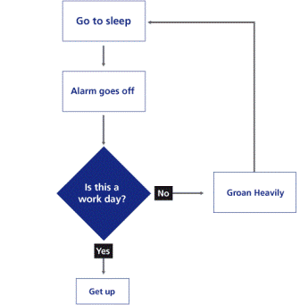
Tools of the Trade
Process tables
Flowcharts
Process mapping

Slide 17
Tools of the Trade Cont’d
Standard Templates
Risk assessment – Occurrence reports
Internal audits / self assessment
Collaboration-Education-Best practices
“Steal Shamelessly” !

Slide 18
Good Documentation
Practices-GDP
Best practices for consistency, quality and maintenance of all documents/records which follow multiple regulations.
Record: Any document which demonstrates the company’s compliance with Quality System requirements. These documents may be in any format including, completed forms, computer printouts, analyzer printouts, electronic files on any media, etc.

Slide 19
GDP -RECORDS
Records are a critical element of a Quality Management System. They demonstrate effective implementation of processes through the completion of various tasks required under QMS.

Slide 20
GDP –RECORDS Continued
Some examples of records include, but are not limited to:
Training Checklists
Room Temperature and Humidity Logs
Bench disinfection records
Equipment Calibration and Maintenance documents
Instrument Qualification records
Method Validation documents
Change Request Initiation Forms
Test Master file Maintenance Request Forms
Protocol Workbooks
Laboratory Requisitions
Quality Control records
External Quality Assessment records

Slide 21
GDP-COMPLETION OF RECORDS
The following rules are established for the completion of hard copy records (forms and worksheets):
Correct version of form or worksheet should be used. Obsolete or old versions of forms or worksheets are never to be used. Uncontrolled copies of forms or worksheets are never to be used.
All records are to be completed in black or blue ink. Red ink and pencil are never to be used for the completion of records.
All records are to be completed legibly.
All records are to be completed promptly and directly on the essential document.

Slide 22
GDP-COMPLETION OF RECORDS Cont’d
NOTE: Postdating (entering a date in the future) is not permitted. Backdating is not permitted.
Fields of forms should not be left blank. If fields are not appropriate to fill in, then write N/A (Not Applicable).
Never remove unneeded sections of forms or worksheets. Cross out unneeded sections and indicate N/A (Not Applicable).
Symbols such as ditto marks and arrows are not to be used on records, as their meaning is obscure.
Individuals completing a form must confine their entries only to the areas of the form intended for entry
Records must be initialed and dated by the individual creating/completing the record (unless a signature is required).

Slide 23
GDP-COMPLETION OF RECORDS Cont’d
Liquid correction fluid and correction tapes may not be used.
Dates will be recorded in a format, which does not confuse the day/month/year intended.
If a function is not carried out on a date (e.g., due to analyzer not being used on the weekend) it must be indicated on the form that the instrument was not in use on that date.
All quality records (maintenance, calibration, verification, etc.) must be reviewed by a Manager or Director at defined frequencies, and initialed/dated where indicated to indicate review.
All records for equipment must be traceable to the equipment inventory
All documents must be uniquely identified

Slide 24
GDP-CORRECTION OF RECORDS
Corrections made to records must not obscure the original entry. The following steps are established for making a correction to a hard copy record:
Place a single line through the incorrect entry
Initial and date adjacent to the cross-out
Indicate the correct data near the original entry
Indicate the reason for the correction being made
The mistake must still be legible through the cross-out
Date of the correction is the date the correction was made, not the date the error was made.
X

Slide 25
DOCUMENT CONTROL
Purpose: To ensure that all procedures, guidelines/standards, forms, and comparative reference standards are approved and updated as required, ensuring that all employees have access to the most current documents for the performance of their work.
Controlled Document: Any procedure, form, guideline/standard, or comparative reference chart that is used by any employee in the performance of their duties. These “documents” may be in any form including hard copy or electronic media.
Types of Controlled Documents: All Policy level documents, All Procedure level documents, All Work Instruction Level documents, All Forms, Comparative Reference Standards, Guidelines and Standards, Training and promotional materials.

Slide 26
DOCUMENT CONTROL
Cont’d
Controlled Circulation: A copy of a controlled document that has been distributed to an individual and will be updated as revisions are made.
Uncontrolled Circulation: A copy of a controlled document which has been issued for informational purposes only and which will not be updated as revisions are made.
Periodically a client, regulatory agency or other party may request a copy of a controlled document. In these cases, the copy is to be released for Uncontrolled Circulation only unless otherwise specified by a client.

Slide 27
QUESTIONS

