Slide 1
Weight Stigma &
Sensitivity Awareness
_{August, 2015}

Slide 2
OBJECTIVES
Upon completion of this module, the learner …
Will have a better understanding of the physical and psychological limitations of people affected by morbid obesity
Will be able to verbalize the causes of obesity
Will have an increased awareness of verbal
nonverbal gestures which may cause sensitivity issues with patients affected by morbid obesity

Slide 3
GOALS OF SENSITIVITY AWARENESS
To make staff more aware of their own bias regarding obesity
To recognize obesity as a disease
To educate staff of some of the verbal and nonverbal cues that maybe insensitive to the patient affected by obesity
To suggest ways to avoid inappropriate words or gestures

Slide 4

Have you ever…
Sat in your plane seat looking away from a passenger affected by obesity—hoping he/she was not going to sit in the seat next to you?
Thought: “why is that person getting a diet coke with the Big Mac and large fries?”
Been bullied because of your weight…
  In school
  On the bus
  Through social media

Slide 5

Or have you…
Had difficulty with adoption proceedings?
Been subjected to lower wages or denied a job or promotion?
Been denied health care benefits?
Had trouble fitting into an amusement park ride?
Heard snickers behind your back?

Slide 6

PERSONS AFFECTED BY OBESITY ARE SUBJECTED TO:
Lower college acceptance rates
Lower wages and being denied jobs and promotions
Difficulties with adoption proceedings
Being denied health care benefits
Difficulty in obtaining housing

Slide 7
OBESITY
These are just some of the experiences a person affected by obesity experiences every day from…
  Family
  Friends
  Teachers
  Strangers
  Health care professionals

Slide 8
OBESITY BIAS & DISCRIMINATION: VIEWS IN HEALTH CARE
Studies have shown that healthcare professionals
have the following views of people affected by
obesity:
  Unintelligent
  Non-compliant
  Hostile
  Dishonest
  Unsuccessful
  …

Slide 9
OBESITY BIAS & DISCRIMINATION
BY HEALTHCARE PROFESSIONALS
Other views of people affected by obesity by
healthcare professionals:
  Inactive
  Lazy
  Weak-willed
  Overindulgent
  Experience unresolved anger

Slide 10
WEIGHT BIAS
IN HEALTH CARE
Heavier patients are more likely to avoid, cancel, or delay important preventative services because of…
  disrespectful treatment
  negative attitudes from providers,
  unsolicited advice to lose weight,
  embarrassment about being weighed,
  bad experiences with medical equipment that is too small for them
_{Yale Rudd Center}
_{For Food Policy & Obesity}

Slide 11
CYCLE OF STIGMA AND OBESITY
Unhealthy Behaviors,
Poor Self Care
Obesity
★
Health
Consequences
Avoidance of
Health Care
Stigma in
Health Care
Negative
Feelings
Increased
Medical Visits
Puhl; 2014

Slide 12
WHAT IS OBESITY?
Definition:
A life-long, progressive, life-threatening, costly, genetically-related, multi-factorial disease of excess fat storage with multiple co-morbidities
Body Mass Index >30

Slide 13
OBESITY IS…
Common
Serious
Costly
Deadly

Slide 14
OBESITY IS COMMON
Major public health problem worldwide
Affects 25% of industrialized world
American statistics:
  More than 1/3 of adults are afflicted with obesity (35.7%)
  17% of children are afflicted with obesity (ages 2-19)
  Since 1980 obesity prevalence among children & adolescents has almost tripled
  5-11 million are afflicted with morbid obesity

Slide 15
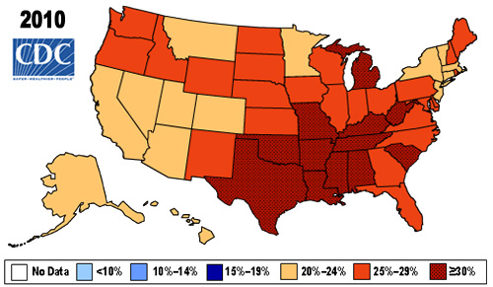
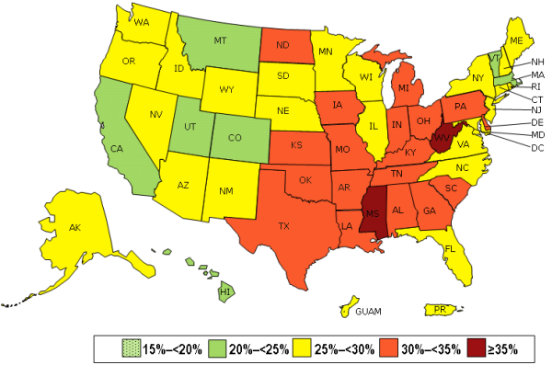
OBESITY TRENDS FOR U.S. ADULTS
1990 1998 2006
2013
http://www.cdc.gov/obesity/data/prevalence-maps.html

Slide 16

OBESITY IS SERIOUS
  Many obesity-related conditions (co-morbidities)
High blood pressure
High cholesterol
Heart disease
Type 2 diabetes
Gastroesophageal Reflux Disease (GERD)
Obstructive sleep apnea
Osteoarthritis
Depression
Stress urinary incontinence
Certain types of cancers

Slide 17
OBESITY IS COSTLY
Medical costs associated with obesity were estimated @ $147 billion
Medical costs paid by third-party payors for people who are obese were $1429 higher than those of normal weight

Slide 18
OBESITY IS DEADLY
4
2nd leading cause of preventable death
Approximately 400,000 deaths/year
Those afflicted with morbid obesity die 10 to 15 years earlier
3
2
Mortality Ratio
1
0
20
25
30
35
40
_{BMI}

Slide 19
WHAT CAUSES OBESITY?
Obesity is multifactorial:
Energy In > Energy Out
Genetic: 25–30%
Endocrine related
Environmental
Metabolic

Slide 20
ENVIRONMENTAL CAUSES
OF OBESITY
Elevator
Moving Sidewalk
Escalator
Computer Games
Television
Automobiles
Riding Lawnmowers

Slide 21
OTHER CAUSES OF OBESITY
Low Cost Easy Available Foods
High Fat-Energy Dense Foods
Larger Food Servings
High Snack consumption

Slide 22
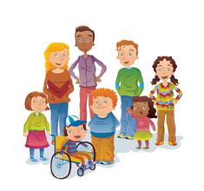
OBESITY @
WINCHESTER HOSPITAL
Inpatients
Outpatients
Visitors
Staff
Adults
Children

Slide 23
PATIENTS AFFECTED BY OBESITY @
Winchester Hospital Are-
Admitted for…
  Metabolic and Bariatric Surgery
  Orthopedic surgery
  Other surgery
  Medical issues
  Labor and delivery
  Emergency Room

Slide 24
PATIENTS AFFECTED BY OBESITY @
Winchester Hospital Have-
Testing…
  Radiology
  Phlebotomy
  Cardiology testing
  Pulmonary testing
  Preadmission testing
  Other

Slide 25
PERSONS AFFECTED BY OBESITY @
Winchester Hospital Come-
Visiting…
  Family
  Friends
  Cafeteria
  Gift shop

Slide 26
CULTURE of SENSITIVITY:
WORDS
Comments by staff can be hurtful, such as…
“You carry your weight well”
Or, for patients having weight loss surgery:
“You don’t look like you need this surgery”
“You took the easy way out”

Slide 27
CULTURE of SENSITIVITY:
GESTURES
Nonverbal gestures can be hurtful
as well, such as…
• rolling of the eyes when caring for obese
patients, or
• lack of touch

Slide 28
How to be more sensitive to patients affected by obesity…
Do not be judgmental—you do not know the patient’s history
Avoid language that places blame on patients
Use respectful language
  “Unhealthy weight”
  “Excess weight”
Use neutral terms such as weight and BMI
Use people first language:
  Instead of obese→ “has obesity” or “with obesity” or “affected by obesity”

Slide 29
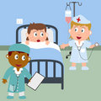
Other ways to be more sensitive to patients affected by obesity …
Maintain the patient’s privacy
Be careful in what you say
Provide care in a positive manner
Treat patients affected by obesity as you would want to be treated with:
  Compassion
  Empathy
  Understanding
  Genuine care

Slide 30
Other ways to be more sensitive to patients affected by obesity …
Involve significant others in care
Support efforts that empower and support, rather than shame or stigmatize
Assess coping patterns and explore strengths and resources
Consult Social Services/ Pastoral Care/ Psychiatry if needed

Slide 31
RESPECT

Slide 32
PATIENT CARE MODEL
R = Rapport (establish a foundation of trust, confidence &
collaboration)
E = Environment/Equipment (appropriate size equipment,
gowns, lifting devices, etc…)
S = Safety (build a culture of safety & security)
P = Privacy (protect patient privacy & dignity)
E = Encouragement (offer support & reassurance)
C = Caring/Comparison (avoid blaming the victim)
T = Tact (be aware of nonverbal signs, body language, tone
of voice, etc…)
National Association of Bariatric Nurses

Slide 33
REMEMBER…
Obesity is a disease
People affected by obesity experience discrimination everyday
People affected by obesity are not:
  Lazy
  Unintelligent

Slide 34
SUMMARY
As health care providers we need to…
Have appropriate size equipment available to accommodate all patients, including those affected by morbid obesity
Be respectful to patients
Treat patients as we would like to be treated

Slide 35
QUESTIONS
For more information about obesity, weight loss surgery and/or sensitivity awareness, please contact:
  Karen Flanders, MSN, CBN, NP-C
  Metabolic and Bariatric Surgery Coordinator/Nurse Practitioner
  Winchester Hospital
  Ext: 7167
  e-mail: kflanders@winhosp.org

Slide 36
Confirmation
By completing this HealthStream Module I fully understand it is my responsibility to comply with this information as it is taught.

Slide 37

References
Addressing Obesity Stigma in Health Care:
Challenges, Remedies, and Implications for Bariatric Care (R. Puhl, 2014)
American Society for Metabolic and Bariatric Surgery, Obesity Compendium
Metabolic and Bariatric Surgery Accreditation and Quality Improvement Program, 2014
National Association of Bariatric Nurses
Obesity Action Coalition, 2014
Yale Rudd Center for Food Policy & Obesity, 2014

