Slide 1
Vein Viewer Flex
Training

Slide 2
Vein Viewer
Non-invasive visual aid device designed to detect superficial blood under the skin and project an image of the blood pattern on the surface on the skin.

Slide 3
How does it work?
Projects near-infrared light that is absorbed by blood and reflected by surrounding tissue.
Information is captured and projected in real time onto the surface of the skin.
Allows you to see veins/arteries up to 10 mm.

Slide 4
Overview

Slide 5
Control Panel

Slide 6
Status Indicator and Display

Slide 7
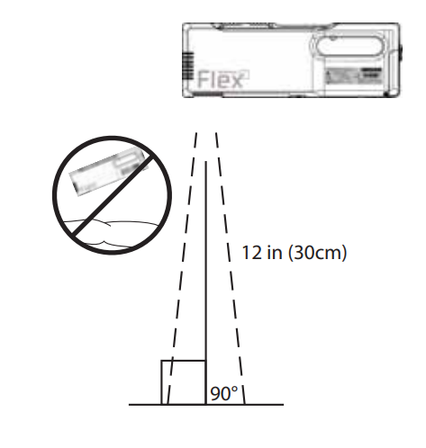
Imaging Modes-Demonstrate
Focus Vein Viewer-12 in for optimal focus.
90° Angle

Slide 8
Warnings
Do not look directly at light.
Vein viewer is non-laser based and presents no heat or eye safety issues. However, the light output is very bright.
Don’t shine the light in eyes or use near the eyes.
Don’t tough the lens.
Shallow arteries may be detected and not distinguished from veins.

Slide 9
Battery/Charging
Demonstrate Battery installation.
Battery only charges while on the charger.
Charge lasts approx. 2 hrs of continuous use.
Takes 4 hrs to fully charge.
Charge lasts approx. 72 hours while in the VeinViewer.
VeinViewer can be connected to wall outlet.

Slide 10
Charger Icons

Slide 11
C Clamp

Slide 12
S Clamp

Slide 13
S Clamp

Slide 14
S Mount

Slide 15
S Mount Adjustment

Slide 16
Cart Overview
Outlet Power
Wheel Locks

Slide 17
Maintenance
Cleaning Surfaces
Wear PPE.
Super Sani-Cloth or 70% isopropyl alcohol
Wipe outer surface (not the lens).
Allow to air dry or towel dry.
Clean after each use.

Slide 18
Maintenance
Cleaning Lens
Power off device and disconnect from outlet.
Use lint-free cloth moistened with 70% isopropyl alcohol.
Dry with lint-free cloth.

Slide 19
Drop Event
Unplug from outlet/remove battery.
Inspect outer casing
Inspect projection window
Inspect Battery
If damaged, do not use.
If not damaged, check image display focus and alignment.

Slide 20
Image Alignment

Slide 21
Questions?

Slide 22
End of Presentation
Please complete the VeinViewer Flex Training Checklist and submit it to your supervisor.
References
Christie VeinViewer Flex User Guide.

Slide 23
Thank you

