Slide 1
Global Harmonization System (GHS)
Safety Data Sheet (SDS)
August 2013

Slide 2
What we need to cover….
What is the GHS?
Why do we need to know about the GHS?
Hazardous Chemical Classification
Physical Hazard Classification
Health Hazard Classification
Environmental Hazard Classification
GHS labels
Pictograms
Signal Words and Hazard Statements
Example of a GHS label
Labeling secondary containers (HMIS)
GHS Data Sheet (Safety Data Sheet)
QUESTions?

Slide 3
What is the GHS?
GHS stands for Global Harmonization System
Federal OSHA has changed the hazard communication standard (29CFR 1910.1200) to bring the United States more in line with the international community
The major changes relate to labeling requirements for manufacturers and suppliers of hazardous materials and establishing a standard format for Safety Data Sheets (formerly known as Material Safety Data Sheets)
Manufacturers and suppliers must update labels and SDS by June 1, 2015
All affected employees (i.e. YOU) must be trained on the new requirements by December 1, 2013

Slide 4
Why do we need to know about the GHS?
Labels and SDSs are starting to change, you need to know how to read the labels and sheets, and be able to and decipher the information.
Information is being standardized and specified. Previously, the order and information were left to the chemical supplier.
All affected employees (i.e. YOU) must be trained on the new requirements by December 1, 2013.

Slide 5
Hazard Class Definitions
Hazard classification is the responsibility of the manufacturer or distributor of chemicals.
The process starts by identifying and reviewing relevant information about the hazards of the substance or mixture
Each physical, health or environmental hazard is identified as a “hazard class” (for example, Carcinogenicity is a health hazard class)
A “hazard class” may be sub-divided into several “hazard categories” based on the degree of severity of the hazard.
Placing a chemical into a “hazard class”, and where necessary, a “hazard category”, is the concept of classification – determining not only the hazard, but also the severity of the effect.

Slide 6
Physical Hazards - Definitions
Physical hazards are related to the physical and chemical properties of the substance or mixture involved.
The physical hazard criteria are based on the criteria of the UN Recommendations for the Transport of Dangerous Goods (TDG).
They refer to the results of tests performed in accordance with the UN Recommendations on the Transport of Dangerous Goods, Manual of Tests and Criteria.

Slide 7
Physical Hazard Classes in the GHS
Explosives
Gases Under Pressure
Flammable Gases
Flammable Aerosols
Flammable Liquids
Flammable Solids
Self-Reactive Substances
Pyrophoric Liquids (spontaneously ignites in air)
Pyrophoric Solids
Self-Heating Substances
Substances which, in contact with water, emit flammable gases
Oxidizing Gases
Oxidizing Liquids
Oxidizing Solids
Organic Peroxides
Corrosive to Metals

Slide 8
Physical Hazard Catagories
Once the hazard class is decided for a specific chemical , then the hazard category may be selected from the available tables to further define the risk
For example, for the Flammable Liquids Class, the categories include:

Slide 9
Hazard Class vs. Hazard Catagory

Slide 10
Health Hazard Definition
Health Hazards are injuries/illnesses that could occur to the user while being exposed to the specific chemical.
Does not infer the specific injury/illness will occur, it simply states what exposure to the specific chemical may do.

Slide 11
Health Hazard Classifications
Acute Toxicity
Skin Corrosion/Irritation
Serious Eye Damage/Eye Irritation
Respiratory or Skin Sensitization
Germ Cell Mutagenicity (causes mutations to a growing cells or organisms)
Carcinogenicity
Reproductive Toxicity
Specific Target Organ Toxicity (STOT) – Single Exposure
Specific Target Organ Toxicity (STOT) – Repeated exposure
Aspiration Hazard (causes pulmonary injury following aspiration)
Simple Asphyxiants (removed oxygen from the air causing suffocation risk)

Slide 12
Health Hazard Catagories
As in the Physical Hazards section, Health Hazards may also be further categorized
For example, the Skin Corrosion/Irritation Hazard Class has the following Categories:
Category | Criteria – Corrosive in > 1 of 3 animals
1A | Exposure of < 3 mins; Reaction observed < 1 hr
1B | Exposure of > 3 mins < 1 hr; Reaction observed < 14 days
1C | Exposure of > 1 hr < 4 hr; Reaction observed < 14 days

Slide 13
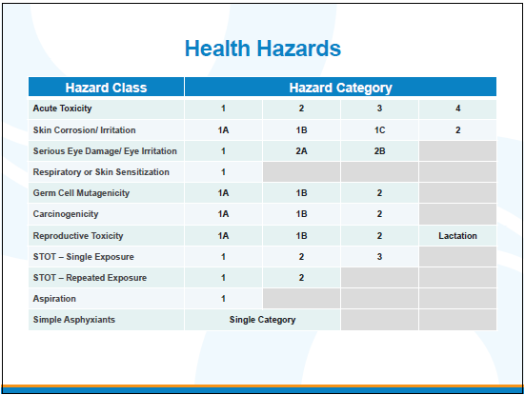
Health Hazards Class vs. Catagory

Slide 14
Environmental Hazard Classification
Hazardous to the Aquatic Environment
  Acute aquatic toxicity (based on LD50 values; the dose where 50% of test subjects are killed)
  Chronic aquatic toxicity (based on LD50 values)
    Bioaccumulation potential
    Rapid degradability
Additional information on the physical, health and environmental hazards for chemical classification can be found in published text and tables

Slide 15
GHS labels
The five (5) elements of an appropriate GHS label are:
Product Identifier – the unique name or number used for a hazardous chemical
Symbols (hazard pictograms) – that convey the physical, health and environmental hazard class
Signal Words - “Danger” or “Warning” are used to emphasize hazards and denote the relative severity of the hazards
Hazard Statements – standard phrases assigned to the hazard class and category that describe the nature of the hazard
Precautionary Statements – additional descriptive instructions for safe handling of the chemical

Slide 16
Symbols (pictograms)
There are nine (9) pictograms that are associated with the hazards of the specific chemical in the GHS.
Some chemicals may have more than one pictogram associated with the chemical.
Following are the 9 pictograms used when labeling chemicals in the GHS.

Slide 17


Pictograms
Oxidizers
Flammables
Self Reactives
Pyrophorics
Self-Heating
Emits Flammable Gas
Organic Peroxides

Slide 18


Pictograms
Explosives
Self Reactives
Organic Peroxides
Acute toxicity (severe)

Slide 19


Pictograms
Corrosives
Gasses under pressure

Slide 20


Pictograms
Carcinogen
Respiratory Sensitizer
Reproductive Toxicity
Target Organ Toxicity
Mutagenicity
Aspiration Toxicity
Irritant
Dermal Sensitizer
Acute toxicity (harmful)
Narcotic Effects
Respiratory Tract
Irritation

Slide 21

Pictograms
Environmental Toxicity

Slide 22
Signal Words
There are two signal words used to indicate the relative degree of severity of a hazard.
  “Danger” for the more severe hazard, and
  “Warning” for the less severe hazard.
Signal words are standardized but some low level hazard categories may not use signal words.
Only one signal word corresponding to the class of the most severe hazard should be used on a label

Slide 23
Hazard Statements
Hazard statements are standardized phrases that describe the hazard(s) as determined by the hazard classification.
More than one hazard statement may be needed for chemicals with more than one hazard.
Examples include:
Toxic if Swallowed
Flammable Liquid

Slide 24
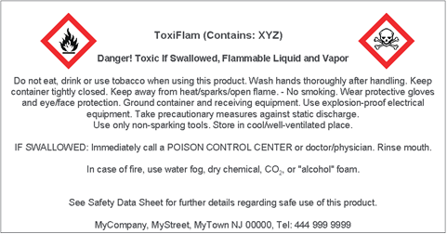
GHS label example
Pictogram, flammable
Product identifier
Pictogram, acute toxic
Signal word
Hazard statement
Precautionary statements

Slide 25
Labeling secondary containers
Primary containers are containers in which the chemical is shipped by the manufacturer or distributor. These containers require the GHS label.
Secondary containers are containers produced by the user.
Labeling secondary workplace containers commonly used in the lab may incorporate the GHS label or label elements; or may remain an alternate labeling system such as the National Fire Protection Assoc. (NFPA) 704 Hazard Rating or the Hazardous Materials Information System (HMIS) rating system if it provides the hazard information as effectively as the GHS label.
We will use the Hazardous Materials Information System (HMIS). Information should be taken from the SDS for the chemical.
If needed, the label information can be place in the work area (e.g. on the instrument or device used to hold the container) if it does not fit on the actual container.

Slide 26
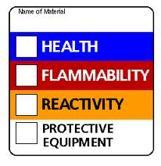
HMIS – Health and Flammability
4. Life-threatening, major or permanent damage may result from single or repeated overexposures
3. Major injury likely unless prompt action is taken and medical treatment is given.
2. Temporary or minor injury may occur.
1. Irritation or minor reversible injury possible.
0. No significant risk to health.
4. Flammable gases, or very volatile flammable liquids with flash points below 73 °F (23 °C), and boiling points below 100 °F (38 °C). Materials may ignite spontaneously with air (e.g., Propane).
3. Materials capable of ignition under almost all normal temperature conditions. Includes flammable liquids with flash points below 73 °F (23 °C) and boiling points above 100 °F (38 °C), as well as liquids with flash points between 73 °F and 100 °F.
2. Materials which must be moderately heated or exposed to high ambient temperatures before ignition will occur. Includes liquids having a flash point at or above 100 °F (38 °C) but below 200 °F (93 °C) (e.g., Diesel fuel).
1. Materials that must be preheated before ignition will occur. Includes liquids, solids and semi solids having a flash point above 200 °F (93 °C) (e.g., Canola oil).
0. Materials that will not burn (e.g., Water).

Slide 27
HMIS – Reactivity and Protective Equipment
4. Materials that are readily capable of explosive water reaction, detonation or explosive decomposition, polymerization, or self-reaction at normal temperature and pressure
3. Materials that may form explosive mixtures with water and are capable of detonation or explosive reaction in the presence of a strong initiating source. Materials may polymerize, decompose, self-react, or undergo other chemical change at normal temperature and pressure with moderate risk of explosion.
2. Materials that are unstable and may undergo violent chemical changes at normal temperature and pressure with low risk for explosion. Materials may react violently with water or form peroxides upon exposure to air.
1. Materials that are normally stable but can become unstable (self-react) at high temperatures and pressures. Materials may react non-violently with water or undergo hazardous polymerization in the absence of inhibitors.
0. Materials that are normally stable, even under fire conditions, and will not react with water, polymerize, decompose, condense, or self-react. Non-explosives.
Personal protection items which need to be used while using the chemical

Slide 28
GHS Safety Data Sheet (SDS)
Will replace the current MSDS (Material Safety Data Sheet) from manufacturers or distributors.
SDS is a standardized format. OSHA requires the change to be complete by June 1, 2015.
It contains 16 headings and provides a clear description of the material’s hazards, safe handling and disposal.
As material is updated, manufactures will convert to the new format.

Slide 29
Safety Data Sheet (SDS) contents
Identification of the material and the supplier (product information, supplier details and emergency phone number).
Hazard identification (GHS classification and label content)
Composition/information on ingredients of the substance/mixture (chemical identity, synonyms, CAS number)
First aid measures (for routes of exposure; e.g. inhalation)
Firefighting measures (extinguishing agents and protective equipment)
Accidental release measures (personal and environmental precautions and clean up materials)
Handling and storage recommendations (safe storage and incompatibilities)

Slide 30
Safety Data Sheet (SDS) contents - continued
Exposure controls and personal protection (engineering controls and PPE)
Physical and chemical properties (e.g. pH, odor, flash point, vapor pressure)
Stability and reactivity (hazardous reactions and conditions to avoid)
Toxicological information (e.g. health effects, routes of exposure, symptoms)
Ecological information (e.g. toxicity to water and land; bio-accumulative potential)
Disposal considerations (safe handling and methods of disposal)
Transport information (e.g. UN number and shipping name; Transport class)
Regulatory information (regulations specific to the product)
Other information including information on preparation and revision of the SDS

Slide 31
QUESTions?
?

