Slide 1
Critique of the CAP FH-A Proficiency Photomicrographs
Presented by:
Lawrence Tsao, MD
Medical Director, East
5/3/2017

Slide 2
Case presentation (01-06)
This peripheral blood smear is from a 34-year-old woman presenting with systemic sclerosis.
Laboratory data include: WBC = 3.8 × 10⁹/L; RBC = 4.42 × 10¹²/L; HGB = 13.3 g/dL; HCT = 39.8%; MCV = 90 fL; and PLT = 215 × 10⁹/L.

Slide 3
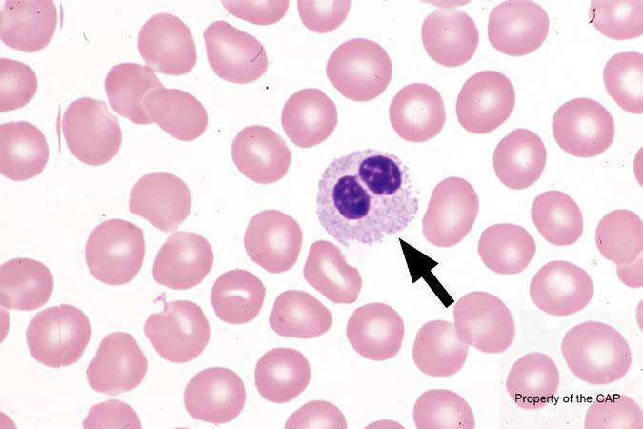
BCP-01
Neutrophil containing Pelger-Huet nuclei (acquired or congenital)

Slide 4
Neutrophil containing Pelger-Huet nuclei
Response | Quest | All Participants (%)
Neutrophil containing Pelger-Huet nuclei (acquired or congenital) | 149 (93.7) | 90.1
Neutrophil, segmented or band | 9 (5.7) | 8.7
Erythrocyte, normal | 1 (0.6)

Slide 5
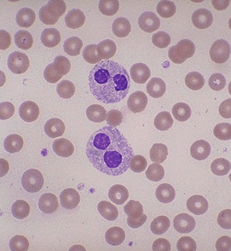
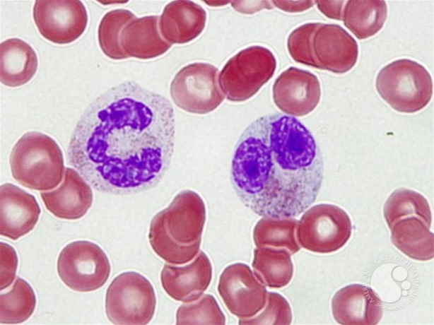
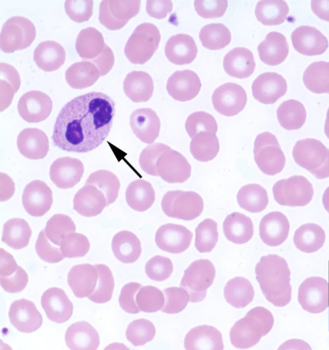
Neutrophil containing Pelger-Huet nuclei
Neutrophil with Pelger-Huet Nucleus (Acquired or Congenital)
Bilobed nuclei in the “prince-nez” conformation
Two round or nearly round lobes connected by a distinct thin filament
Inherited autosomal dominant disorder – will be seen in virtually all neutrophils
Acquired in association with multiple disorders – will be seen in a subset of neutrophils
Myelodysplastic syndrome, medications, infections
Pseudo-Pelger-Huet cells

Slide 6
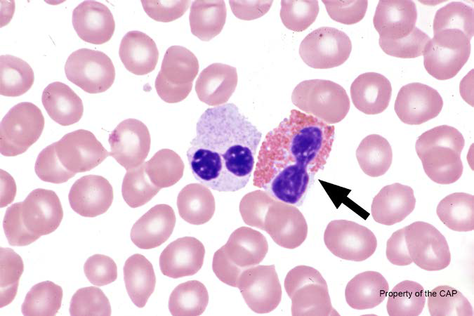
BCP-02
Eosinophil, any stage

Slide 7
Eosinophil, any stage
Response | Quest | All Participants (%)
Eosinophil, any stage | 159 (100) | 100.0

Slide 8
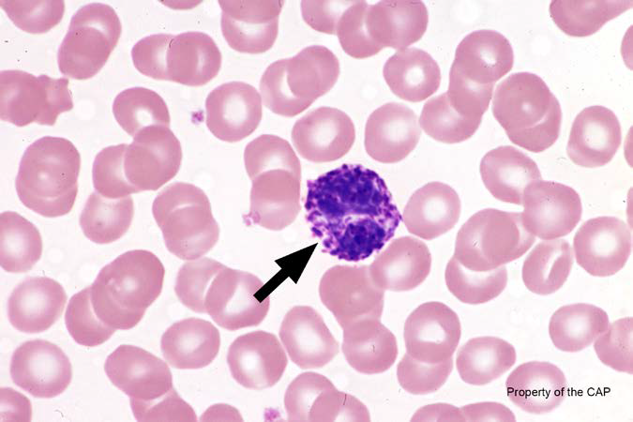
BCP-03
Basophils, any stage

Slide 9
Basophils, any stage
Response | Quest | All Participants (%)
Basophils, any stage | 159 (100) | 99.7

Slide 10
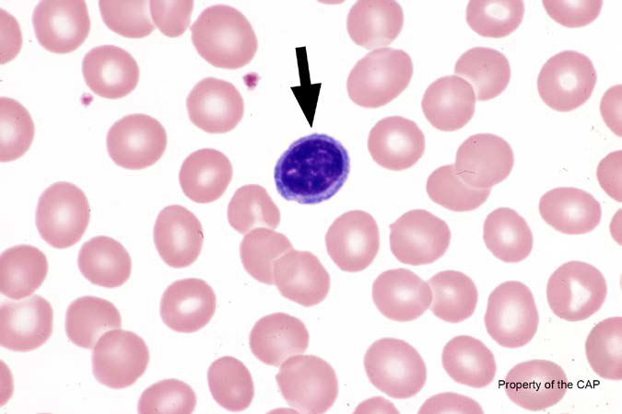
BCP-04
Lymphocyte

Slide 11
Lymphocyte
Response | Quest | All Participants (%)
Lymphocyte | 153 (96.2) | 96.4
Lymphocyte, reactive |  | 1.1
Nucleated red cell, normal or abnormal morphology | 5 (3.1) | 2.3
Plasma cell, mature/abnormal | 1 (0.6)

Slide 12
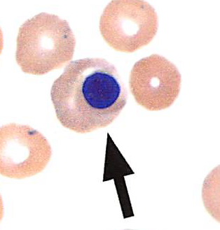
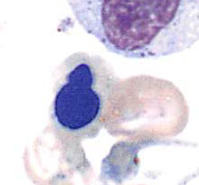
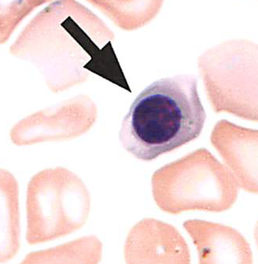
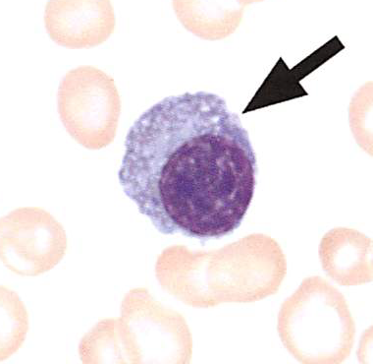
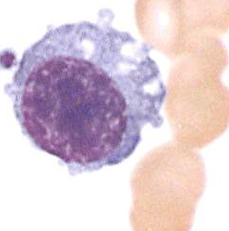
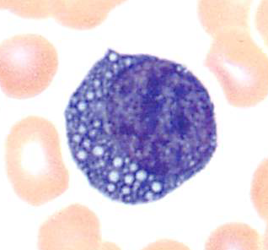
Lymphocyte
Nucleated RBCs
Plasma cells

Slide 13
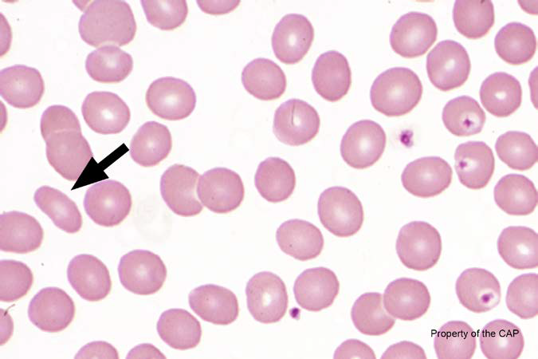
BCP-05
Ovalocyte (elliptocyte)

Slide 14
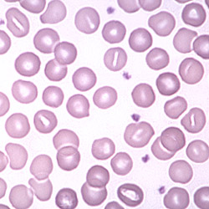
Ovalocyte (elliptocyte)
Response | Quest | All Participants (%)
Ovalocyte (elliptocyte) | 159 (100) | 99.4
Erythrocyte, normal |  | 0.3
Stomatocyte |  | 0.0
Stomatocyte
Red blood cells with central pallor that is not round but straight or curved rod-shaped slit

