Slide 1
Case presentation (04-07)
This urine sample is obtained from a 56-year-old man presenting with cirrhosis of the liver.
Laboratory data include: specific gravity = 1.035; pH = 6.0; blood, leukocyte esterase, nitrite, bilirubin, and urobilinogen = positive; glucose, ketones, and protein = negative.

Slide 2
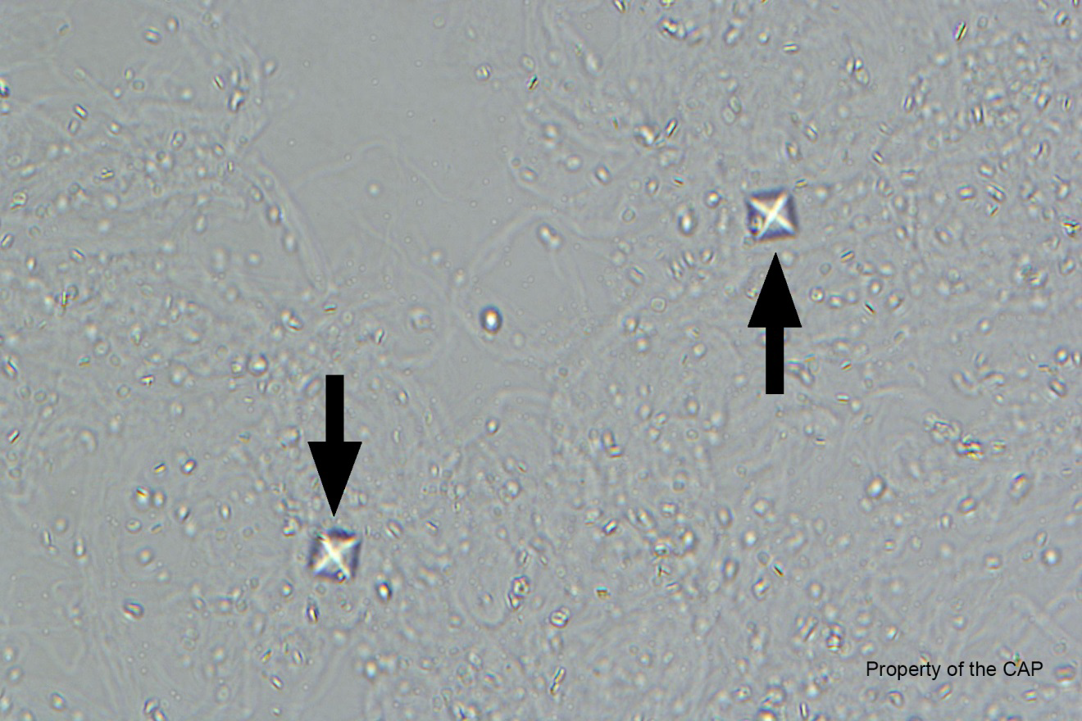
CMP-04
Calcium oxalate crystals

Slide 3
Calcium oxalate crystals
Response | Quest | All Participants (%)
Calcium oxalate crystals | 149 | 99.6

Slide 4
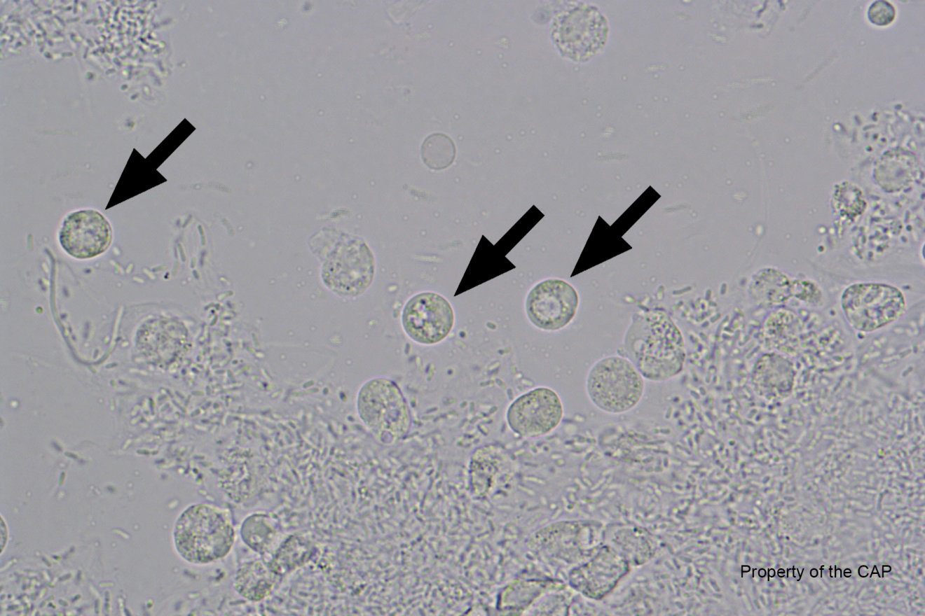
CMP-05
Leukocytes (neutrophil, eosinophil, lymphocyte)

Slide 5
Leukocyte (neutrophil, eosinophil, lymphocyte)
Response | Quest | All Participants (%)
Leukocyte (neutrophil, eosinophil, lymphocyte) | 148 | 98.0
Renal Tubular Epithelium | 1

Slide 6
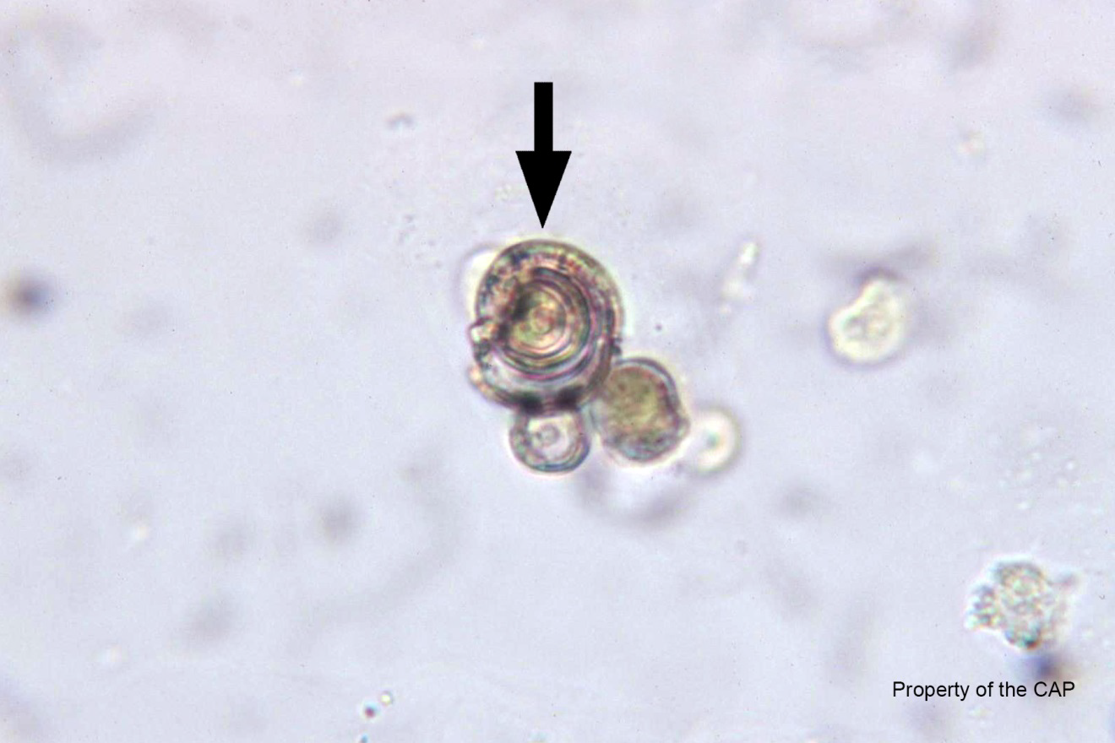
CMP-06
Leucine crystals

Slide 7
Leucine crystals
Response | Quest | All Participants (%)
Leucine crystals | 140 | 90.8
Pollen grain | 4
Fat droplets | 2
Starch granule | 2
Tyrosine crystals | 1
Immature/Abn Refr | 1

Slide 8
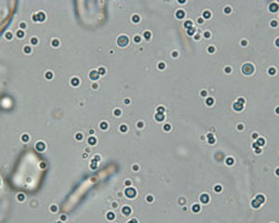
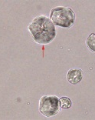
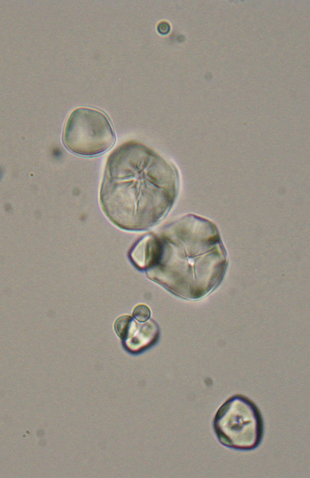
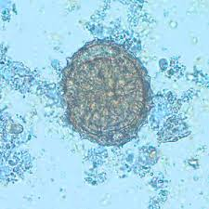
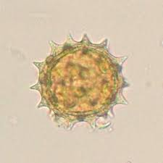
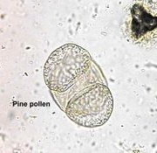
Miscellaneous

Slide 9
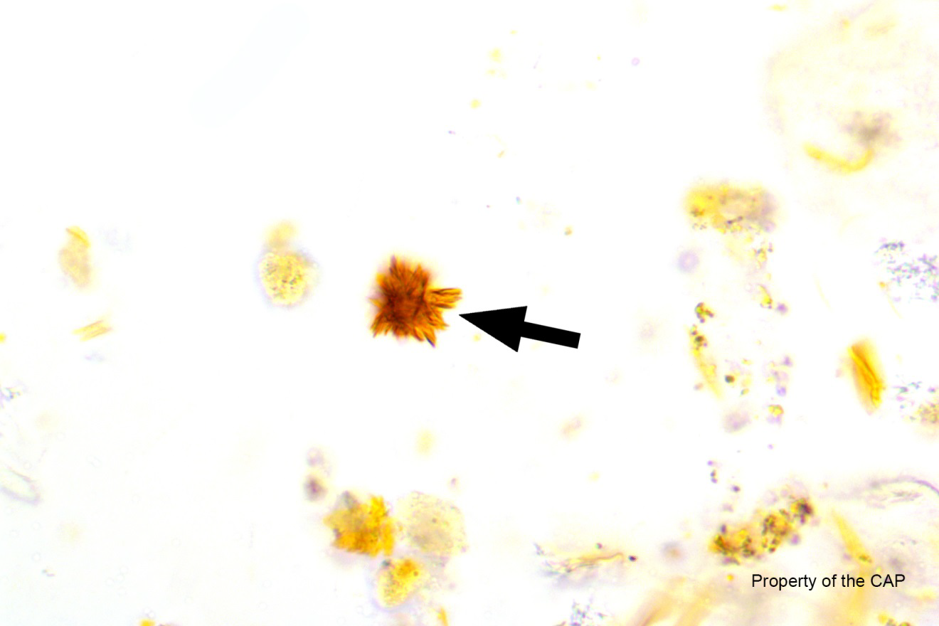
CMP-07
Bilirubin crystal

Slide 10
Bilirubin crystal
Response | Quest | All Participants (%)
Bilirubin crystal | 141 | 93.1
Tyrosine crystal | 6
Sulfonamide crystal | 1
Immature/Abn Refr | 1

