Slide 1

Case Presentation (08-13)
The patient is a 51-year-old man whose primary complaint is shortness of breath. Chest x-ray reveals the presence of pleural effusion.
Pleural fluid sample laboratory findings include: WBC = 23,500/μL (23.500 × 10³/μL); RBC = 71,500/μL (71.500 × 10³/μL).

Slide 2
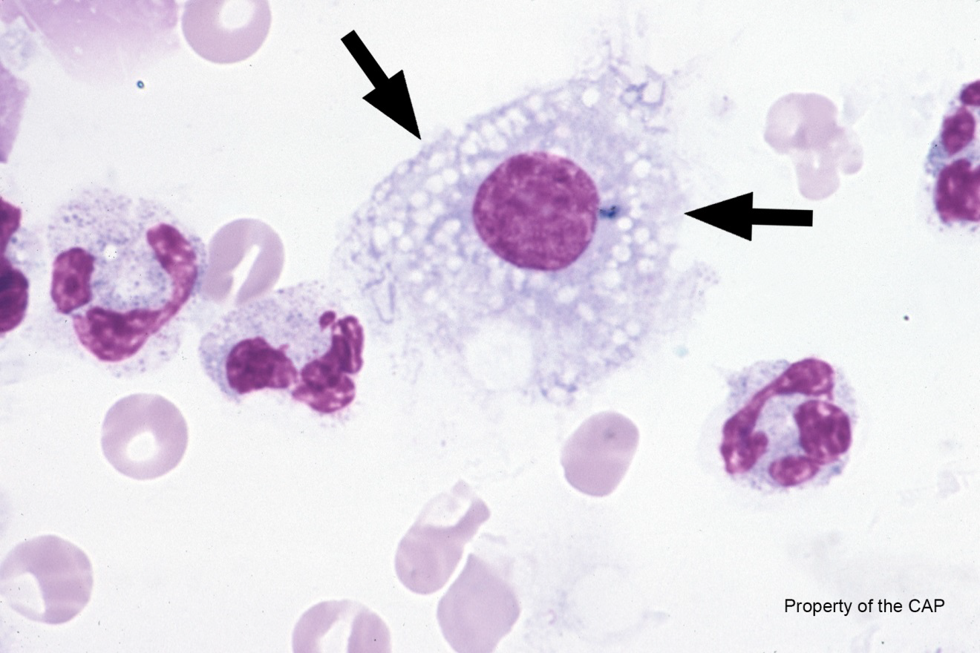
CMP-08
Macrophage containing abundant small lipid vacuoles/droplets (Lipophage)

Slide 3
Macrophage containing abundant small lipid vacuoles/droplets (Lipophage)
Response | Quest | All Participants (%)
Macrophage containing abundant small lipid vacuoles/droplets (Lipophage) | 48 | 65.8
Monocyte/macrophage | 5 | 19.8
Macrophage containing hemosiderin (Siderophage) | 5 | 6.2
Neutrophil/macrophage with phagocytized bacteria | 1 | 3.4
Immature/Abn Refr | 1

Slide 4
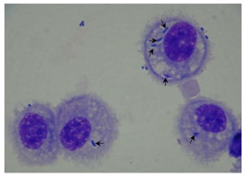
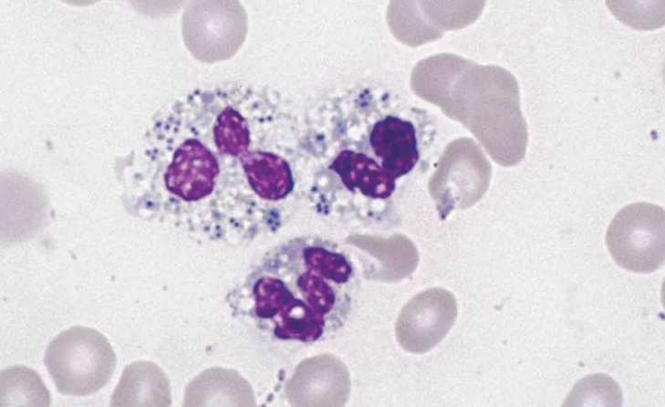
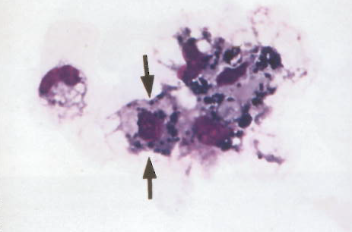
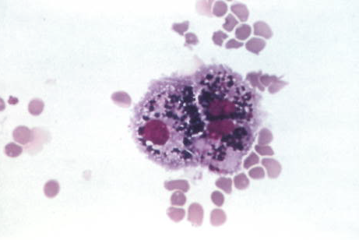
Bacteria
Siderophage

Slide 5
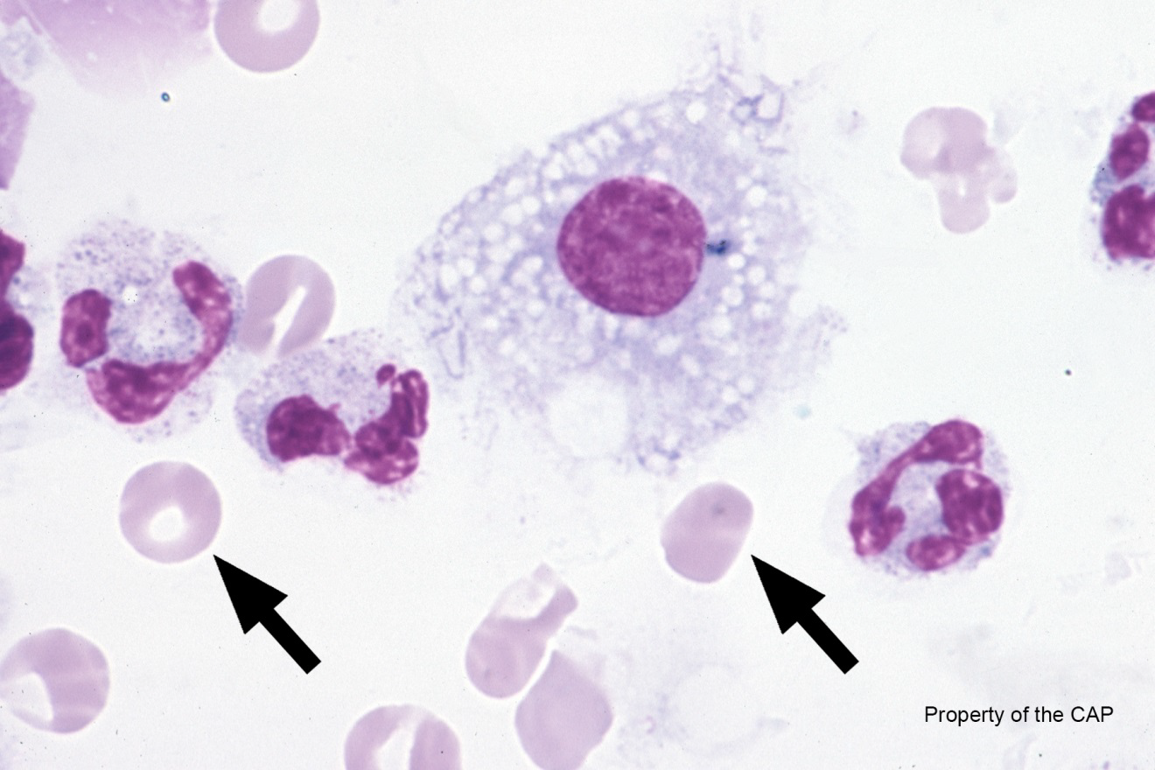
CMP-09
Erythrocytes

Slide 6
Erythrocytes
Response | Quest | All Participants (%)
Erythrocytes | 61 | 99.9

Slide 7
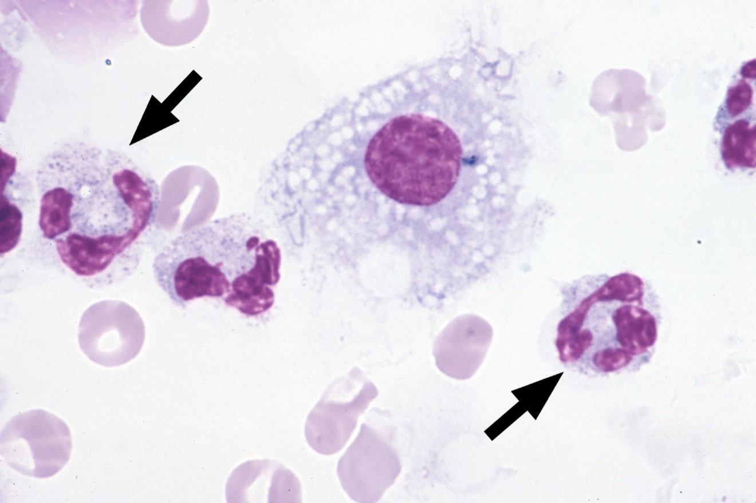
CMP-10
Platelet, normal

Slide 8
Neutrophil, segmented or band
Response | Quest | All Participants (%)
Neutrophil, segmented or band | 61 | 98.9

Slide 9
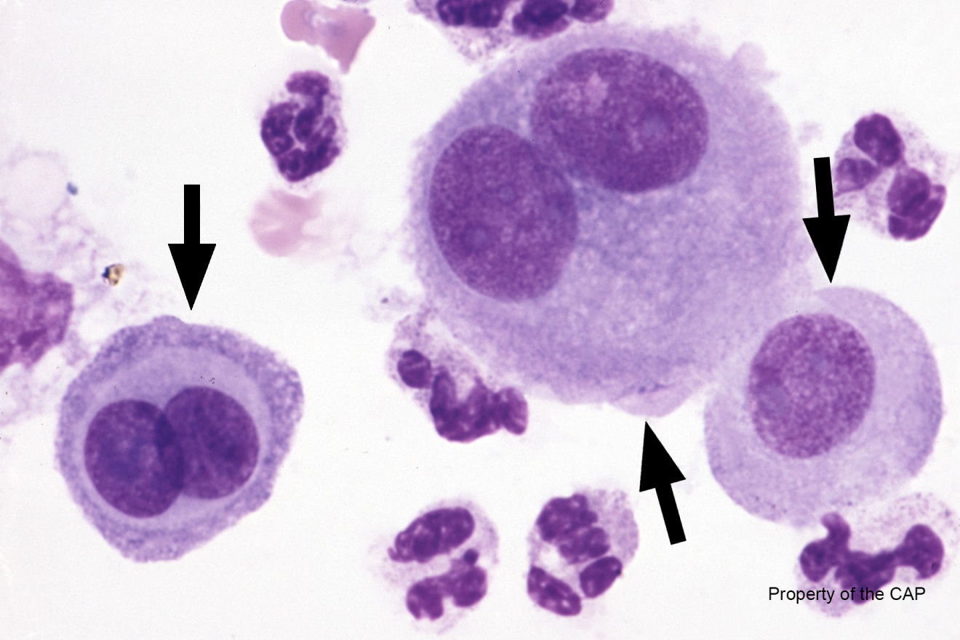
CMP-11
Mesothelial cells

Slide 10
Mesothelial cells
Response | Quest | All Participants (%)
Mesothelial cells | 59 | 96.2
Immature/Abn Refr | 2

Slide 11
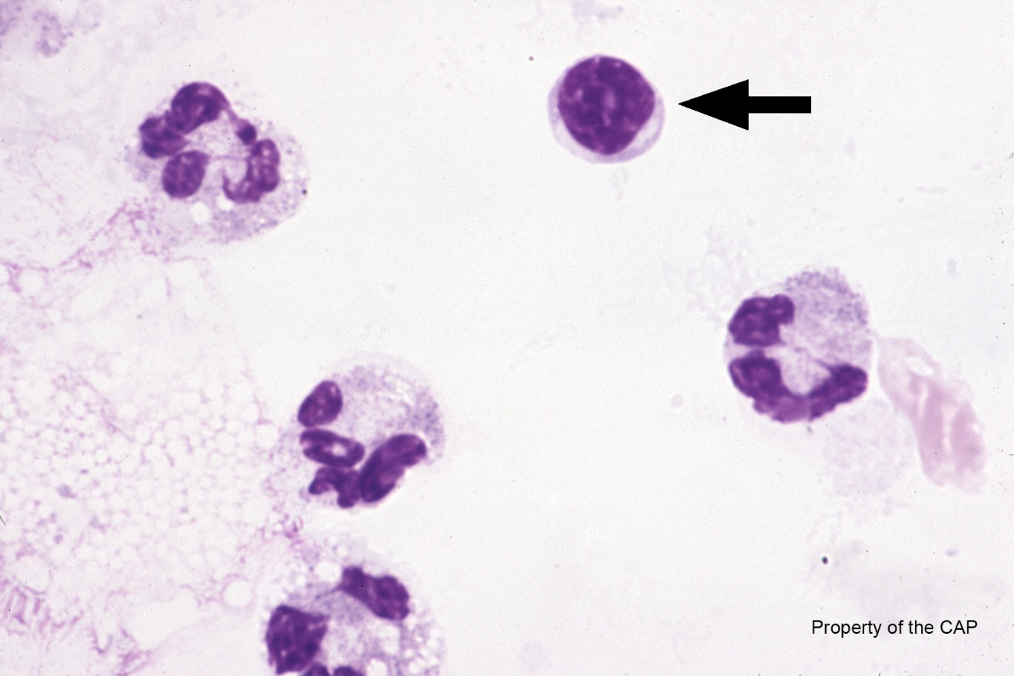
CMP-12
Lymphocyte

Slide 12
Lymphocyte
Response | Quest | All Participants (%)
Lymphocyte | 61 | 99.3

Slide 13
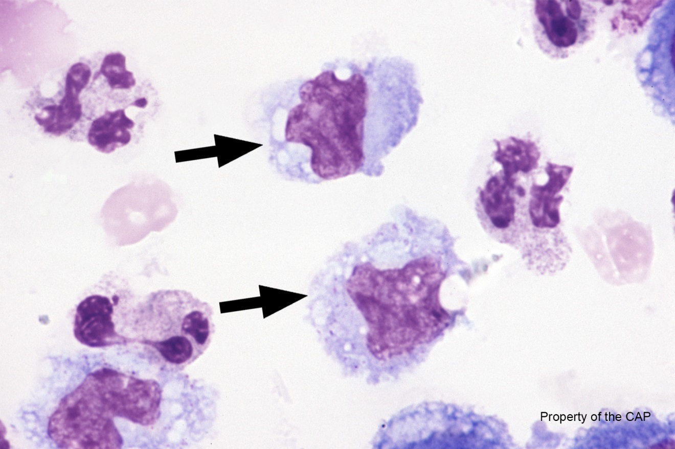
CMP-13
Monocytes/macrophages

Slide 14
Monocytes/macrophages
Response | Quest | All Participants (%)
Monocytes/macrophages | 62 | 98.3

Slide 15
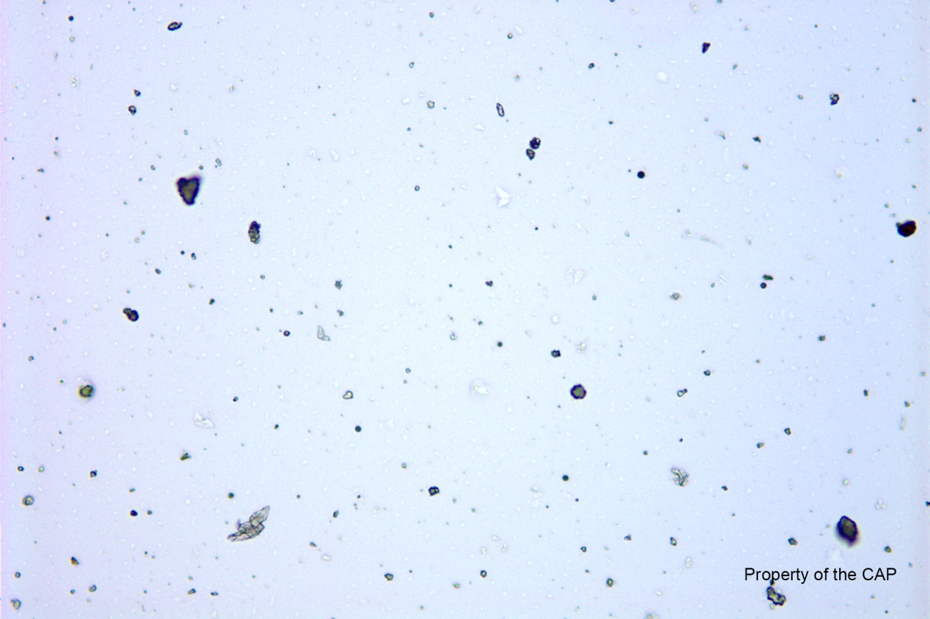
CMMP-30
Ferning is absent

Slide 16
Ferning is absent
Response | Quest | All Participants (%)
Ferning is absent | 9 | 99.9

Slide 17
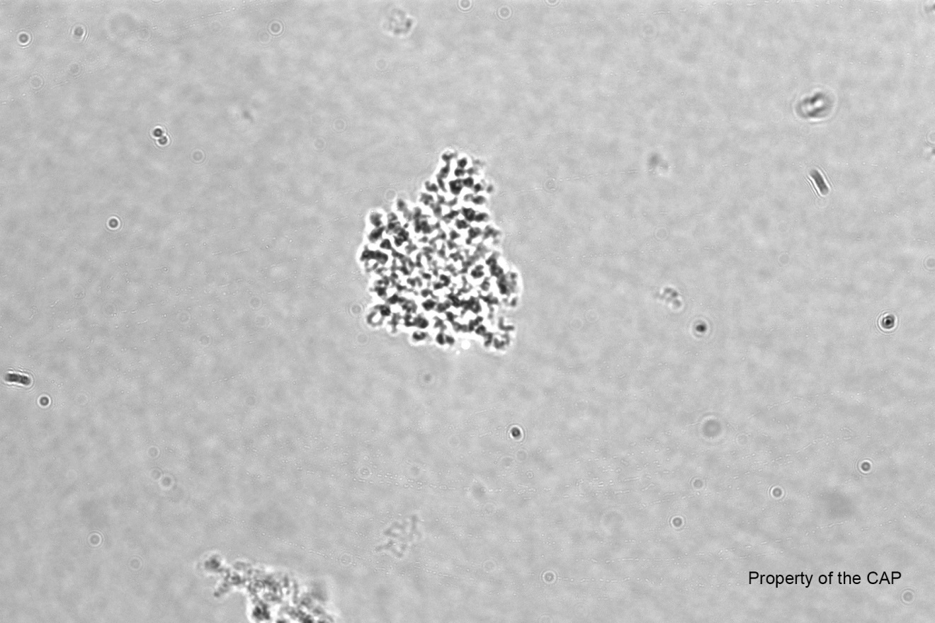
CMMP-31
Yeast/fungi are absent

Slide 18
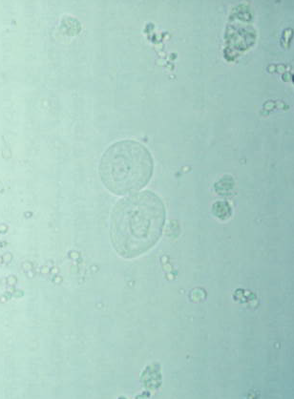
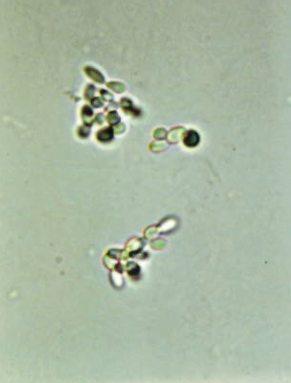
Yeast/fungi are absent
Response | Quest | All Participants (%)
Yeast/fungi are absent | 34 | 84.8
Yeast/fungi are present | 8

