Slide 1
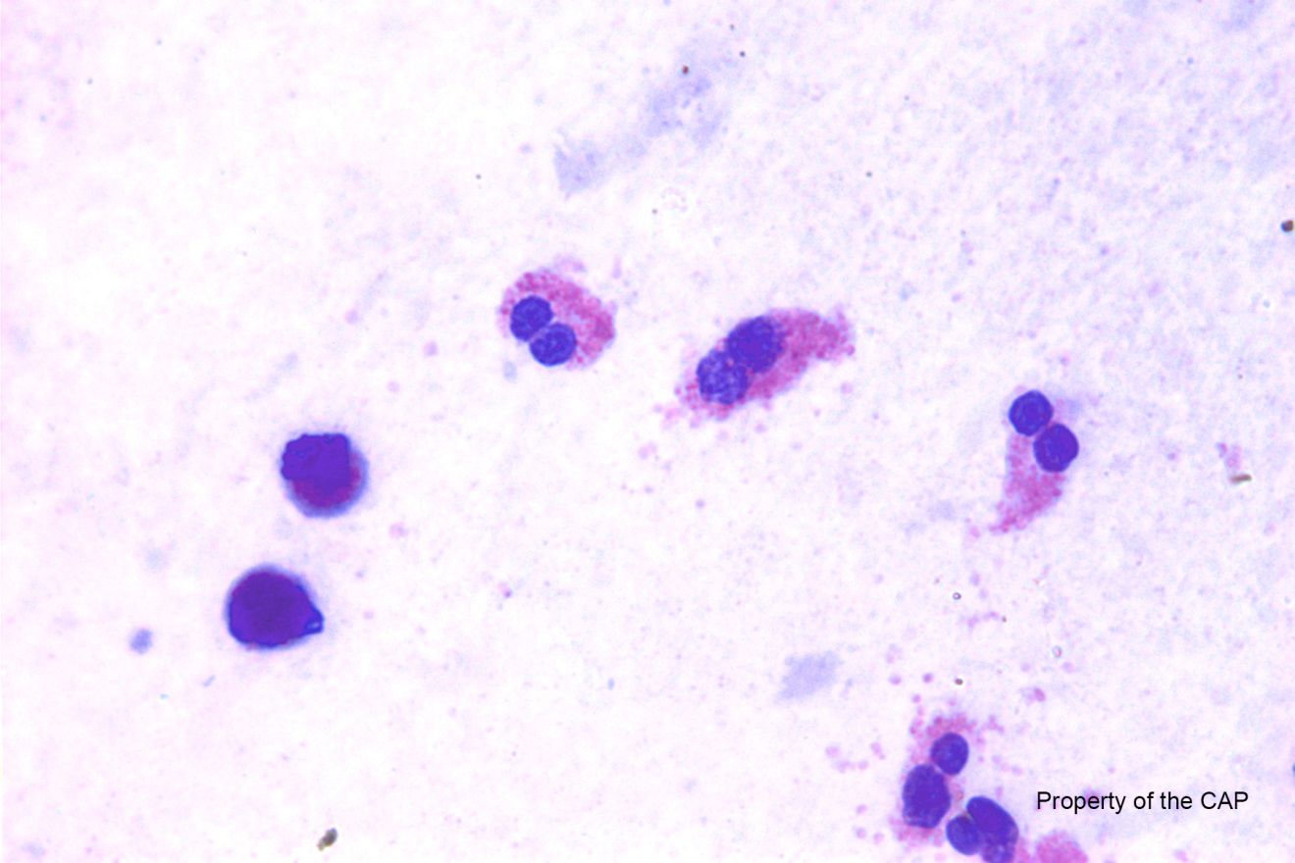

CMMP-32
Eosinophils are present

Slide 2
Eosinophils are present
Response | Quest | All Participants (%)
Eosinophils are absent | 37 | 99.5

Slide 3
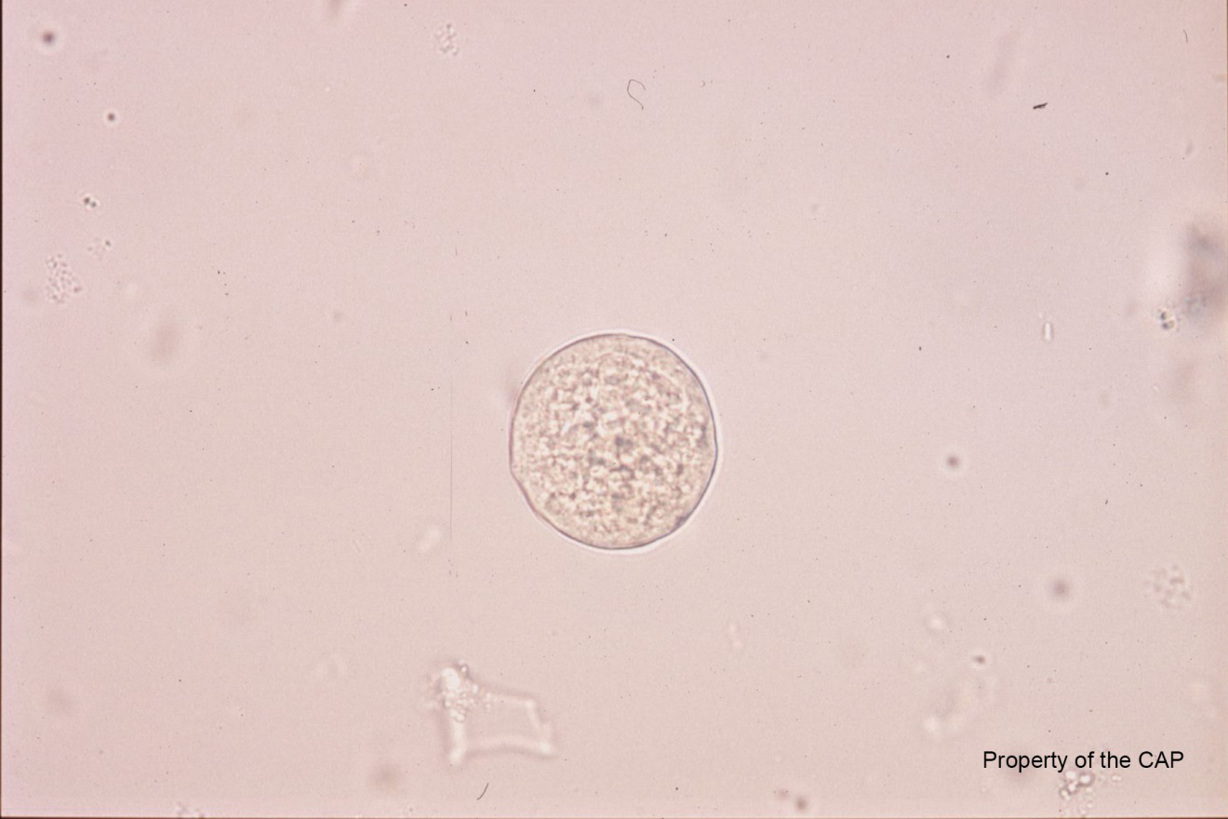
CMMP-33
Pinworm/pinworm eggs are absent

Slide 4
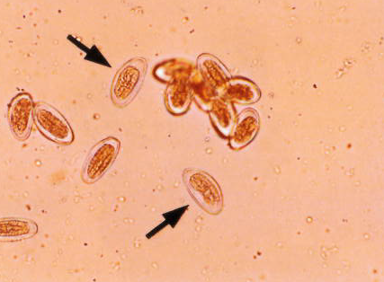
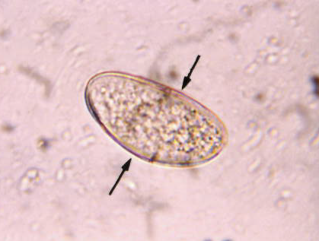
Pinworm/pinworm eggs are absent
Response | Quest | All Participants (%)
Pinworm/pinworm eggs are absent | 36 | 98.0

Slide 5
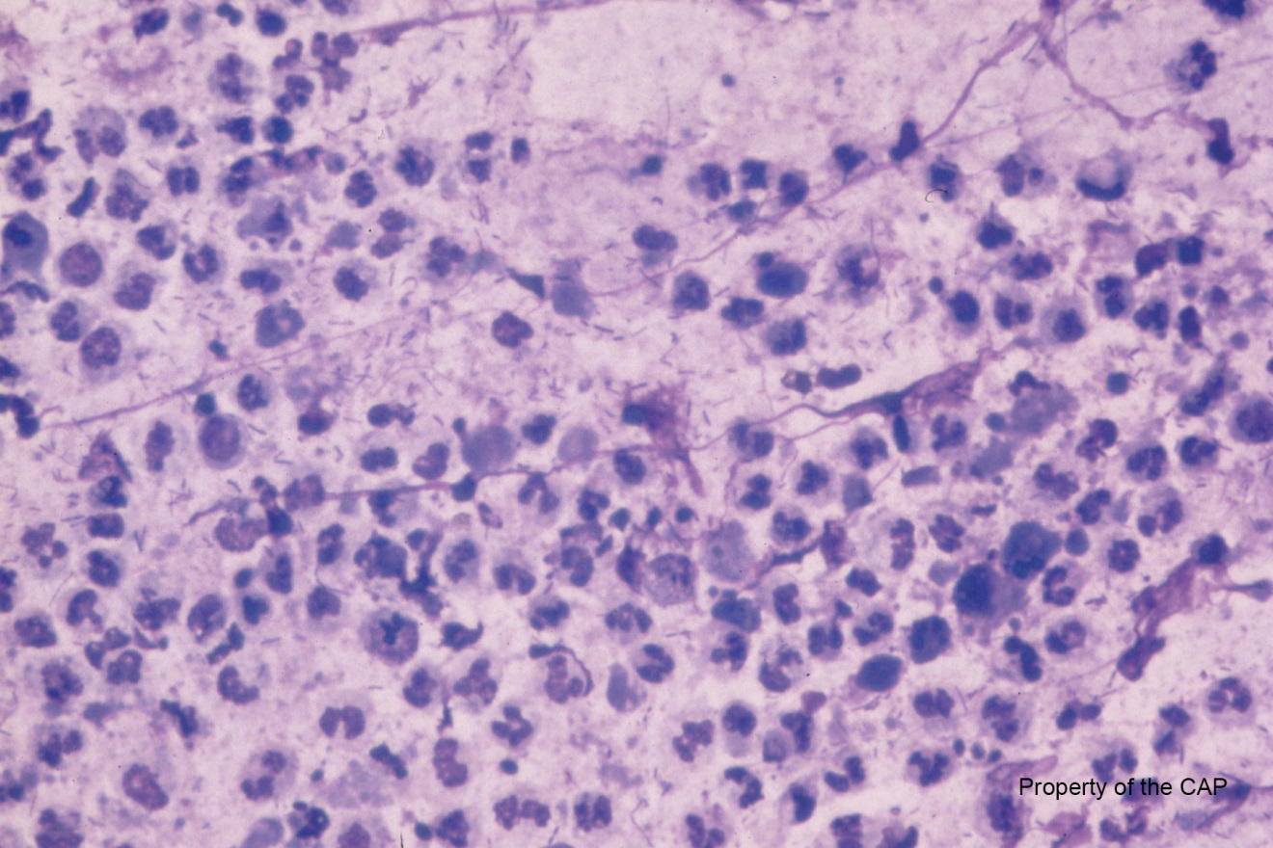
CMMP-34
Leukocytes are present

Slide 6
Leukocytes are present
Response | Quest | All Participants (%)
Leukocytes present | 50 | 99.8

Slide 7
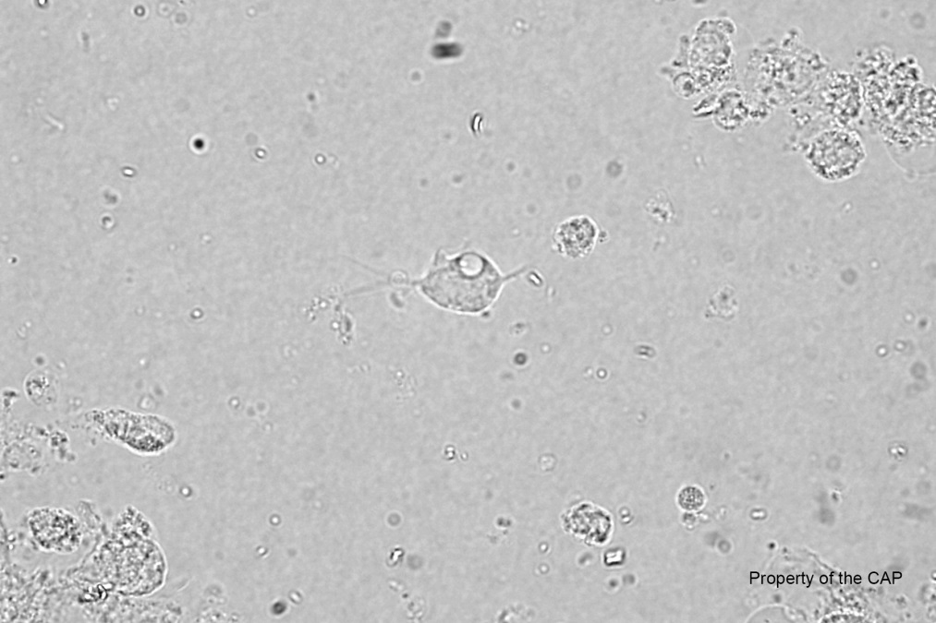
CMMP-35
Spermatozoa are absent
Trichomonas are present
Clue cells are absent
Epithelial cells are absent

Slide 8
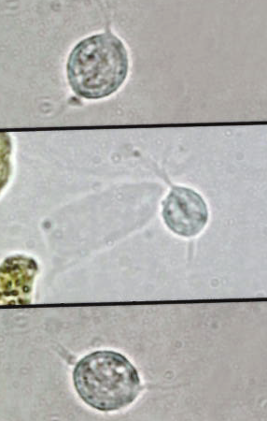
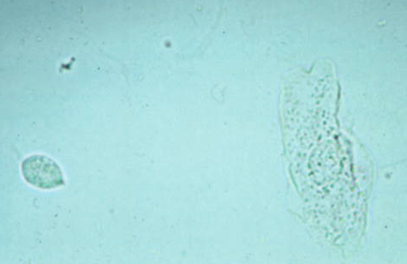
CMMP-35
Response | Quest | All Participants (%)
Spermatozoa are absent |  | 99.2
Trichomonas are present |  | 98.6
Clue cells are absent |  | 83.1
Epithelial cells are absent |  | 77.1

Slide 9
??Questions??
lawrence.x.tsao@questdiagnostics.com

Slide 10


