Slide 1

Case Presentation (06-10)
This peripheral blood smear is from a 65-year-old woman with past medical history of breast carcinoma presenting with fatigue.
Laboratory data includes: WBC = 14.7 × 10⁹/L; RBC = 2.52 × 10¹²/L; HGB = 7.6 g/dL; HCT = 22.7%; MCV = 93 fL; PLT = 52 × 10⁹/L; and MPV = 7.2 fL.

Slide 2
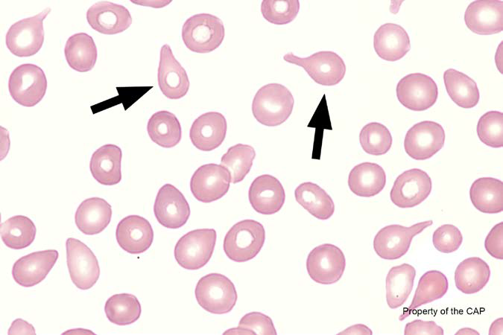
BCP-06
Teardrop cell (dacrocyte)

Slide 3
Teardrop cell (dacrocyte)
Response | Quest | All Participants (%)
Teardrop cell (dacrocyte) | 157 (100) | 99.7

Slide 4
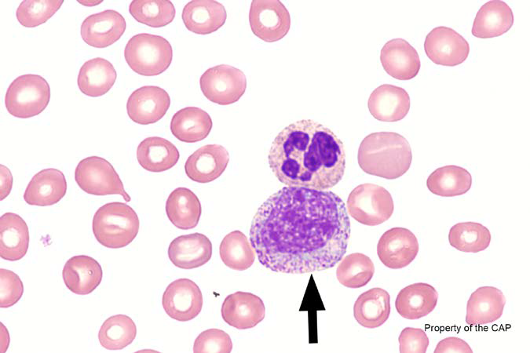
BCP-07
Neutrophil, myelocyte

Slide 5
Neutrophil, myelocyte
Response | Quest | All Participants (%)
Neutrophil, myelocyte | 134 (85.4) | 87.0
Neutrophil, promyelocyte | 7 (4.4) | 5.3
Neutrophil, toxic | 1 (0.6) | 0.6
Neutrophil, giant band | 1 (0.6)
Neutrophil, metamyelocyte | 1 (0.6)
Monocyte | 1 (0.6)
Immature/Abnormal cell, refer | 12 (7.6)

Slide 6
Neutrophil, myelocyte
Myelocytes
  10 to 18 um
  Round to oval in shape with nuclear:cytoplasm ratio of 2:1 to 1:1
  Chromatin is clumped and lacks nucleoli
  Nuclei can show flattening at one side
  Can show a clear space or hof adjacent to nuclei
  Both azurophilic and specific granules are present in cytoplasm

Slide 7
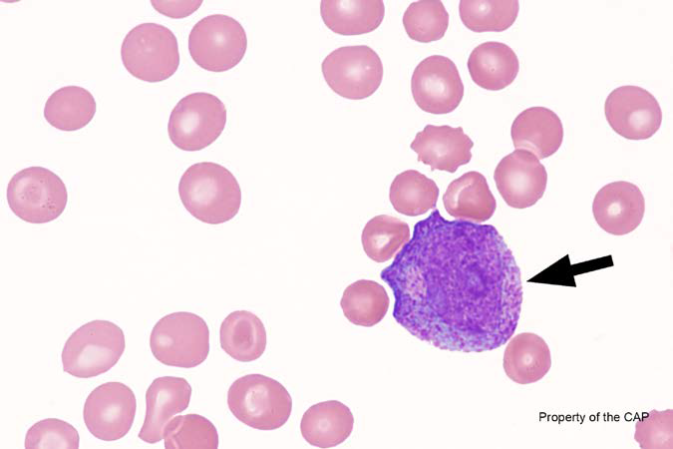
BCP-08
Neutrophil, promyelocyte

Slide 8
Neutrophil, promyelocyte
Response | Quest | All Participants (%)
Neutrophil, promyelocyte | 129 (82.2) | 81.9
Neutrophil, promyelocyte abnormal containing/lacking Auer rods | 9 (5.7) | 7.3
Neutrophil containing dysplastic nuclei and/or hypogranular cytoplasm |  | 0.0
Lymphocyte, large granular |  | 0.1
Malignant lymphoid cell (other than blast) |  | 0.3
Blast cell | 3 (1.9)
Neutrophil, myelocyte | 2 (1.3)
Lymphocyte, reactive | 1 (0.6)
Monocyte, immature (promonocyte, monoblast) | 1 (0.6)
Immature/Abnormal cell, refer | 12 (7.6)

Slide 9
Neutrophil, promyelocyte
Promyelocytes
  12 to 24 um
  Round to oval in shape with nuclear:cytoplasm ratio of 5:1 to 3:1
  Chromatin is fine and contains distinct nucleoli
  Typically will show a clear space or hof adjacent to nuclei
  Distinct azurophilic granules are present in cytoplasm

Slide 10
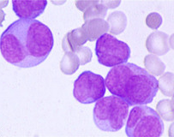
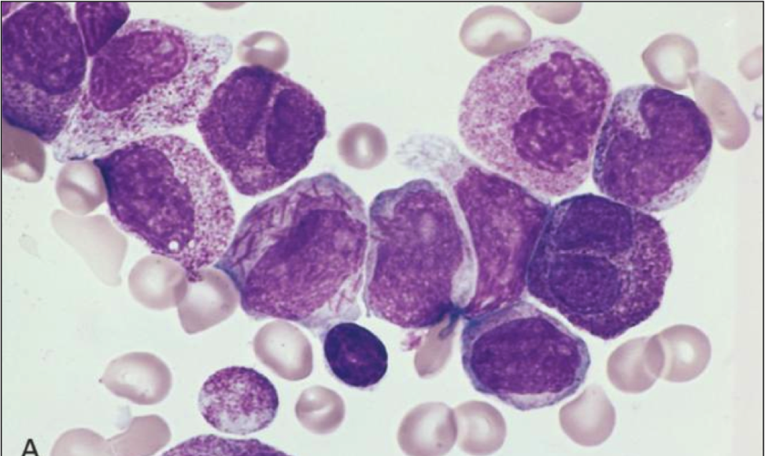
Neutrophil, promyelocyte, abnormal with/without Auer Rod(s)
Promyelocytes, abnormal
  12 to 24 um
  Folded, bilobed or irregular nuclei
  May not show a clear space or hof adjacent to nuclei
  Azurophilic granules may or may not be present in cytoplasm and may appear abnormal

Slide 11
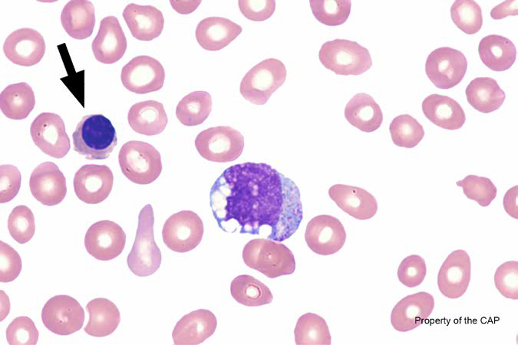
BCP-09
Nucleated red cell, normal or abnormal morphology

Slide 12
Nucleated red cell, normal or abnormal morphology
Response | Quest | All Participants (%)
Nucleated red cell, normal or abnormal morphology | 155 (98.7) | 99.1
Lymphocyte | 1 (0.6)
Immature/Abnormal cell, refer | 1 (0.6)

Slide 13
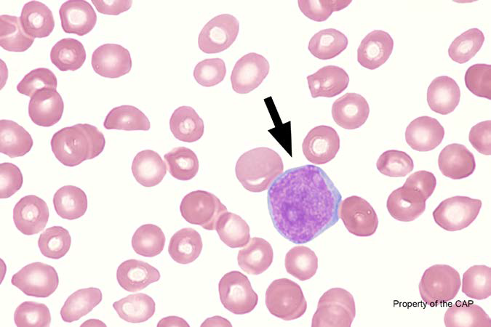
BCP-10
Blast cell

Slide 14
Blast cell
Response | Quest | All Participants (%)
Blast cell | 135 (85.9) | 87.5
Lymphocyte, reactive | 4 (2.5) | 2.3
Monocyte, immature (promonocyte, monoblast) |  | 1.6
Malignant lymphoid cell (other than blast) | 3 (1.9) | 1.9
Lymphocyte, large granular |  | 0.2
Immature/Abnormal cell, refer | 14 (8.9)
Lymphocyte | 1 (0.6)

Slide 15
Blast cell
Blast cell
  10 to 20 um
  High nuclear:cytoplasm ratio 7:1 to 5:1
  Round to oval nucleus
  Fine chromatin, indented or folded, prominent nucleoli
  “Because blasts are quite variable in appearance, it is often impossible to correctly classify an individual cell based on morphology alone.”

Slide 16
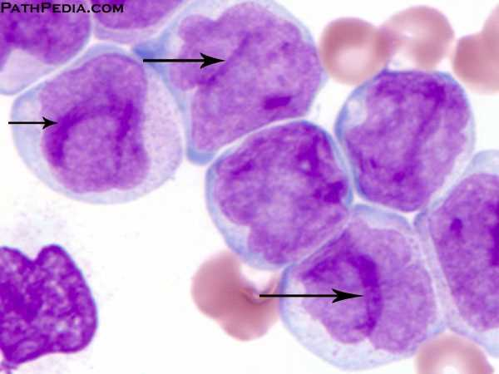
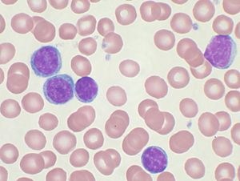
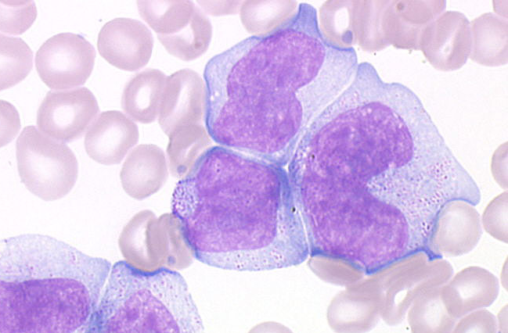
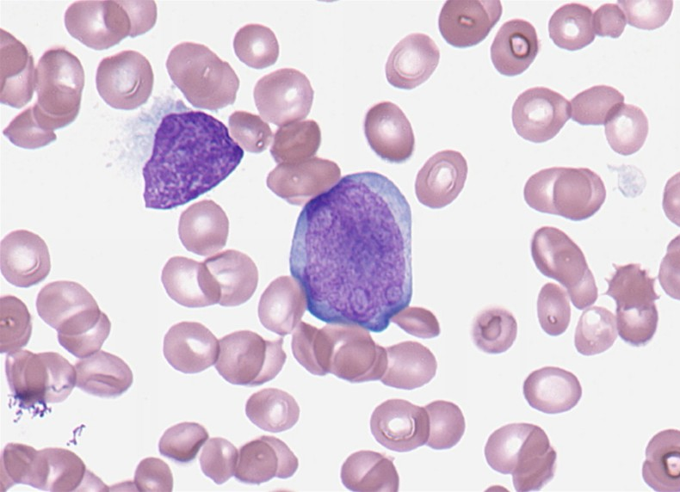
Monocytes
Monocyte, immature
Lymphoma cell

Slide 17
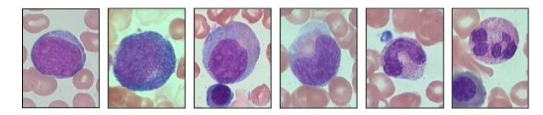
Myeloid maturation
Blast
Promyelocyte
Myelocyte
Metamyelocyte
Band
Segmented
Maturation

Slide 18
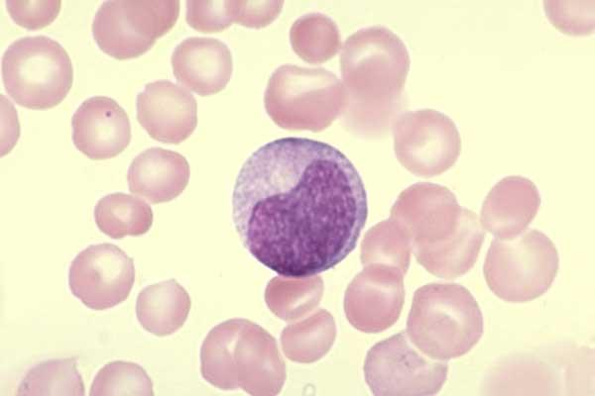
Neutrophil, metamyelocyte
Metamyelocyte
  10 to 18 um
  Round to oval
  Nuclear:cytoplasm ratio 1.5:1 to 1:1
  Condensed chromatin
  Indented nuclei, less than half the maximal nuclear diameter
  Cytoplasm contains rare azurophilic or specific granules

Slide 19
??Questions??
lawrence.x.tsao@questdiagnostics.com

Slide 20
FH series performance
Survey | Total Challenges | Total Misses | % Misses
2016 FH-A | 743 | 32 | 4.3
2016 FH-B | 771 | 24 | 3.1
2016 FH-C | 829 | 26 | 3.1
2017 FH-A | 788 | 17 | 2.2

Slide 21
Continued education credit for each call will be available through ASCLS P.A.C.E. program. This program is accepted by California and Florida. The CE level is Intermediate and will provide 0.5 Contact Hours per conference call. To obtain P.A.C.E. credit you must complete a survey following your participation in this program. The link to the survey required to obtain the CE credit is below.
https://www.research.net/r/CAPFH-A5-3-17

