Slide 1
Critique of the CAP FH-A Proficiency Photomicrographs
Presented by:
Lawrence Tsao, MD
Medical Director, East
4/6/2016

Slide 2
Case presentation (01-06)
This peripheral blood smear is from a 64-year-old man without significant past medical history who presents for his annual routine physical with loss of appetite.
Laboratory data include: WBC = 247.6 x 10⁹/L; RBC = 4.23 x 10¹²/L; HGB = 14.8 g/dL; HCT = 42.2%; MCV = 100 fL; RDW = 16%; and PLT = 111 x 10⁹/L.

Slide 3
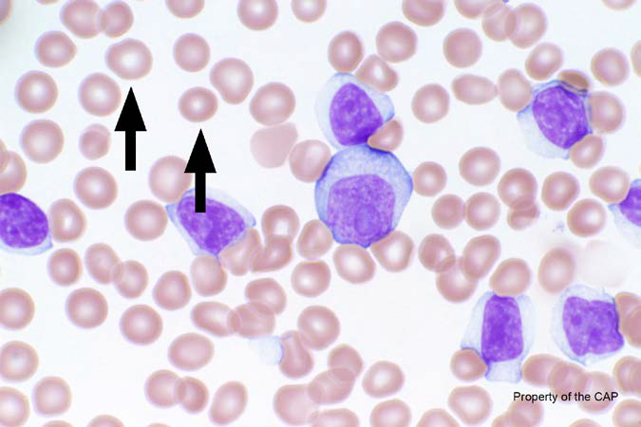
BCP-01
Erythrocyte, normal

Slide 4
Erythrocyte, normal
Response | Quest | All Participants (%)
Erythrocyte, normal | 153 | 92.8
Microcyte (with increased central pallor) |  | 4.7

Slide 5
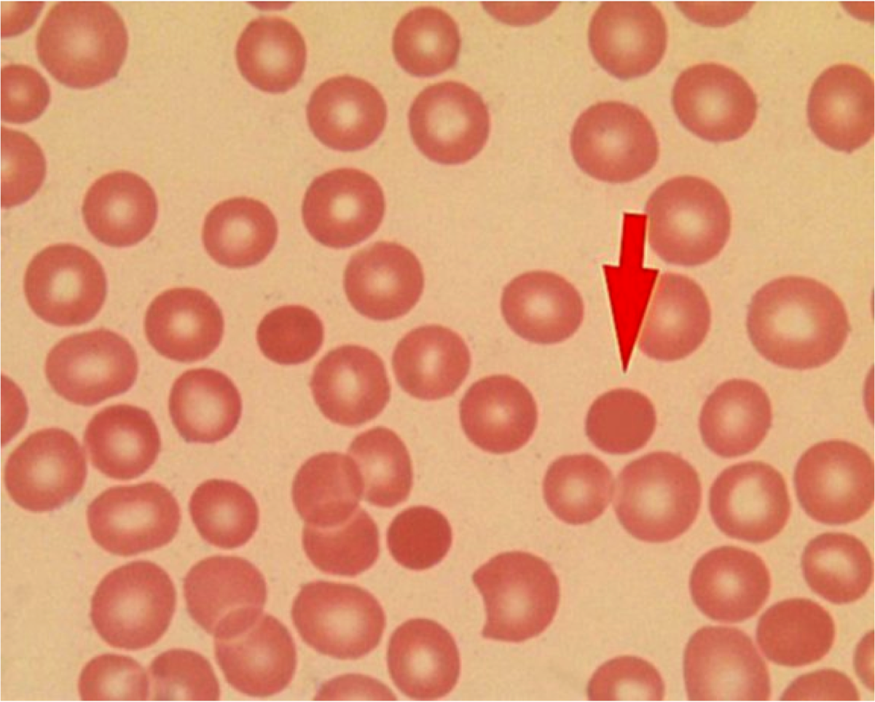
Central pallor
Central pallor = 1/3 diameter of cell

Slide 6
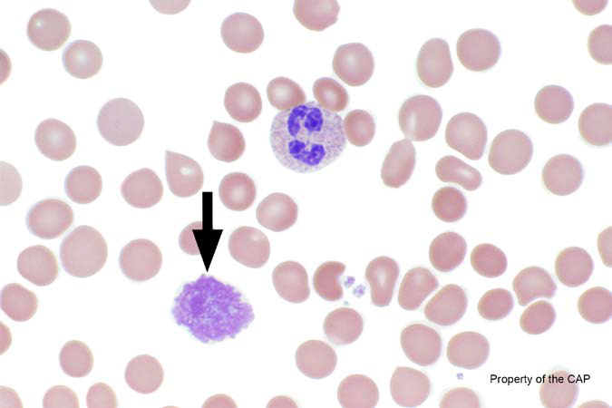
BCP-02
Basket cell/smudge cell

Slide 7
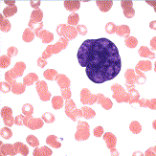
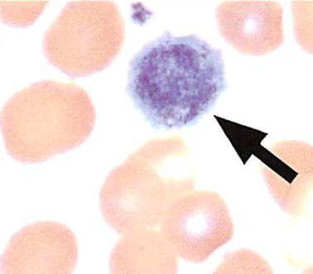
Basket cell/smudge cell
Response | Quest | All Participants (%)
Basket cell/smudge cell | 143 | 88.4
Platelet, giant |  | 7.7
Megakaryocytic cell |  | 0.9

Slide 8
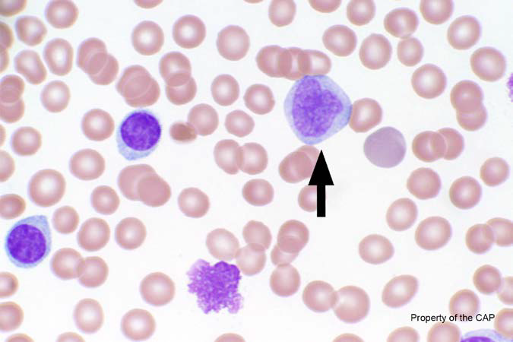
BCP-03
Monocyte

Slide 9
Monocyte
Response | Quest | All Participants (%)
Monocyte | 136 | 87.3
Monocyte, immature (promonocyte, monoblast) |  | 4.0
Neutrophil, myelocyte |  | 0.6
Malignant lymphoid cell (other than blast) |  | 1.3
Neutrophil, metamyelocyte |  | 2.3

Slide 10
Myeloid maturation
Blast
Promyelocyte
Myelocyte
Metamyelocyte
Band
Segmented
Maturation

Slide 11
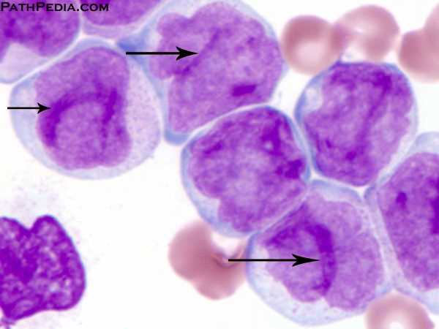
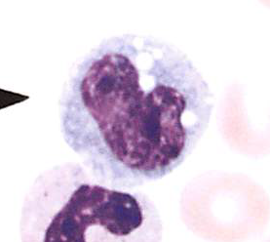
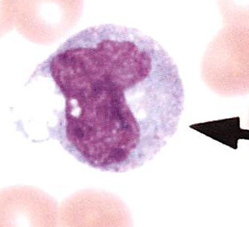
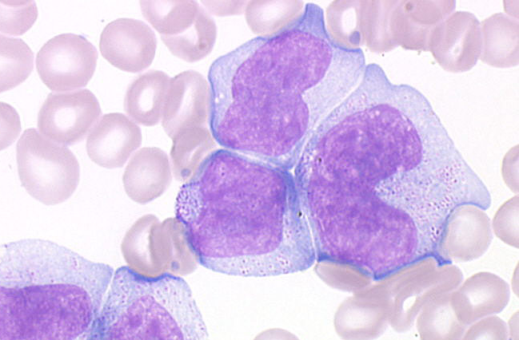
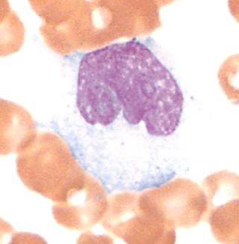
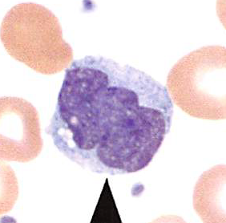
Monocytes
Monocyte, immature
Monocyte

Slide 12
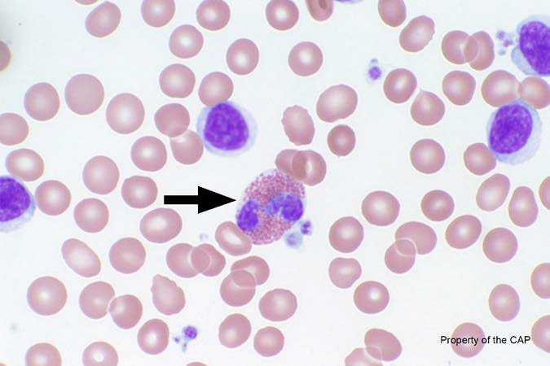
BCP-04
Eosinophil, any stage

Slide 13
Eosinophil
Response | Quest | All Participants (%)
Eosinophil | 155 | 99.8

Slide 14
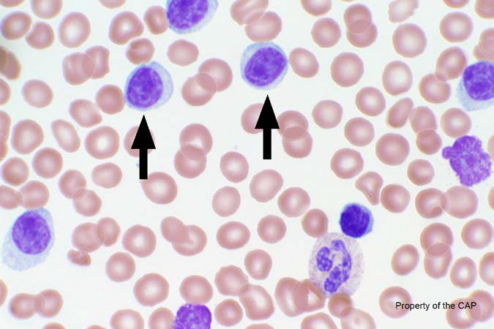
BCP-05
Malignant lymphoid cell (other than blast)
Lymphocyte

Slide 15
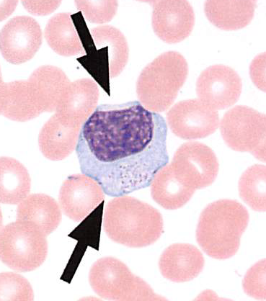
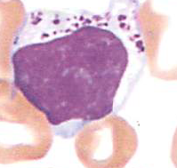
Malignant lymphoid cell (other than blast)
Response | Quest | All Participants (%)
Lymphocyte | 153 | 90.5
Malignant lymphoid cell (other than blasts) |  | 4.8
Lymphocyte, large granular |  | 1.8

