Slide 1

Critique of the CAP FH-C Proficiency Photomicrographs
Presented by:
Lawrence Tsao, MD
Medical Director, East
1/4/2017

Slide 2
Case presentation (21-25)
This peripheral blood smear is from a 20-year-old woman who recently emigrated from Africa. She presents with persistent cyclical fevers.
Laboratory data include: WBC = 4.8 x 10⁹/L; RBC = 2.67 x 10¹²/L;HGB = 8.3 g/dL; HCT = 30.2%; MCV = 70 fL; RDW = 18; PLT = 148 x 10⁹/L.

Slide 3
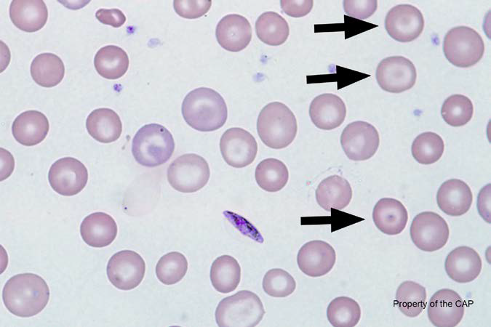
BCP-21
Target cell (codocyte)

Slide 4
Target cell (codocyte)
Response | Quest | All Participants (%)
Target cell (codocyte) | 167 | 97.8
Microcyte (with increased central pallor) | 3

Slide 5
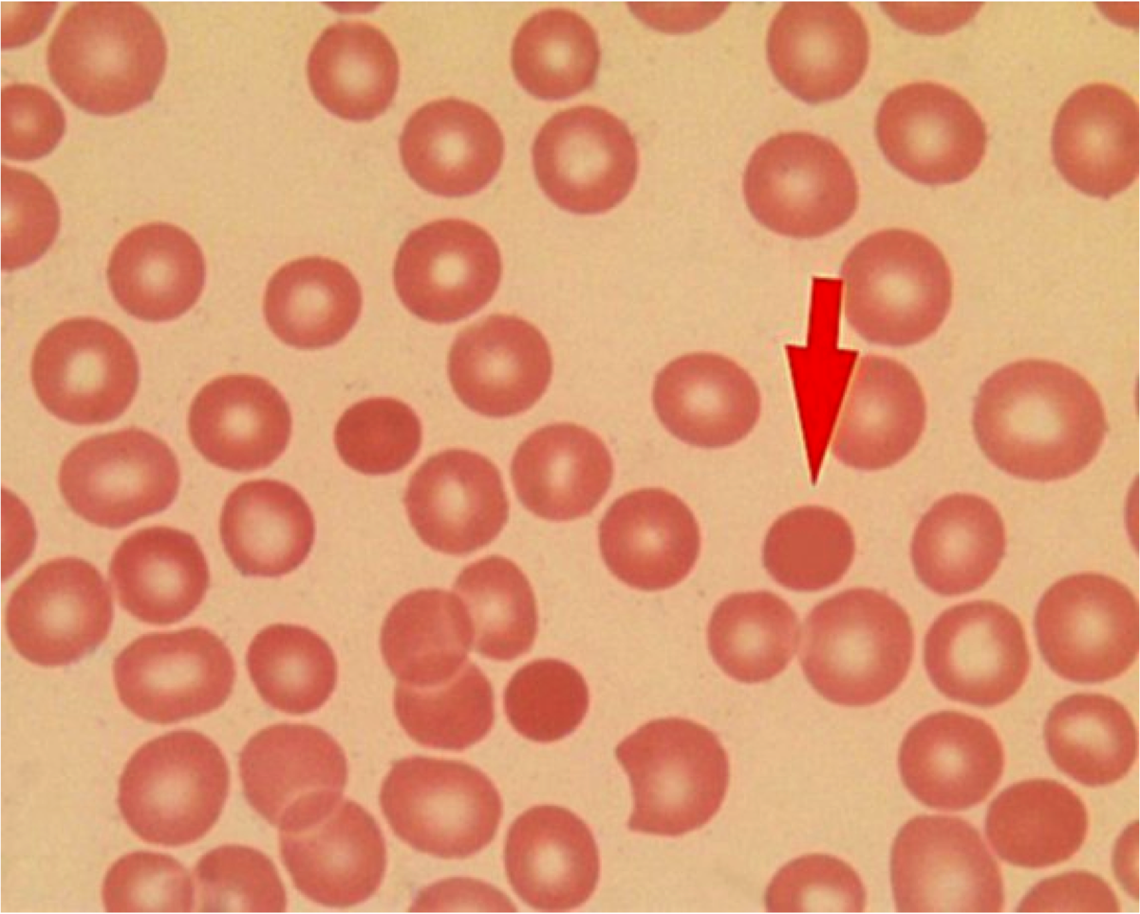
Central pallor
Central pallor = 1/3 diameter of cell

Slide 6
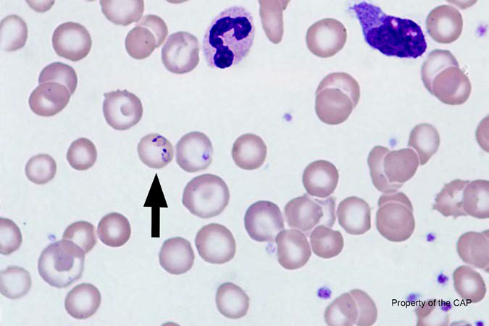
BCP-22
Plasmodium sp. (malaria)

Slide 7
Plasmodium sp. (malaria)
Response | Quest | All Participants (%)
Plasmodium sp. (malaria) | 166 | 85.2
Babesia sp. | 1 | 1.1
Pappenheimer (iron stain) | 1
Basophilic stippling | 1
Protozoan (non-Malaria) | 1

Slide 8
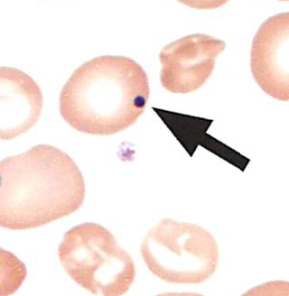
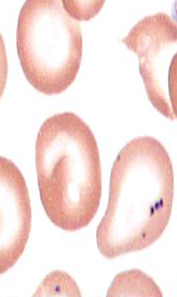
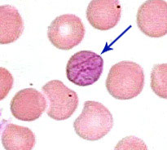
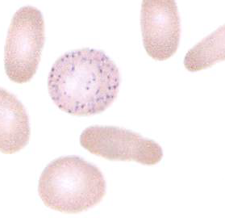
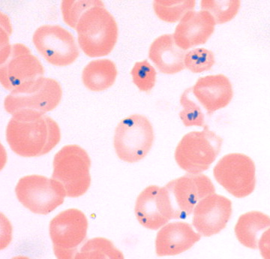
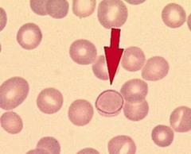
RBC Inclusions
Howell-Jolly body
Pappenheimer body
Cabot ring
Basophilic stippling

Slide 9
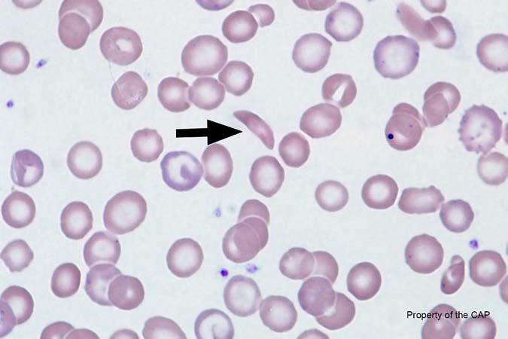
BCP-23
Sickle cell (depranocytye)

Slide 10
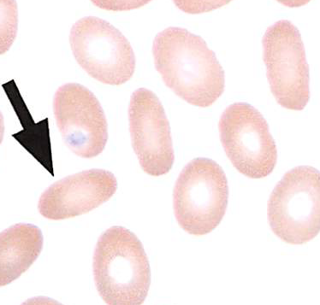
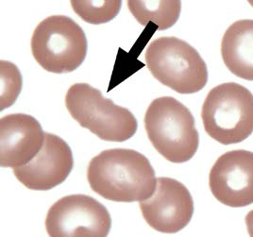
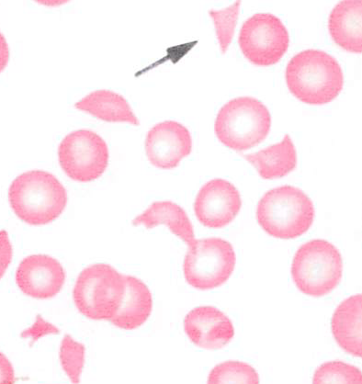
Sickle cell (depranocyte)
Response | Quest | All Participants (%)
Sickle cell (depranocyte) | 163 | 91.5
Fragmented red cell | 4 | 4.2
Ovalocyte | 2 | 2.8
Plamodium sp. (malaria) | 1
Ovalocyte/Elliptocyte
Fragmented red cell

Slide 11
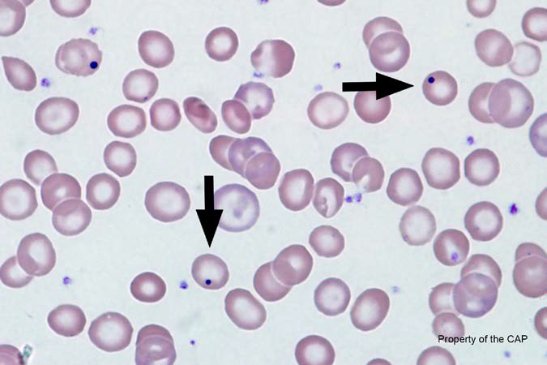
BCP-24
Howell-Jolly body (Wright stain)

Slide 12
Howell-Jolly body (Wright stain)
Response | Quest | All Participants (%)
Howell-Jolly body (Wright stain) | 169 | 99.2
Pappenheimer, (Wright stain) | 1

Slide 13
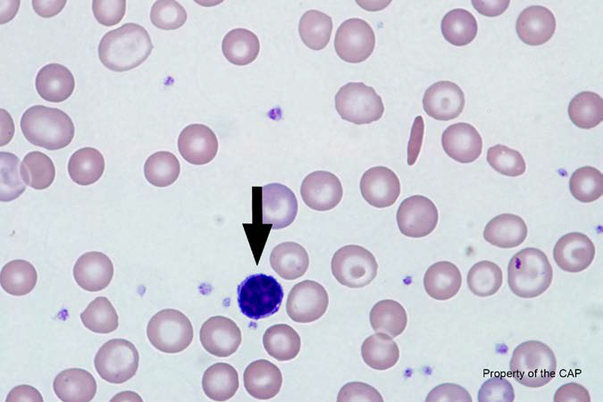
BCP-25
Lymphocyte

Slide 14
Lymphoycte
Response | Quest | All Participants (%)
Lymphocyte | 161 | 88.3
Nucleated red cell, normal or abnormal morphology | 4 | 4.5
Lymphocyte, reactive | 1 | 1.9
Basophil, any stage | 2 | 2.1
Megakaryocytic cell | 2 | 0.7

Slide 15
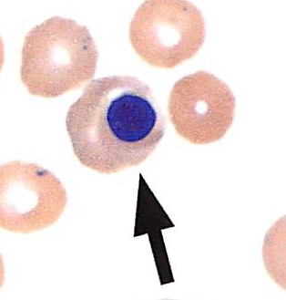
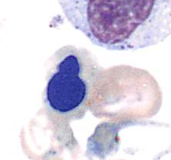
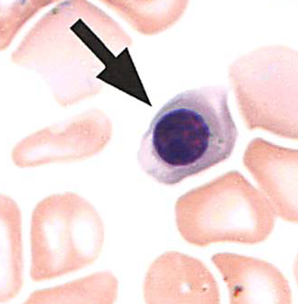
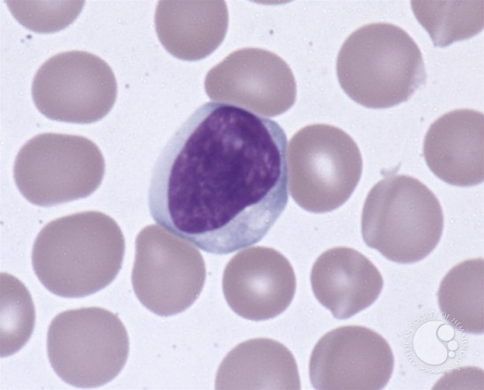
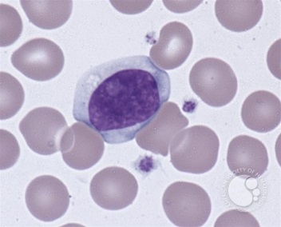
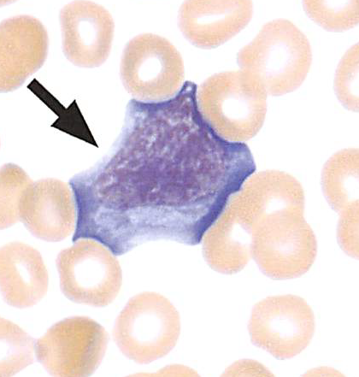
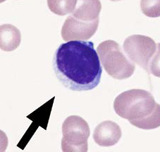
Lymphocyte
Nucleated RBCs
Lymphocytes, reactive

Slide 16
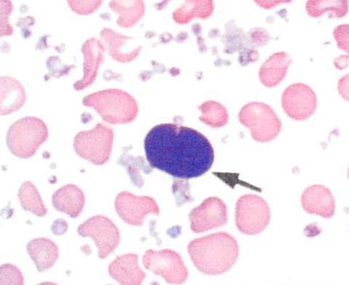
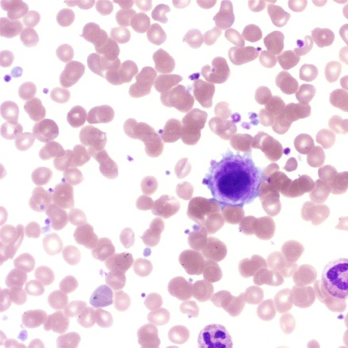
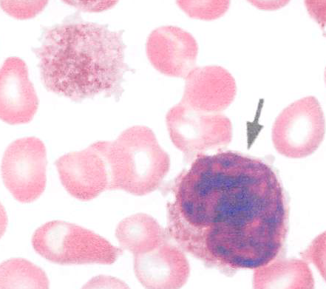
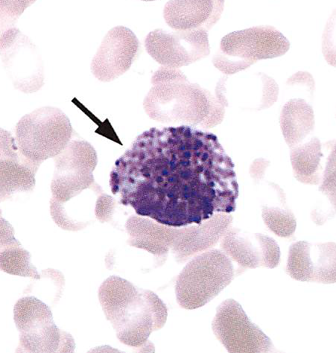
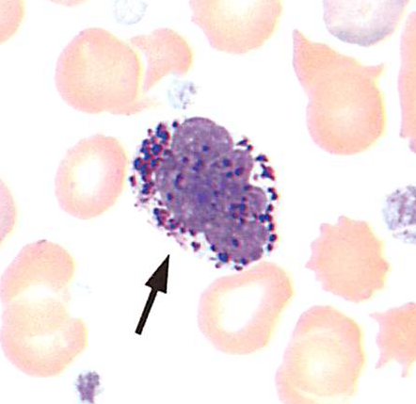
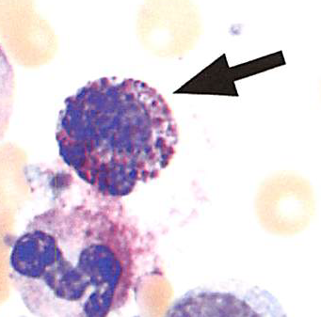
Lymphocyte
Megakaryocytes
Basophils

