Slide 1

Case Presentation (26-30)
This peripheral blood smear is from a 45-year-old man with a previous history of axillary lymphadenopathy who now presents with lymphocytosis.
Laboratory data include: WBC = 19.4 x 10⁹/L; RBC = 2.75 x 10¹²/L; HGB = 8.5 g/dL; HCT = 34.8%; MCV = 97 fL; RDW = 20; and PLT = 138 x 10⁹/L.

Slide 2
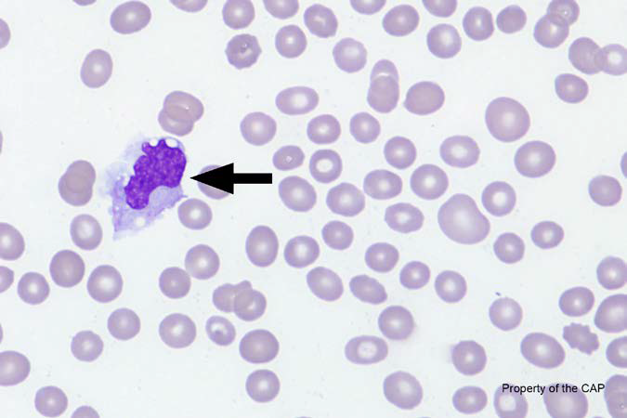
BCP-26
Monocyte

Slide 3
Monocyte
Response | Quest | All Participants (%)
Monocyte | 161 | 93.3
Lymphocyte, reactive | 3 | 2.5
Monocyte, immature (promonocyte, monoblast) | 1 | 0.7
Neutrophil with dysplastic nucleus and/or hypogranular cytoplasm |  | 0.1
Immature/abnormal cell, refer | 2
Neutrophil, toxic | 1
Parasite, refer | 1
Neutrophil, metamyelocyte | 1

Slide 4
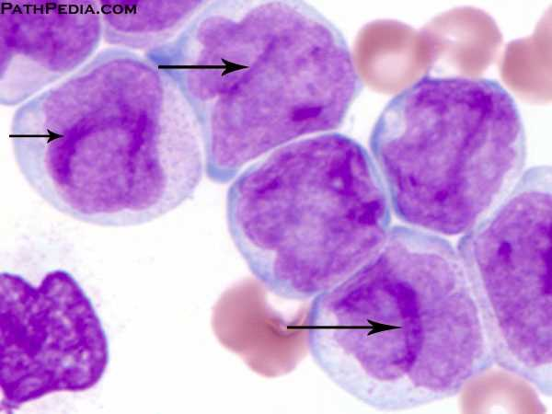
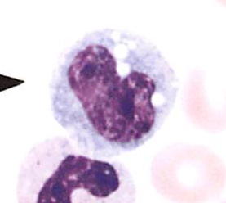
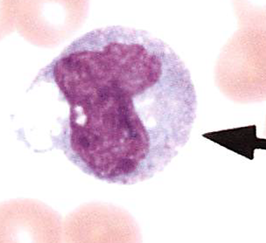
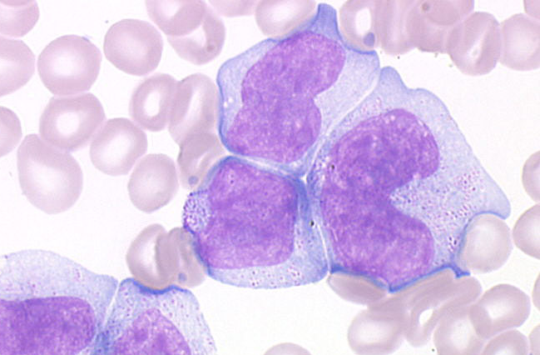
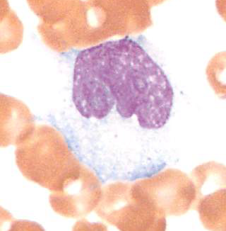
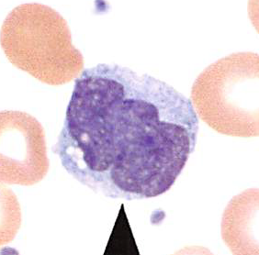
Monocytes
Monocyte, immature
Monocyte

Slide 5
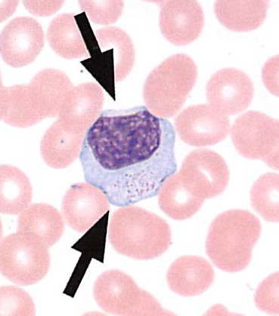
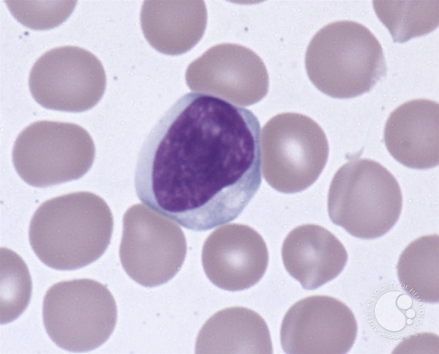
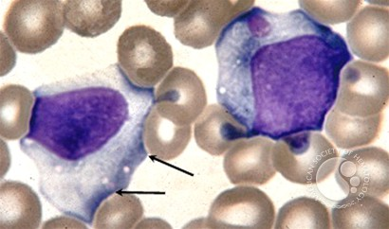
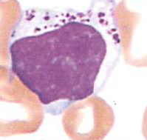
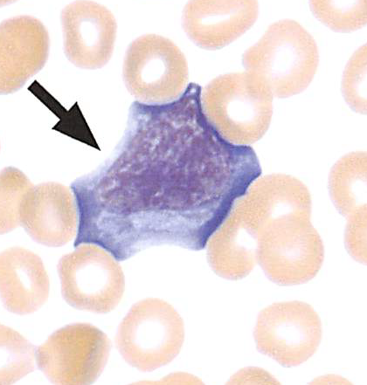
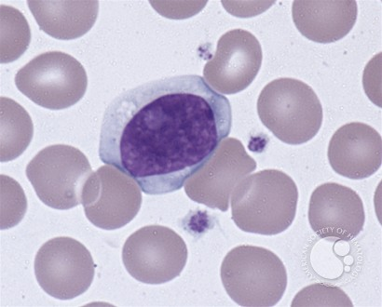
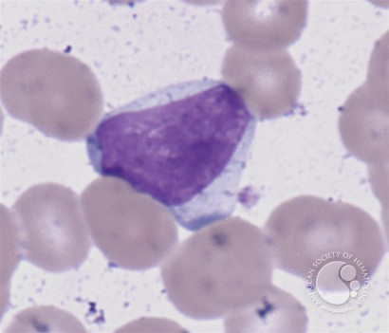
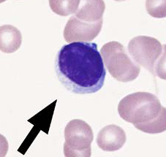
Lymphocytes
Reactive/Atypical
Large granular

Slide 6
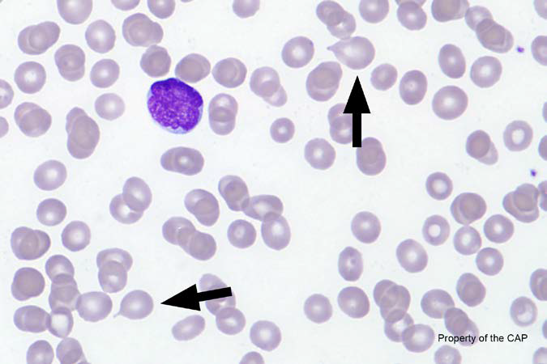
BCP-27
Teardrop cell (dacrocyte)

Slide 7
Teardrop cell (dacrocyte)
Response | Quest | All Participants (%)
Teardrop cell (dacrocyte) | 168 | 99.7
Target cell (codocyte) | 1

Slide 8
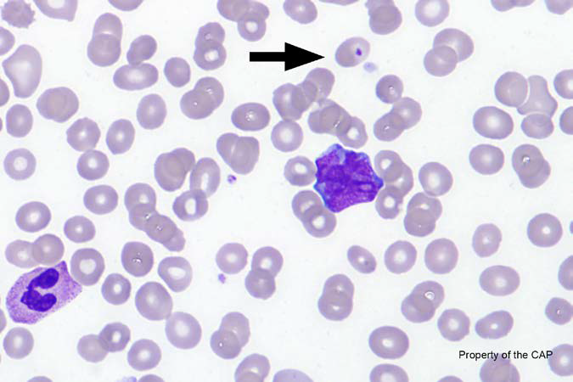
BCP-28
Erythrocyte with overlying platelet

Slide 9
Erythrocyte with overlying platelet
Response | Quest | All Participants (%)
Erythrocyte with overlying platelet | 163 | 96.3
Erythrocyte, normal | 1 | 0.2
Howell-Jolly body (Wright stain) | 1 | 0.7
Platelet, normal | 1
Pappenheimer (iron stain) | 1
Pappenheimer (Wright stain) | 2
Ovalocyte | 1

Slide 10
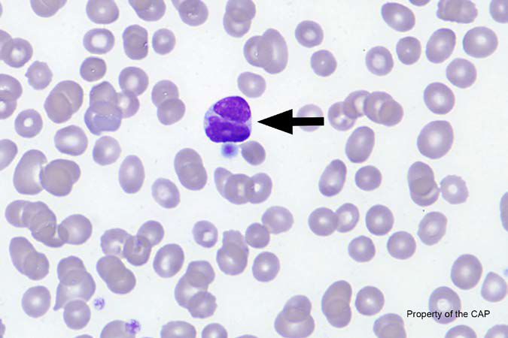
BCP-29
Malignant lymphoid cell (other than blast)

Slide 11
Malignant lymphoid cell (other than blast)
Response | Quest | All Participants (%)
Malignant lymphoid cell (other than blast) | 90 | 52.2
Lymphocyte, reactive | 21 | 13.9
Lymphocyte | 20 | 9.5
Neutrophil with dysplastic nucleus and/or hypogranular cytoplasm | 4 | 4.2
Neutrophil with Pelger-Huet nucleus (acquired or congenital) | 3 | 4.0
Lymphocyte, large granular |  | 0.3
Monocyte, immature (promonocyte, monoblast) | 4 | 2.0
Neutrophil, segmented or band | 3 | 1.8
Neutrophil, metamyelocyte |  | 0.4
Immature/abnormal cell, refer | 16
Blast cell | 2

Slide 12
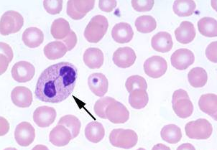
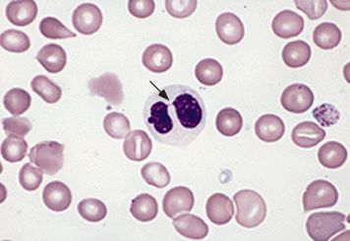
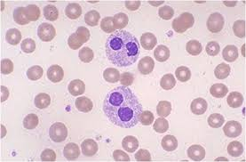
Unknown cell
Lymphocyte | Granulocyte | Monocyte | Other
Malignant lymphoid cell (other than blast) | Neutrophil with dysplastic nucleus and/or hypogranular cytoplasm | Monocyte, immature (promonocyte, monoblast) | Immature/abnormal cell, refer
Lymphocyte, reactive | Neutrophil with Pelger-Huet nucleus (acquired or congenital) |  | Blast cell
Lymphocyte | Neutrophil, segmented or band
Lymphocyte, large granular | Neutrophil, metamyelocyte

Slide 13
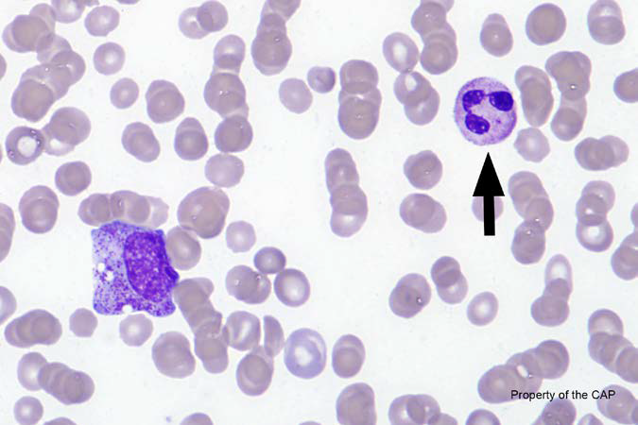
BCP-30
Neutrophil, segmented or band

Slide 14
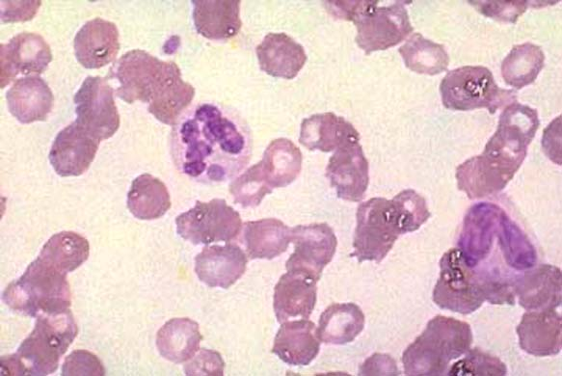
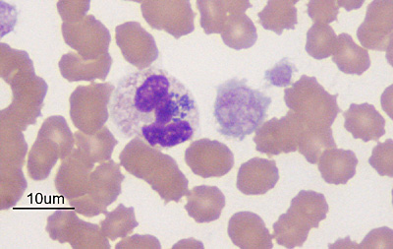
Neutrophil, segmented or band
Response | Quest | All Participants (%)
Neutrophil, segmented or band | 149 | 88.8
Neutrophil, toxic | 20 | 10.3
Leukocyte with Anaplasma/Ehrlichia |  | 0.1
Neutrophil, polyploid | 1

Slide 15
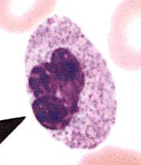
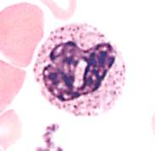
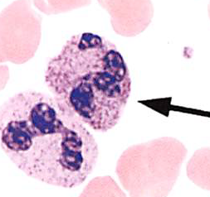
Neutrophil, toxic
Coarse, purplish to dark blue granules
Toxic changes:
  Toxic granulation
  Toxic vacuolization
  Dohle bodies

Slide 16
??Questions??
lawrence.x.tsao@questdiagnostics.com
https://www.research.net/r/CAPFHCJan4

