Slide 1
Annual PT Training 2017 for Specimen Management and Referral Testing Guidelines for Communication and Handling of Proficiency Material
( NOTE: No audio included with Presentation)
Notes:
Welcome:
I am Thomas Hayden, Manager for Medical Quality Assessment, Clinical Pathology and I have the pleasure of presenting part 1 of the 2017 Annual Proficiency Testing training: Guidelines for Communication and Handling of Proficiency Material.

Slide 2
Annual PT Training
Why?
Confusion still exists for some employees
Accidental referrals of samples to other laboratories
Inappropriate discussions/email about PT during active test period
Slides / instrument print outs / submission forms sent outside of the performing laboratory for review
Notes:
Read Slide

Slide 3
Proficiency Testing Handling
Who sets the requirements?
Federal Government as cited in CLIA 493.801
What are the requirements?
DO NOT:
Accept or Test PT material FROM another laboratory
Refer any portion of a PT sample TO another laboratory
Discuss/email about PT results during active testing
DO to the extent possible, test PT samples the same as patient samples UNLESS a patient sample is referred
Notes:
Do not discuss PT results with staff from other Quest or outside laboratories (this includes hospitals within the same management system). These all have a different CLIA license than your laboratory.
National Laboratory Operations (NLO) as they may have knowledge of how another/other laboratory/ laboratories are performing with regards to that PT.
If a question comes up about the active PT it is acceptable to discuss with your supervisor, local QA, Lab Ops, Laboratory Director

Slide 4
How Can PT Material Be Identified?

Slide 5
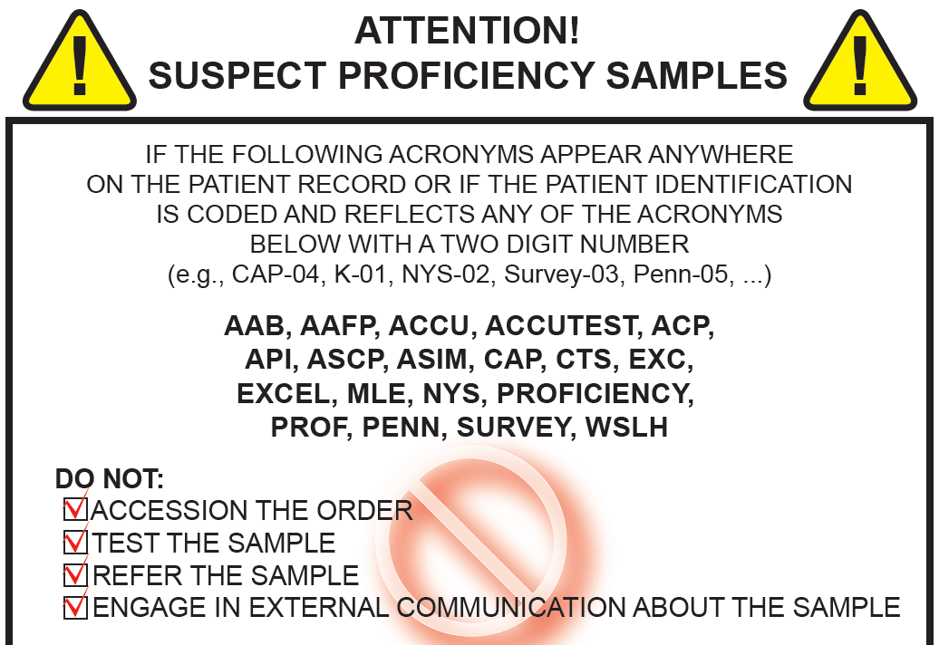
Is this PT material?
Use the Suspect PT Poster
Notes:
The first step in identifying suspect PT is to utilize the Suspect PT Poster. The poster should be posted throughout the laboratory. If there isn’t a poster in your laboratory department, please contact your local QA department for a copy of the poster.

Slide 6
Samples should be considered suspect PT if:
Any of the following are included in the patient identification:
AAB, AAFP, ACCU, ACCUTEST, ACP, API, ASCP, ASIM, CAP, CTS, EXC, EXCEL, MLE, NYS, PROF, PROFICIENCY, SURVEY, PENN, or WSLH
The sample or requisition has any of these words and a 2 digit number
Examples: CAP, K-O, SURVEY 08, Proficiency Sample - 09 or PENN-03
The words “Proficiency” or “CAP” or “Survey” appear on the label or requisition, or identification is similar to that used for PT.
The specimen appears to be a commercially prepared product or has the physical characteristics compatible with the consistency of an active PT survey sample
A specimen has a similar name or sample type as a PT survey that you are in the process of testing
Notes:
Samples should be considered suspect PT if they are labeled with any of the acronyms listed in the first bullet such as AAB, API or CAP. These identifiers are commonly found in the patient identification but, could also be printed on the sample or requisition.
Bullet 5 Example:
In Microbiology, one of the PT samples for bacterial identification is for a rather uncommon organism that you rarely see in your laboratory. During the time of the survey, your laboratory receives a request for Bacterial ID and the organism appears to have the same identification as that of your PT sample. Even though the name of the patient appears to be a valid name (i.e., not labeled as “proficiency” or “survey”, etc.), you should question whether or not this may be an inappropriate PT referral and follow the process outlined in the SOPs for suspect PT referral.

Slide 7
How should PT in the testing department be handled?

Slide 8
PT Handling for Testing Personnel Every time I handle a PT sample I must:
Treat PT the same as a patient sample
Run with patient samples
Follow SOP for repeat testing and reporting
Follow SOP for consultations, as applicable
Not refer the specimen to another laboratory for additional testing or confirmation, even if that is the standard process for patient testing
Store PT samples appropriately when testing is complete
NOTE: To prevent inadvertent referral, accidental release or inappropriate use, sequester PT samples away from patient samples
Notify my supervisor if I work at more than one lab and I already performed testing for this PT event
Notes:
1: PT samples may require some preparation, such as reconstitution. Following that, the samples must be treated as a patient sample.
PT samples may not be re-tested to confirm results if patients are not. Repeat criteria as outlined in the technical SOP must be followed for PT samples.
PT samples cannot be tested in duplicate if patient samples are not
PT samples must be run in the same batch/load/run as patient samples. If this is not possible (e.g., patient volume is very low and samples are not received every day and PT samples are either unstable and cannot be held or perhaps results are due back to the PT provider before patient samples are received). If the PT samples cannot be tested along with patient samples, documentation must be maintained that indicates why it was not possible.
PT samples must be stored/placed in a manner to prevent inadvertent referral or accidental release to another laboratory.
4. Although it is acceptable to work at more than one facility, Quest policy does not permit a technologist to test the same PT at more than one facility.

Slide 9
PT Handling for Supervisors / Managers
PT material is identified according to local practice
Test orders are correct and samples are handled according to the survey kit instructions
Ensure PT is rotated among techs, performed on different shifts, and on different equipment, as applicable
Verify PT material is treated like a patient samples
Confirm that PT samples were not sent to another laboratory for testing.
Ensure PT samples are stored appropriately
Ensure that PT samples are not used for other purposes until survey results are evaluated by the provider
Notes:
Is it identified as PT? (internal identifier)
If not – notify your local QA department immediately – each laboratory should have a process for identifying PT
Do I have the correct paperwork?
If not – notify your local QA to obtain the paperwork
Am I rotating appropriately (e.g. different techs, different shifts, different equipment)
PT must be rotated among techs, shifts and equipment to help ensure that each testing personnel is involved in performance of PT.
After testing is complete:
Was it treated like a patient sample?
Following SOP for repeats, consultations – If SOP states to consult a supervisor this MUST be done before release of results.
Reporting – no peer review
Run with samples
Was it sent to another laboratory for confirmation?
Was it stored it appropriately?
Sequestered away from patient samples to help prevent inadvertent referrals or use prior to formal evaluation is complete

Slide 10
PT PAPERWORK and COMMUNICATION
PT should never be discussed with:
A non-Quest / client laboratory
A co-worker that asks a question about a result
A sister-lab about a potential problem (ie: reagent lot issue)
The NLO or BPT about questionable results.
Paperwork review
Never send active PT paperwork to a supervisor / lab director when they are working at a different location (must stay within the four walls)
Notes:
Read slide.
NOTE Discussing PT with NLO or BPT is providing information re an active PT event to someone that has access to multiple BU’s. National Laboratory Operations (NLO) as they may have knowledge of how another/other laboratory/ laboratories are performing with regards to that PT.
They may have knowledge of how another/other laboratory/ laboratories are performing with regards to that PT.

Slide 11
Responsibilities for Specimen Management Personnel
Identify test orders that may be suspect proficiency testing from another laboratory.
Stop suspect PT samples from entering the normal work flow.
Notify a supervisor immediately.

Slide 12
Responsibilities for Referral Testing Personnel
Identify test orders that may be suspect proficiency testing from another laboratory.
Stop referral test orders before being sent to another laboratory.
Notify a supervisor immediately.

Slide 13
NEVER send PT samples outside of the 4 walls of the lab for ANY REASON!
Refer when test is down
TSO
Refer for
Method Comparison
Refer for
Correlation Study
Refer for Consultation
Refer for Confirmation

Slide 14
Corrective Action for Non-compliance
The following may result in corrective action up to and including termination:
Knowingly referring a PT sample to another laboratory
Knowingly accepting a PT sample from another laboratory
Knowingly engaging in any inter- or intra-laboratory communications about proficiency testing sample(s) before formal evaluation of results by the proficiency testing provider.
Failure to fully cooperate and be truthful in any investigation regarding suspected non-compliance with this policy may result in corrective action up to and including termination.
Notes:
Do not be confused about the term “Knowingly”.
The Administrative law Judges (ALJ) have ruled that ANY referral is intentional
We cannot plead “ignorance” of the law.
Education and documented training is critical.

Slide 15
Proficiency Testing Resources

Slide 16
Proficiency Testing: Resources
Local QA Department
Medical Operations and Quality (MOQ)
www.cms.hhs.gov/clia 493.801
CLIA Brochure #8: https://www.cms.gov/Regulations-and-Guidance/Legislation/CLIA/downloads/cliabrochure8.pdf
https://www.cms.gov/regulations-and-guidance/legislation/clia/cytologyproficiencytesting.html
Notes:
Read Slide:
MOQ – Medical Operations and Quality
MRA – Medical Regulatory Affairs

Slide 17
Next Steps

Slide 18
NEXT STEPS….
Testing personnel – Review audio presentation and take quiz in MediaLab
Specimen Processing and Referral Testing: Take the quiz and Sign the Verification on the bottom of the training.
If you have any questions, please contact your Supervisor or your Quality Assurance Department
Thank you for your time!

