Slide 1
Extra-Analytical Errors and
Improbable Results
Sample handling
Sample collection
Communication
Test Results

Slide 2
The mission of the Alliance Laboratory is to report a result, which can be used by the clinician to assist in the diagnosis, help determine treatment , or monitor ongoing therapy.
The process normally is divided into three phases: pre-analytical, analytical, and post-analytical. The analytical phase (while not immune from error) has a high degree of accuracy due to advanced technology in analyzers, QC programs, and electronic transmission of results.
Quality test results
Pre-analytical
Analytical
Post-analytical

Slide 3
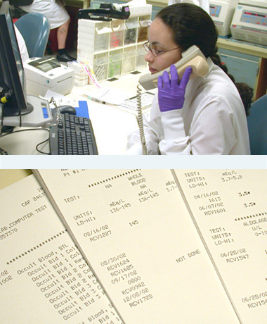
Post-analytical errors usually involve a disconnect between the lab and the rest of the healthcare system. These can be:
Caregivers handing off patients to colleagues
Incomplete closure of information loops to physicians
Critical test results not communicated and documented
Failures in communication to outside care settings
Quality in the post –analytical phase helps ensure clear, reliable, and timely result reporting.

Slide 4

Accreditation agencies are increasingly requiring labs to go beyond analytical quality and take responsibility for the extra-analytical phases where most errors arise.
This may cause some unease in labs when asked to consider activities outside their immediate control to benefit patient safety and quality improvement.

Slide 5
Alliance Labs has a well documented process for communicating critical test results to caregivers with read back requirements.
These policies –
ADM-1001 Critical Test Results and
ADM-1019 Read Back of Verbal Orders and Critical Tests can be accessed through the Alliance Lab Site on Policy Tech from any CFHA network computer.
Script?
Laboratory
Caregiver

Slide 6

In the event of an extreme value (high or low) OR improbable result based on the reference range of a healthy person, the laboratory has a responsibility and policy to question the caregiver concerning any collection issues and/or patient’s condition before reporting the test results.
Policy ADM-1028 Repeat Testing and Delta Checks contains a procedure for questionable results including:
Question the phlebotomist or nurse who collected the specimen regarding integrity of the sample.
Question the nurse or physician as to the patient’s condition and how it correlates with the lab results.
Review the situation with another tech or supervisor.
Repeat the testing on another instrument after checking the integrity of the tube.
Collect another specimen.

Slide 7

Not much data exists about improbable values and it is not possible to set a clear distinction between measured values compatible or non compatible with life due to methodological limitations.
Patient results must be checked to be sure that they are physiologically possible and that the results make sense before sending out a test result with may be acted upon.
Published data suggest 24-30% of lab errors have an effect on patient care while actual or potential harm occurs in 3-12%.

Slide 8

Pre-Analytical Factors
Specimens should be processed, transported, and stored within a timeframe and under conditions that do not interfere with specimen quality.
A compromised specimen could include a sample transported at the incorrect temperature, delay in transport, or a sample contaminated with something that would interfere with specific tests.
The process begins when the specimen is received into the lab. The collection time and collector entry into the computer must reflect what has been written onto the label by the collector.
The samples are evaluated for acceptable filling of tubes, sample size, and delays in transport.

Slide 9
Analytes subject to cellular metabolism (Na, K, Glu, etc) need prompt separation from cells.
Ideally, when plasma or serum is needed, blood should be processed within 2 hours of collection to ensure separation in gel tubes or for pour off of serum into secondary tubes for storage.
Na
K
Glucose

Slide 10

Glucose levels decrease as the length of time before serum/plasma separation increases.
An extremely low glucose in the absence of patient symptoms should trigger an investigation into sample handling and time of transport, particularly if the sample was collected at a facility outside of the hospital environment.
Glucose level
Separation time

Slide 11

The storage temperature of a specimen influences the results of coagulation tests such as PT and PTT.
Storage of plasma in contact with cells beyond 7 hours shortens the PT. When a blood collection tube is kept well stoppered and stored at room temperature, the PT is stable for up to 48 hours.
The PTT should be performed preferably within 2-4 hours of collection.

Slide 12
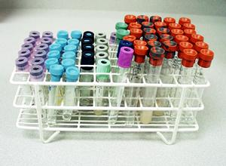
Correct order of draw will minimize anticoagulant additive carryover.
An example of improper order of draw that can lead to an incorrect chemistry result is drawing an EDTA tube prior to a heparin tube used for testing.
The potential cross contamination of EDTA on the needle from the lavender tube to the chemistry tube can lead to an elevated potassium result.
Contamination with EDTA may also cause decreases in calcium, magnesium and iron.
A pattern of extreme hyperkalemia with hypocalcaemia should trigger suspicion of EDTA contamination.

Slide 13

One of the most common interferences to accurate measurement of analytes is hemolysis.
Hemolysis can occur by cell rupture when collected through small bore needles, vigorous shaking of collection tubes, or prolonged contact of serum or plasma with cells.

Slide 14
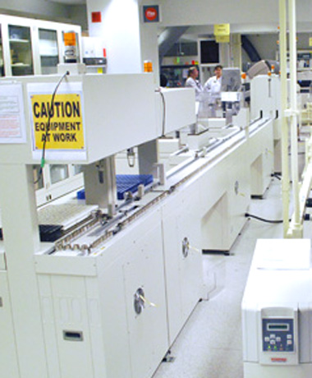
In general, slight hemolysis has a negligible effect on many routine chemistry procedures. Severe hemolysis has a substantial effect on constituents that are at a much higher concentration within the RBC than in plasma (LDH, K, AST and ALT).
The concentration of potassium inside the RBC is approximately 23 times as much as that found in plasma. The results of these tests would be invalidated when the specimen is hemolyzed severely.

Slide 15
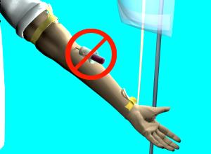
Blood collection from indwelling lines by non-lab staff requires technique to avoid hemolysis, fluid contamination, or dilution of samples.
IV contamination can occur by drawing from the line without flushing with an appropriate discard volume, or from venipuncture above the IV site. For example, chloride, potassium and glucose are commonly administered by IV and could appear dramatically elevated if IV fluid is introduced.
If a sample has been diluted with a large volume of IV fluid, overall changes in results may occur and many analytes may decrease simultaneously.

Slide 16

Testing results must be checked to sure that they are physiologically plausible and that the results make sense when compared with other results from the same sample.
Tools like delta checking and automated checks for results that are implausible; along with increased communication to phlebotomist or caregiver are used to perform result verification and ensure an error free test result.

