Slide 1
Blood Bank How To’s and Helpful Trick Review

Slide 2
How to Thaw/Irradiate
To irradiate or Thaw a product you will need to go to Inventory, Edit, Create product and select change product. You may also do this when aliquoting blood for baby’s using divide instead of change. If it is already selected for a patient you will need to go to Inventory, Product Orders Service, Create Product, Change etc.

Slide 3
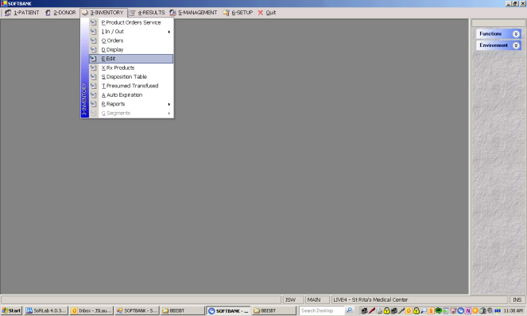
How to Thaw/Irradiate

Slide 4
How to Thaw/Irradiate
You will need to enter the product you are wanting to change either by hand using lists in blood bank or scan in the product code. If you hand enter with ISBT this means you may have to look this up on the spreadsheet in blood bank. The E code with four numbers after is the product and spreadsheet will show the name as we use it in bank. So 24F =E2619 the change code will be in the drop down although the thaw codes and IRR codes are also available on the spreadsheet in blood bank.

Slide 5
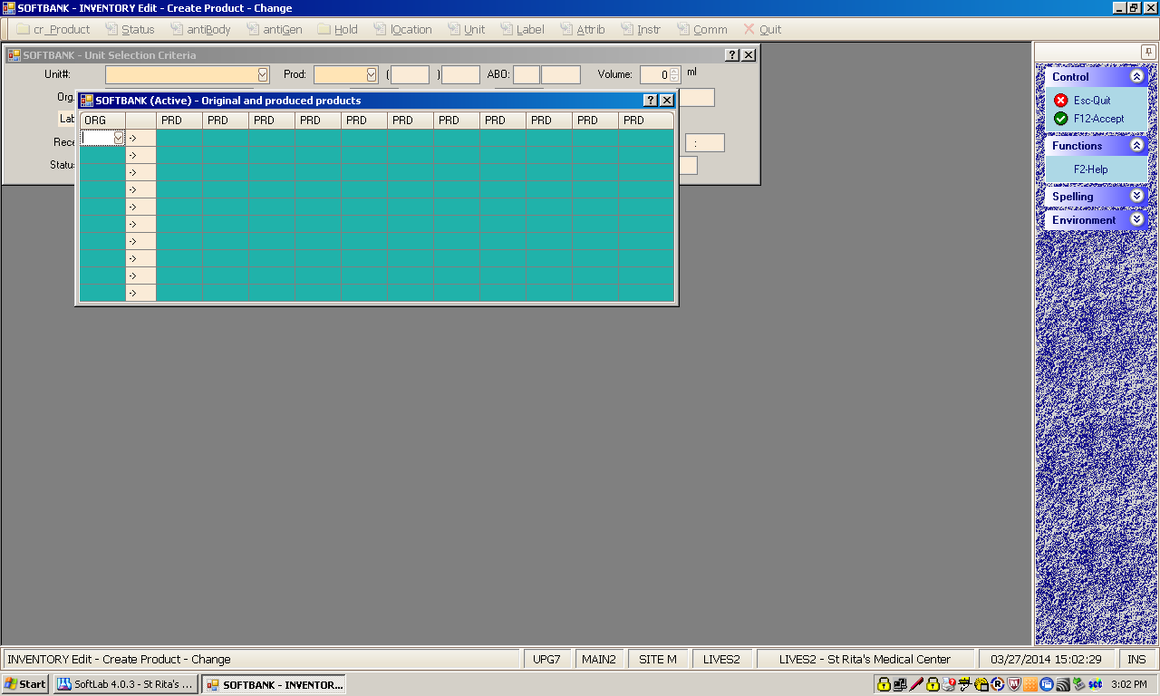
How to Thaw/Irradiate
You can scan product code here! Then Tab over

Slide 6
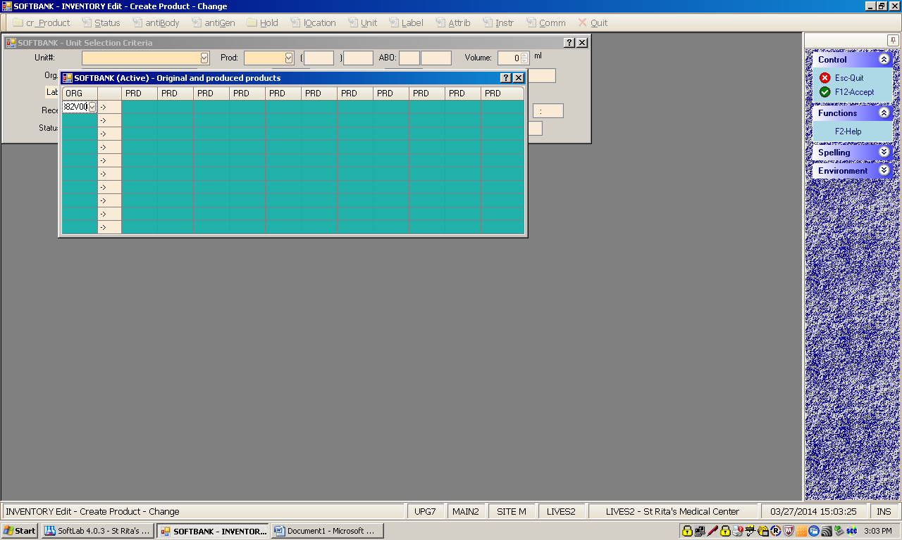
How to Thaw/Irradiate

Slide 7

How to Thaw/Irradiate
SRMC code appears

Slide 8

How to Thaw/Irradiate
Only one choice should appear in the drop down for IRR or Thawing or dividing

Slide 9
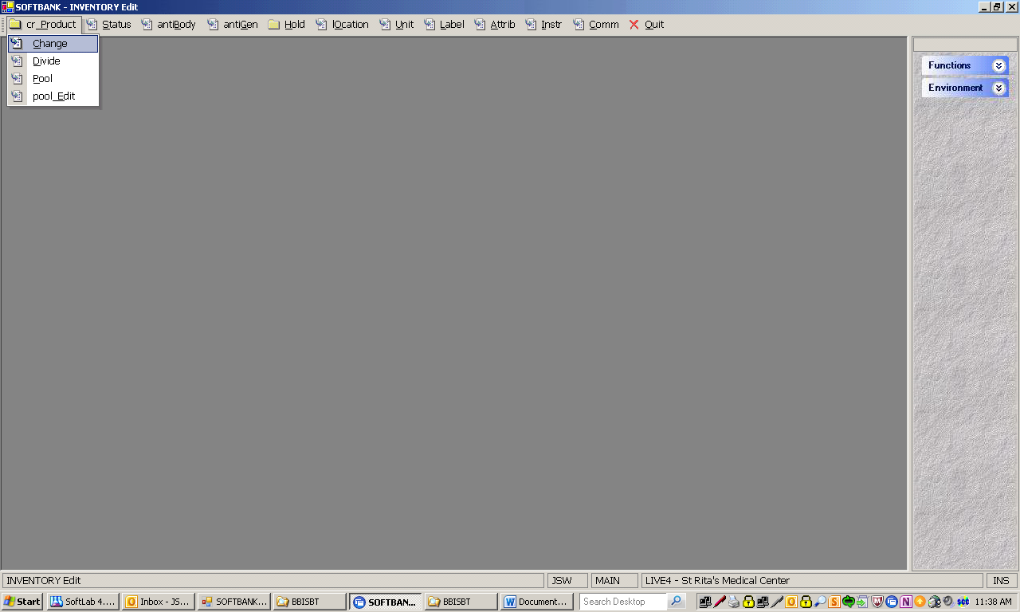
Example of Thawing FFP

Slide 10
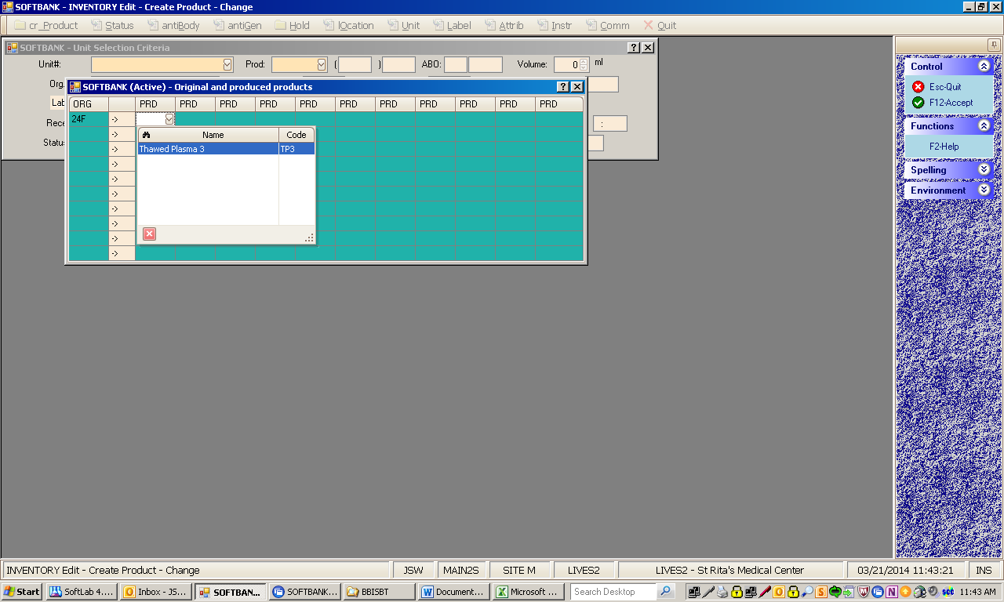
Example of Thawing FFP

Slide 11
Example of Thawing FFP

Slide 12
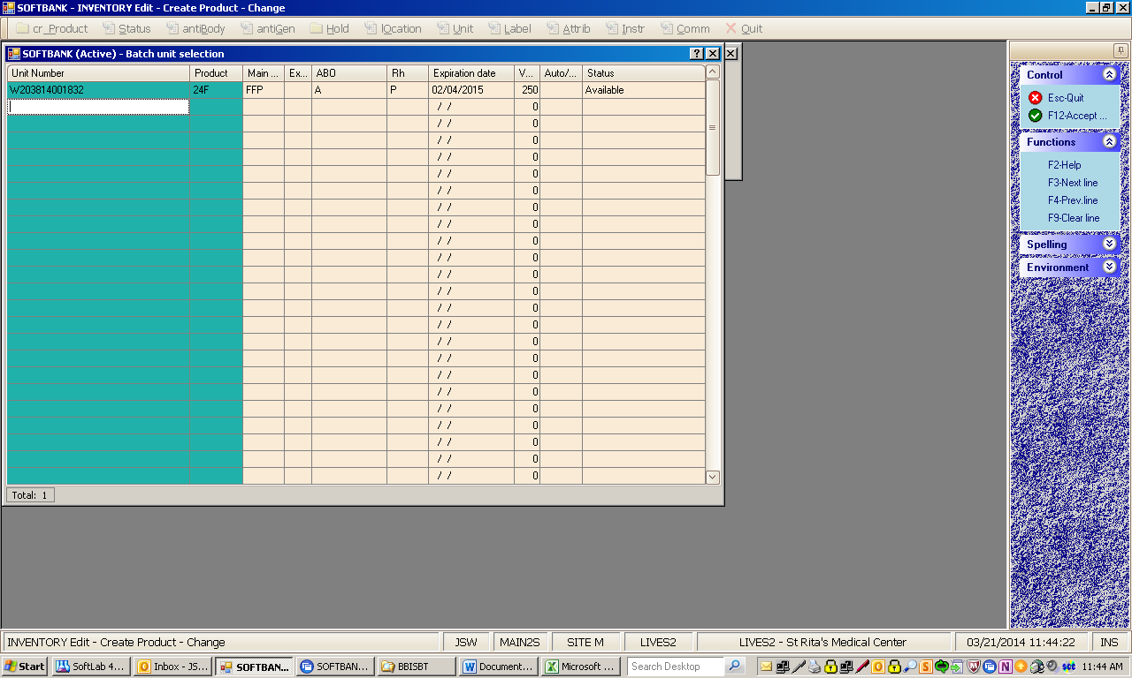
Example of Thawing FFP

Slide 13
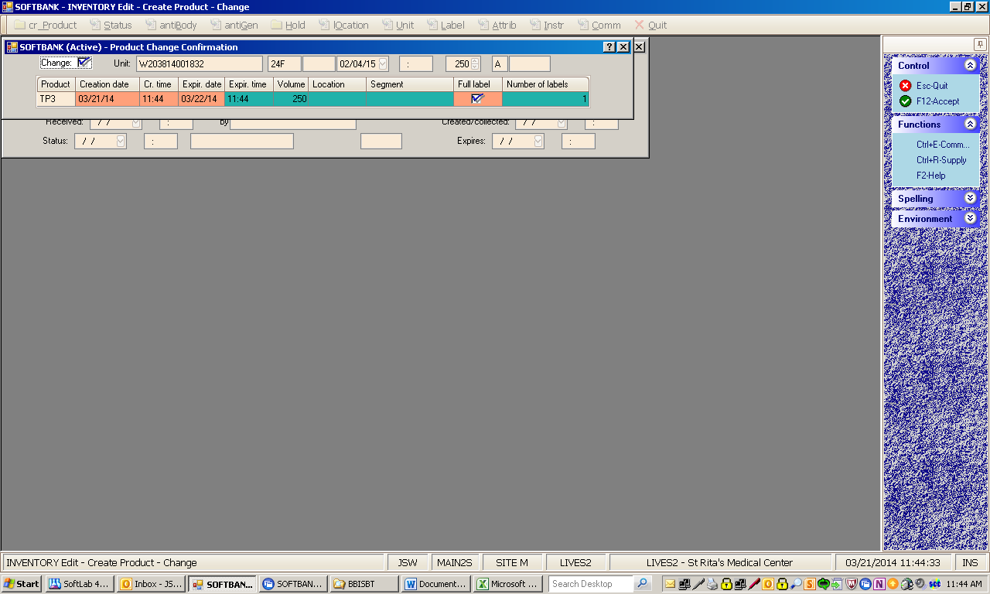
Example of Thawing FFP

Slide 14
Example of Thawing FFP
You will print a full face (4X4) label to the LBB printer. This should be placed over the current label. The system will not allow you to issue a frozen product only a thawed product.

Slide 15
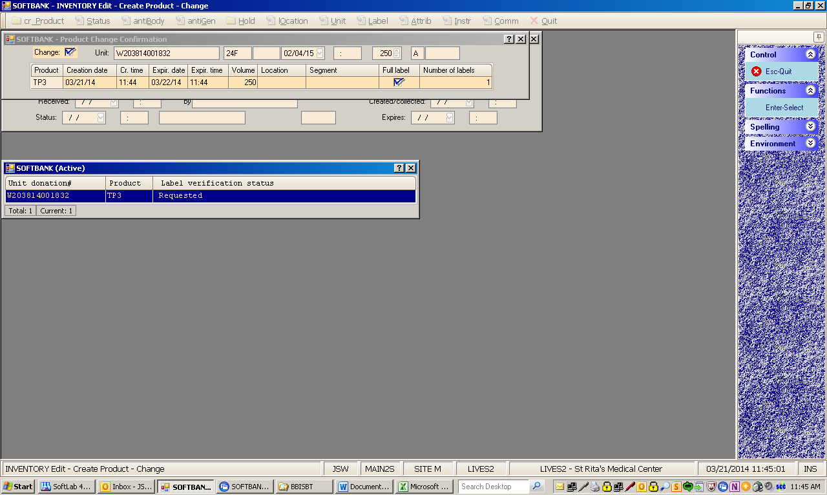
Example of Thawing FFP

Slide 16
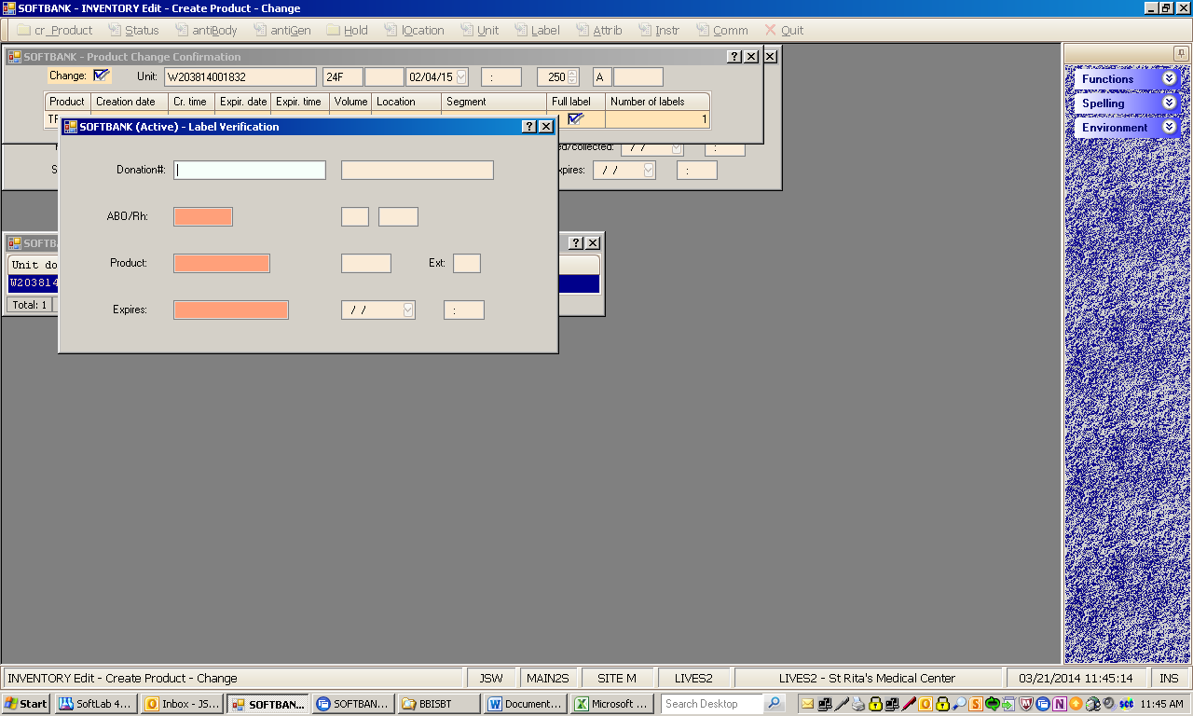
Example of Thawing FFP

Slide 17
Differences in Irradiated
You do NOT need to add irradiated as an instruction to a unit as we did previous.
If a patient is requested as Irradiated, change the LRC to a URC. (this is the screen where you can select how many units you would like) Likewise change platelets from a LPH to a ILP.
Screenshot following

Slide 18
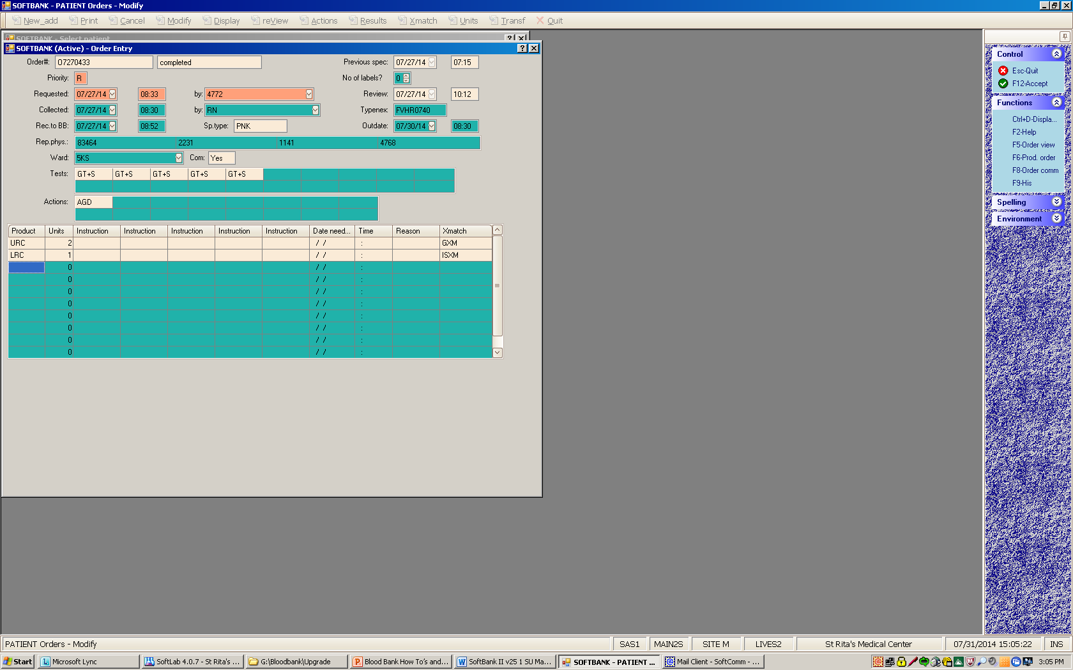

Slide 19
Add the following message to remind other techs to change the product
Screenshot following

Slide 20
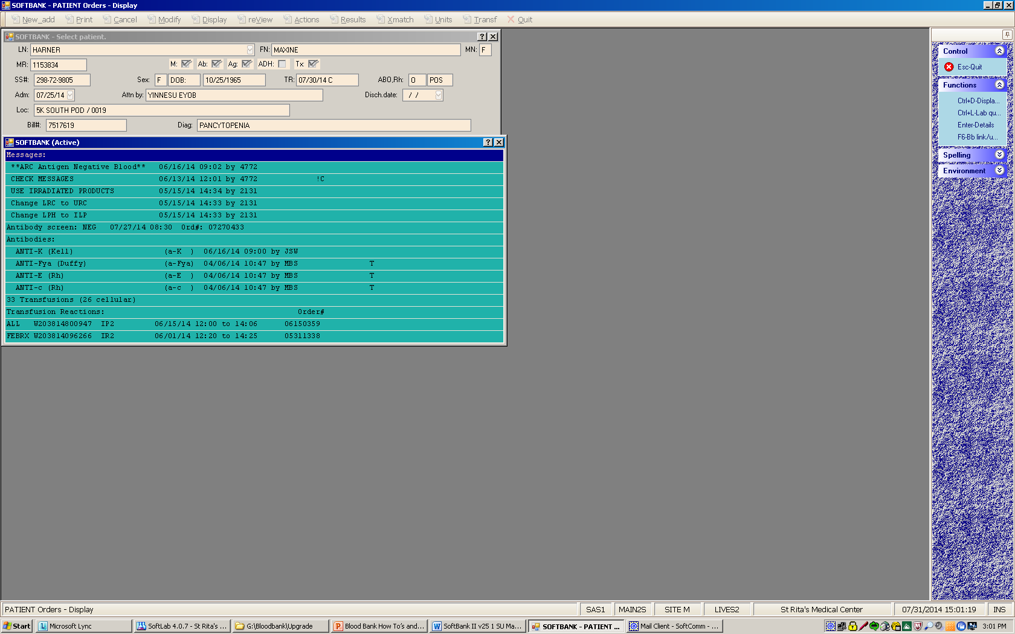

Slide 21
WHY AM I DOING THIS?!
Label verification is a requirement by CAP and AABB and it will pop up this box once you enter on above screen. You will have TWO tries to scan the printed label. This is to ensure the label printed properly with the proper information. Saves us having to have another tech present to check each one.
You must scan this label as you can hand enter but you must know the ISBT code for each item. Like A pos would be 6200 etc. If you exceed the two tries you will go to Inventory.edit.label and it will allow you to reprint and try again. Products will not issue unless this has been completed. Emergency issue is the only way it will allow you to bypass and it should only be used in those cases.

Slide 22
More Tips
Inventory
When entering units into inventory batch you can choose ARC at both source and collection
ISBT will read barcode from whatever facility when you scan it in.
Turn off cap lock before scanning
Remember to enter OK at the condition before continuing to enter units
Scan units and enter volume at the end of each line then TAB before entering the next unit or F12 to exit.

Slide 23
QC

Slide 24
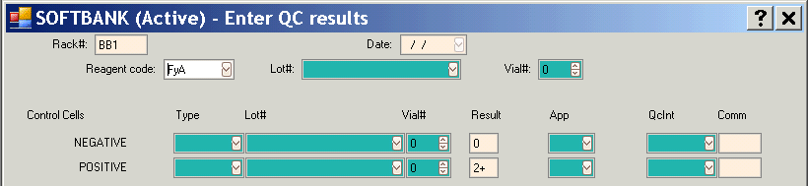
Antigen Typing QC
Prompted when resulting
  Added to current rack
  May want antigen typing rack
Enter lot number of antisera
Enter lot number and reagent type
  Negative control
  Positive control

Slide 25
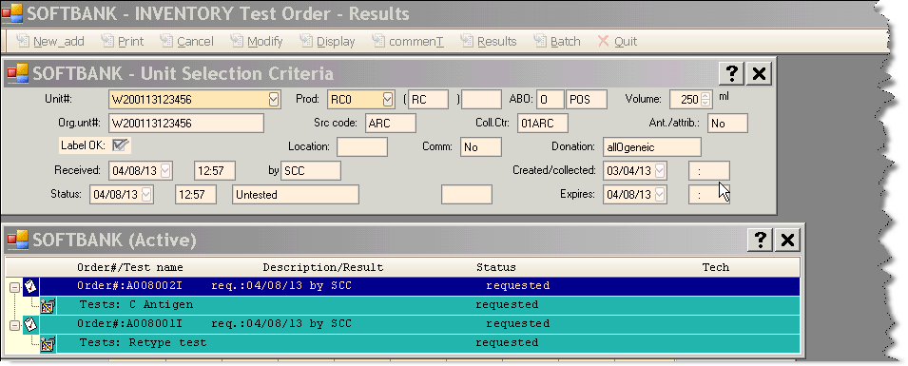
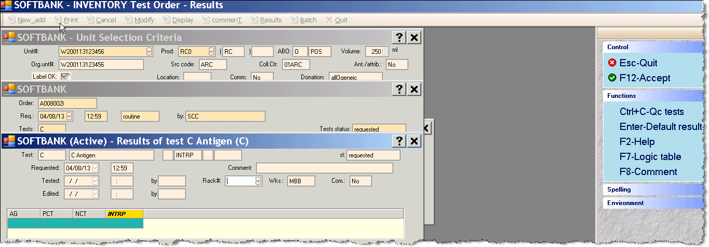
3. Result the “C” Antigen test. In this example, we result the test in the 3-INVENTORY > Orders > Results option.
a. Access 3-INVENTORY > Orders > Results and enter in the unit number.
b. Click on the “Tests: C: Antigen” and then the Rack #.
Result: the “Results of test C Antigen” window displays.

Slide 26
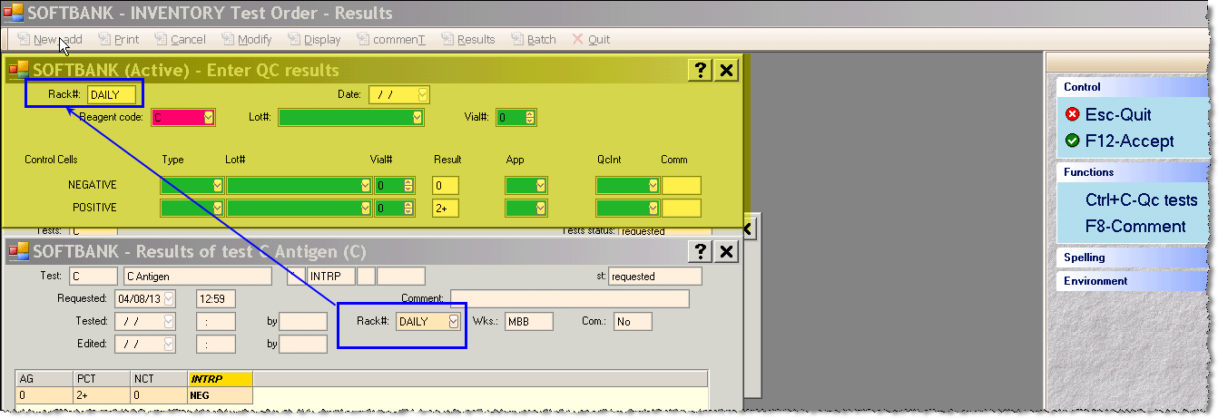
c. Enter valid results and then click/ press F12-Accept.

Slide 27
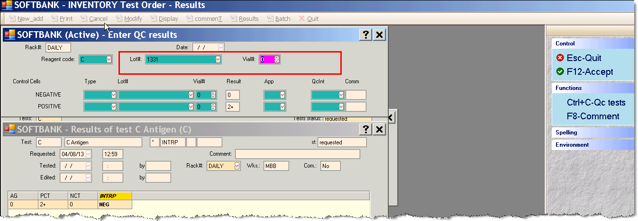
d. Access the “Lot#” field and enter the Lot# of the reagent. Use the drop down arrow to choose Lot number.

Slide 28
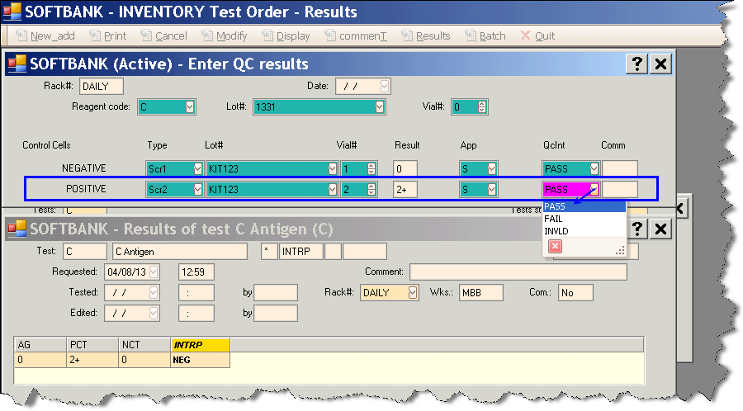
Enter in the Positive Control results
i. In the “Control Cells” column, place the cursor in the “POSITIVE” row and choose the reagent type in the “Type” field by using the drop down arrow.
j. Enter the lot number of the positive control cells reagent in the “Lot#” field by using the drop down arrow.
k. Enter the result in the “Result” field and the Appearance in the “App” field by using the drop down arrows.
l. Enter the QC Interpretation in the “QcInt” field.

Slide 29
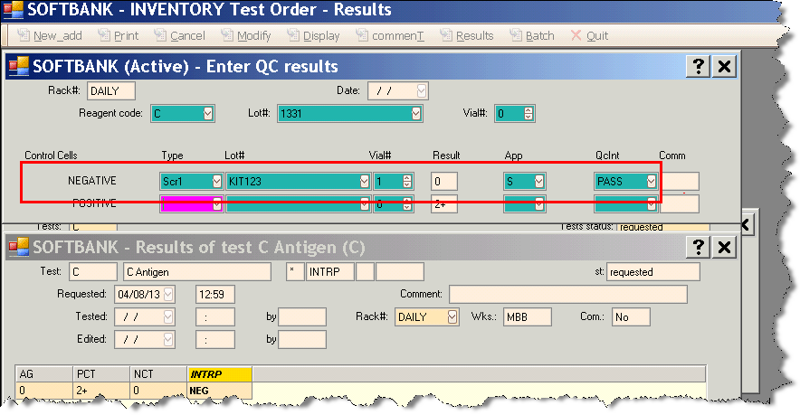

Enter in the Negative Control results
e. In the “Control Cells” column, place the cursor in the “NEGATIVE” row and choose the reagent type in the “Type” field by using the drop down arrow.
f. Enter the lot number of the negative control cells reagent in the “Lot#” field by using the drop down arrow.
g. Enter the result in the “Result” field and the Appearance in the “App” field by using the drop down arrows.
h. Enter the QC Interpretation in the “QcInt” field.

Slide 30
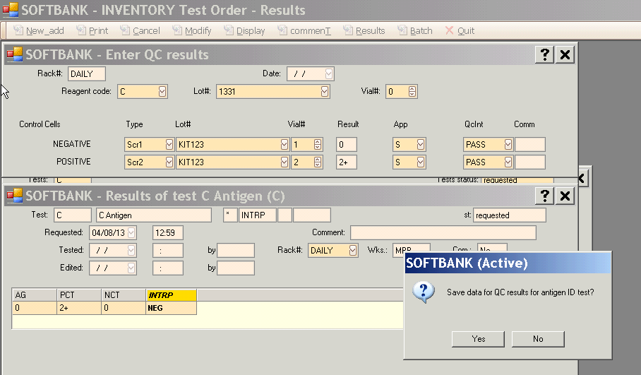
m. Click F12-Accept and then click “Yes” to the prompt “Save data for QC results for antigen ID test?”

Slide 31
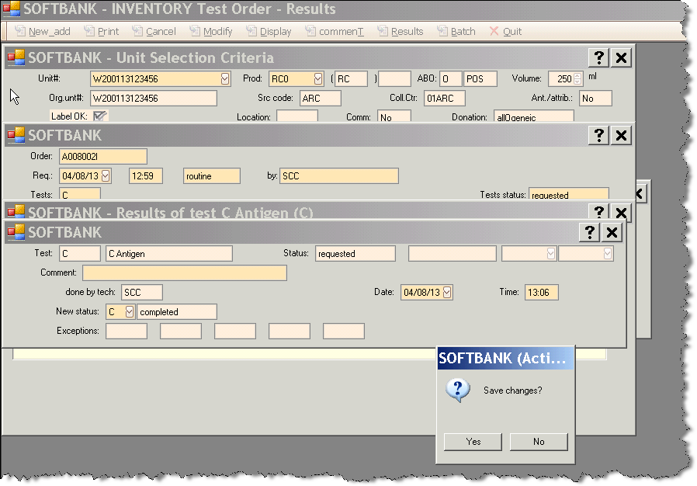
n. Click F12- Accept and then “Yes” to Save changes.

Slide 32
Do I need to Write them in the book?
We will begin to move away from the book. If you successfully entered qc, there is no longer a need. You can check the rack to see what qc has been done for the day

Slide 33
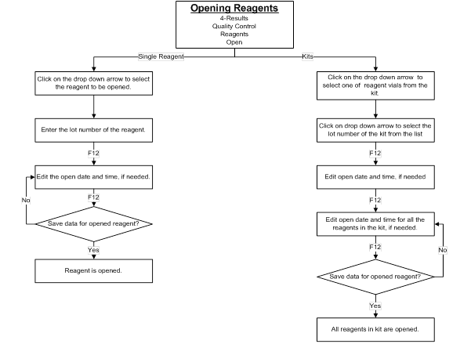
Open Single Reagents
Click Results Icon from the Main Menu.
Click: Quality Control> Reagents> Open.
At the Type field, click the drop down arrow and select the reagent to be registered.
Enter the lot number of the reagent and Click: F12-Accept.
Edit the open date and time, if desired. Click: F12-Accept.
System displays: “Save data for opened reagent?” Click: Yes.
Click: Quit to exit to the QC Menu
Click: Quit to exit to the Main Menu.
Opening Reagent Kits
Click Results Icon from the Main Menu.
Click: Quality Control> Reagents> Open.
At the Type Field, click the drop down arrow and select one of the vials in the kit that is to be opened.
Enter the lot number of the kit. Click F12-Accept.
Edit the open date and time, if desired. Click: F12-Accept.
The system will display all reagents in the kit. Edit the open date and time, if desired. Click: F12-Accept.
System displays: “Save data for opened reagent?” Click Yes.
Click: Quit to exit to the Main Menu.

Slide 34
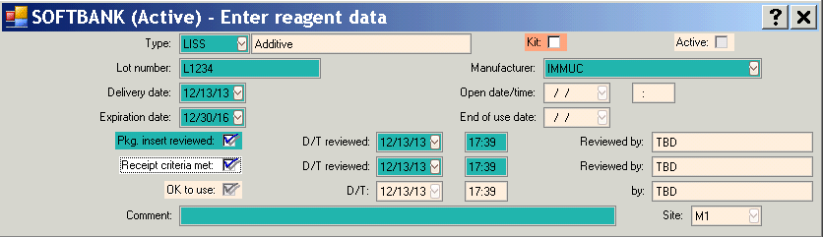
Register Reagents
Access: 4-Results>Quality Control> Reagents>Registration
Register all lot numbers
  Reagents
  Reagent kits

Slide 35
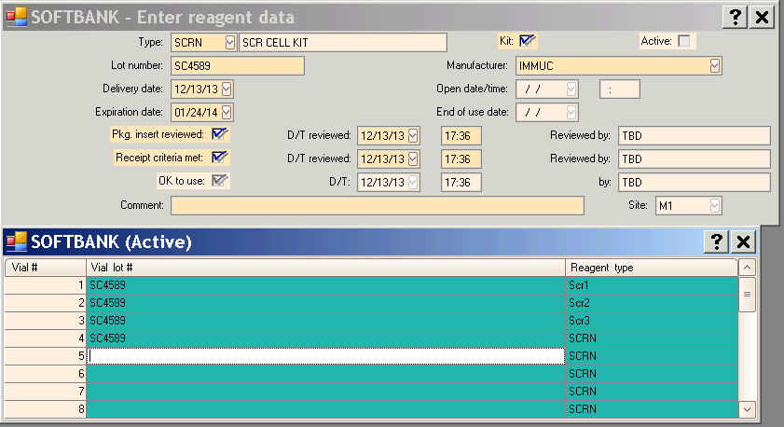
Registering Kits
Registering a reagent kit
  Add all lot numbers in kit
  Include reagent type

Slide 36
Open Reagents
Access: 4-Results>Quality Control> Reagents>Open
Open all lot numbers before use
  Reagents and Reagent kits
Search by lot number
  Click F12 to pull up all unopened reagents
Modify Rack – system will auto open

Slide 37
Enter Results
Access: 4-Results>Quality Control> Results>Edit
Select rack
Enter results

Slide 38
Just one of those quirky things….
IMPORTANT!
Any time you try to add an instruction to a unit, the unit will ask you to change the product. THERE IS NO NEED TO CHANGE THE PRODUCT. Just hit the ‘x’
Soft is looking into this but may be unable to remove
You no longer have to add ‘irradiated’ as an instruction.

Slide 39
OI Issues
Please make a note, If you ever have OI patients for a GT+S or LRC with no previous blood type, always make sure at least a AB2 is ordered.
This helps as a preventative step to in best patient care

Slide 40
FINISH
Thank you!

Slide 41
Part 2

Slide 42
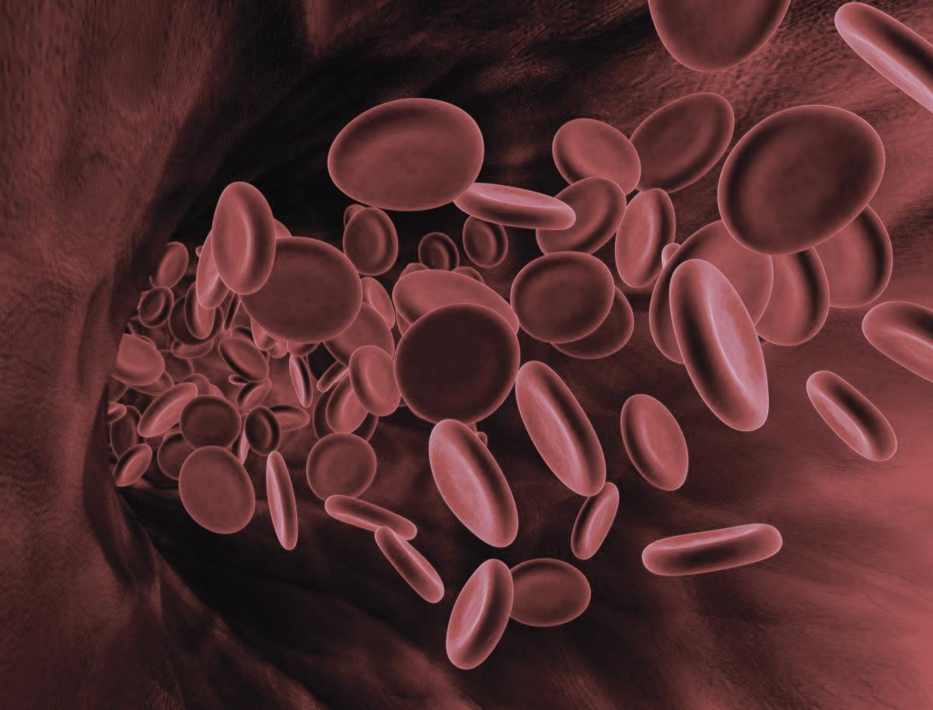
Emergency Blood – Labeling Packaging and Sending of Emergency Issued Blood

Slide 43
Emergency Blood – Labeling Packaging and Sending of Emergency Issued Blood

Slide 44
Please review the following flow chart.

Slide 45
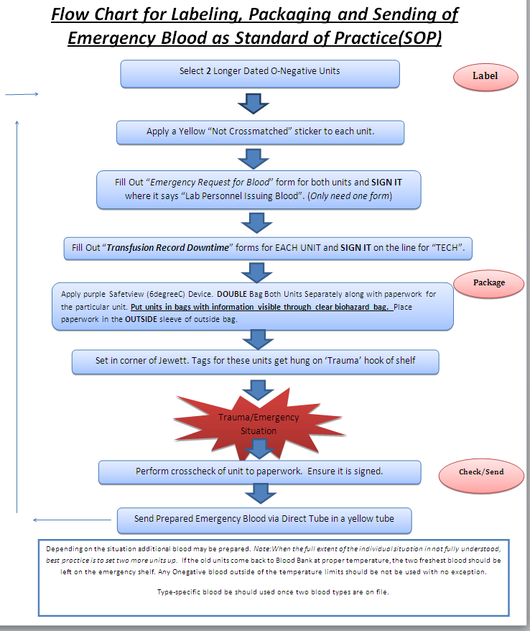

Slide 46
Written Procedure
Standard of Practice for Emergency Blood
A. Labeling
1. Select 2 Longer Dated Units
2. Apply a yellow “Not Crossmatched” Sticker to each of the units
3. Fill out “Emergency Request for Blood” form for both units and sign it where is says “Lab Personnel Issuing the Blood”
a. Only one form is needed for 2 Units of Blood
4. Fill out a “Transfusion Record Downtime Form” for each unit and sign it on the line for ‘TECH’.
B. Packaging
1. Apply a purple SafeTview (6 Degree C) Device. Double bag both units separately along with
paperwork for the particular unit. Put units in bags with information visible through the clear biohazard bag. Place the paperwork on the outside sleeve of the outside bag.
2. Set in the corner of the Jewett. Tags for these units get hung on the “trauma” hook of the shelf.
C. Checks/Sending
1. Perform cross check of the unit to the paperwork. Ensure it is signed.
2. Send packaged blood through the Direct Tube system in a yellow blood bank tube.

Slide 47
Thank You.

