Slide 1
What to do in the case of a CODE PINK.

Slide 2
What qualifies as a Code Pink?
Any time a child* is unresponsive, without a pulse and/or is not breathing, call a CODE PINK. If unsure what to do with an unresponsive child, call a CODE PINK! Remember, we would rather over respond with too much equipment than under respond with not enough.
In the event of CODE PINK that is outside of ER or ASU/Surgery, the Nursing Supervisor or ACT Responder is to bring the Broselow Cart. It may come from 2nd Floor or ASU.

Slide 3
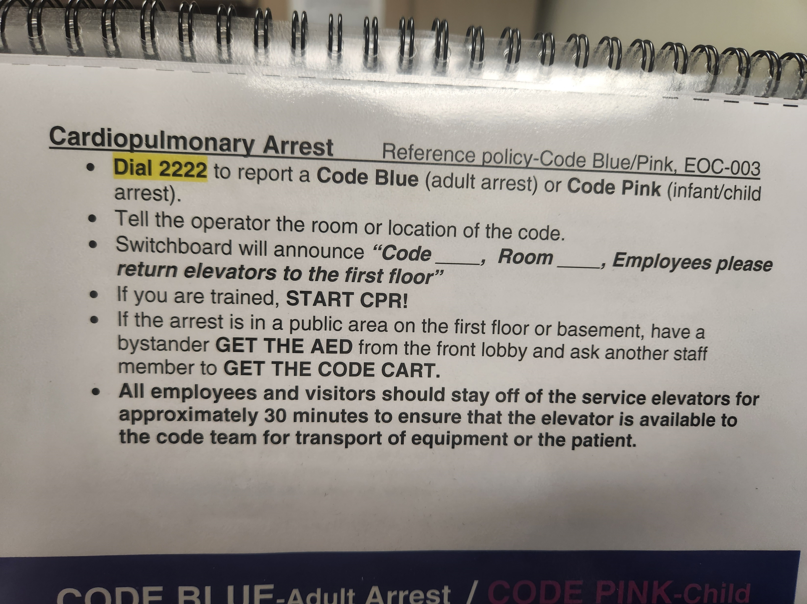
How do I call a Code Pink?
From Safety Flip Chart:

Slide 4
Code Pink Responders & Roles
1st Responder | -Assess patient’s LOC and his CABs: circulation, airway, breathing -Note time -Call for help -INITIATE CPR
2nd Responder | -Dial 2222 to signal operator or communicate clearly to someone to do so -Assist 1st person with CPR -Bring crash cart or delegate other personnel on floor to bring crash cart unless brought from another designated area
Switchboard | -Page “CODE PINK-{location}” over speaking 3 times at 10 second intervals
ED RN | -Bring RSI Kit, IO kit, and Glidescope to all CODE PINK locations
PALS Nurse/ICU, ER, or others | -Acts as Lead nurse role and identifies roles of the Code Response Team -Unlocks crash cart, places on crash cart monitor in Lead II -Ensures correct lead placement, monitor function, runs rhythm strips -Follows American Heart Association Guidelines for Resuscitation -Relays appropriate information to code team using “AMPLE” model -Oversees patient transfer as needed

Slide 5
Code Pink Responders & Roles
Nursing Supervisor/ ACT Responder | -Will bring the BROSELOW CART, with exception to ED and ASU. Should come from 2nd floor or ASU. -Documents on appropriate code sheet according to JTDMH recommendations, using room clock as time reference -Ensures roles of the code response team are identified -Call for assistance as needed from other physicians, pharmacists, electrocardiograph, or lab technicians, and supplies -If most of the nursing staff is tied up with the code, he/she will need to delegate essential care to others who can answer call lights, give medications, and provide family support
Nursing Assistants | -Retrieves needed supplies as directed. Sets up suction. -May assist with CPR if BLS trained -Help move furniture out of room
Lab Personnel | -Should respond to all code situations and perform venipuncture for blood
Physicians/ Advanced Providers | -ED physician and any other available providers in the area are expected to respond to all CODES. -The provider directs the CODE -First physician there becomes charge unless he/she relinquishes it to another physician.
Respiratory Therapist | -Assumes care of airway and manual ventilation -RT to initiate and maintain ETCO2 monitoring device when crash cart arrives
Patient Representative | -Called when available to relay information to the family and assist with their needs

