Slide 1
Blood Culture Collection
New Vision Medical Laboratory

Slide 2
Introduction
Blood is collected and cultured so isolation and identification of microorganisms can take place.
The Blood of a healthy individual is usually sterile. However, microorganisms may be recovered.
The quality of the blood culture depends primarily upon the quality of the skin preparation.

Slide 3
Importance of Proper Collection
The quality of the blood culture depends a lot on the phlebotomy technique.
ANY contaminant picked up from the skin or from the surface of the rubber stopper on the blood culture bottle can be introduced into the blood culture bottle and can produce a false result.
This can lead to the patient being unnecessarily treated.
Also, if a sterile technique is not used to draw, it is possible to introduce a bacteria into that patient’s bloodstream and cause a nosocomial infection (This is an infection acquired in the hospital).

Slide 4
Steps
Properly identify your patient and explain the procedure.
Place gloves on hands.
Apply a new tourniquet.
Select the venipuncture site.
Release tourniquet.

Slide 5
Correct use of the ChloraPrep Applicator
Click Above To Play Video

Slide 6
If the patient is <2 months of age
Cleanse the area first with 70% isopropyl alcohol rubbing in a circular motion.
Start in the center of the proposed venipuncture site and progress outward in ever enlarging circles. Apply firm but even pressure.
Then cleanse the area with Tincture of Iodine prep using the same technique.
Allow the Tincture of Iodine to remain on the area for 2 minutes.
Remove iodine with 70% alcohol to prevent systemic absorption and/or localized skin reaction.

Slide 7
Cleansing Blood Culture Bottles
Flip the plastic tops off the blood culture bottles.
Cleanse the bottle stoppers with 70% Isoprophyl alcohol.

Slide 8
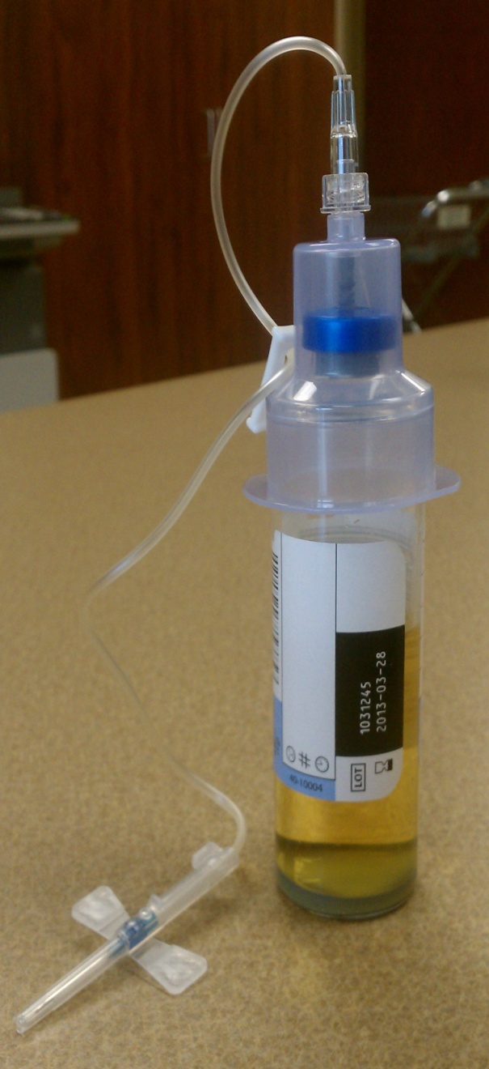
Perform the Procedure
Perform the venipuncture and fill blood cultures with the necessary volume of blood.
Note: If using a butterfly you may fill the bottles directly. The blood culture bottles must be held below the patient's arm with the bottle in an upright position.
Do not allow the liquid media to touch the stopper.
After collection invert the bottles gently to mix.
Label each bottle with the patient date and time of collection and sequence of collection number.

Slide 9
Volume
Adequate volume of blood is critical to the culture results.

Slide 10
Optimal Volume
Age | Volume Needed | Bottles
Adult (>10) | 20 ml. | Aerobic & Anaerobic (10 ml each)
Child (<10) | 1 ml. per year of life | Aerobic Only
Newborn | 1-4 ml | Pediatric Aerobic Only
Use the measuring tool provided to aid in your collection.

Slide 11
Minimum Sample Volumes (Use for Difficult Draws)
Age | Volume | Bottles
Adult (> 10 Years) | 1-10 ml | Aerobic Only
Child (<10 Years) | 1 ml | Aerobic Only
Newborn | 1 ml | Pediatric Aerobic
***If the patient is a difficult draw it is more important to adequately fill
the Aerobic bottle rather than trying to collect both bottles.

Slide 12
Antibiotics
Write antibiotic (If any) on the voucher or bottle.
Take the specimens and voucher to Specimen Processing for immediate processing.

Slide 13
Collection Intervals
If the physician does not specify collection intervals, blood cultures should be drawn from alternate sites 5 minutes apart.
When blood cultures are ordered times two 5-15 minutes apart, if the first venipuncture is unsuccessful, any subsequent successful venipuncture may be used to collect the entire volume of blood to be divided between the two cultures. Documentation must accompany the specimen.
If a physician orders more than two sets of blood cultures in a 24 hour period a Pathologist must be notified for approval.

Slide 14
Blood Cultures drawn off Lines
This is Nurse collect only.
The Nurse draws 10 ml of blood to be discarded before inoculating the blood culture bottle.
When blood is drawn off a line for Blood Cultures the specific port must be documented. (Example: Brown, Red, Green)

Slide 15
Blood Culture Collection
New Vision Medical Laboratory

