Slide 1
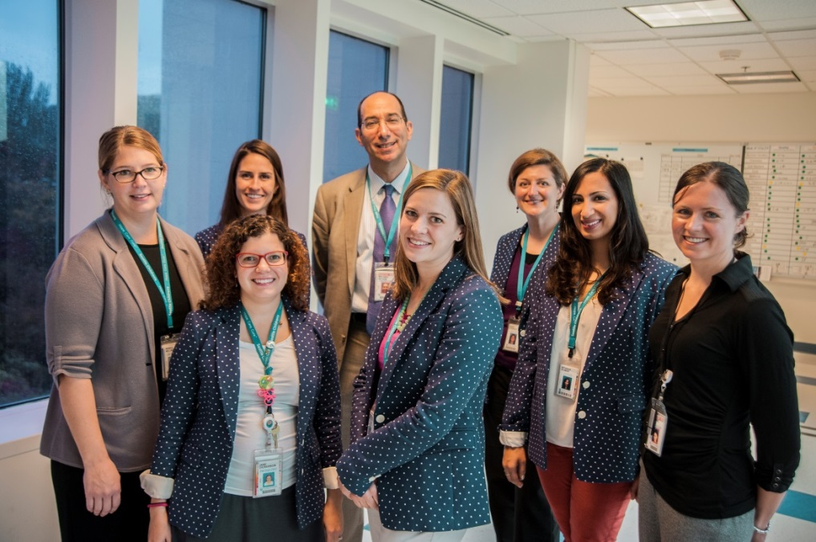
Send-out-omics: Identifying & Mitigating errors in Diagnostic Testing
Seattle Children’s Faculty
Michael Astion, MD, PhD
Jane Dickerson, PhD
Bonnie Cole, MD
Stephanie Wallace, MD
Rhona Jack, PhD
Joe Rutledge, MD
Patrick Mathias, MD, PhD
Business Operations
Nitasha Kumar
Monica Wellner
Lisa Wick
Joanne Simpson
Lab Genetic Counselors
Jessie Conta
Darci Sternen
Shannon Stasi

Slide 2
Send-outs-omics
“Omics” = Study of many constituents considered collectively
  Pre-analytical: Provider orders test, sample collection, sample transport
  Analytical: Not our lab
  Post-analytical: Result entry, result acknowledgement
Notes:
While it is less technologically fancy than some of the other things happening in the lab, like the new rapid flu tests or identifying organisms with MALDI-TOF MS, it IS cutting edge work and is important for patient safety. I’m hoping that by giving this field due deference by promotion in title to “send-out-omics”, it will follow in the footsteps of the other “omics” (genomics, proteomics, metabolomics) and start a world wide trend and increased funding.

Slide 3
Objectives
Identify challenges related to interpreting and processing test orders that contribute to diagnostic error
Evaluate the patient safety risks related to variable processes of entering test results
Design pre and post-analytical workflows for optimal lab test coordination

Slide 4
Diagnostic error
“an accurate and timely explanation of a patient's health problem”
Estimated to reach 5% of outpatient visits in the U.S. (12,000,000)
Significant portion of diagnostic errors are associated with the testing process
  Test Selection
  Test Interpretation
  Test Retrieval
National Academics of Science Engineering, Medicine. Improving diagnosis in healthcare. Washington, DC: The National Academies Press; 2015.
Singh H, Meyer AND, Thomas EJ.BMJ Quality & Safety 2014.
Singh H, Giardina T, Meyer A, et al. JAMA Internal Medicine 2013;173:418-425.

Slide 5
The Send-outs Problem
Send-out tests include all clinical lab tests which are sent to other clinical labs
SCH lab sends to >100 labs; 20% of send-outs are genetic tests
Nationally, testing is increasing at a rate of ~15-20%
Biggest growth is in proprietary, overbundled tests
Motivation to improve lab use is to ↑value of lab tests to patient and society

Slide 6
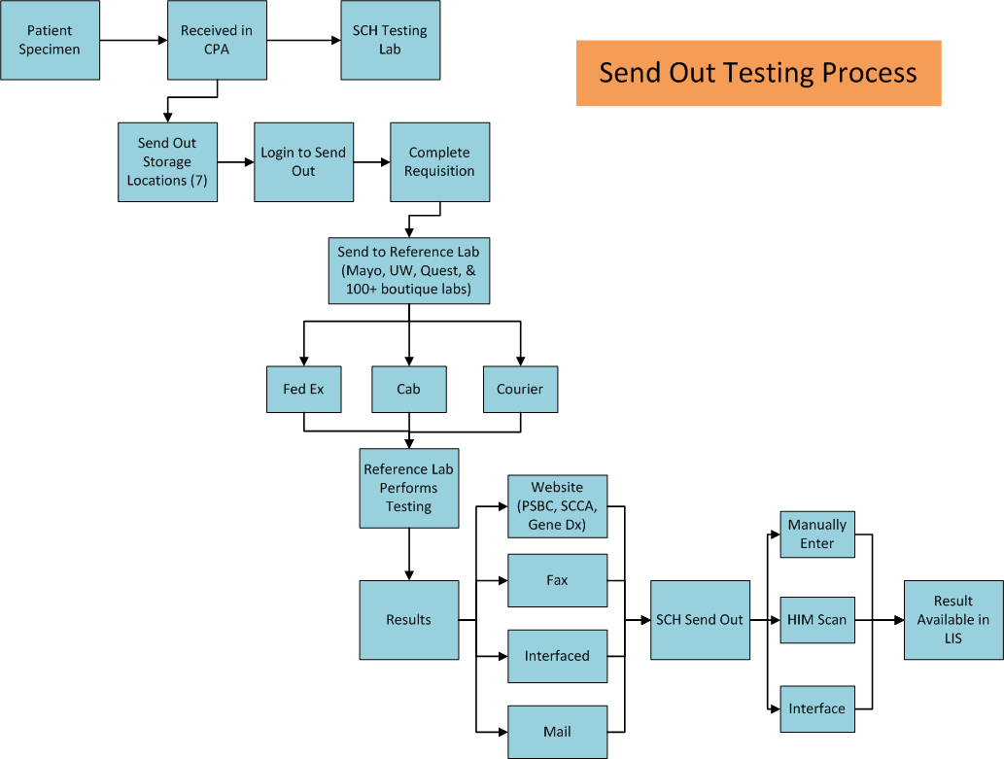
UW has 5 testing locations and misrouting occurs frequently
Pre-analytic
Analytic
Post-analytic

Slide 7
Pre-analytic
Analytic
Post-analytic

Slide 8
Test Selection
Approximately what % of orders are entered electronically by the clinician or designee, e.g. CPOE?
How is test selection by clinicians facilitated?
  Customized order templates or order sets
  Consultative services by lab personnel or reminders or prompts based on patient history
  Algorithms, guidelines, clinical pathways
  None of the above
Clin Chim Acta. 2014 Jul 1;434:1-5

Slide 9
Case Example
12 y/o boy admitted with hyperparathyroidism, bilateral renal stones and hydronephrosis, chronic constipation, parathyroid adenoma
Resident on-service is told to order genetic testing for MEN2 syndrome
Submits a miscellaneous request for:
“send ret testing”
Lab staff look up “ret” in test catalog and find Rett Syndrome

Slide 10
Reduction of Miscellaneous Tests
Number of Unique Miscellaneous Tests
Months (Sept 2011 to Aug 2012)
Notes:
Miscellaneous volumes have decreased by 40%

Slide 11
Miscellaneous growth over time
Jan 2014
Jan 2015
# Unique MISC Tests
Jan 2013
Months (Sept 2011 – Jul 2015)

Slide 12
Sample processing
Do you maintain a dedicated space to process send-out samples?
What is the least amount of time any employee processing send-out samples will do this activity?
How often are you notified by a referral lab that a test cannot be performed due to a sample issue?
How often are you notified that a send-out test cannot be performed because the sample was not received within an allowable time?
When a send-out specimen is lost, do you have a tracking system that lets you know at which stage it was lost?

Slide 13
Case Example
Newborn baby admitted with fever and rule out sepsis, including HSV
Testing for HSV PCR in blood and CSF was ordered
Results expected following day by care team, but were not received until 2 days later
This delay prolonged patient discharge by > 12 hours. Patient received at least 2 additional doses of Acyclovir, a potentially nephrotoxic drug, while awaiting test results.

Slide 14
Current Schedule
Log-in times
Package times
Pick-up times
UW (1)
10:20
Overnight
15:00
ARUP
15:20
Quest
16:30
UW (2)
17:00
Mayo
20:00
HSV Run Time
Sendouts Start Shift Time
8:00
UW (1)
Mayo
10:00
Overnight
14:15
Quest
ARUP
15:00
UW (2)
Mayo
15:45
Sendouts End Shift Time
17:00
Log-in
8:30
Log-in
12:00
Log-in
15:30

Slide 15
UW HSV Specimen Draw Times: May 2014 - July 2014
00:00 - 5:00
15:00 - 24:00
 | May | June | July
Number of specimen 1500-500 (per month) | 98 | 117 | 156
Number of specimen between 1500-500 (per day/per month) | 3.16 | 3.90 | 5.03
Total UW HSV specimen (per month) | 160 | 217 | 271
Percent of total specimen drawn between 1500-500 (per month) | 61.3% | 53.9% | 57.6%
Notes:
2 hours after draw time
**Note**
14:00-18:00 chosen because Mayo packaged at approximately 16:00 by Sendouts.
Specimen picked up by mayo at 20:00.
All specimen between 14:00-18:00 are not sent out on that day.

Slide 16
Solution:
(1) CPA completes all packaging and log-ins after 15:00
(2) Move morning UW pick-up to 07:15 (change Sendouts wet bench shift start)
Log-in times
Package times
Pick-up times
Changes in wet bench duties
UW (1)
7:15
Overnight
15:00
ARUP
15:20
Quest
16:30
UW (2)
17:00
Mayo
20:00
Sendouts
Wet Bench Start Shift Time
6:15
UW (1)
6:45
Overnight
14:15
Quest
ARUP
15:00
Quest
16:00
UW (2)
16:30
Mayo
19:00
Sendouts Wet Bench End Shift Time
15:00
Log-in
6:30
Log-in
13:45
Log-in
15:30
Log-in
18:30
Completed by CPA employee

Slide 17
Utilization Management
How often do you actively manage and intervene in test utilization?
Who determines the rules for implementing utilization management?
How are the utilization management rules enforced?
How often is a test delayed due to the review process?
How often are orders cancelled or modified as a result of UM review?

Slide 18
SBAR: 1,25 Dihydroxyvitamin D Intervention
Situation: Retrospective chart review found 68% of the 1,25 Vit D were ordered in error and 25-OH Vit D was the intended test.
Background: 1,25 Dihydroxy Vit D is common send-out with > 300 tests/yr
Assessment: Ordering the wrong test is not good for patient care, and can result in wrong assumptions about nutritional status.
Recommendation: Email template describing the use of the two Vit D tests, and asking if provider wants to cancel and change order to 25 Vit D.

Slide 19
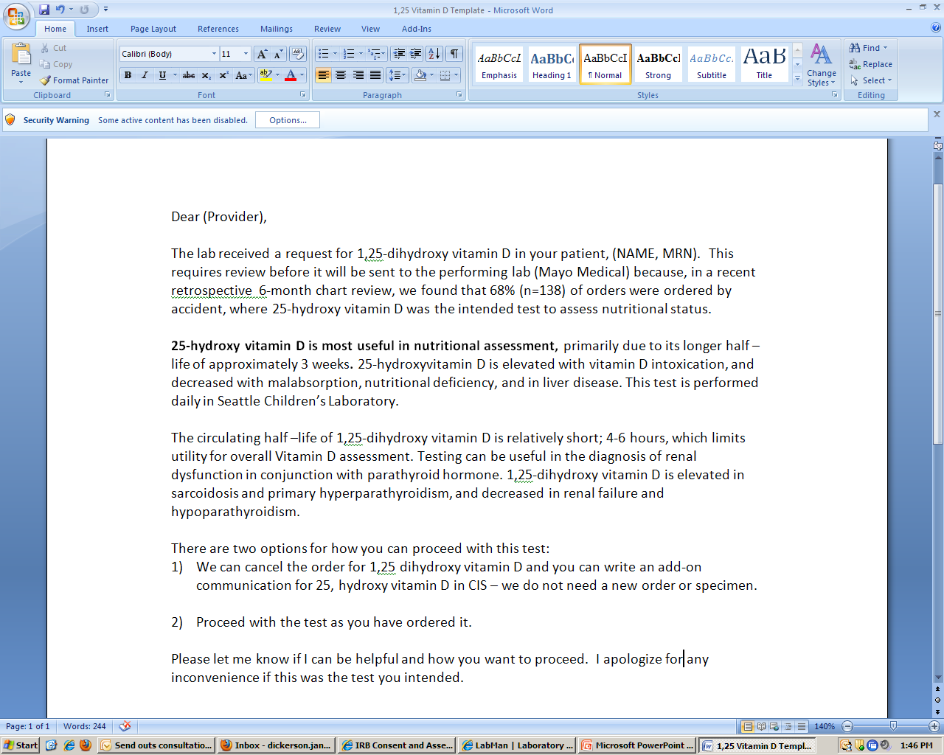
1,25 Vitamin D Intervention
The lab received a request for 1,25 dihydroxy vitamin D on your patient
In our lab, we found that this is ordered accidentally 68% of the time.
Utility of 25- Vit D vs. 1,25 Vit D
Two options:
Cancel and add-on 25-OH Vit D
Proceed with original order
Dickerson J, Cole B, Jack R, Astion M. Another laboratory test utilization program: our approach to reducing unnecessary 1,25 Vitamin D orders with a simple intervention. Am J Clin Pathol. 2013. 140(3):446-7.

Slide 20
Effect of an email to doctors on Vitamin 1,25 D orders
(2012-2013, 7 months)
Intervention
After intervention:
58% (n=134) of the 1,25 Vit D orders were changed to 25 Vit D.
1,25 Vit D now <10 /mo
Privileging added
Dickerson J, Cole B, Jack R, Astion M. Another laboratory test utilization program: our approach to reducing unnecessary 1,25 Vitamin D orders with a simple intervention. Am J Clin Pathol. 2013. 140(3):446-7.

Slide 21
Doctors Love the 1,25 Vitamin D Intervention
“Thank you so much for the email. You are correct I wanted 25-hydroxy. I will cancel and reorder.”
“Thanks so much for your help (and education.) You are exactly right—please cancel the order of 1,25 and I’ll add on for 25 hydroxy. ”
I am not making these up.
Notes:
Privileging

Slide 22
Privileging
“Dear Seattle Children’s Send-out Team,
I’ve created a list of our privileged providers who do not need to be contacted regarding ______ orders. Simply, send these tests out. ”

Slide 23
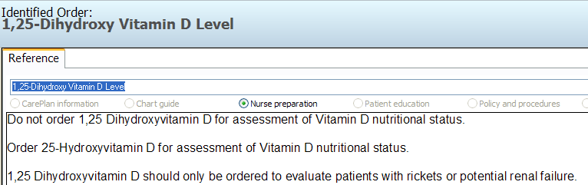
Implementing “IT” intervention
Intervention 2: Changed names in Cerner to “Vitamin D, Bone Disease/Renal Disease” and “Vitamin D, Nutritional Status”
Intervention 3: Pop-up

Slide 24
Plan-Do-Check-Act your interventions.
Name Change Feb. 10
Pop-up
Intervention held
Hid Test

Slide 25
Case Example 2
12 y/o inpatient with hypoglycemia secondary to hyperinsulinism and associated seizures evaluated by Endocrinology
Genetic testing recommended to work up possible genetic etiology vs. insulinoma
Requested concurrent analysis of 8 genes including “GLUT-1”
Error caught on review by utilization management GC
GLUT-1 (glucose transporter type-1)
SLC2A1 gene
De Vivo disease
Order
Modified
GLUD-1 (glutamate dehydrogenase-1)
GLUD1 gene
Hyperinsulinemic hypoglycemia
Notes:
I’ll start off with a case. A 12 y/o has recurrent episodes of hypoglycemia determined to be secondary to hyperinsulinism and experiences seizures associated with these episodes.
He’s evaluated by Endocrinology, who recommends genetic testing to rule out a genetic cause, and a concurrent analysis of 8 genes, including GLUT-1 is requested
The order is reviewed by a laboratory genetic counselor, who then catches a test order error.
The provider ordered GLUT-1, a gene associated with De vivo disease, which is developmental disorder associated with infantile seizures, but intended to order GLUD-1 testing, which is associated with hyperinsulinemic hypoglycemia
The testing turned out to be negative and the patient is still being worked up. In the setting of ruling out the genetic cause for the patient’s symptoms, if the order had been completed as ordered, the clinician would not have actually ruled out such as cause for the disease.

Slide 26
What harm does poor utilization cause?
INCREASED COST WITHOUT INCREASED VALUE
  Patients receive large (unexpected) bills
  Increased societal cost
INCREASED RISK OF FALSE POSITIVES
  Increased worry and associated harm
  Especially in low prevalence populations
INCREASED RISK OF FALSE NEGATIVES
  Falsely reassuring when the wrong test is ordered
Lewandrowski K. Managing utilization of new diagnostic tests. Clin Leadersh Manag Rev. 2003 Nov-Dec;17(6):318-24.
Notes:
One significant harm to patients and their families, I’ll argue, is unnecessary financial liability.
In many cases, the bills unexpected financial liability
False + much > then false -

Slide 27
Methods for guiding or restricting lab testing
Gentle
Posting of guidelines on the requisition
Computerized reminders regarding utilization guidelines
Medium
Utilization report cards
Strong
Privileging
Utilization report cards with peer or leadership review
Requirement for high level approval (e.g. Pathologist) or consultation (e.g. genetic counselor)
Rules Requirement
Changes to manual requisition or CPOE
Send-outs formulary
Gentle Guidance
Strong Guidance
Solomon DH et al. Techniques to improve…use of diagnostic tests. JAMA. 1998; 280:2020-2027.
Calderon-Margalit et al. An administrative intervention to improve the utilization of laboratory tests within a university hospital International Journal for Quality in Health Care 2005; 17(3): 243–248
Notes:
Strongest = testing restrictions and peer pressure
Interventions must remain or behavior drifts back
Best to combine > 1 intervention
- So that is what we did, we created a formal rotation of doctoral level consultants to review orders, and we hired a genetic counselor for the lab, and she is here now to talk more about this process.

Slide 28
Results Reporting
What methods are used to receive send-out results from the referral lab?
How often are you aware that an interface to any of your referral labs go down?
What % of send-out results are provided to providers by electronic access (e.g. EMR)?
For interfaced results, how frequently have you had reports by providers of result misinterpretations due to result formatting issues in EMR or scanned documents?

Slide 29


Results are Back
Check for duplicate entries
Scan to PDF
Use OCR to transfer to EMR
Notes:
80% of the results are interfaced (because they go to our two major reference labs) – the remainder, and a significant portion of these are long, complex reports, come to us in a variety of ways:

Slide 30

Test was ordered, now where are the results?
Problem: You’ve ordered an expensive genetic test, you’re patient has footed the large bill, it’s been over 4 weeks and you finally get the result…but you can’t (find it, read it, understand it) because it has been hand-entered in the patient record.
Notes:
The remaining 20% of manually entered results can cause significant confusion because of the how the result is displayed in downstream systems.

Slide 31
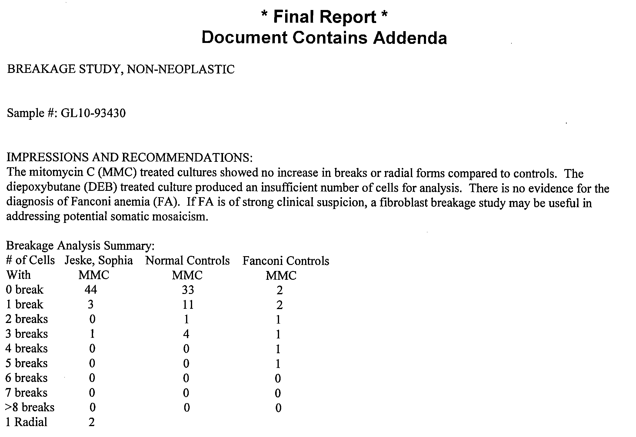
Error Example
Before
Fanconi Anemia result incorrectly transcribed as abnormal instead of normal.
Notes:
Fanconi anemia is a genetic condition that has defect in DNA repair genes – so these patients are predisposed to develop bone marrow cancers

Slide 32
Intervention 4: Resolution
After
New PROCESS:
Check for duplicate records
Complete an official result form
Take results and forms to Hospital Information Management (2 floors down)
  3x day
  Scanned within 4 hours
Differentiates results from outside labs which were not ordered by children’s hospital
Notes:
“Non-Seattle Children’s Data”

Slide 33
Additional Intervention Tool: Dashboard
Month | Corrected Report Goal=<0.20% | # Of Manual Reports Left Overnight Goal = <5%
May '11 | 0.14% (3/2202) | 7.80%
June '11 | 0.13% (3/2251) | 3.41% (23/674)
July '11 | 0.20% (3/2025) | 1.47% (6/613)
Aug '11 | 0.01% (2/2428) | 4.03% (33/818)
Sept '11 | 0.14% (3/2178) | 4.02% (28/696)
Oct '11 | 0.13% (3/2303) | 1.86% (13/698)
Nov '11 | 0.05% (1/2133) | 2.20% (14/635)
Dec '11 | 0.04% (1/2328) | 0% (0/681)
Jan '12 | 0.14% (3/2193) | 0.46% (3/646)
Feb '12 | 0.04% (1/2504) | 3.91% (29/741)
March '12 | 0.11% (3/2576) | 0% (0/756)
April '12 | 0.04% (1/2300) | 2.46% (18/733)
Notes:
We use another tool to monitor the success or progress of the intervention, a visual dashboard which tracks the number of corrected reports (transcription errors) and number of results left overnight (TAT). Since we’ve implemented the scanning system, we have seen our TAT go down and corrected reports remain low.

Slide 34
1 Month Internal Study with Send-Outs
Summary | Number
Total Results | 1254
Abnormal | 281 (22%)
Unacknowledged | 127 (45%)
Avg TAT to complete | 6.9 days
Median TAT to complete | 2.8 days
45% of ABNORMAL results not documented in medical record after 90 days

Slide 35
Potential Harm Cases
Mutation in connexin 26 gene result: delayed diagnosis 84 days, which explained cause of deafness in child.
Positive anti-phospholipids (Lupus): failure to treat due to delayed diagnosis 30 days
Thyroglobulin being monitored for thyroid cancer recurrence: potential failure to treat if it had been high (in this case, it was appropriately low.)

Slide 36
How do we monitor the interventions? Quality measures.
Volume of miscellaneous entered test orders
Volume of results/orders left un-entered after 8 hrs
# or % of samples that miss pick-up (or run) time
% results not retrieved or acted on by care team
Laboratory test volume by analyte
Utilization management impact (e.g. % orders modified)
Measures of sample quality (e.g. mislabels, QNS, etc)
Corrected result rate

Slide 37
Checklist to Improve Send-outs
Preanalytic
Establish computer interfaces to major reference labs.
2. Consolidate to as few reference labs as possible.
3. Establish a call center to answer provider questions.
4. Get the specimens out the door as quickly as possible.
5. Implement active test utilization management.
6. Define as many tests as possible in the LIS.
7. Adjust in-house test menu as needed.
Dickerson, et al. Clinical Laboratory News 2012: 38(4). http://www.aacc.org/publications/cln/2012/april/pages/default.aspx#
Notes:
We have a grant with the AHRQ to develop a checklist to mitigate patient safety risks in send-out testing. The idea is that this checklist can be filled out by any hospital lab to give them an assessment for where they stand in terms of send-out safety risks. The items on the list cover preanalytical issues– like “do you have an active test utilization management program?” “do you have a call center to answer provider questions?” as well as the topics that Dr. Astion will cover, “can you reduce send-outs by bringing testing in?”

Slide 38
Checklist to Improve Send-outs
Postanalytic
8. Establish computer interfaces as much as possible.
9. Have a system to ensure physician acknowledgement of results.
10. Develop quality metrics to ensure the other nine areas are in control.
Dickerson, et al. Clinical Laboratory News 2012: 38(4). http://www.aacc.org/publications/cln/2012/april/pages/default.aspx#
Notes:
The checklist also covers the postanalytical areas that I talked about, including interfacing as many results as possible, developing a system to ensure result acknowledgement, and use quality metrics like our dashboard to ensure that everything is in control.

Slide 39
In Conclusion: Create Standard Practice
Dedicated staff
Reduce Manual Processes
  Consolidate reference labs
  Interface
  Build/define tests in LIS
Measure!
  Visual tracking board

