Slide 1
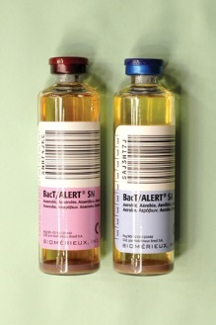
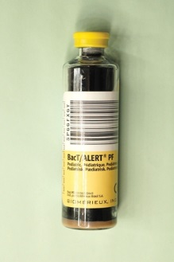
Importance of Blood Culture Volumes

Slide 2
Did You Know?
The volume of blood collected for each blood culture set is the single most important variable in recovering microorganisms from patients with Bloodstream Infections.
When the volume of blood was increased from 2 to 20 ml, the yield of positive cultures increased by 30 to 50%.
In infants and young children, blood cultures with greater than 1 ml of blood detected more bacteremias than blood cultures with less than 1 mL.
SO…. How can we increase our blood culture volumes?

Slide 3
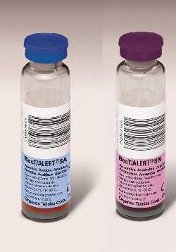
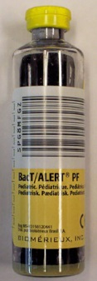
First, lets look at the minimum and maximum blood volumes required according to our procedure SPCL - 208
Adult: 10 mL drawn into one (1) aerobic and 10 mL drawn into one (1) anaerobic bottle (minimum of 5 mL / maximum of 10 mL per bottle)
Children < 20 kg (45 lbs) : 1-4 mL drawn into one (1) pediatric bottle (draw approximately 1 mL per year in age)
Children 20-40 kg (45-88 lbs): 2-4 mL drawn into one (1) pediatric bottle. Collect two pediatric bottles (minimum of 1mL / maximum of 4 mL per bottle).

Slide 4
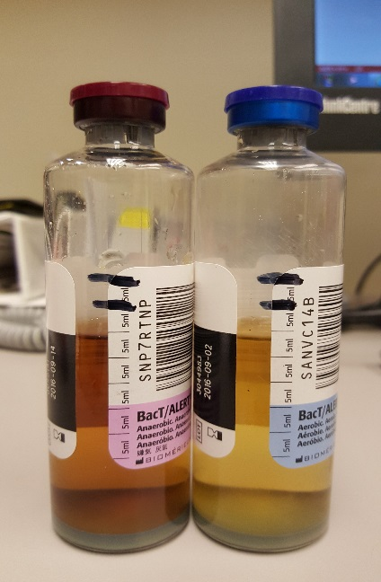
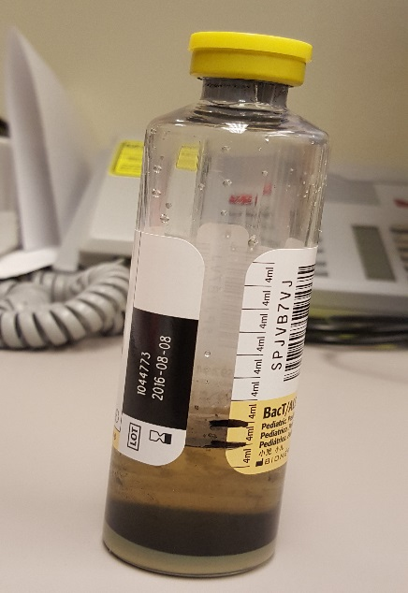
Now that we know how much we need to collect…… How do we ensure we collect this amount in the patient’s blood culture bottle?
The side of each adult blood culture bottle is marked in 5 mL increments (the pediatric bottles are marked off in 4 mL increments). Prior to collection the bottle should be marked to indicate the minimum and maximum volumes required.
By marking the blood culture bottles with the minimum and maximum marks we can ensure we get the right amount of blood!!!
Maximum
Minimum
Maximum
Minimum

Slide 5
So, Why are Minimum and Maximum Volumes so Important?
As previously stated, the volume of blood collected for each blood culture set is the single most important variable in recovering microorganisms from patients with Bloodstream Infections.
Do not OVERFILL or UNDERFILL blood culture bottles. Only collect the minimum and maximum volumes according to your patient type.
Furthermore, bloodstream infections aka Sepsis can be DEADLY!!!
It kills more than 258,000 Americans each year
leaves thousands of survivors with life-changing after effects.
According to CDC, there are over 1 million cases of sepsis each year
it is the ninth leading cause of disease-related deaths.

Slide 6
Keypoints To Remember:
The volume of blood collected in each blood culture volume is the single most important variable to recovering microorganisms causing a bloodstream infection.
Do not overfill or underfill blood culture bottles but collect at least the minimum and not above the maximum for each patient type.
Adults: minimum is 5 mL and the maximum is 10ml for each bottle collected
Children < 20 kg (45 lbs) : The minimum is 1 ml and the maximum is 4 ml drawn into one (1) pediatric bottle (draw approximately 1 mL per year in age)
Children 20-40 kg (45-88 lbs): Collect 2 pediatric bottles with the minimum amount of blood collected is 2 ml and the maximum is 4 mL per bottle.
Minimum and Maximum volumes can be easily obtained if each bottle is marked at the minimum volume allowed and the maximum volume allowed before the patient is drawn.
Minimum and maximum volumes are important to quickly recover the microorganism causing the patient’s bloodstream infection which can be DEADLY!!

Slide 7
Quiz:
What is the minimum and maximum blood culture volumes to be drawn on a patient 45 years old?
The phlebotomist collect 0.5 ml on the newborn. According to our procedure was this enough blood volume collected?
To ensure the proper blood culture volume level is collected, mark the minimum and maximum level of the bottle before the patient is drawn? True or False?
The amount of blood drawn is directly related to the increase detection of positive (growth of microorganisms) blood culture bottles? True or False?
Based on this presentation wouldn’t you want the person collecting one of your family member’s blood culture specimen to collect the proper amount?

