Slide 1
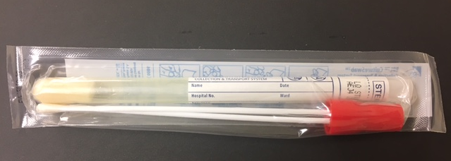
ATTENTION NURSING STAFF
WOUND, TISSUE & ABSCESS CULTURES
NEW ORDERS AND SAMPLE TYPES
Effective Date:
June 6, 2017
The microbiology lab will streamline the ordering process for wound, tissue, and abscess cultures.
Old Name | New Name | New Lab Order Number*
Wound Culture | Aerobic Culture | LAB9435
Tissue Culture | Aerobic/Anaerobic Culture | LAB9434
Abscess Culture | Aerobic/Anaerobic Culture | LAB9434
*See Tips and Tricks for Inpatient Lab Culture Order Changes
Aerobic: Required Swab
Aerobic/Anaerobic: Required Swab
Aerobic Culture
Contact Information: Jeff Beaman, Manager of Microbiology, at jeff.beaman@conehealth.com or 336-832-8389.

