Slide 1
Dry Ice Safety Training

Slide 2
Purpose
CAP has given new requirements for labs handling dry ice.
CAP now require policies, practices, and training documentation for employees
New Policy- Dry Ice Safety and Shipping
SDS is available in SiteHawk
Training is provided to all employees on a one time basis and will be added to the new employee orientation.

Slide 3
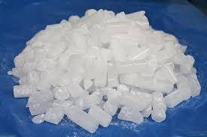
Dry Ice Properties
The solid form of carbon dioxide
Sublimates into gas at -78.5°C or higher
Used in the laboratory for shipments that must remain frozen
Preferable over wet ice due to lower temperatures and does not leave behind residue.

Slide 4
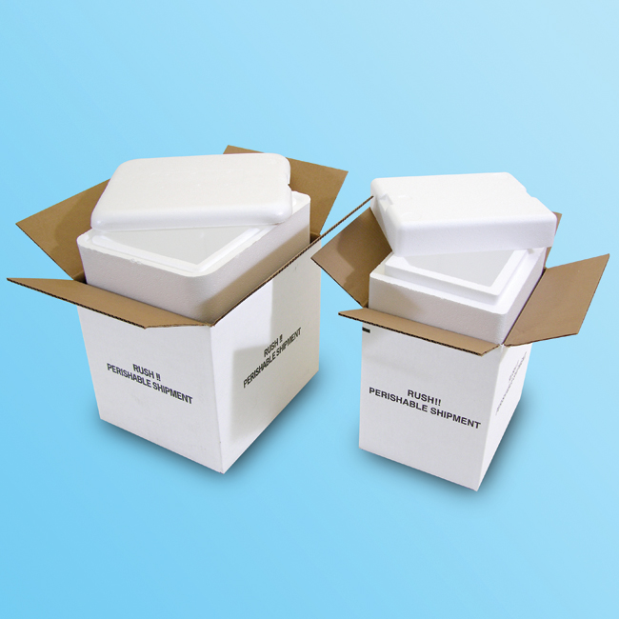
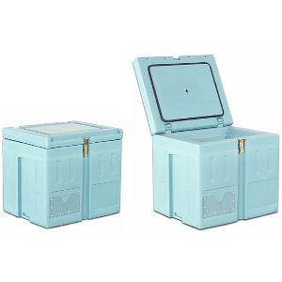
Dry Ice Storage
Must be stored in a well ventilated area to allow vapor dispersion
Must be kept in an insulated cooler or box
Can damage tile or laminate surface by destroying adhesive
Labeled container must not be sealed to allow proper ventilation
Never store in confined area such as walk-in refrigerator or rooms with no ventilation

Slide 5
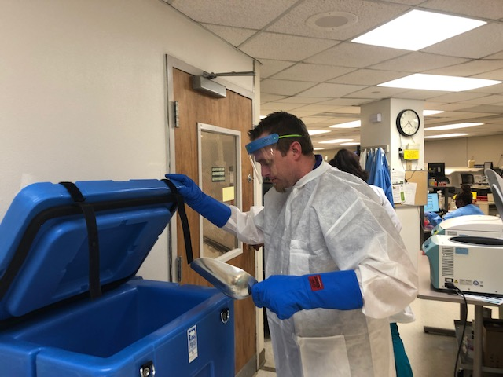
Dry Ice Handling
NEVER touch dry ice without appropriate PPE
Cryogenic gloves must be worn while handling dry ice
Face shield or safety goggles must be worn
Impermeable lab coat must be fully closed and buttoned

Slide 6
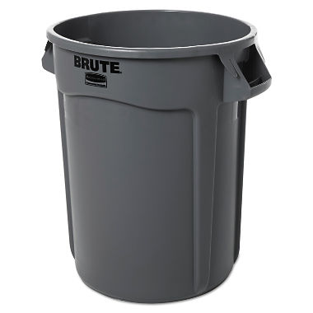
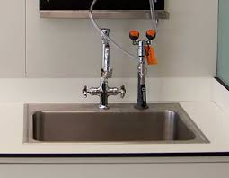
Dry Ice Disposal
Unused dry ice should be allowed to sublimate within the insulated container while in a well ventilated area
NEVER dispose of dry ice in a sink, toilet, trashcan, or other receptacle

Slide 7
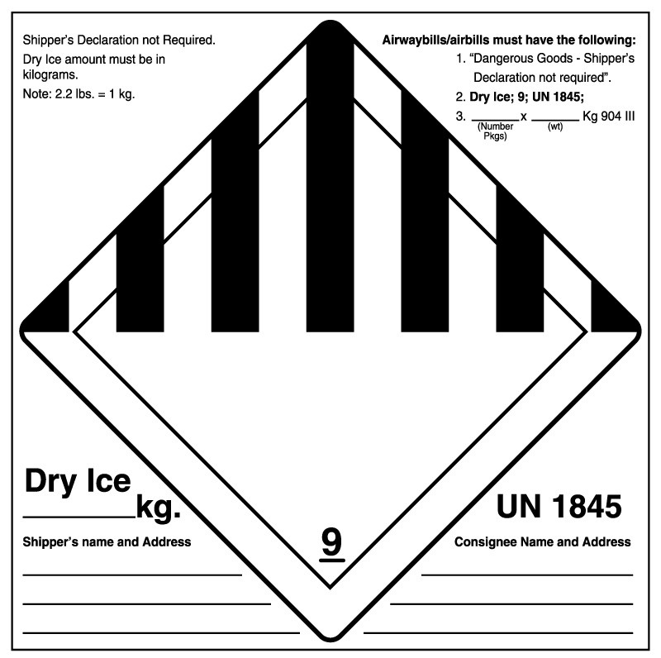
Dry Ice Usage
Dry ice has various uses within the laboratory, mostly for shipping
Dry ice should always be placed in insulated containers
Proper dry ice shipping labels must be affixed to the outside of the container
Shipping container must never be sealed so that gas can escape
Refer to Dry Ice Safety and Shipping procedure for appropriate shipping instructions

Slide 8
Dry Ice First Aid
Upon direct exposure, remove unnecessary clothing that is not frozen to the skin
Do NOT rub frozen body parts because further tissue damage can occur
Place the affected body part in warm water(not above 40°C)
Do no use dry heat
Seek medical assistance as soon as possible

Slide 9
References
Dry Ice Safety. Safety in Laboratories. The University of Vermont. http://www.uvm.edu/safety/lab/DryIce. Accessed 10/12/2018.
OSHA Quick Facts: Laboratory Safety Cryogens and Dry Ice. Occupational Safety and Health Administration Website-https://www.osha.gov/Publications/laboratory/OSHAquickfacts-lab-safety-cryogens-dryice.pdf. Reviewed October 2011. Accessed 10/10/2018.

