Slide 1
Cone Health Laboratories
Latex Sensitivity Training

Slide 2
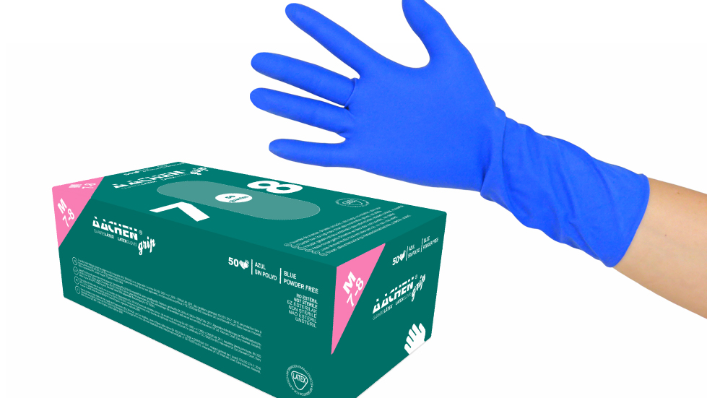
Why?
CAP mandates that employees receive education and training on latex allergies/sensitivities

Slide 3
Types of Latex Sensitivity Reactions
Irritant Contact Dermatitis- Most common reaction to exposure to latex products. This includes the development of dry, itchy, irritated areas of the skin. This is not classified as a true latex allergy.

Slide 4
Types of Latex Sensitivity Reactions
Allergic Contact Dermatitis- This results from exposure to certain chemicals used in the harvesting, processing, or manufacturing of latex products. A rash similar to poison ivy will appear 24-48 hours after exposure and may produce oozing skin blisters or spread away from the contact point.

Slide 5
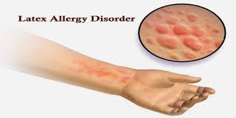
Types of Latex Sensitivity Reactions
Latex Allergy- The most serious form of reaction. Reactions usually occur within minutes of exposure. Can result in skin irritation, hives, runny nose, itchy eyes, difficulty breathing, and in rare cases, shock.

Slide 6
Diagnosing Latex Sensitivity
Latex allergy/sensitivity should be suspected if anyone develops any sort of reaction after exposure to latex containing products.
Any employee who experiences any type of reaction after exposure to latex should immediately report their reaction to Health at Work and complete a Safety Zone Portal (SZP).
After an initial reaction, the individual is more likely to have a more serious reaction if repeated exposure is experienced.

Slide 7
Latex Sensitivity Treatment
Early detection of latex allergy/sensitivity is crucial to preventing more serious reactions.
Special precautions must be taken once an individual is determined to have latex allergies/sensitivities.
These precautions include prevention of exposure and in some cases, medication may be necessary.

Slide 8
How Cone Health Prevents Exposure
Cone Health Corporate Policy: Latex Sensitivity / Allergy
All products utilized within Cone Health facilities are reviewed for latex-free alternatives.
When feasible, Cone Health will chose the latex-free option.
All non-sterile gloves within Cone Health are latex-free. All sterile gloves are latex-free or latex-safe (meaning they have minimal amounts of latex) depending on the clinical situation.
In the event staff or patients have a known latex allergy, only latex-free options will be used.
All staff are evaluated by Health at Work for latex allergy/sensitivity during the post-offer hire screen.

