Slide 1
ACTH Stimulation Test
What you need to know…

Slide 2
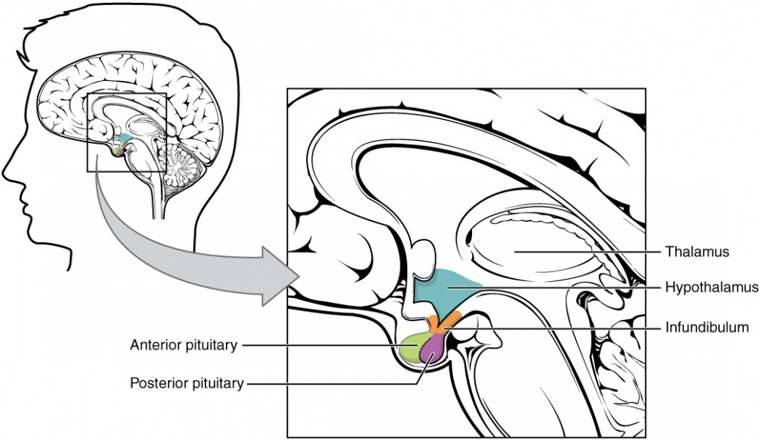
What is it?
The ACTH stimulation test measures
a how well a patient’s body responds
to certain hormones.
These hormones are needed to trigger
the body’s response to other hormones
needed to regulate the body.
We can simulate this process by injecting
the patient with ACTH.

Slide 3
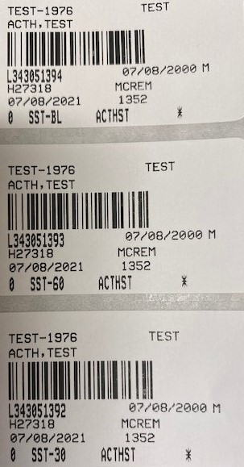
What do I need?
3 separate draws are needed for this test.
DO NOT draw all at the same time.
Container type: SST

Slide 4
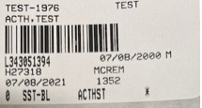
What do I need to do?
Before you draw the BASELINE (draw #1), notify the nurse you are scheduled to begin the ACTH Stimulation test.
Note: this is critical because the ACTH injection must be acquired
by the pharmacy.

Slide 5
Once the nurse has been notified,
Draw the BASELINE (pre-injection) SST tube.
Be sure to document on the tube as well as the ACTH Stimulation Test Collection Time form.
Print a copy of the form from Sharepoint. SPCL-4020F-CH ACTH Stimulation Test Collection Time.
Complete the form completely
(patient info, collection time,
initials, etc.)

Slide 6
Nurse administers the injection…

Slide 7
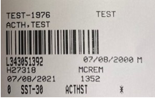
Promptly 30 minutes after the injection, draw SST #2. Be sure to record the time on the tube AND the Collection Time form.

Slide 8
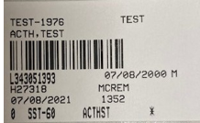
Promptly 30 minutes later…
Draw SST #3. Record collection time on the tube AND on the Collection Time form.
NOTE: this is a TOTAL of 60 minutes AFTER the injection.

Slide 9
Next…
All tubes go in 1 bag WITH the ACTH Stimulation Collection Time form.
Process and batch as usual.

Slide 10
The END.

