Slide 1
Sunquest 8.0 Upgrade

Slide 2
BLOOD ORDER PROCESSING
Click “More” button to expand BAD File

Slide 3
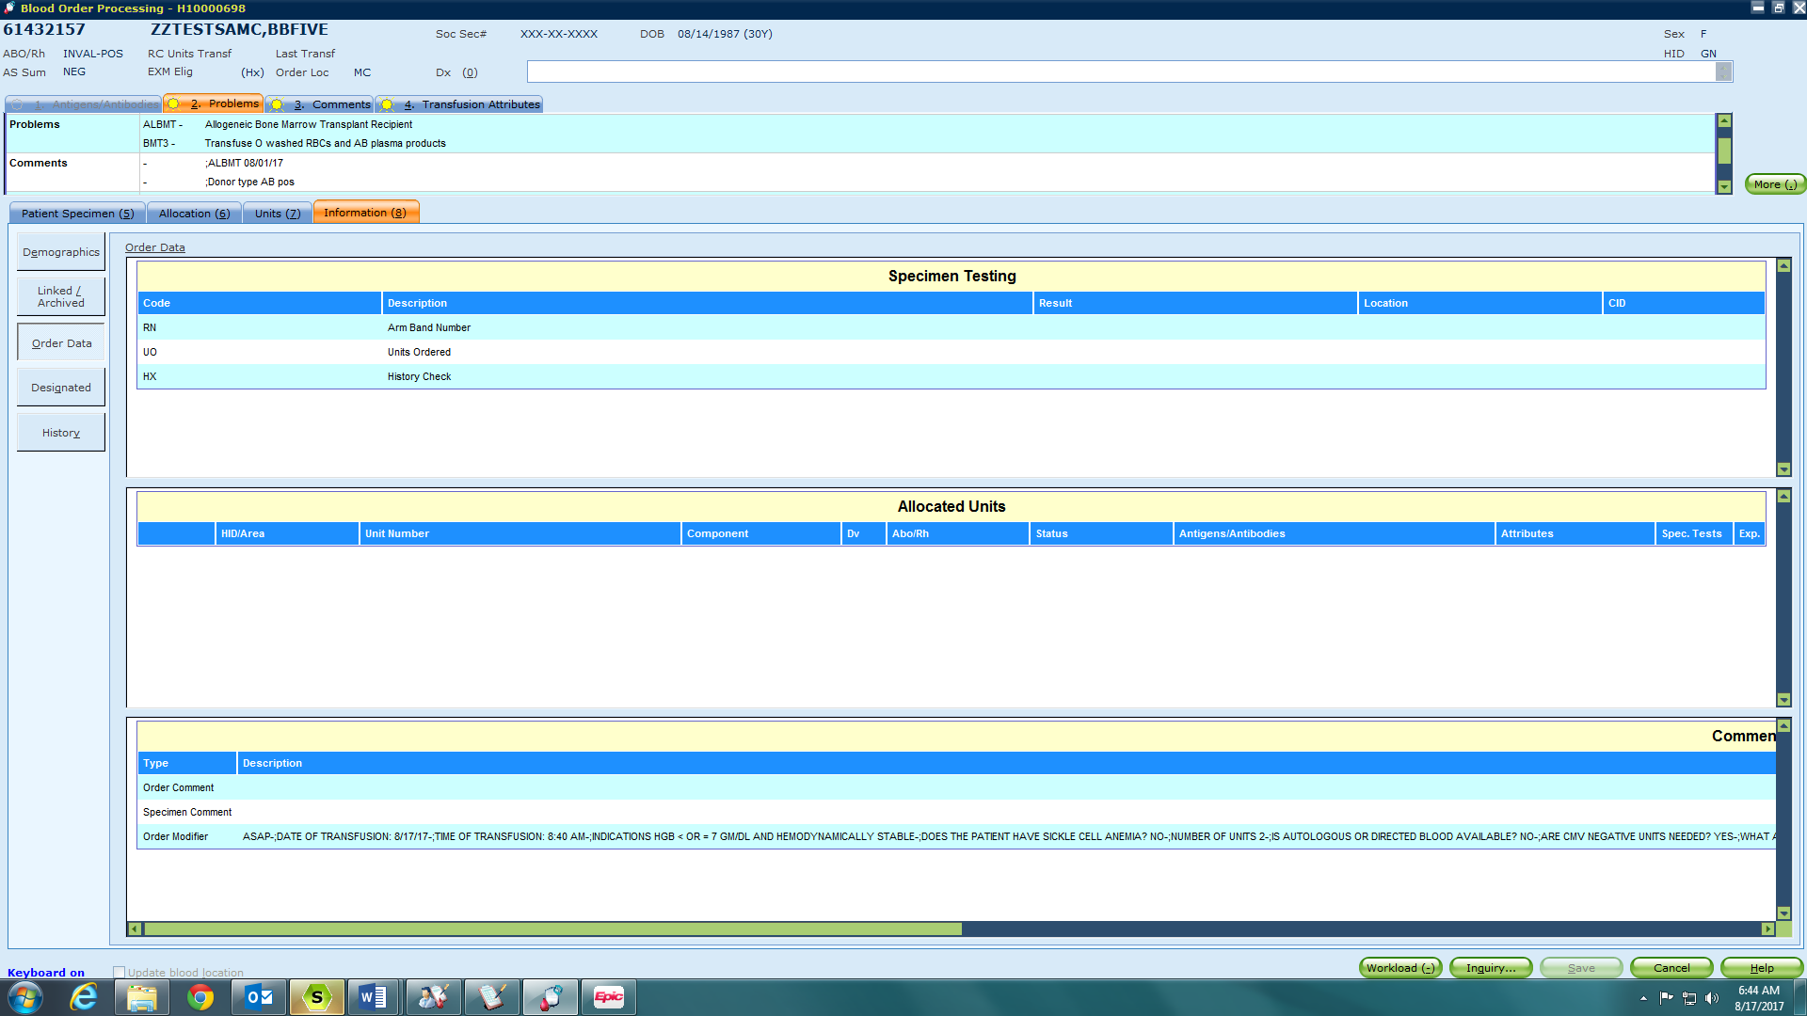
BLOOD ORDER PROCESSING

Slide 4
BLOOD PRODUCT ENTRY

Slide 5
BLOOD PRODUCT ENTRY-Fail Visual Inspection

Slide 6
BLOOD PRODUCT ENTRY-Quarantine Status

Slide 7
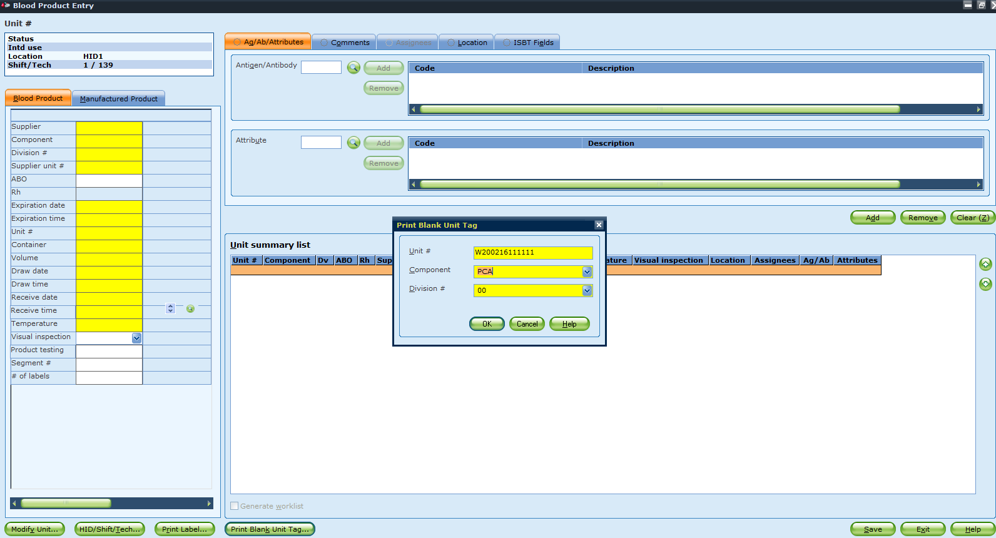
Blank Unit Tag

Slide 8
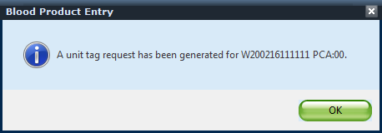
Blank Unit Tag

Slide 9
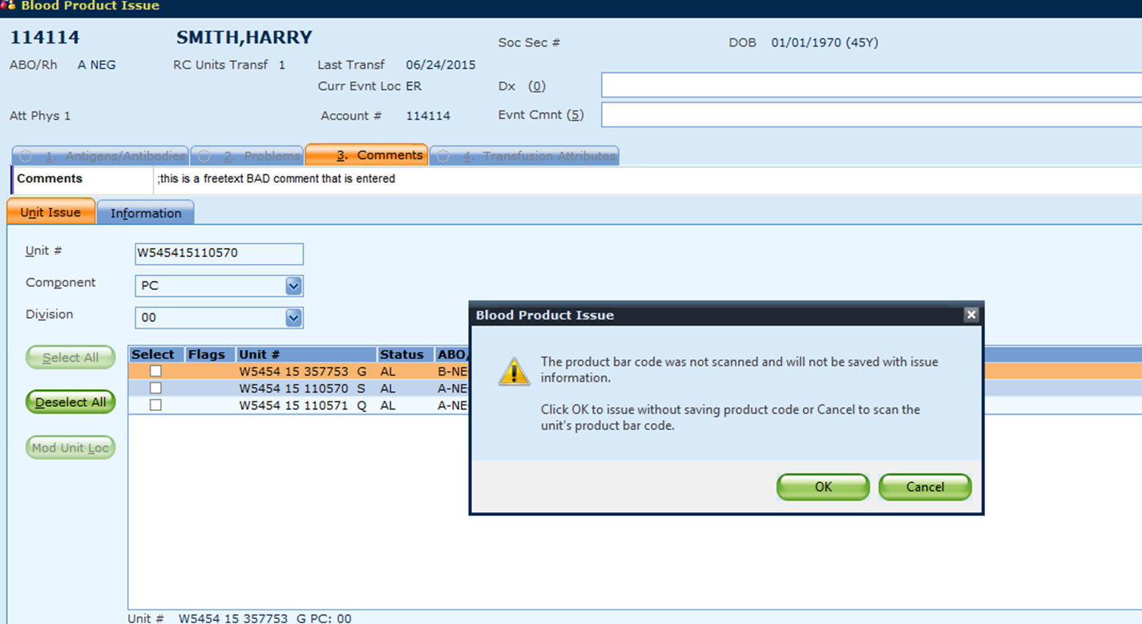
BLOOD PRODUCT ISSUE-Product Code Not Scanned

Slide 10
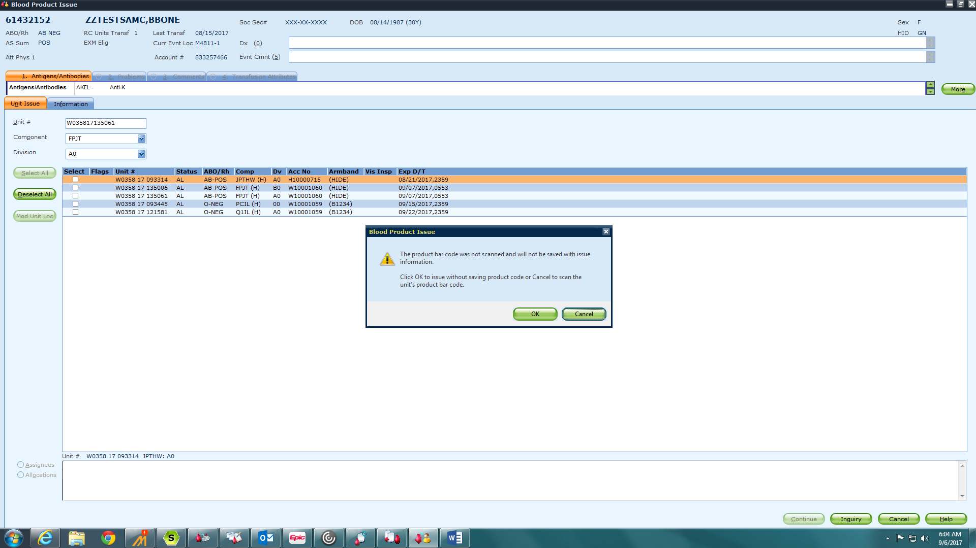
BLOOD PRODUCT ISSUE-Product Code Not Scanned

Slide 11
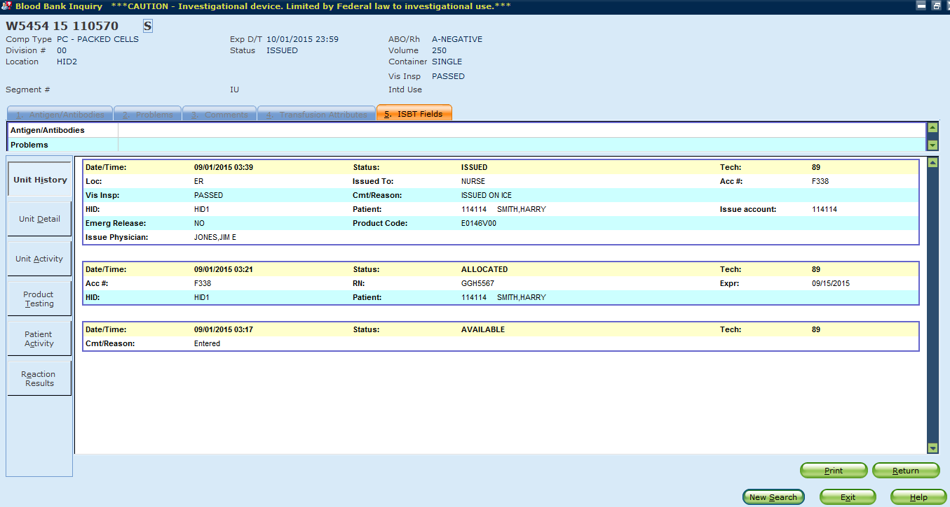
BIQ-Product Code Displays

Slide 12
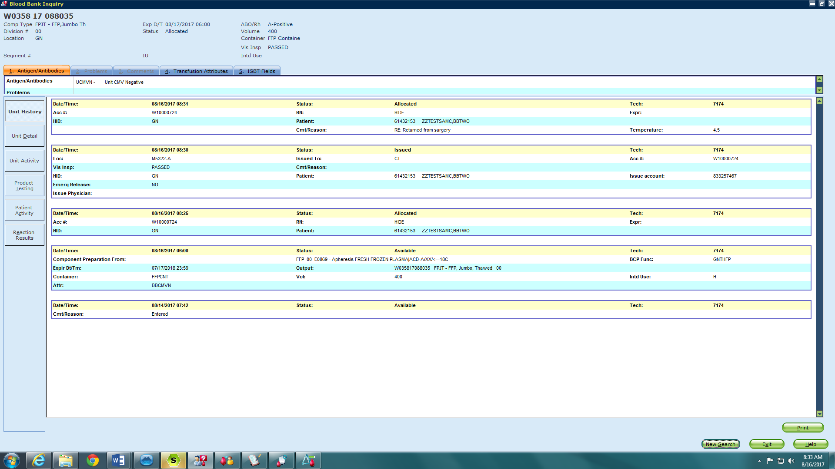
BIQ-Temperature Check Displays

Slide 13
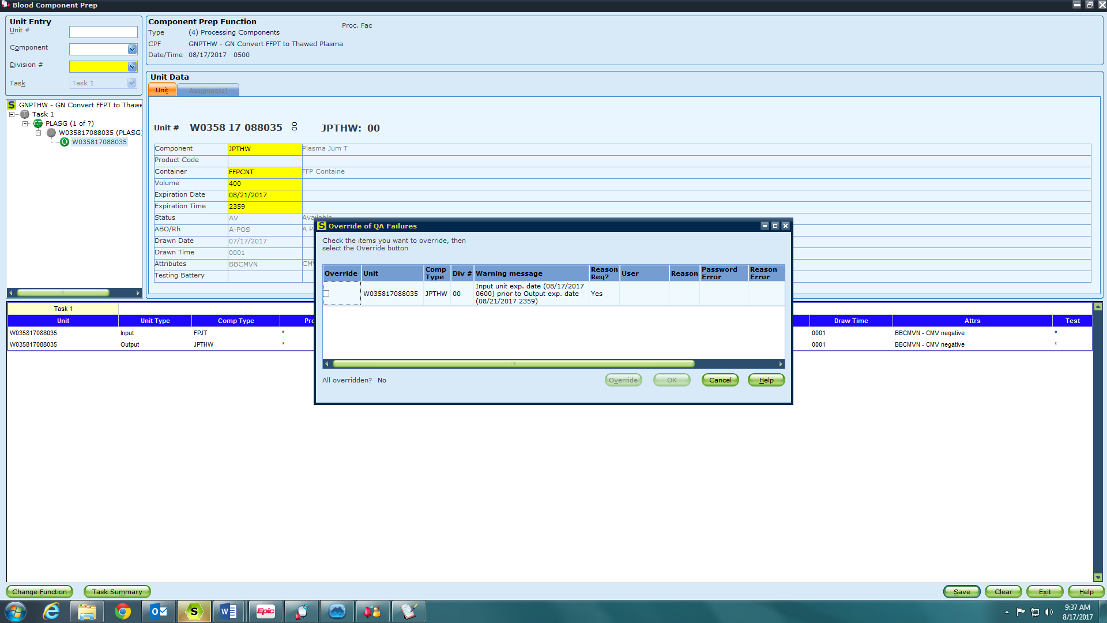
BCP- QA 31 Failure for Converting to 5 day Plasma

Slide 14
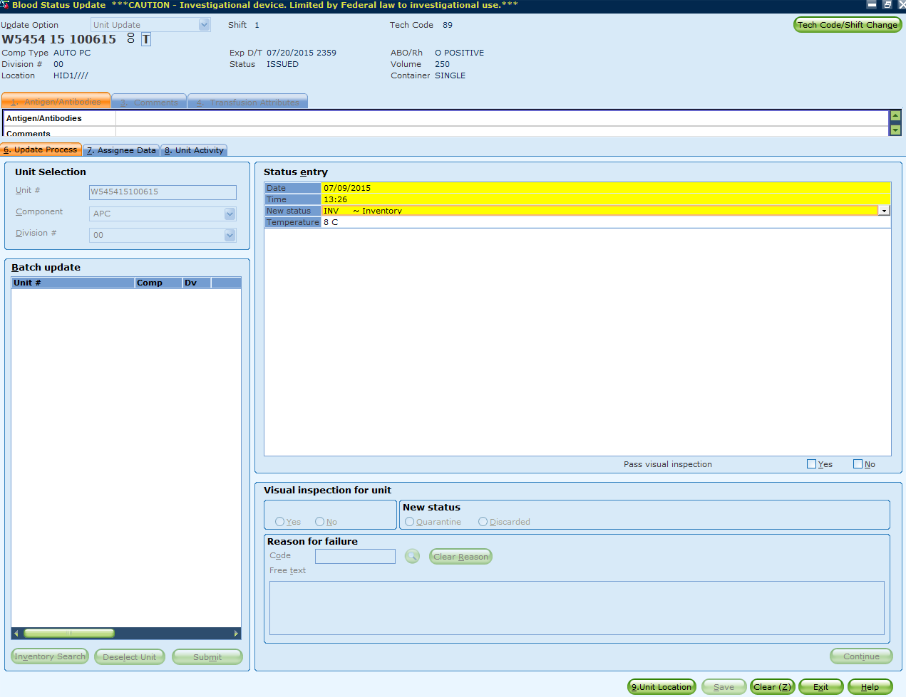
Blood Status Update

Slide 15
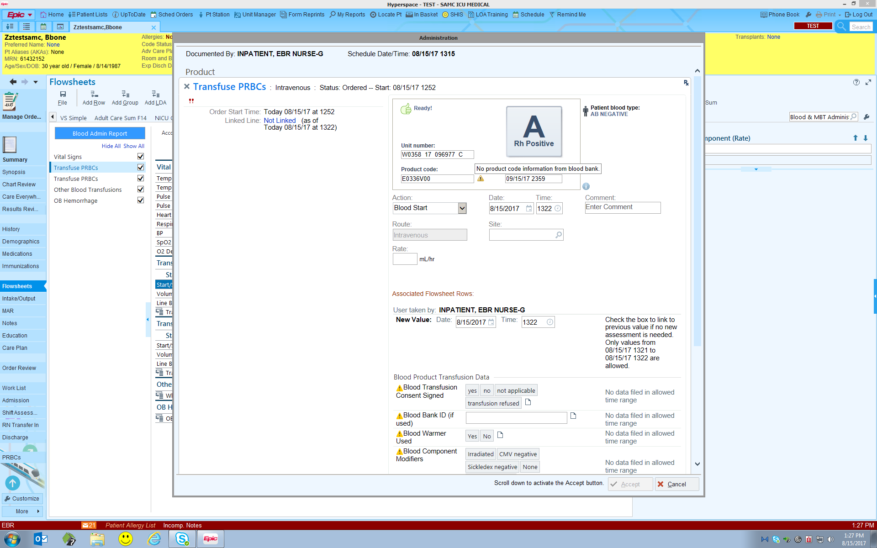
Full Matching

Slide 16
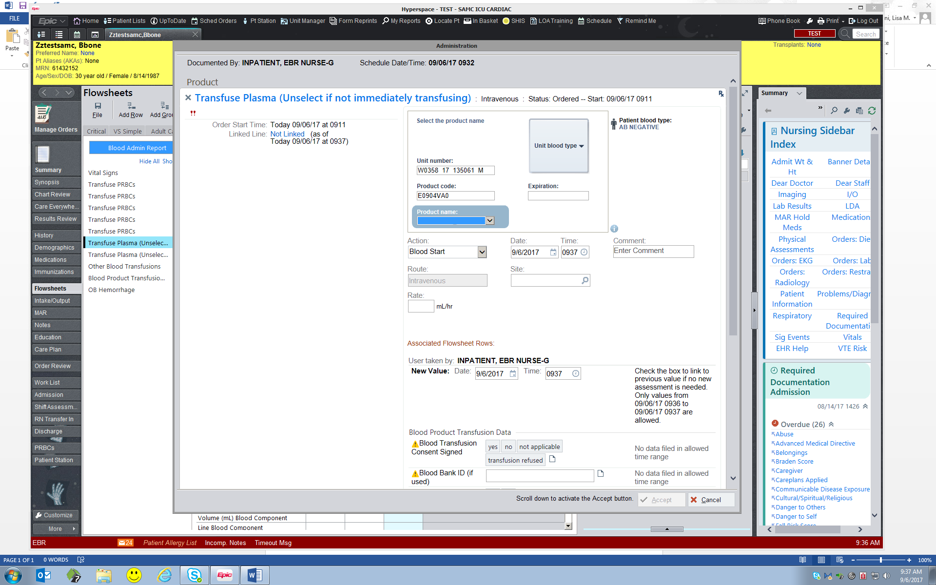
Partial Matching

