Slide 1
Sutter Roseville Medical Center Monitoring Blood Culture Volume In-Service
October 2018

Slide 2
Purpose and Background
To provide instructions for monitoring the volume of blood collected in blood cultures
The volume of blood added to the blood culture bottles directly affects the ability to detect true positives
If under-filled, there is a potential for false negatives for septicemia.
If over-filled, there is a potential for false positive alerts using the automated systems

Slide 3
Policy
The volume of blood added to blood culture bottles will be periodically monitored for appropriate volumes and feedback provided to clinical staff when appropriate
The monitoring will be conducted during the normal processing workflow of the laboratory and PSCs for all shifts.
Blood culture volume monitoring is assigned to the Specimen Processor 1 (C1)
Each day and on each shift, two blood culture bottles are randomly selected to monitor for adequate blood volume
The Form A Daily log is used to document the monitoring of blood culture volumes

Slide 4
Procedural Steps
Each Day and on each shift, the C1 specimen processor will randomly select two blood culture bottles to monitor for adequate blood volume. If no or one bottle is received during the shift, note on Form A. If blood cultures were not received on the shift for monitoring, indicate on Form A: Daily Log that no blood culture samples were received
This process is performed prior to the specimen receipt process to allow comments to be made in Sunquest if bottle is under- or over-filled (see Step 6)
Individual performing monitoring should be different than individual collecting blood cultures bottles to be assessed.

Slide 5
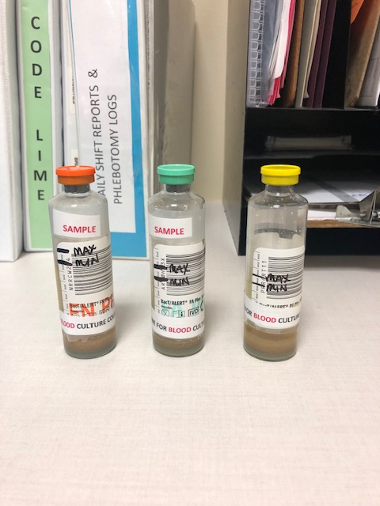
Procedural Steps, cont.
Compare patient blood culture bottle to un-inoculated bottle to estimate the amount of blood added. Use the bottle's volume hash markings on the label to assess

Slide 6
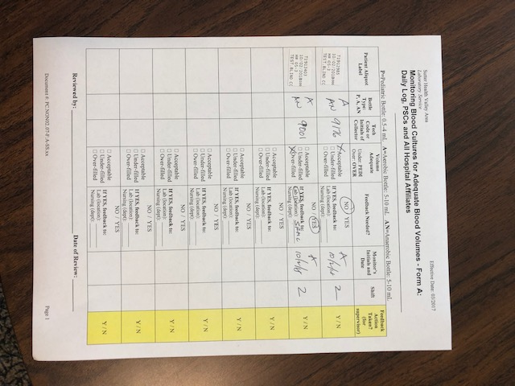
Procedural Steps, cont.
Complete Form A Daily Log as shown in the example below
Form A Daily log is located by the specimen processor 1 workstation

Slide 7
Procedural Steps, cont.
Receive blood culture order in the LIS
If blood culture bottle is under filled or overfilled then append with the correct ETC in the SREQ field
PEDI-underfilled
OVER-overfilled
After LIS receipt, small aliquot labels are used as patient documentation on Form A Daily log

Slide 8
Records Review
Records are reviewed by the Client Services Supervisor at least monthly
Action is taken to provide feedback when necessary

