Slide 1
Sutter SQ V8.2
General Lab Features and Enhancements

Slide 2
New Sunquest Icon

Slide 3
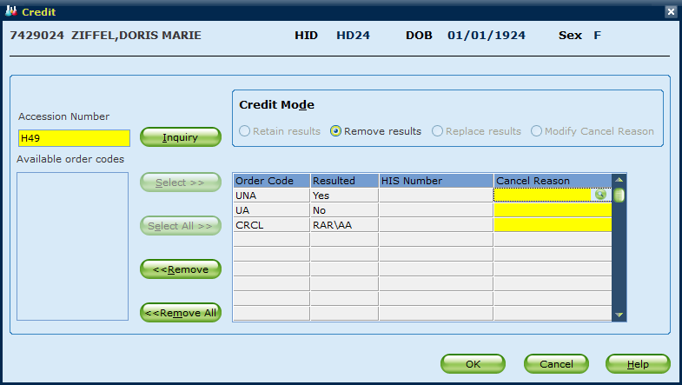
Credit option MUST be selected to proceed. Default option no longer pre-selected.
© 2018 Sunquest Information Systems, Inc. | Confidential and Proprietary 2018 Sunquest Information Systems, Inc.

Slide 4
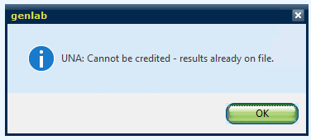
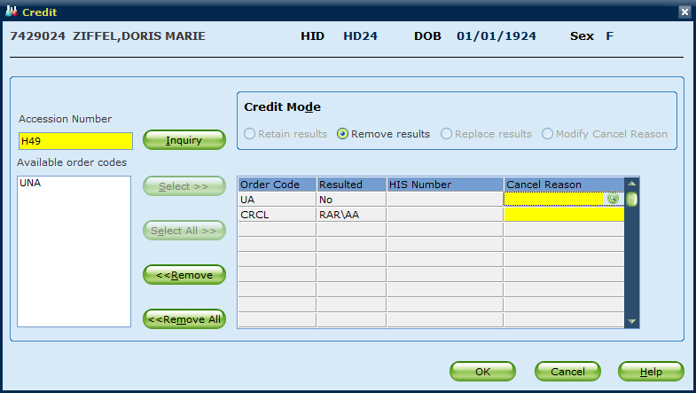
Can NO longer remove test results and replace with cancellation codes. Only time this can occur is with result fields that are required upon order entry (i.e. source).

Slide 5
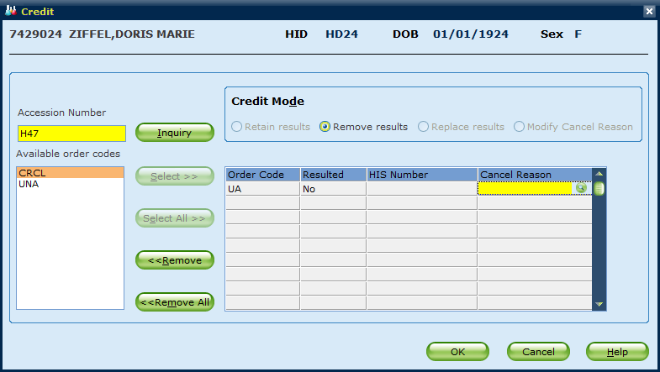
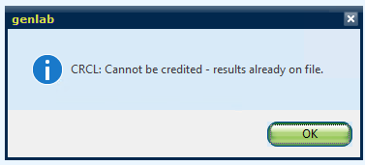
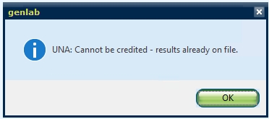
Credit example showing error message if attempt is made to remove results

Slide 6
Credit – NEW Replace Results mode
Allow users to credit orders and replace result(s) with the Cancel Reason.
Cancel reason becomes the new result of all tests on the order
Correction statement is generated if there are existing results
Results appended with HIDE do not generate correction statement and suppression status is removed
Replaced results will be sent across the interface
Blood Bank, Microbiology, and Bill-only orders are blocked

Slide 7
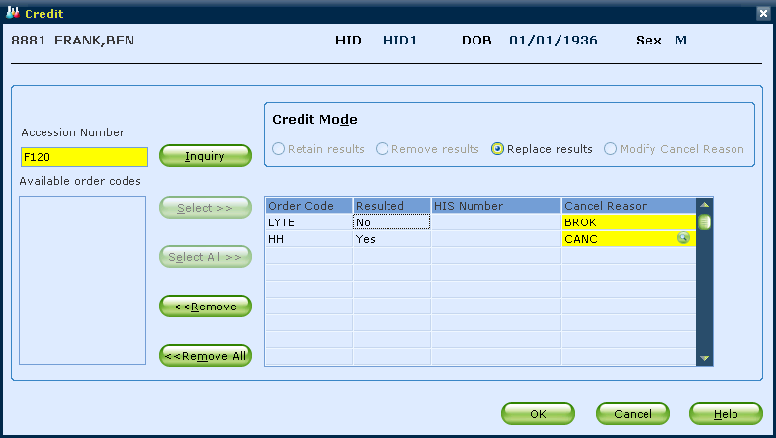
Example of NEW Credit Function – Replace Results mode
Credit orders with different Cancel Reasons

Slide 8
Credit – Replace Results mode
View in Inquiry
All tests resulted with cancel reason
Correction statement contains previous result if present

Slide 9
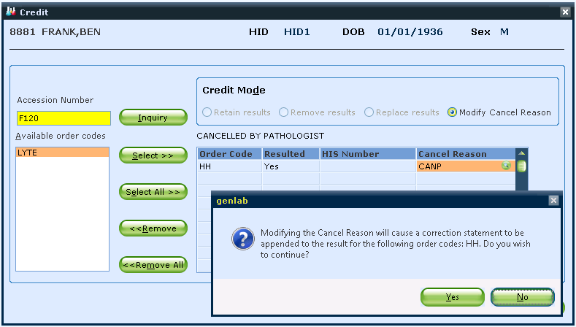
Example of NEW Credit function if you have to modify the previously entered cancel reason

Slide 10
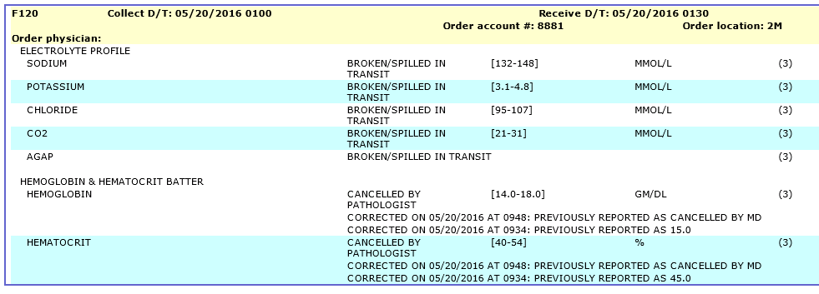
Credit – Replace Results mode
View in Inquiry
Additional correction statement for cancel reason modification

Slide 11
Reschedule order code
Enhancements to allow reschedule to send updates back to EPIC and allow search for reason code

Slide 12
ORM Reschedule Button
General Lab Function – ORM (Receiving Orders/Modifying Orders)
Enhanced the reschedule option so that it will
Credit the rescheduled order
Create a new accession for the rescheduled order
The reschedule reason will become the credit reason
A credit transaction will be sent to EPIC
The new accession will get a lab generated EPIC order number
The request to update the lab generated EPIC order number will be sent to EPIC and if an update is sent back, the EPIC order number sent will replace the Lab generated EPIC order number
In ORM, the reschedule reason field has a lookup option.
Notes:
NOTE: The navigation in this screen still requires the use of the up and down arrows and not the TAB.

Slide 13
ORM: General Lab – Order Receipt/Modify

Slide 14
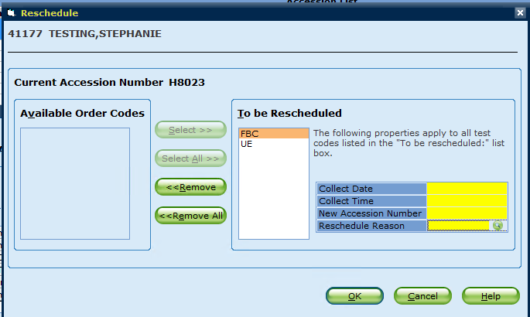
Reschedule Reason - Search Option

Slide 15
Additional Updates to Reschedule
Any auto answers or results at request entered on the original order will be moved to the reschedule order
Any modifiers, order comment codes, specimen comment codes on the original order will be moved to the rescheduled order

Slide 16
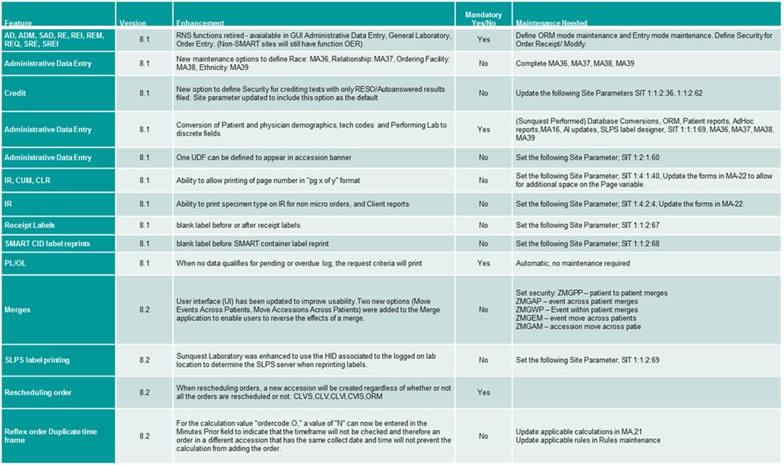
Table Summary of All Changes

