Slide 1

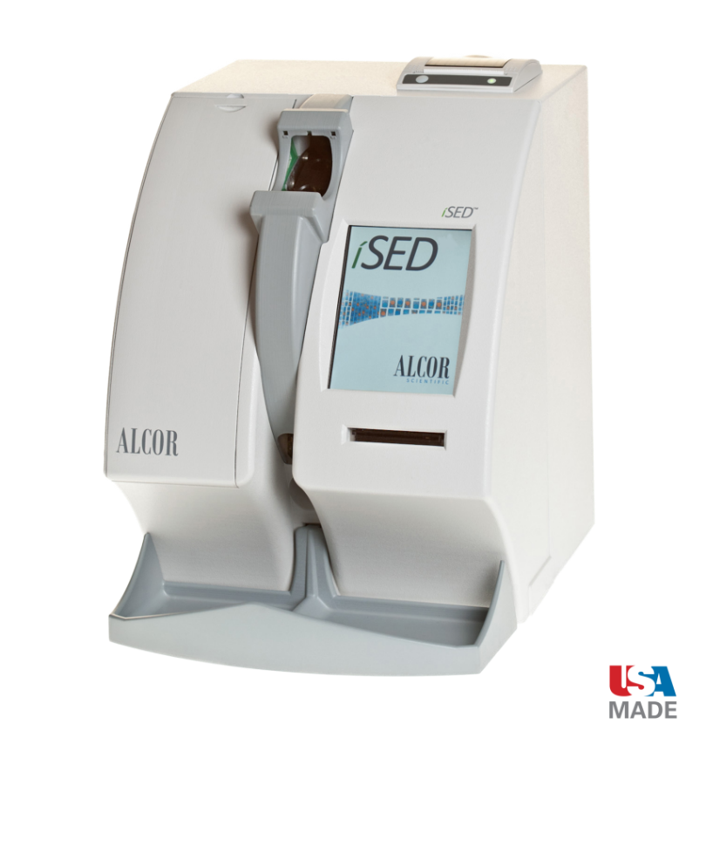
Operational Training
ÍSED®
Erythrocyte Sedimentation Rate Analyzer

Slide 2

ÍSED Methodology

Slide 3
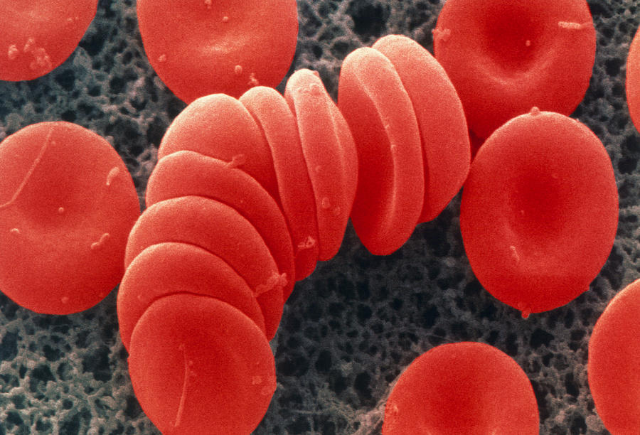
Innovative Technology
The ÍSED uses advanced Rheology Technology to measure the “earliest and most critical phase” of the ESR, which is the Rouleaux formation.
Directly measures the aggregation of the red blood cells (RBCs).

Slide 4

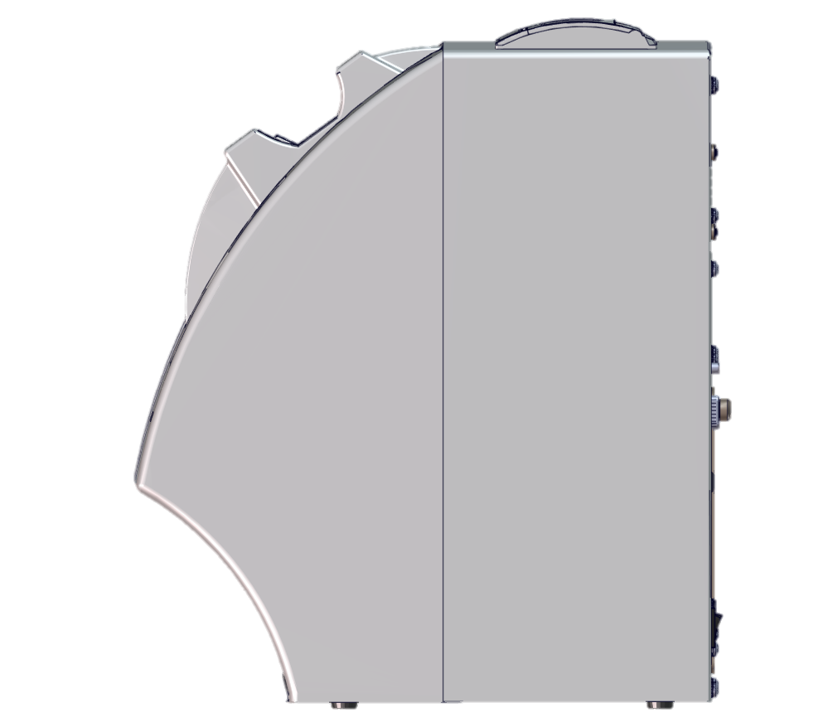
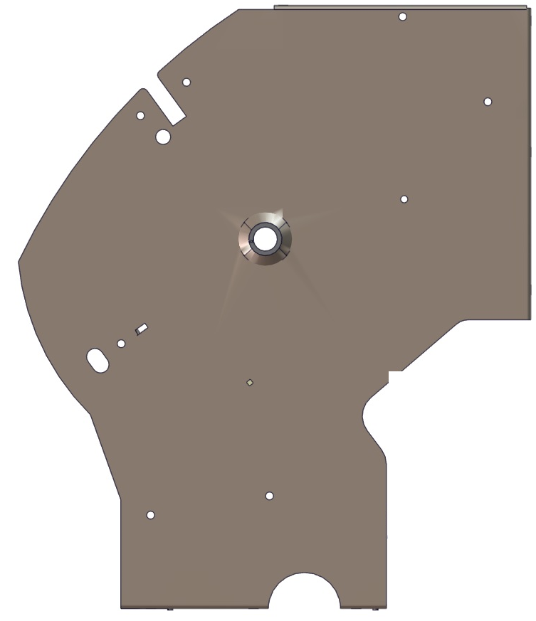
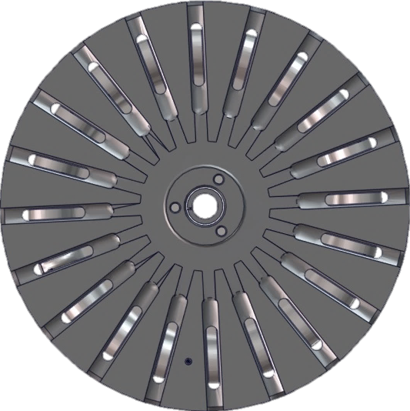

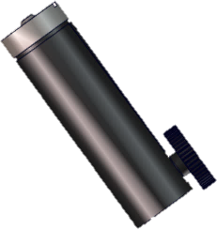
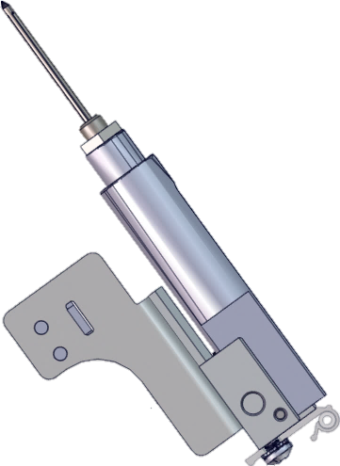
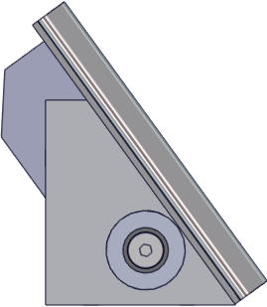
Innovative Technology
INSTRUMENT’S CONTROL
1 – The instrument moves all subassemblies to home position.
Then it positions the rotor in the Rotor home position (Load position).
The routine is started.
2 – The barcode reader beeps until the flag from the spring activate the cuvette presence sensor. Then the barcode reader reads the barcode on sample tube. OBS. It’ll try for 3 times then a manual ID input is needed.
3 – It positions the rotor on the Rotor pierce position.
4 – The Piercing system pierces the tube, which causes the Probe tube to deactivate the probe sensor (magnet is not aligned with the needle probe sensor) then the Primary pump starts to aspirate the sample.

Slide 5


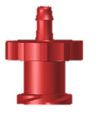

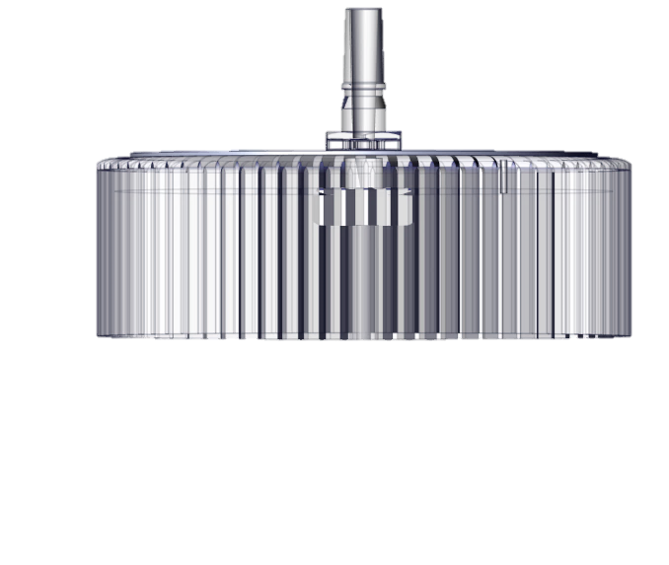
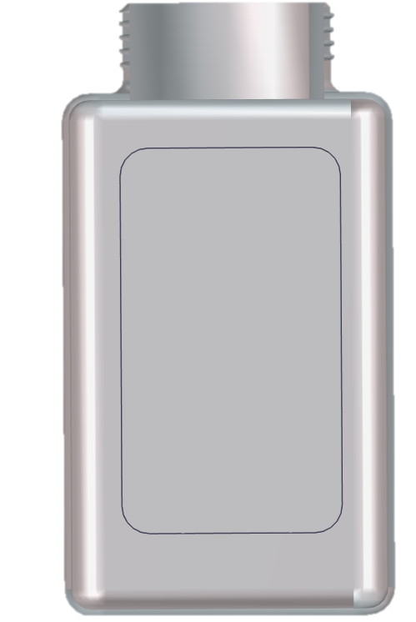

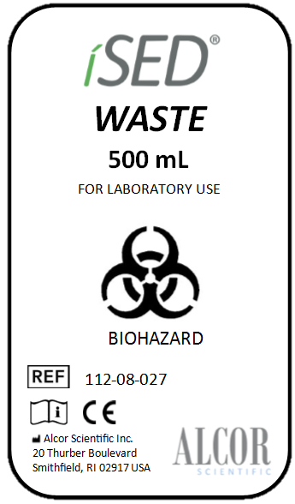
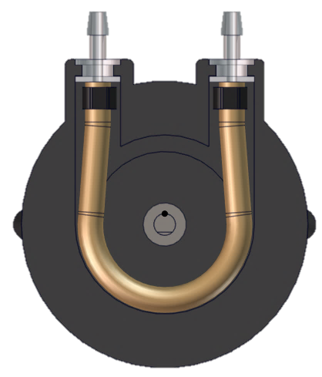



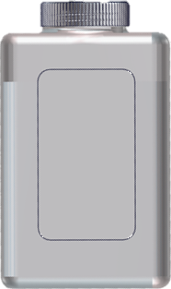

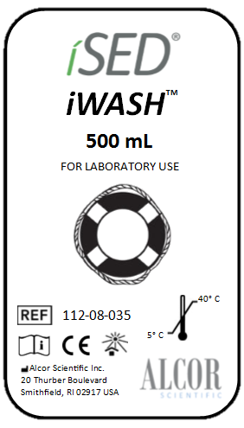


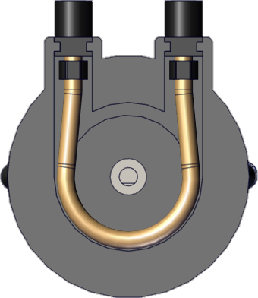
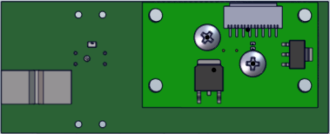
Innovative Technology
SAMPLE WITHDRAWN
✓
Tail Sensor senses the beginning of the sample.
Tail Sensor senses the end (tail) of the sample.
Analyze the sample.
Purge.
✓
✓
Reading
✓
WP
PP
Reading cell

Slide 6
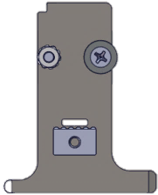
Innovative Technology
TUBE EJECTION
5 - When the result is released, the rotor positions the sample tube on the ejection position.
6 - The cuvette download sensor checks if there is a tube positioned, then the tube is ejected.
7 - If there are more samples to be analyzed, the rotor will position the next sample on the piercing position.
If not, the rotor will move to home position.

Slide 7
ÍSED Parts Identification

Slide 8
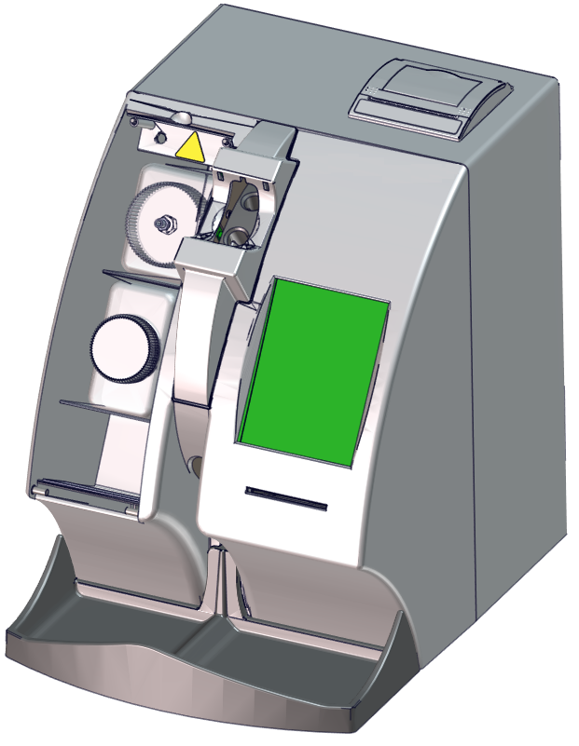
ÍSED Front View
Sample accessioning port
Thermal printer
Waste bottle
Main bezel
iWASH bottle
Touch screen display
Sample ejection port
Smartcard reader
Sample tray

Slide 9
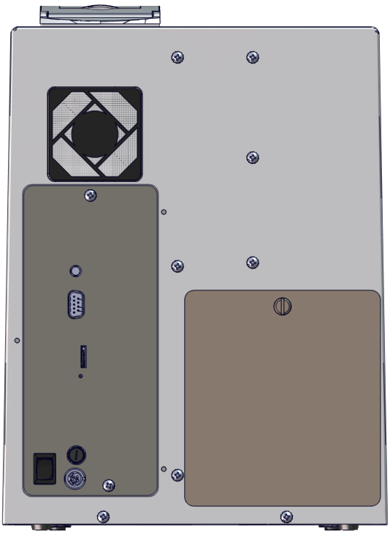
ÍSED Back View
Thermal printer
Back enclosure
Air filter
Antenna port (not used)
Back panel
RS232 port
MicroSD card
Reset button
Needle door
Fuse
Power switch
Power connector

Slide 10

ÍSED Touch Screen
System info
Adjust time/date
Replace iWASH bottle (reset count)
ÍSED status indicator
Replace waste bottle
Sample information
Print
Retrieved stored data
Send to LIS
Previous sample
Next sample
Add sample
Add sample (manual patient data entry)
End/Stop
Service
Deep wash cycle
Wash cycle

Slide 11
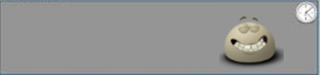


ÍSED Status Screen
The ÍSED Status screen displays useful information to the operator including available positions, available credit, and analyzer status.
Available Positions: 20
Available Credit: 1898
ÍSED is Idle
ÍSED Active
ÍSED Warning
ÍSED Idle
The ÍSED Status Indicator

Slide 12
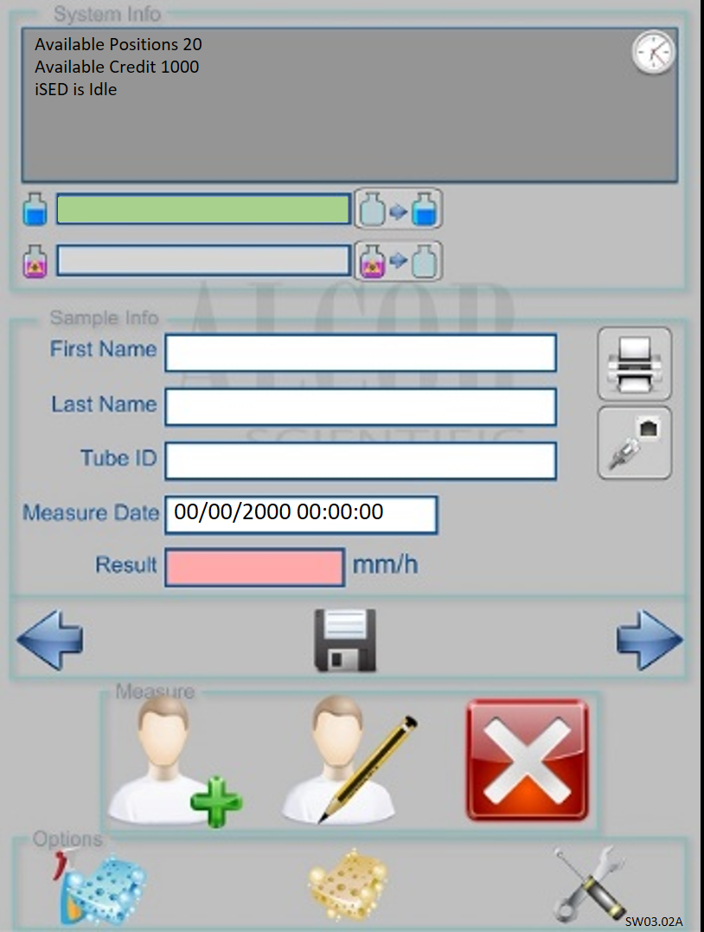
ÍSED iWASH and Waste Bottle Status
The iWASH and Waste bottle indicators display current approximate volume of iWASH and Waste bottles.
A green bar is displayed as a volume indicator.
The indicators are updated based on cycle counts.

Slide 13
Patient Demographics
The fields in the center of the home screen display patient demographics and results. Patient results can be printed or retransmitted from the icons in this section.

Slide 14
Navigating Through Results
The “Previous Sample” and “Next Sample” icons allow the operator to scroll through single results.
The “Retrieve Stored Data” icon allows the operator to search through archived data.

Slide 15
Add Sample Icons & End/Stop Icon
Program samples to be run with bar code labels.
Program samples to be run without bar code labels.
Stop all testing and eject the sample tubes.

Slide 16
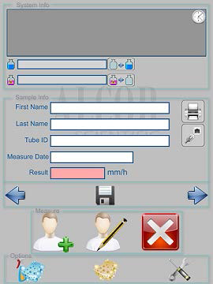
Wash Cycle Icons & Service Screen Icon
Deep wash cycles can be performed by selecting this icon.
Routine wash cycles can be performed by selecting this icon.
The wrench and screw driver icon on the right allows access to the service screen.

Slide 17
ÍSED Smart Cards

Slide 18
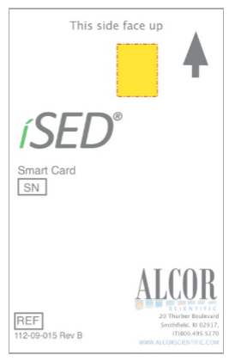
Smart Cards
In order to process and analyze samples, tests, known as “credits”, must be downloaded onto the ÍSED from a Smart Card.
The ÍSED comes pre-loaded with 100 tests for correlation purposes.
Smart Cards come pre-loaded in various quantities.

Slide 19
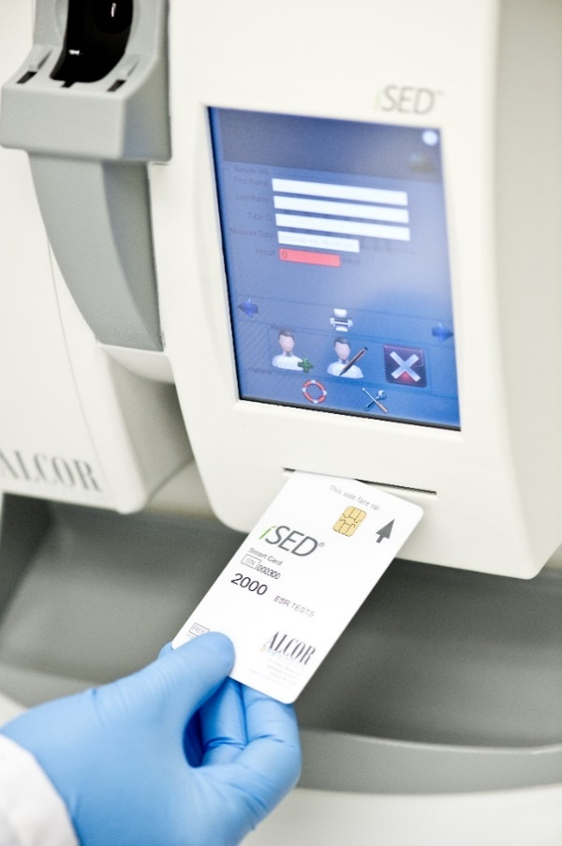
Downloading Credits from Smart Card
With the arrow facing upward and forward, insert the test card into the Smart Card Reader located on the front of the ÍSED.
Once inserted, the credits will automatically download onto the ÍSED, and the ÍSED will display a message on the touch screen.
Total credits available will include the newly downloaded credits and any residual credits prior to download.
Once all credits have been downloaded onto the ÍSED, the test card can be removed and SHOULD BE DISCARDED.

Slide 20
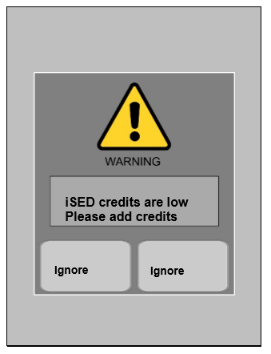
“Low Credit” Indicators and Alarms
In the event the credits are below the alarm threshold; a warning message will appear on the screen to remind the operator to order or load additional credits.
If “Ignore” is selected, the ÍSED skips the warning and the operator can continue the sample load process.

Slide 21
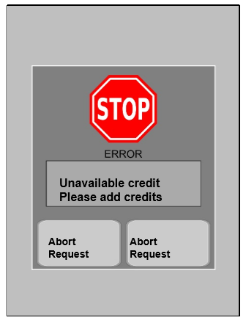
“Zero Credit” Indicators and Alarms
In the event that there are no test credits remaining, an error message will appear on the screen and can be resolved by downloading test credits.
If “Abort Request” is selected, the ÍSED automatically aborts the sample loading process.

Slide 22
ÍSED Operation

Slide 23
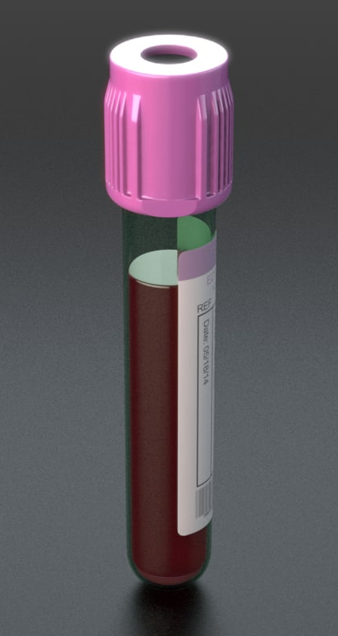
Sample Requirements
100uL whole blood (500uL dead volume)
Whole blood collected in EDTA anticoagulant tube
Sample should not be clotted or hemolyzed
Sample should be tested within 24 hours of collection refrigerated or at room temp
Sample must be brought to room temp for at least 15 minutes

Slide 24
Tube Requirements
13 x 75mm tube with pierceable cap
EDTA anti-coagulant (lavender top)
Sarstedt 3.4mL Monovette EDTA Tube
BD Microtainer (MAP) Microtube
Notes:
****Use only tightly capped samples!
****Do not use if the tube stopper is missing!

Slide 25
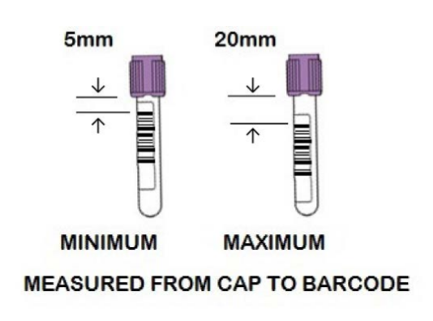
Patient Identification
Patient samples are read and identified by the instrument’s internal barcode reader automatically as they are loaded into the instrument.
All common laboratory barcodes are supported including code 39, UPC, and code 93 formats. Note barcode location range.
If the barcode won’t read for some reason, you have the option of entering the patient in manually.

Slide 26
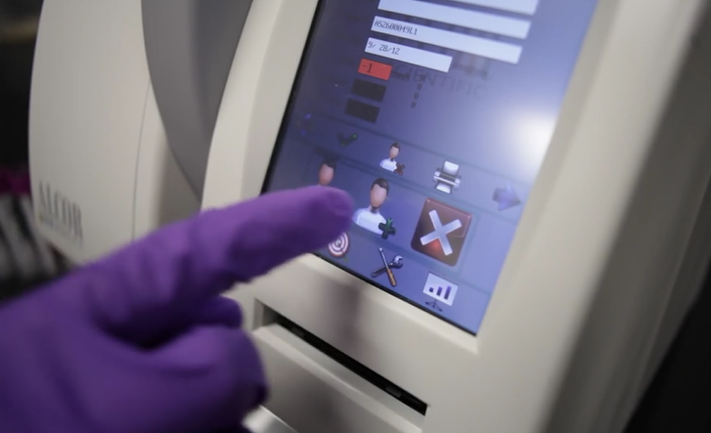
Processing Barcoded Samples
Step 1
Add Sample
Select the “Add Sample” icon.
The sample wheel rotates to the next available position on the sample entry port.
The iSED will beep for a 5 second window as you load the sample.

Slide 27
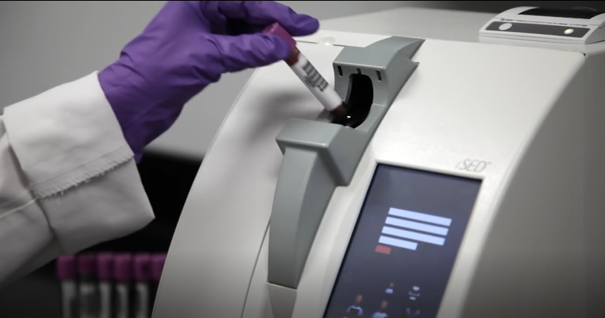
Processing Barcoded Samples
Step 2
Load Samples
Insert the barcoded tube into the sample entry port with the barcode label oriented to the right. The ÍSED will beep once when the barcode has been read. Automatic sample processing then begins.

Slide 28
Processing Barcoded Samples
Step 3
Repeat
Repeat until all samples have been loaded and/or all positions in the sample wheel are filled.

Slide 29
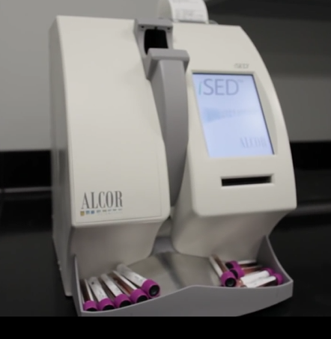
Processing Barcoded Samples
Step 4
Walk away
Completed samples will be ejected into the collection tray.

Slide 30
Finger Sensor Safety
Finger Sensors
During the sample loading process, the operator may invoke the Finger Sensor Safety feature.
The ÍSED is NOT going to recognize or process the sample.
Notes:
Ex: The operator selects the “Add Sample” icon; as the ÍSED wheel rotates looking for an available position, the operator accidently brings the same too close to the wheel and the wheel stops.
Video INSERT

Slide 31
Manual Patient Data Entry
For samples where the barcode cannot read or for non-barcoded samples, the sample ID can be entered manually.
Select the “Add Sample Manually” icon. The ÍSED will then prompt the operator to enter the patient identification data.

Slide 32
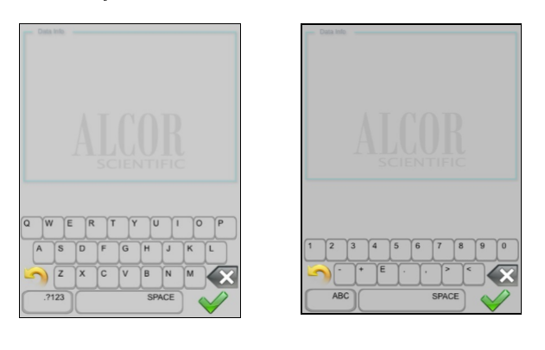

Manual Patient Data Entry
Enter the patient identification data using the alpha-numeric keyboard.
Select the green check mark to advance.
Sample processing will then begin.
ALPHA
NUMERIC

Slide 33
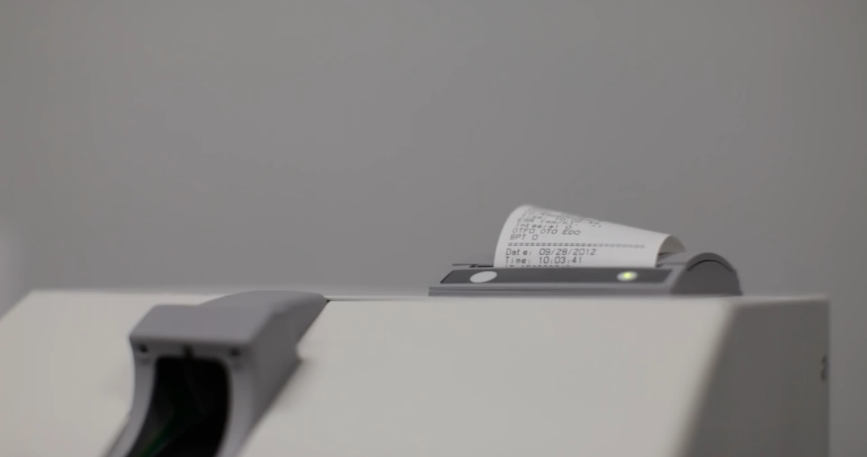
Results
When testing is complete results are printed and/ or sent to the Laboratory Information System (LIS).

Slide 34
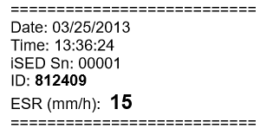
Results Format
Results are displayed on the screen after analysis and also printed by the instrument’s internal printer.

Slide 35
Reprinting of Results (Entire day)
From the home screen, select the “Retrieve stored data” icon.

Slide 36
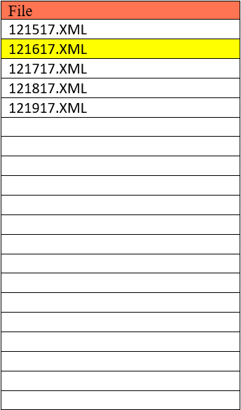
Reprinting of Results (Entire day)
Select the desired date file by highlighting it.
Select the “Print” icon to print results.
Select the “Retransmit” icon to send results from the entire day to the LIS.
Select the “Home” icon to return to the main screen.

Slide 37
Review/Printing/Retransmitting a Single Result
From the home screen, use the “Previous” or “Next” icons to scroll through each result.
Once the desired result is located, press the “ Print” icon to print the result, or the “Retransmit” icon to send the result to the LIS.
123245
12/15/2017 11:11:11
11
Notes:
Animate each step.

Slide 38
Routine Maintenance
Notes:
Animate each step.

Slide 39
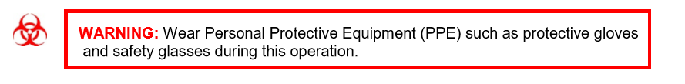
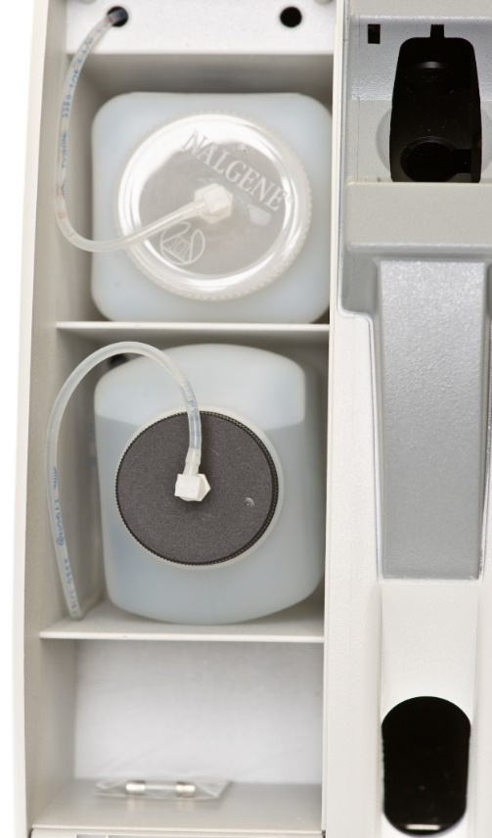
Replacing/ Emptying the Waste Bottle
Waste bottle can be emptied and reused or can be replaced with new clean bottles.
To remove the waste bottle from the analyzer:
Open the iWASH and waste compartment. The waste bottle is located in the upper compartment.
Disconnect the luer connector from the waste bottle screw cap. Remove the waste bottle from the instrument and dispose according to your laboratory protocol.
Recap
Replace
Reconnect
Recap
Replace
Reconnect
Notes:
Insert video

Slide 40
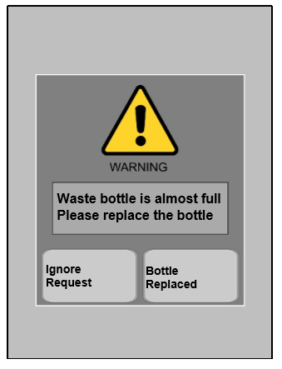
Waste Bottle Indicators and Alarms
In the event that the waste bottle is nearly full, an error message will appear on the screen and can be resolved by choosing one of the two options listed:
Ignore Request – The instrument skips the warning and the operator can continue.
Bottle Replaced – This is selected immediately after the operator replaces the waste bottle.

Slide 41
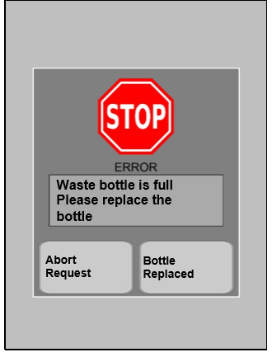
Waste Bottle Indicators and Alarms
In the event that the waste bottle is full, an error message will appear on the screen and be accompanied by an alarm. This can be resolved by choosing one of the two options listed:
Abort Request – The instrument automatically aborts the sample loading procedure.
Bottle Replaced – This is selected immediately after the operator replaces the waste bottle.

Slide 42
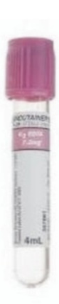
Deep Clean Procedure
The Deep Clean Procedure needs to be performed either monthly or every 1,000 samples, whichever comes first.
This procedure will clean the aspiration pathway from the needle to the reading cell.
Materials Needed:
Empty an unused 13x75 tube (Do not use SST tube.)
6-7% hypochlorite (Bleach). Do not dilute unless >7%.
On board iWASH solution.

Slide 43
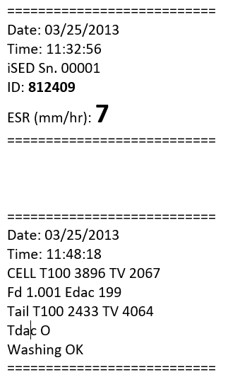
Routine Wash Cycle
The wash cycle will occur automatically 15 minutes after the last patient sample has processed.
“Washing OK” is printed when the wash cycle is complete.
It is recommended that the lines are cleaned before powering down the ÍSED.
Select the “Wash Cycle” icon to activate self-washing.
Printout
Before Wash
123245
12/15/2017 11:11:11
11
Printout
After Wash

Slide 44

Seditrol® ESR Quality Controls

Slide 45
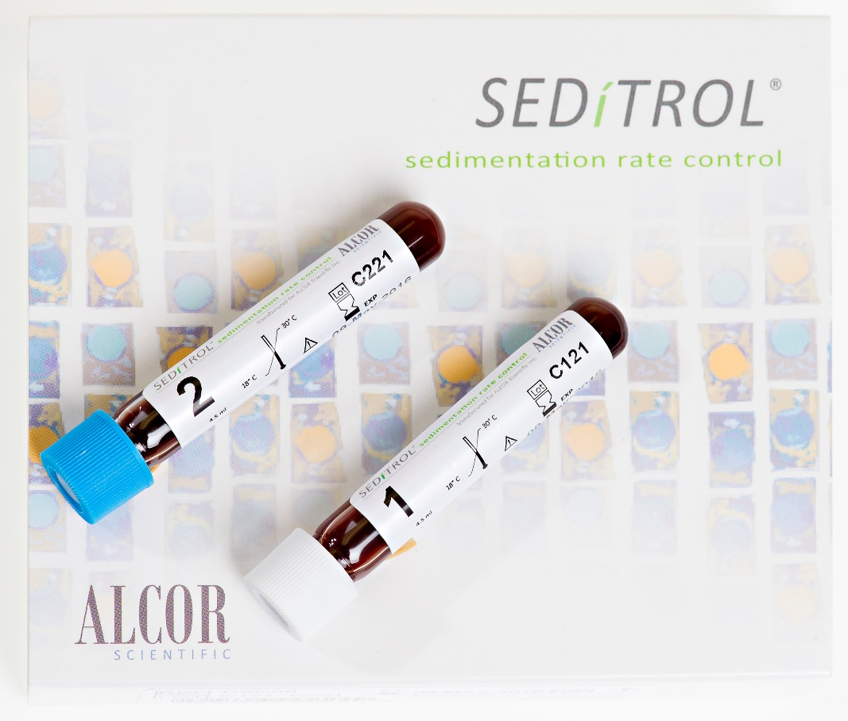
Seditrol ESR Quality Controls
ALCOR ESR controls are intended for use exclusively on ÍSED as a QC tool to monitor the precision of ESR laboratory testing procedures.
The product is composed of stabilized human red blood cells suspended in a buffered fluid and preservative.

Slide 46
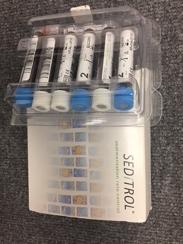
Control Storage & Stability
DO NOT REFRIDGERATE/FREEZE OR EXPOSE TO EXCESSIVE HEAT
18 month shelf life
Stable to expiration date when stored unopened at 18°C to 30°C (RT)
Open vial stability 31 days at RT
Kit includes 3 Level 1 and 3 Level 2 tubes

Slide 47
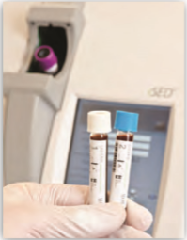
Running Controls
First time use controls for 25 minutes on a rocker.
Recommend rotating controls odd/even.
Due to the sample matrix QC takes longer to process than patient samples – a full 16 minutes.
Product should be treated the SAME as patient specimens.

Slide 48
Error Messages & Troubleshooting

Slide 49
Troubleshooting
ÍSED is a fast and reliable analyzer, however, as with any analyzer problems may occur.
Refer to the ÍSED Operator’s Manual for troubleshooting guide or please contact ALCOR Technical Support at 800-495-5270

