Slide 1
Clinical Pathology (CP) Beaker
Epic Upgrade – August 2021
Jennifer Casey, ITS Principal Trainer – AP & CP Beaker

Slide 2
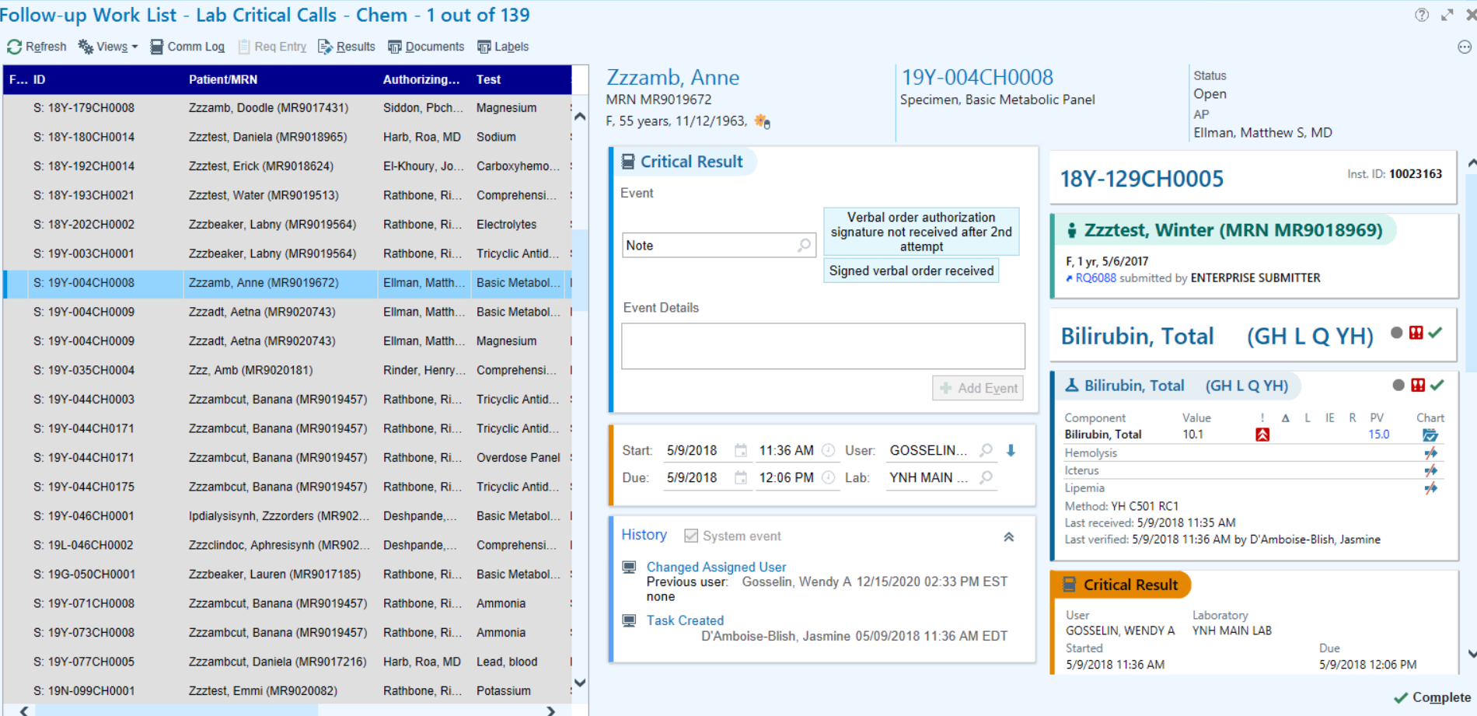
Redesigned Follow-up Work List
Hard Coded Functional Change
In a redesigned Follow-up Work List, you can record notes and events, quickly change user assignments, see specimen, history, and contact information, and review a complete history of the actions taken to resolve a follow-up so far.
Notes:
RN 743158
Nov 2020 update
Appears in:
Beaker Anatomic Pathology
Beaker Clinical Pathology
Let users know they can drag the right border of the list to collapse the center and right side panes together and see the activity in a two-pane layout.

Slide 3
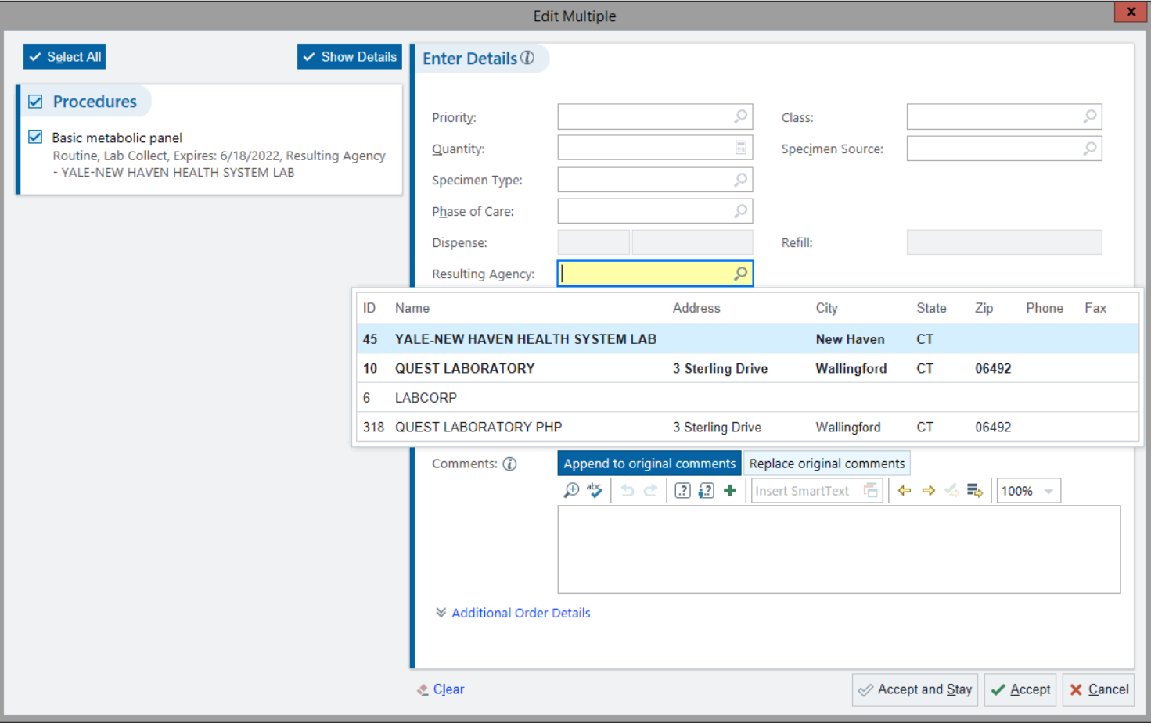
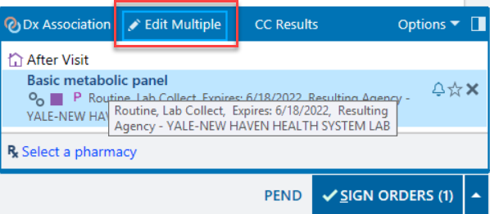
A New Look on “Edit Multiple” activity
Hard Coded Functional Change
For users who use the Transcribe Orders activity the “Edit Multiple” activity can be used when signing orders to change the Preferred Lab and other items. When you click Edit Multiple to update your unsigned orders, you'll notice that the form has a fresh look, and frequency-related fields might have moved.
Notes:
RN 723399
Roles: Anyone who places orders.

Slide 4
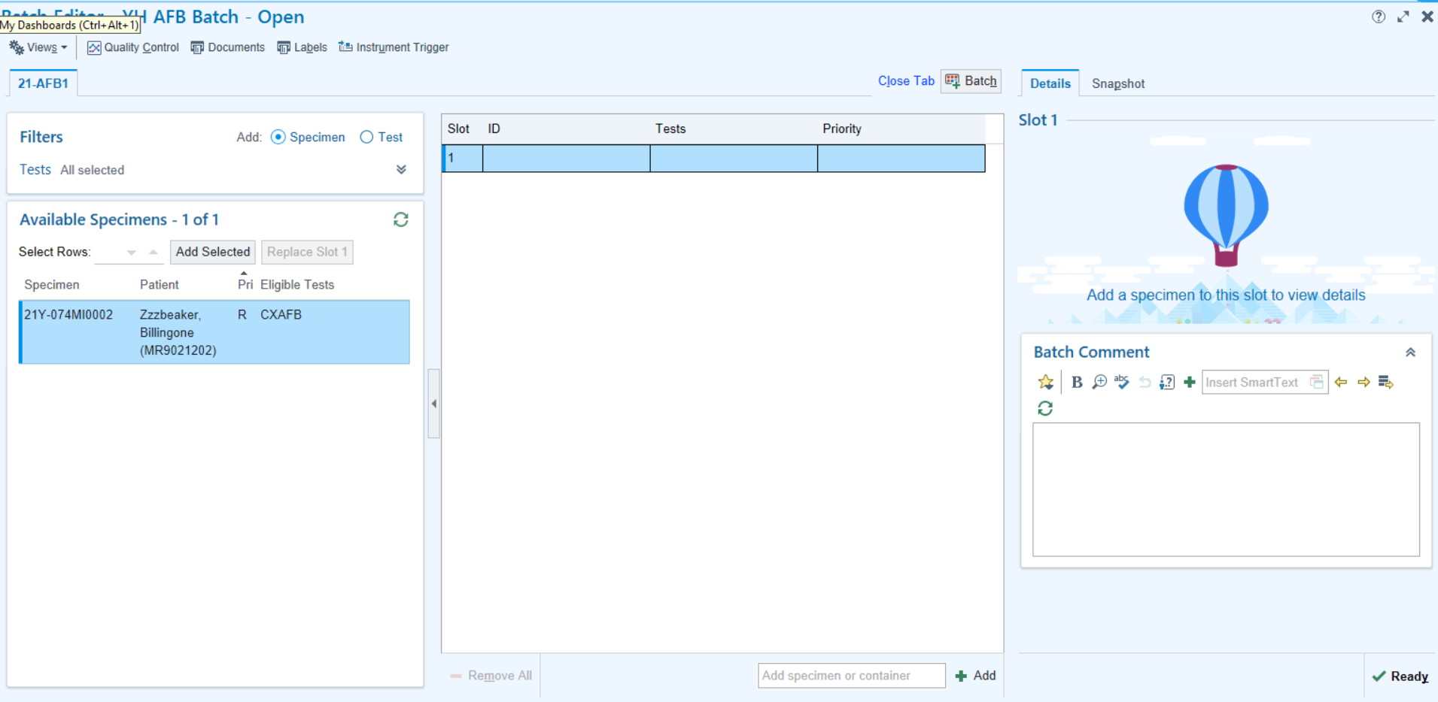
Updated Batch Editor Activity
Hard Coded Functional Change
Use filters to see and add specimens for specific tests or components in an integrated batch queue, verify slot information in a flexible report view, and update the tests or components for a single slot in the tray without needing to remove and re-add it.
Notes:
RN 734081
Appears in:
Beaker Anatomic Pathology
Beaker Clinical Pathology
Roles:
Lab Tech
Molecular Tech

Slide 5
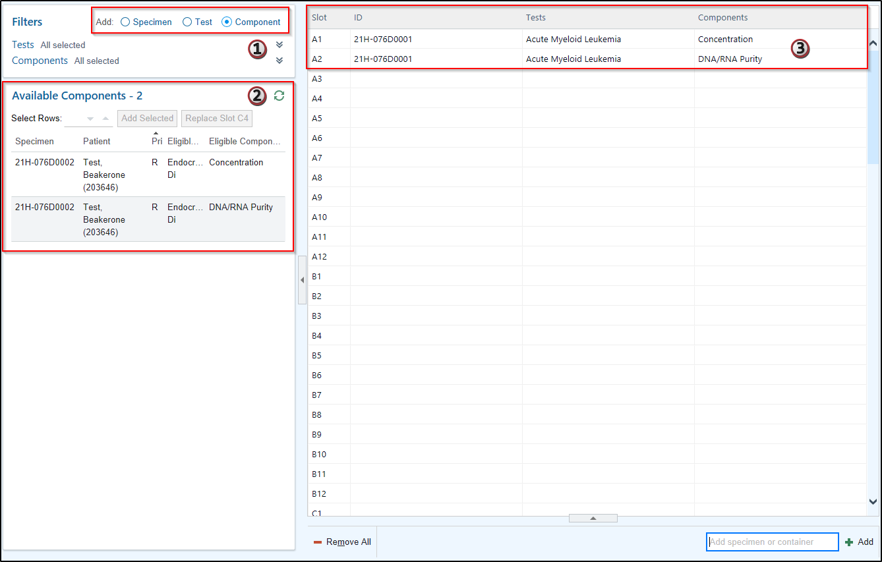
Quickly Filter the Batch Queue
Hard Coded Functional Change
Use new filtering options in Batch Editor to add records to a batch based on the option selected. Users can choose to show either a specimen, test, or result component per row on the batch queue. The selected option also affects users that are adding to the batch by scanning a barcode or manually entering specimen IDs; records are added to a new slot in the batch based on the selected option.
Notes:
Say a user scans the barcode for a specimen with multiple tests that contain multiple components that are allowed on a batch:
With the specimen filter selected, scanning the barcode adds the specimen to a single row that contains all allowed tests and components.
With the test filter selected, scanning the barcode adds each allowed test to a separate row with all of the corresponding components for that test in the row.
With the component filter selected, scanning the barcode adds each allowed component to a separate row.

Slide 6
New Warnings on Batch Editor
Good
To
Know
Epic now saves changes you make in the Batch Editor more often, so you now see a warning when an action, like closing your batch or selecting a new row, would remove a specimen from the batch. If you don't want to remove a specimen or container, click No to back out the changes before you try the action again.
Notes:
RN 761350
Roles:
Lab processor
Lab tech
Appears in:
Beaker Anatomic Pathology
Beaker Clinical Pathology

Slide 7
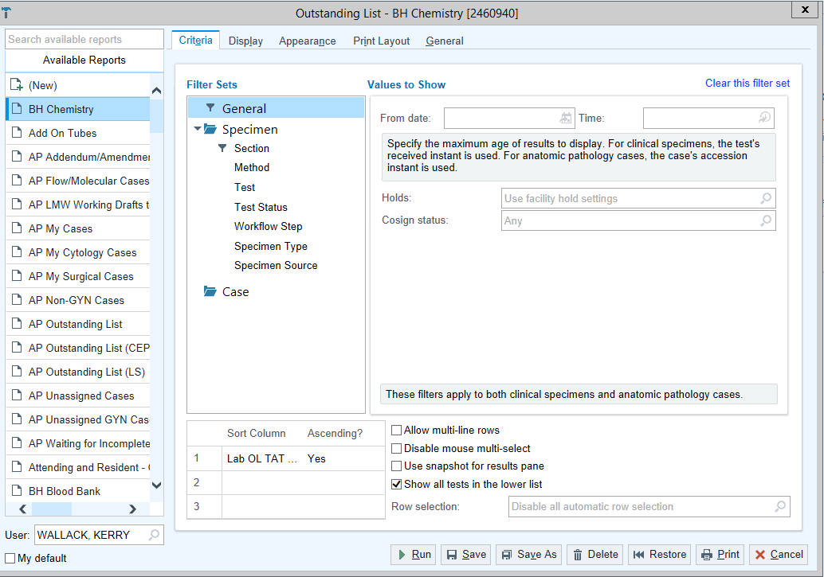
Outstanding List Report Setting
Good
To
Know
When you click the “Views” menu on the Outstanding List and click “Settings” you will see a new look to the Outstanding List Report Settings. There is no change to the menu and you will continue to set a Default in the same manner.

Slide 8
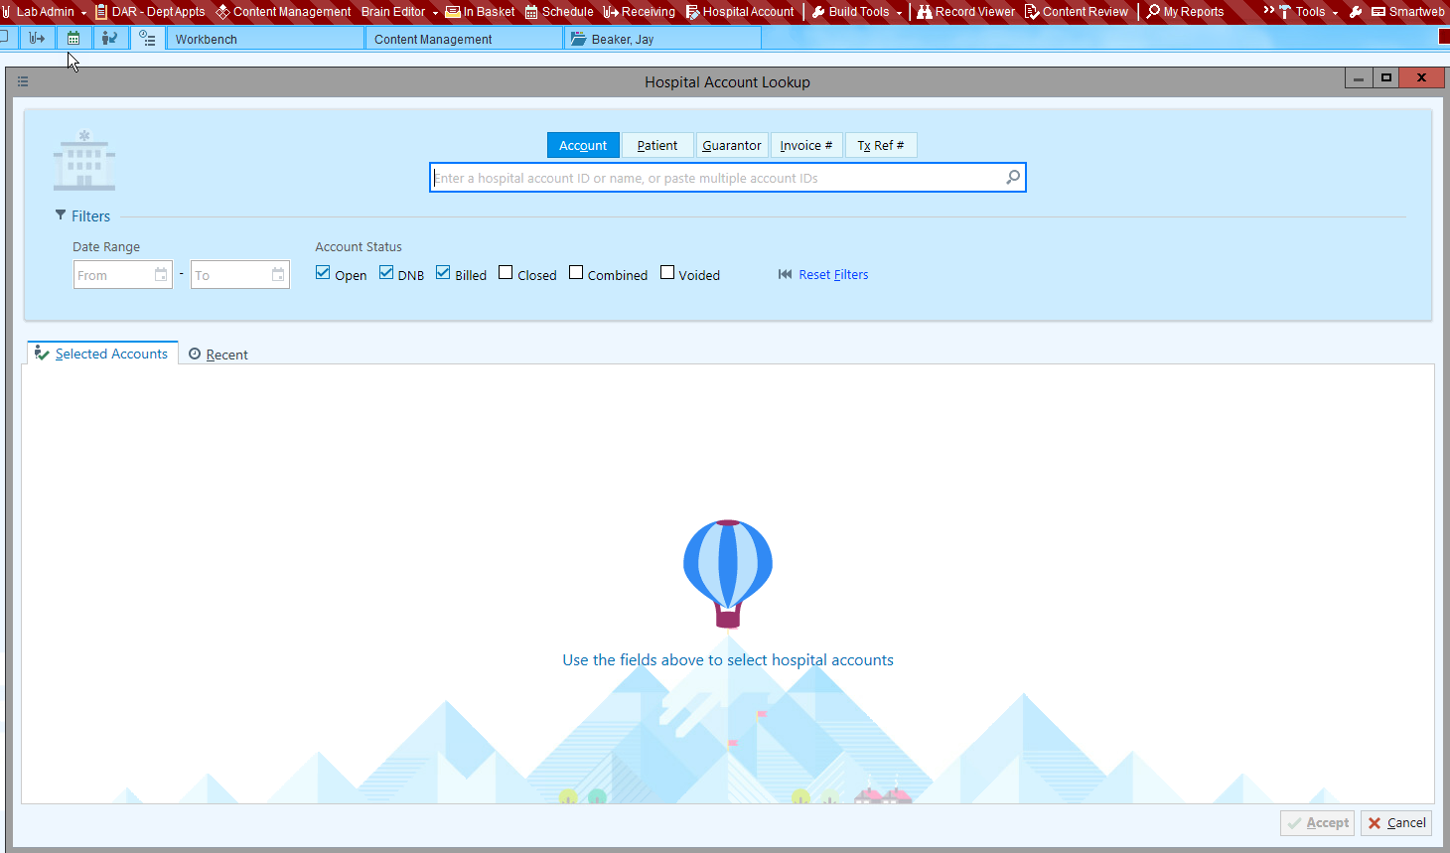
Account Maintenance Activity
Good
To
Know
The Account Maintenance activity is now called Hospital Account Lookup and has a new look

Slide 9
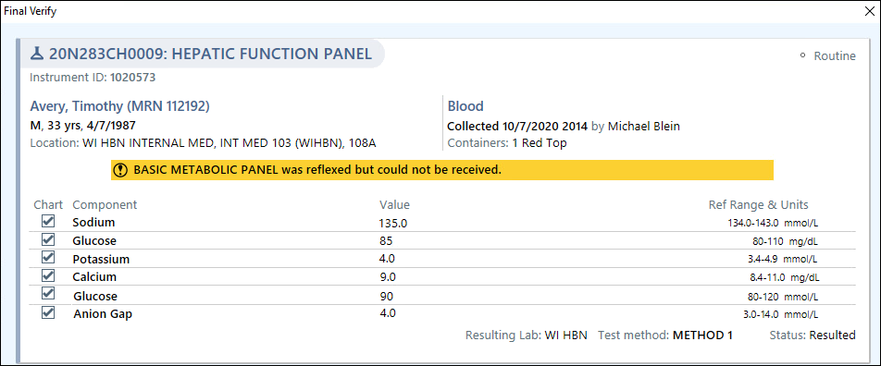
New Warning About Pending Orders When a Reflex is Partially Successful
Good
To
Know
When a reflex order is only partially successful, like when a test is ordered as expected but a specimen record can't be created, you now see a warning when Prelim or Final Verifying so you can make sure all the parts of a test are accounted for.
Notes:
RN 757948
Roles:
Lab Techs
Pathologists
Appears in:
Beaker Anatomic Pathology
Beaker Clinical Pathology

Slide 10
Result Routing: Coordination of Care
Good
To
Know
Result Routing now applies for Coordination of Care recipients like it does for other types of orders so Coordination of Care recipients should expect to see result reports more often for orders on which they are not the authorizing or ordering provider. They now also receive In Basket messages when they are added to results as a primary recipient after results are final verified.
Notes:
In addition, Coordination of Care recipients appear in print groups and SmartLinks that show provider contact information and CC List recipients throughout the system.

Slide 11
Results Routing Communication Preferences Update
Good
To
Know
Previously, if a provider's communication preference is InBasket and a user wanted to fax them a copy of results, the provider's fax number appeared in Result Report (By Patient/Specimen) activities only if the provider record has the lab fax number defined.
Now, the RR enhancement will allow the system to automatically pull in the office fax number in case the lab fax number is blank for those providers whose has IB as their communication method.

Slide 12
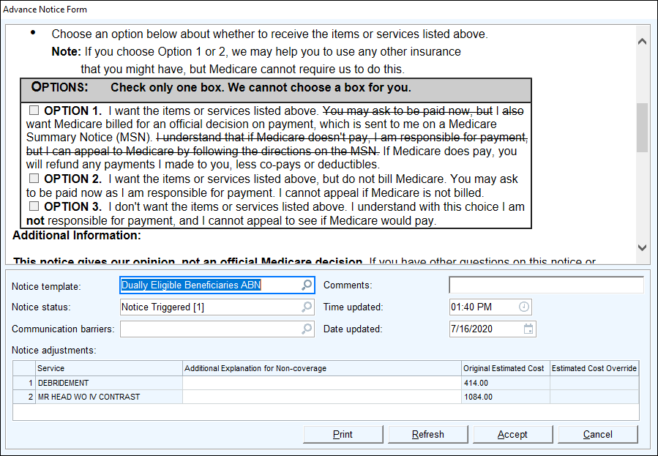
New ABN Template Document for Dually Eligible Beneficiaries
Good
To
Know
Use the new Dually Eligible Beneficiaries ABN template when giving an ABN form to patients who are eligible for both Medicare and Medicaid. The form already has specific lines crossed out so you don't have to cross them out manually to follow CMS guidelines for patients with dual eligibility.
Notes:
Following up with Kaneil and Cadence team to determine if we are implementing this
RN 743019
Appears in:
Beacon
Cadence
EpicCare Ambulatory
Prelude
Roles:
Clinicians
Front Desk Staff
Work with your compliance and build teams to determine how the new form for dually eligible beneficiaries should be used.

Slide 13
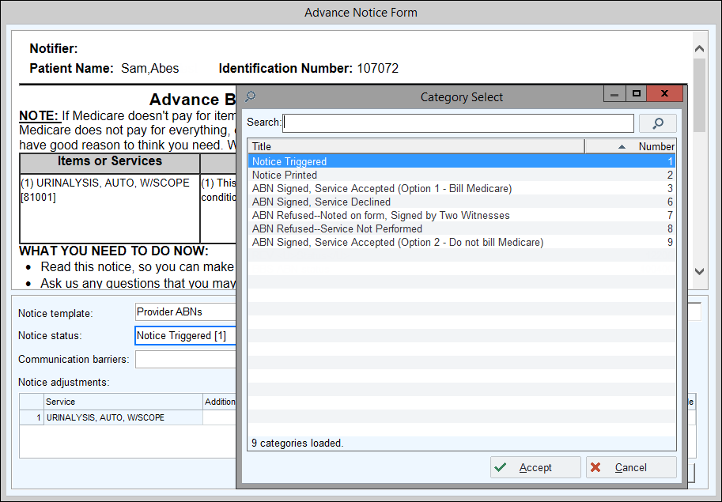
Don't Mark ABNs As Void
Good
To
Know
The ABN Voided status no longer appears as an option when you click on the Notice status field.
Unnecessary ABN’s will be automatically voided, so no manual intervention is needed to change the status manually.
Schegistrar Updates

Slide 14
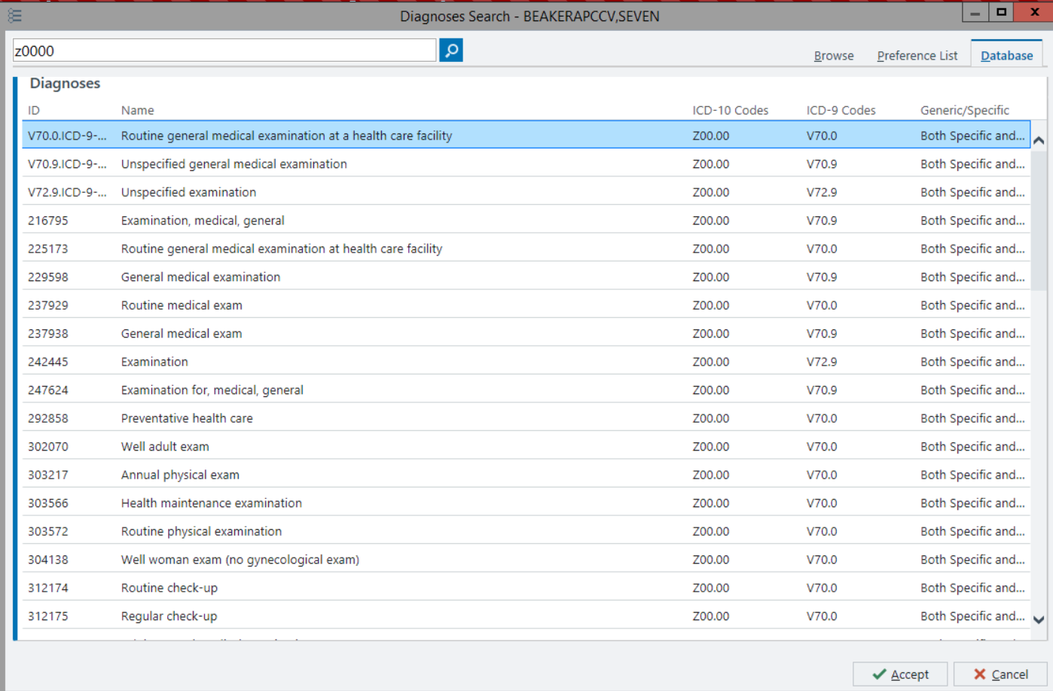
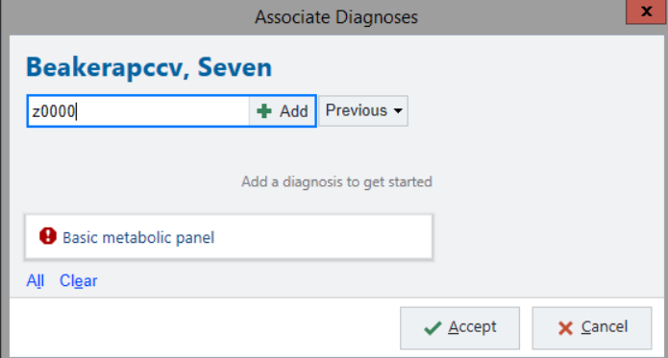
A New Look for Diagnosis Association
Good
To
Know
When Transcribing Orders, users need to Click “Associate Diagnosis before signing an order. There is no change to the workflow when you search for a Diagnosis, you’ll notice a new look to the list of available choices for Diagnosis.
Notes:
RN 733921
Appears in:
EpicCare Ambulatory
EpicCare Inpatient Orders
We recommend assessing the workflows that your clinicians frequently complete and customizing the training slide to meet your needs. For example, the New Problem window looks different and might require training, but it applies only to inpatient workflows. Additionally, the same windows launched from some locations, such as from Order Review, have not changed.

Slide 15
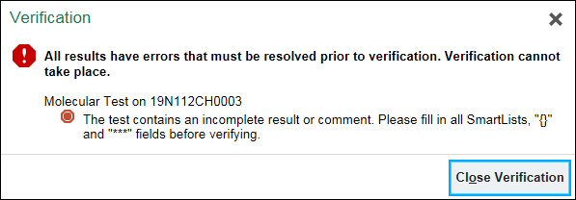
Additional Checks for Missing Information
Good
To
Know
Epic now checks for incomplete SmartLists and wildcards (***) in more results so you have the chance to check that results are really complete before they are verified. This enhancements aims to establish less Result Corrections as fields will not be left blank or incomplete.
Notes:
RN 734906
Appears in:
Beaker Anatomic Pathology
Beaker Clinical Pathology
Roles:
Lab Techs
Molecular Techs
Pathologists

Slide 16
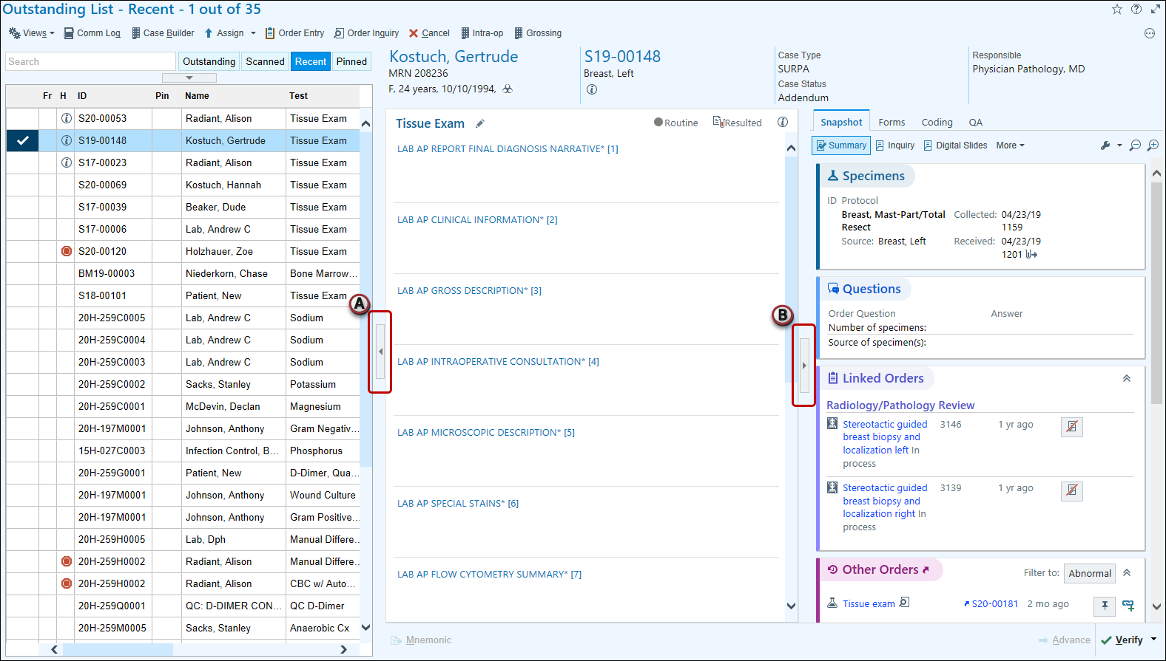
Expand and Collapse Sidebars with Keyboard Shortcut
Good
To
Know
You can use the shortcuts Alt+Shift+ to expand and collapse the (A) left and (B) right panes or sections within them in the following activities:
Batch Editor
Batch List
Downtime Specimen Linking
Follow Up Work List
Result Update
Setup Bench
Outstanding List
Notes:
RN 751674
Appears in:
Beaker Anatomic Pathology
Beaker Clinical Pathology
Roles:
Lab Techs
Pathologists
Only the web-migrated versions of the listed activities include the new shortcuts, so you should remove the following activities from the list if you have not yet enabled them:
Batch Editor (available starting in August 2020)
Follow Up Work List (which is available starting in November 2020)
Outstanding List (which is available starting in Epic 2018 for molecular tests and August 2019 for AP tests)
Result Routing Home (which is available starting in August 2020)

Slide 17
“Previous Values” Report Comments Field Updated
Good
To
Know
To keep the report that appears when you hover over previous values easy to scan, we removed the full comments. Now, an icon indicates when a comment is present. Click the link for the value that you hovered over to see the full comment.
Notes:
RN 762094

Slide 18
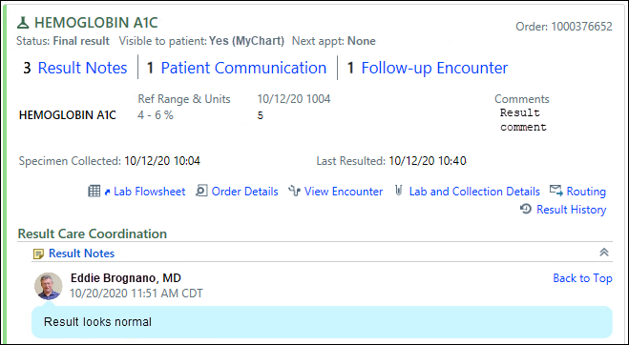
Navigate Through Results Print Groups Quicker with a New Navigation Bar
Good
To
Know
When reviewing a result in a print group, clinicians can now more easily identify whether a result note, patient communication, or follow-up encounter is already attached to the result with a new navigation bar. This bar appears at the top of the print group and has links to jump to specific sections in the print group. When a clinician is done reviewing one of these sections, they can click Back to Top to quickly jump to the beginning of the result.
Notes:
Note that only the Result Notes section still appears in the navigation bar when there are zero result notes. Other sections, such as Follow-up Encounters, do not appear in the navigation bar when there isn't any of that information on the result.

Slide 19
Set Up Bench Manual activity in Specimen Inquiry
Good
To
Know
In Specimen Inquiry, you can see when a specimen is manually added to or removed from the Setup Bench to make it easier to figure out how a test was processed and investigate its current status.
Notes:
RN 744236
Roles:
Lab Manager
Lab Tech
Pathologists
Appears in:
Beaker Anatomic Pathology
Beaker Clinical Pathology

Slide 20
Edit Verified Order Links in Order Linking
Good
To
Know
You can now edit links in a verified order or links to a verified order in an in-progress order, as long as the verified order is not included in result reports. This allows you to correct unreported results directly in the Order Linking activity or order linking print groups.
Notes:
Need more information on this change
RN 752506
Appears In:
Beaker Anatomic Pathology
Beaker Clinical Pathology
Roles:
Lab Techs
Pathologists
Phlebotomists

Slide 21
SmartPhrase Manager: New Look
SmartPhrase Manager has a new look.
Check out the new It’s Possible Video on “Borrowing SmartPhrases” which can be linked to directly from within Epic.

Slide 22
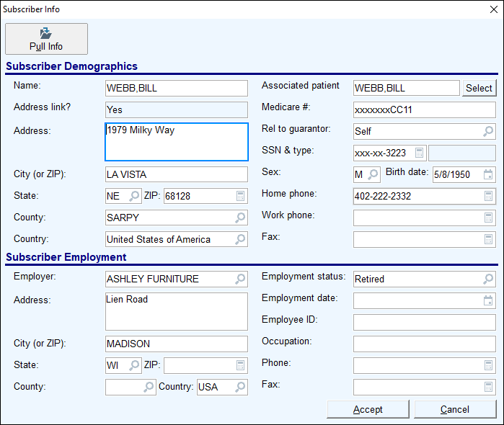
Automatically Pull a Patient's Coverage Info
Good
To
Know
When creating a coverage from a Real Time Eligibility response where the patient's relationship to subscriber is "self," the system now automatically populates the coverage with the patient's demographic information.
Previously, you had to click the Pull Info button to populate this information.
Schegistrar Updates
Notes:
Patient access –upgrade

Slide 23
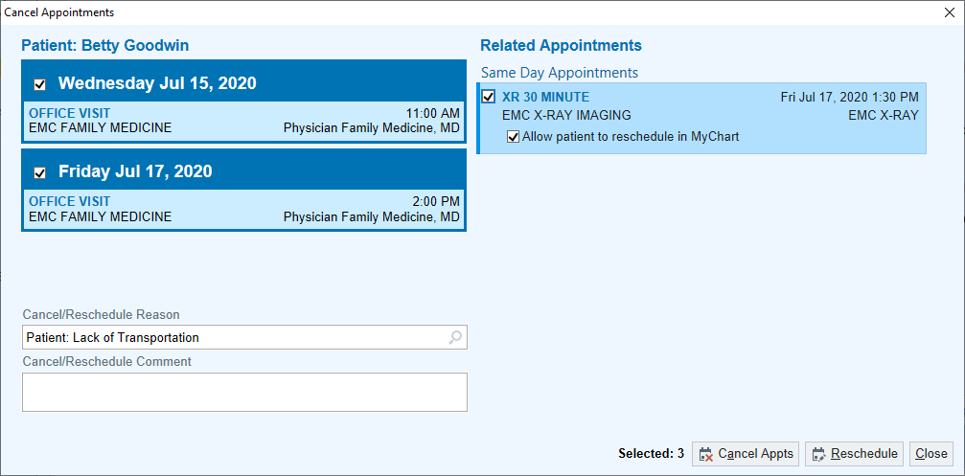
A New Look for Canceling and Rescheduling Appointments
Good
To
Know
When canceling or rescheduling appointments, a new Cancel Appointments window opens.
Clicking Cancel Appts or Reschedule, closes the window
Linked appointments will appear in the Related Appointments section on the right of the window,
Schegistrar Updates

Slide 24
Rover

Slide 25
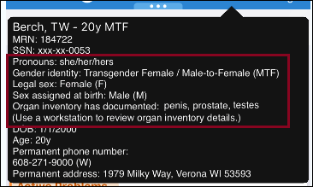
See a Patient’s Sex and Gender Identity Information in Mobile Tooltips
When you tap and hold a patient's name, information about their documented sex and gender identity now appears.

Slide 26
Chart Review

Slide 27
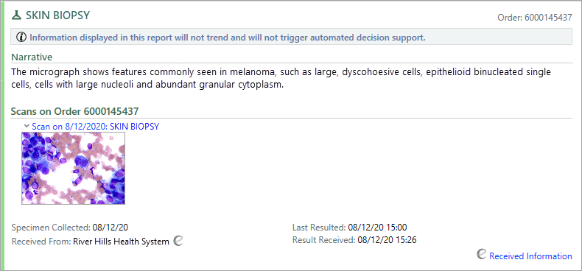
Images Appear for External Lab Results in Chart Review
Good
To
Know
When you receive images for lab results from outside organizations, you can now see them in the Labs tab of Chart Review. Before this change, images appeared only in the Media tab or in a Care Everywhere document.
Notes:
RN 761361
Roles:

Slide 28
Quickly View Encounters for External Lab Results
Good
To
Know
A new View Encounter link appears for external lab results in the Labs tab of Chart Review. You can click the link to open the Care Everywhere document that included the lab result.
Notes:
RN 762338

Slide 29
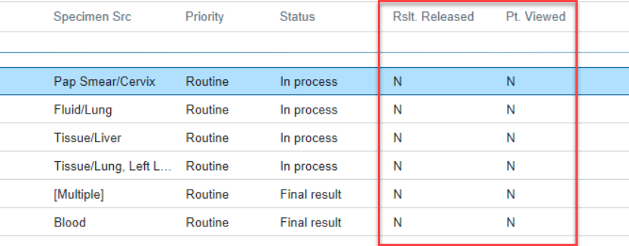
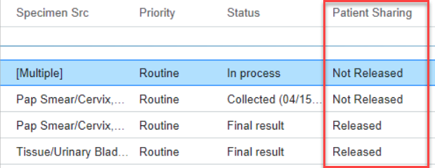
New Patient Sharing Column in Chart Review
Good
To
Know
The new Patient Sharing column in Chart Review shows the current status of a result and whether it’s been released to the patient. This column replaces two columns: Rslt Released and Patient Viewed.
OLD
NEW
Notes:
RN 758389

Slide 30
Search for Labs Using Component Values and Comments
Good
To
Know
You can now search for labs using the text of component values and comments.
Notes:
RN 760575

Slide 31
New Look for Care Everywhere Documents
Good
To
Know
To align more closely with Chart Review, we've updated the appearance of Care Everywhere documents. For example, most action buttons now appear in the report toolbar. Also, you can use the wrench icon to modify your preferred section order.
Notes:
RN 750554

