Slide 1
Laboratory Safety Orientation and Training
Department of Pathology and Genomic Medicine
Created 5/25/2017, Updated 12/26/2018, Version 10

Slide 2
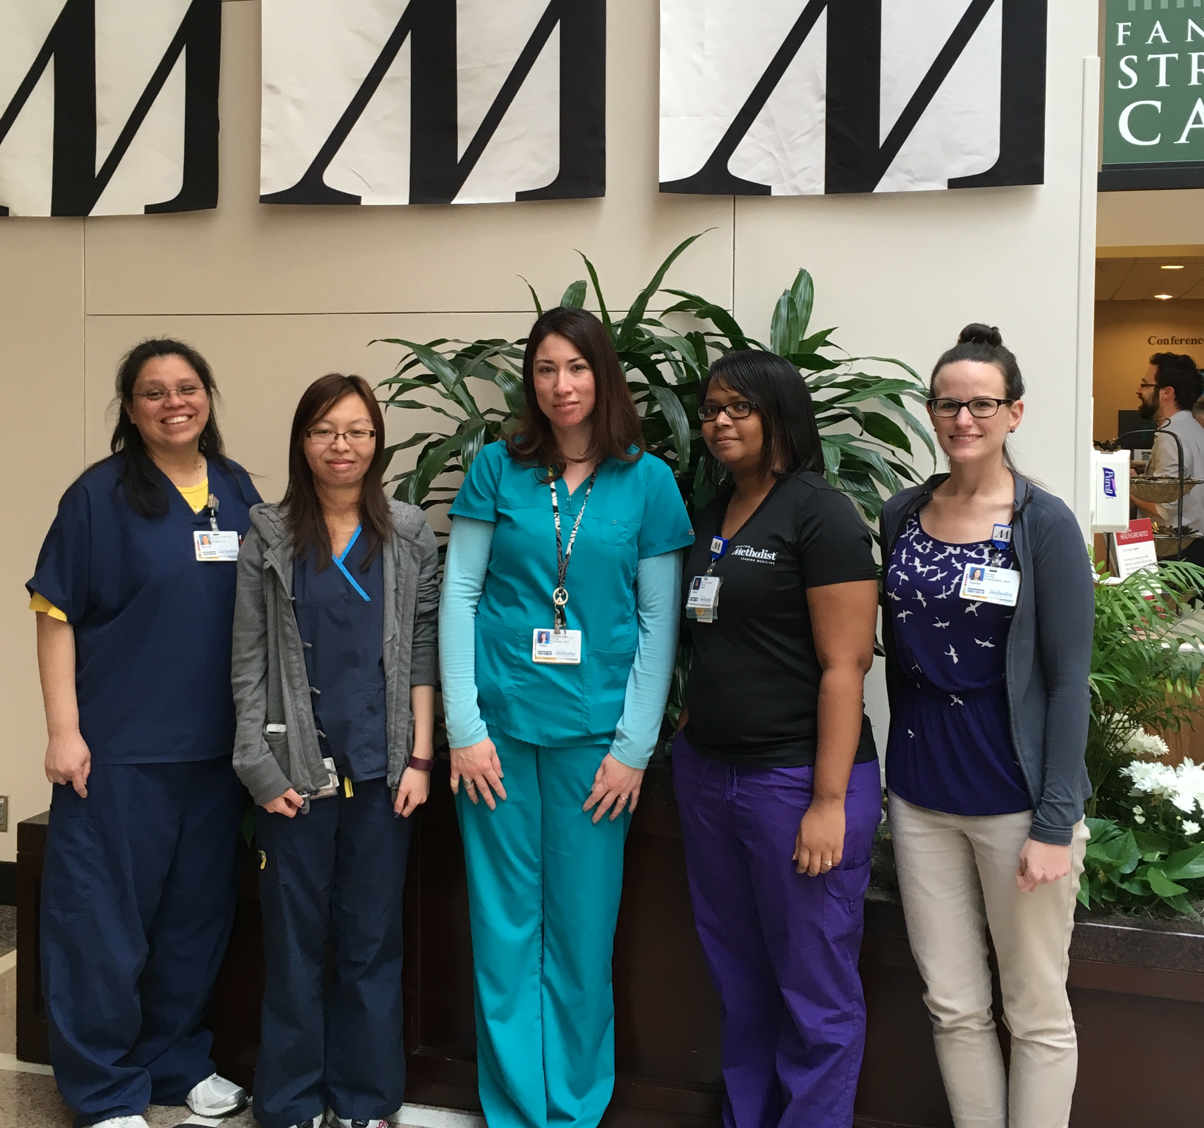
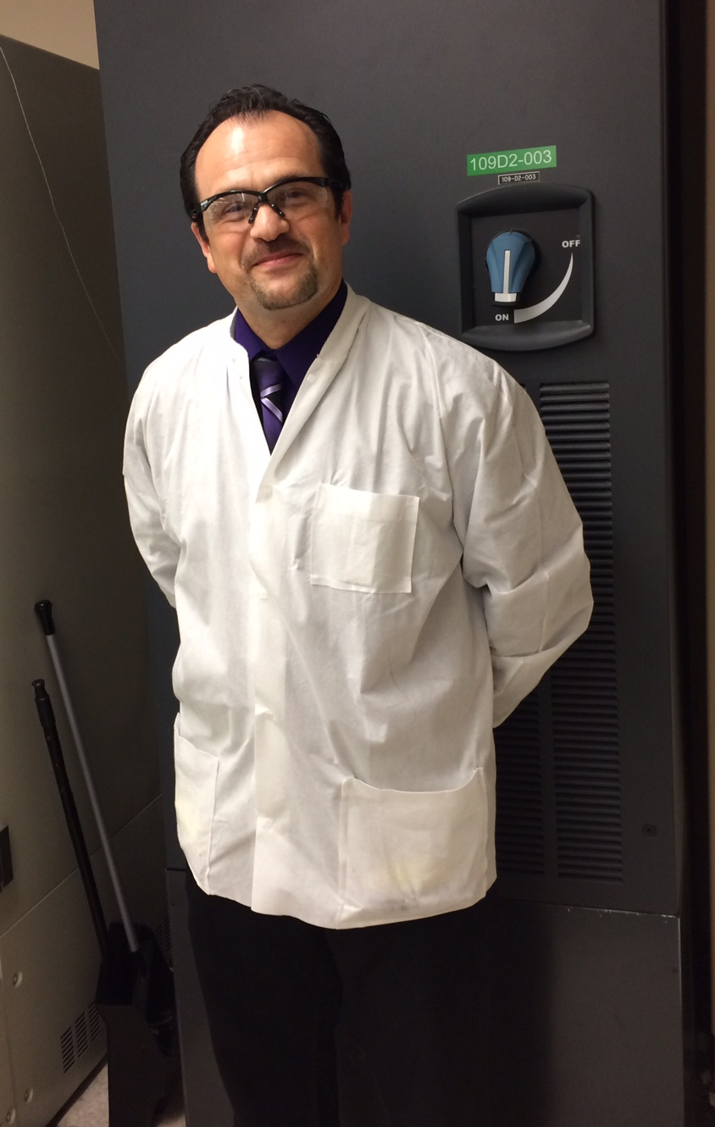
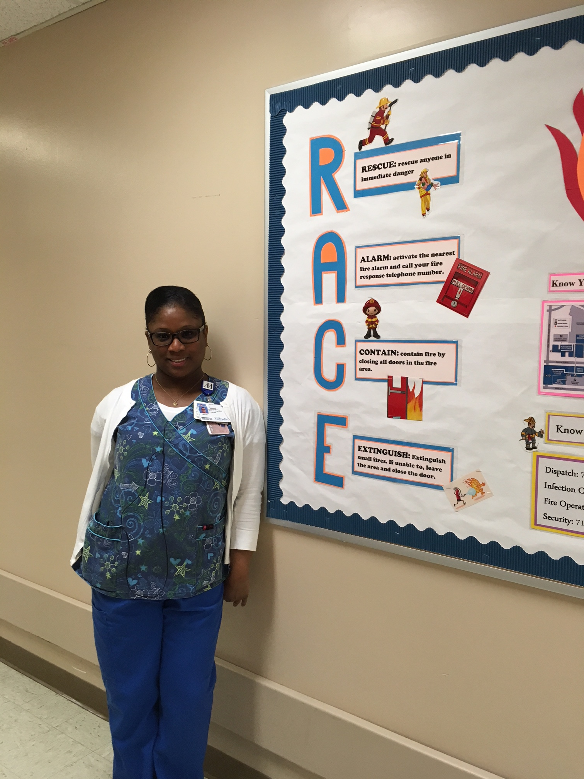
Department of Pathology and Genomic Medicine Laboratory Safety Orientation
Safety Officers
David Barefield, Core Lab
Ashley Siverly, Diagnostic Immunology
Robert Scarlett, Outpatient Lab
Diedre Williams, HLA/Flow
Diann McAlpin, Outpatient Lab
Vacant, Pathology Administration
Uma Narra, Histology
Page Slocum, Microbiology
Marcella Sustaita, Blood Bank
Bonnet Bazile, Microbiology
Heather Hendrickson, Chair of Safety Committee
Luis (Al) Jimenez, Core Lab
Nadara Bishop, Core Lab
Tammi Haynes, Molecular
Dorathy Akpan, Microbiology
Ivonne Vega, Cytology

Slide 3
Department of Pathology and Genomic Medicine Laboratory Safety Orientation
Safety Standard Operating Procedures
Safety standard operating procedures to read
Sharepoint link: safety procedures

Slide 4
Department of Pathology and Genomic Medicine Laboratory Safety Orientation
HMH Environmental Health & Safety
Intranet link: http://www.tmh.tmc.edu/dept/Safety/home.htm

Slide 5
Department of Pathology and Genomic Medicine Laboratory Safety Orientation
Emergency Procedures Guide: Also known as the “Yellow Book”
Link to access this guide on the intranet:
http://www.tmh.tmc.edu/dept/Safety/Emergency_Guide_Index.htm
Why is this book useful?
Useful as a reference for many different scenarios.
Eg. Your co-worker Mary is complaining of heart pain and suddenly falls. What do you do? Refer to the cardiac arrest section of the yellow book.
Location – refer to your specific safety representative.

Slide 6
Department of Pathology and Genomic Medicine Laboratory Safety Orientation
Emergency Codes
Emergency Code Name | Emergency Code Meaning
Red | Fire
Blue | Cardiac Arrest
Pink | Infant/Child Abduction
Orange | Bomb Threat
Purple | Security Needed
Yellow | Disaster
Silver | Active Shooter
Grey | Severe Weather
Gold | Accreditation

Slide 7
Department of Pathology and Genomic Medicine Laboratory Safety Orientation
Emergency Preparedness plan
Emergency Preparedness Procedure: LAB020
Employee’s role in the event of a disaster
Lab section specific
Refer to your manager for your role in the event of a disaster.
What is Ride out versus Recovery?
Ride out team: According to each lab section’s staffing needs, this team comes prepared to stay for the duration of the incident or until released.
Recovery team: Those not on the ride out team come to relieve the ride out team.
Periodically call into Employee Disaster Information line, 713-441-6733, for updates

Slide 8
Department of Pathology and Genomic Medicine Laboratory Safety Orientation
Emergency Management
Link to the HMH Emergency Management Plan
Scenarios
Severe Weather (Code Grey)
Mass casualty (Code Yellow)
Bomb threat (Code Orange)
Active shooter (Code Silver)

Slide 9
Department of Pathology and Genomic Medicine Laboratory Safety Orientation
Emergency Preparedness
Severe Weather Scenario (Code Grey)
Communication: Everbridge mass communication
Ensure your information is up to date in MARS. This is how Everbridge communications to employees.
Await communication from your leader about next steps.

Slide 10
Department of Pathology and Genomic Medicine Laboratory Safety Orientation
Emergency Preparedness
Mass Casualty Scenario (Code Yellow)
Activation of command center
Department unit leader (Tech in charge, Lab Manager, Lab administrative director) assesses staffing, inventory & reports to command center
Await communication from your leader for next steps.

Slide 11
Department of Pathology and Genomic Medicine Laboratory Safety Orientation
Emergency Preparedness
Bomb threat scenario (Code Orange)
Activation of command center
Department unit leader (Tech in charge, Lab Manager, Lab administrative directo) assesses staffing, inventory & reports to command center
Await communication from your leader for next steps.

Slide 12
Department of Pathology and Genomic Medicine Laboratory Safety Orientation
Emergency Preparedness
Active Shoot scenario (Code Silver)
Accept that incident is occurring
Assess the situation and determine next steps
Act
Avoid by getting out of danger
Barricade yourself and other by securing your environment and sheltering in place
Fight back if no other options exist to protect yourself and others
Alert as soon as possible by calling police/security

Slide 13
Department of Pathology and Genomic Medicine Laboratory Safety Orientation
Personal Protective Equipment
Liquid impervious lab coats
Nitrile gloves (our lab only uses latex free gloves)
Face shields
Goggles/Safety glasses
Gooseneck safety shield with magnetic base
Fume hoods
Grossing stations
Biosafety cabinets
BSL2
BSL3 (microbiology only)
Powered air purifying respirator (PAPR)

Slide 14
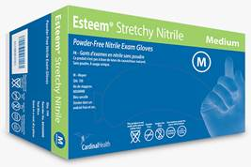
Department of Pathology and Genomic Medicine Laboratory Safety Orientation
Nitrile Gloves
Laboratory standardized nitrile gloves
Cardinal Esteem Tru-Blu Stretchy Nitrile gloves
Cardinal Esteem Stretchy Nitrile gloves
Latex gloves are not permitted per LAB 050
The certain sections of the anatomic pathology department use a longer cuff cardinal nitrile glove

Slide 15
Department of Pathology and Genomic Medicine Laboratory Safety Orientation
Why is PPE important?
Why is PPE important?
Protection from:
Exposures
Splashes
Cuts
That can lead to:
Blood borne pathogen exposure
Infectious aerosols
Infectious pathogens
Skin, eye or face injury

Slide 16
Department of Pathology and Genomic Medicine Laboratory Safety Orientation
Morgue PPE Don & Doff
Morgue PPE Don & Doff
Donning PPE key point
Wearing appropriate thicker nitrile gloves
Wearing cut gloves
Doffing PPE key point
Remove gloves, then face shield

Slide 17
Department of Pathology and Genomic Medicine Laboratory Safety Orientation
Disposing PPE
Disposing PPE
All disposable PPE (including but not limited to liquid impermeable lab coats, face shields, gloves) should be discarded in the biohazardous trash at all times.
Though PPE may not appear to be soiled, it is our policy to discard in the biohazardous trash to mitigate any risk of exposure.
Please do not discard lab coats, face shields or gloves in sharps containers.

Slide 18
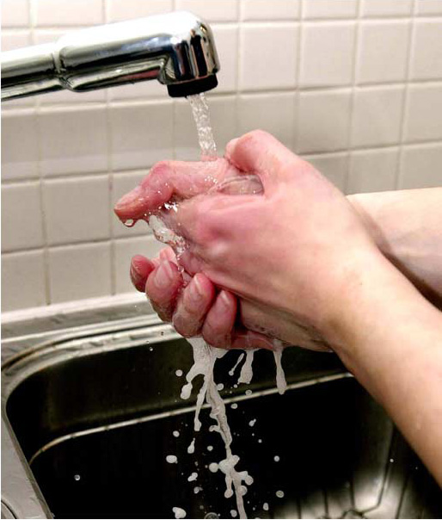
Department of Pathology and Genomic Medicine Laboratory Safety Orientation
Hand Washing & Hand Hygiene Policy
Why is hand washing important?
It is one of the most important steps in prevention of spreading pathogens to other surfaces in the hospital, hospital acquired infections and food contamination. Proper hand washing technique removes infectious organisms present on the hands.
Link to Hand Hygiene Policy

Slide 19
Department of Pathology and Genomic Medicine Laboratory Safety Orientation
Infection Prevention
Why is it important to remove gloves before touching door handles?
To prevent the spread of infectious fluids or blood borne pathogens to colleagues, patients and visitors.
Eating, drinking, smoking, handling contact lenses, applying cosmetics and storing food for human use are not permitted in the laboratory work areas.

Slide 20
Department of Pathology and Genomic Medicine Laboratory Safety Orientation
Infection Prevention
Do not dispose of empty cups or food trash in lab work areas.
This is a HMH policy and best practice that eliminates the question of whether or not our team is following the no eating or drinking in the work area policy.
Dirty lab coats or other personal protective equipment may not be worn outside of the laboratory.
Supplies must be stored at least 4” off the floor.
This is to allow adequate clearance for the floors underneath to be kept clean and free of pests.
4”

Slide 21
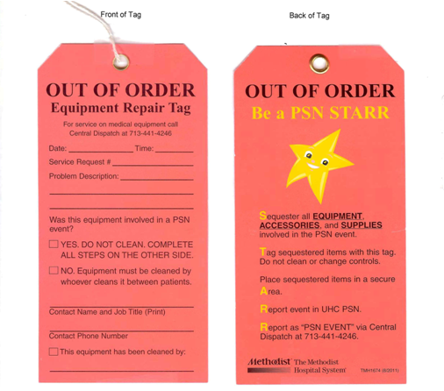
Department of Pathology and Genomic Medicine Laboratory Safety Orientation
PC/PS104 and HMLAB002
Equipment Problems
PSN/SI STARR TAG
Biomed is responsible for the maintenance and repair of all medical equipment.
When there is a problem with medical equipment, lab leadership and biomed need to be notified.
A service request can be made on the intranet under “Frequently Accessed Pages” or call 713-441-4246 Central Dispatch.

Slide 22
Department of Pathology and Genomic Medicine Laboratory Safety Orientation
PC/PS104 and HMLAB002
Equipment Problems
PSN/SI STARR TAG
PSN STARR tag:
Date and time of the request
Service request number which will be provided by Central Dispatch or intranet request.
A description of the problem.
If the equipment was involved in a PSN.
Name, title and contact number of the person making the request.
Equipment has been cleaned and by whom.

Slide 23
Department of Pathology and Genomic Medicine Laboratory Safety Orientation
PC/PS104 and HMLAB002
Equipment Problems
PSN/SI STARR TAG
If the equipment has been involved in a PSN event, the equipment should not be cleaned and none of the controls or settings should be changed. Notify supervisor of PSN event.

Slide 24
Department of Pathology and Genomic Medicine Laboratory Safety Orientation
Red Outlets
Red Outlets
These outlets provide emergency power by generator. It takes 15-30 seconds to switch to generator power.

Slide 25
Department of Pathology and Genomic Medicine Laboratory Safety Orientation
Life Safety
Fire Sprinkler 18-inch rule
-The purpose of the “18-inch rule” is to prevent
storage or any other obstruction from interfering
with the spray of water from a sprinkler head
during a fire.

Slide 26
Department of Pathology and Genomic Medicine Laboratory Safety Orientation
Life Safety
Hallway Clearance & Corridor Etiquette
- There must be an unobstructed egress of at least 4 feet from one end of the area to the other.
- All equipment should be stored on one side of the hallway and mobile.
- Equipment or other objects cannot block life
safety systems such as: fire extinguishers, pull
stations, fire exits, fire doors or medical gas shut off
valves.

Slide 27
Department of Pathology and Genomic Medicine Laboratory Safety Orientation
Accreditation
AABB Accreditation
Facilities and Safety
The BB/TS shall have policies, processes, and procedures to ensure the provision of safe environmental conditions.
The facilities shall be suitable for the activities performed
Safety programs shall meet local, state, and federal regulations, where applicable.
Safe Environment
The BB/TS shall have processes to minimize and respond to environmentally related risks to the health and safety of employees, donors, volunteers, patients, and visitors.
Suitable quarters, environment, and equipment shall be available to maintain safe operation
Biological, Chemical, and Radiation Safety
The BB/TS shall have a process for monitoring adherence to biological, chemical, and radiation safety standards and regulations, where applicable
Discard of Blood, Components, Tissue, and Derivatives
Blood, blood components, tissue, and derivatives shall be handled and discarded in a manner that minimizes the potential for human exposure to infectious agents

Slide 28
Department of Pathology and Genomic Medicine Laboratory Safety Orientation
Accreditation
ASHI Accreditation
According to OSHA, all of the US labs are required to have access to updated MSDS Manual.
There is a yellow sticker on every phone in the lab that contain the phone numbers of SDS. Whenever anyone have question on certain chemical, they can call the number and have the data, fax, e-mail, or read it over for you by the phone
The Data is also available on the Houston Methodist Hospital Intranet
Training programs that review the safety requirements for “blood-borne pathogens” including use of personal protective equipment will be provided in the Safety orientation that given to all of the new employees and visitors.
It is very important to don the PPE while collecting, transport, storage, and handling of blood and tissue specimens
All labs must have a policy that describes its plan to respond to an internal and external disaster’s impact on laboratory operation
It is recommended the lab to develop one or more written agreements with outside laboratories capable of accepting transferred tests in the event of an internal or external disaster.
During the natural disaster, all labs need to make sure the emergency power supplies are available for the essential testing equipment and freezers to keep the lab work going
The laboratory’s floor plan and traffic flow must ensure that amplified material cannot be return to a pre-amplification area
Everyone needs to use the dedicated lab coats, gloves and disposable supplies in the pre-amplification area.
It is also very important to know the PPE that were used in the pre-amplification area do not be taken to the post area and vise versa.
All of these are to ensure our own safety to the exposure to the specimens and avoiding cross contamination
All of the laboratories are required to establish and follow a written policy to ensure the confidentiality of the patient record
Test results must be released only to authorized persons and the individual for using the test results and/or to the laboratory that initially requested the test
This is a big part of patient safety that us the staff have to follow

Slide 29
Department of Pathology and Genomic Medicine Laboratory Safety Orientation
Accreditation
CAP Accreditation
Safety procedures have to be posted or available for all employees.
All laboratories injuries and accidents need to be documented and report to Occupational Safety and Health (OSHA)
Accredited labs must have automatic fire extinguishing system and fire doors closing when fire occur
Visual alarm system must be available for the hearing-impaired staff
Fire drills must be performed with all of the lab staff participating once a year
All laboratory equipment and devices need to be grounded and checked before first time using, after modification and repair
Every chemicals in the lab need to be listed and documented. Material Safety Data Sheet (MSDS) have to contain information for each chemical
MSDS must be available to all of the laboratory staff at all times in any format
Personal Protective Equipment (PPE) must be provided and worn whenever using the chemicals.
Universal Precaution: OSHA requires all laboratory staff to be educated on the importance of wearing PPE while handling the patient specimens.
The Environmental Protection Agency regulates and requires all of the bio hazardous waste must be either incinerated or disinfected appropriately before transported to the proper disposal place
All sharp waste should be discarded in the sharp containers with the lid tightly seal around it
Sets of guidelines and policies must be available in the event such as fire, electrical outage, or any other natural disaster
In the policies and procedure, they are required to have a section that pointed the need of the laboratory as well as the evacuation plan for all of the laboratory staff, patients, visitors, and the people with disability.

Slide 30
Department of Pathology and Genomic Medicine Laboratory Safety Orientation
Accreditation
DNV Accreditation
The organization shall have a means for establishing clear expectations for identifying and detecting the prevalence and severity of incidents that impact or threaten patient safety. This shall include medical errors and adverse patient events
Facilities, supplies, and equipment must be maintained to ensure an acceptable level of safety and quality.
All supplies should be stored and maintain properly to ensure their safety (protection against theft or damage, contamination, or deterioration), as well as that the storage practices do not violate fire codes or otherwise endanger patients (storage of flammables, blocking passageways, storage of contaminated or dangerous materials, safe storage practices for poisons, etc.).
All equipment must be inspected and tested for performance and safety before initial use and after major repairs or upgrades.
All equipment must be inspected, tested, and maintained to ensure their safety, availability and reliability.

Slide 31
Department of Pathology and Genomic Medicine Laboratory Safety Orientation
Accreditation
COLA Accreditation
All HM Emergency departments are COLA accredited (except for the Kirby ED)

Slide 32
Department of Pathology and Genomic Medicine Laboratory Safety Orientation
Document Control
Why is document control important?
To ensure all procedures and posted documents are up to date and do not contribute to near misses, patient safety events or employee accidents.
All procedures and policies are in:
Sharepoint for laboratory specific procedures and policies.
Policy tech for all other hospital department procedures and policies.
Posted documents contain:
HMH document control sticker or
Six required DNV elements
Hospital name or logo
Department name
Document title
Creation date
Version number
Page numbers (if 2+ pages long)

Slide 33
Department of Pathology and Genomic Medicine Laboratory Safety Orientation
3E SDS Online SDS
What is 3E SDS Online?
Online chemical search portal
Where the workplace chemical list is located
How do I access 3E SDS Online or SDS sheets?
HM intranet home page frequently accessed pages menu
Call 1-800-451-8346.
All lab phones should have a sticker with this phone number.

Slide 34
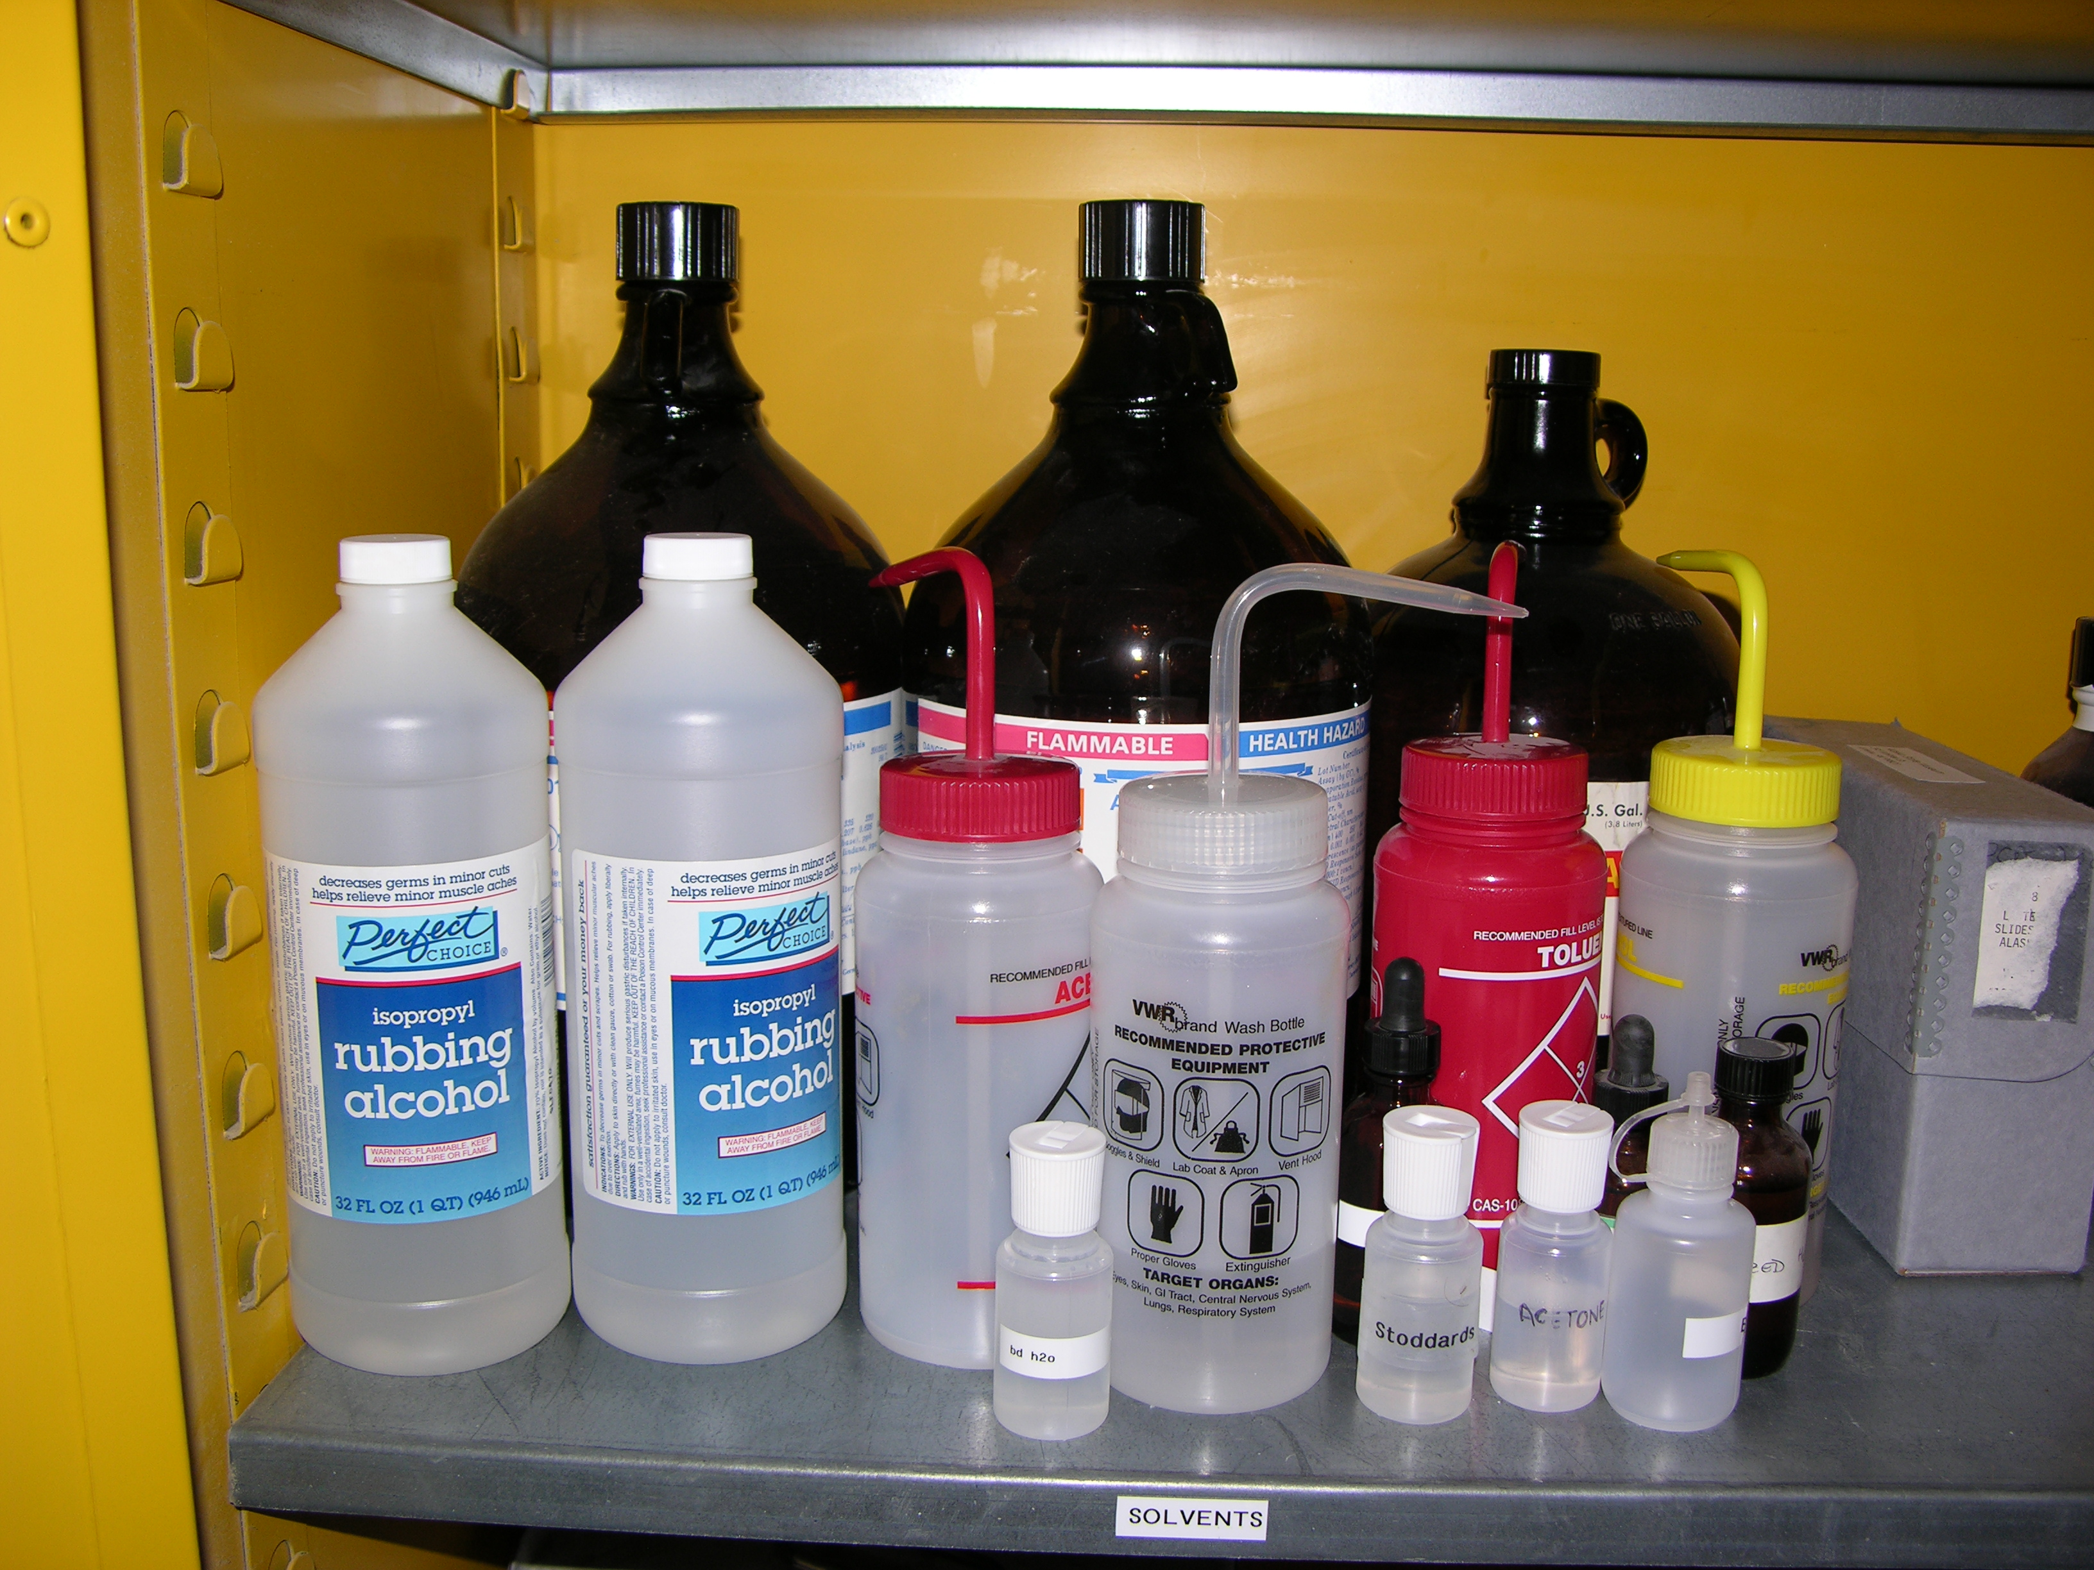
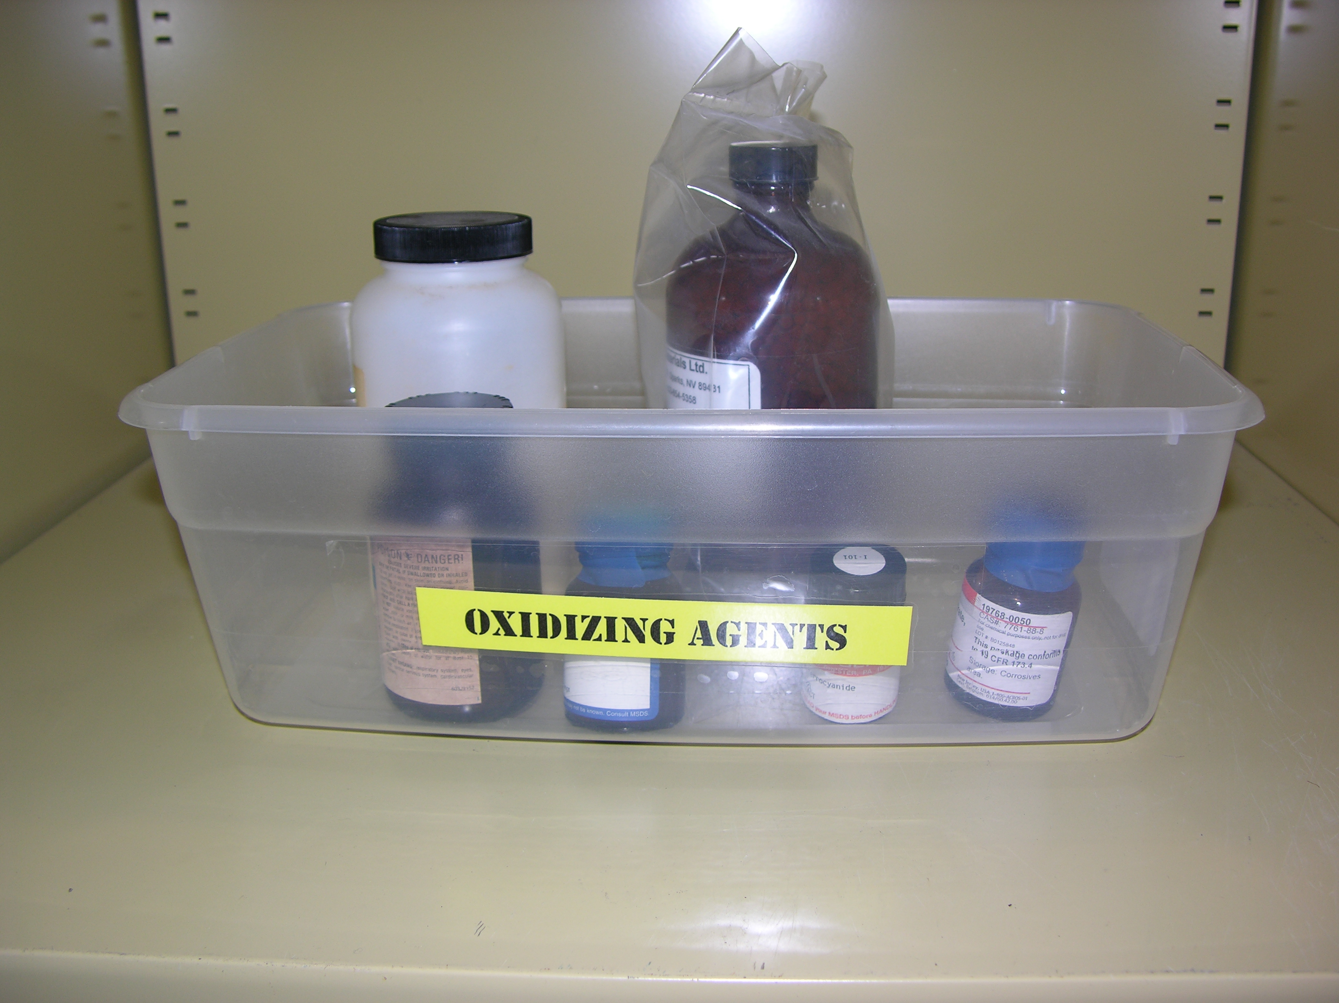
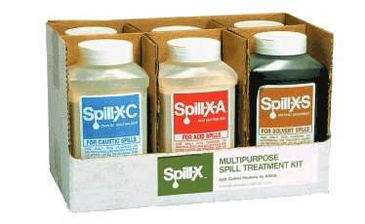
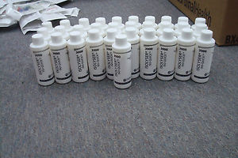
Department of Pathology and Genomic Medicine Laboratory Safety Orientation
Spills
Prevention
Prevention is the key to ensure a healthy and safe work environment. The following tips can help in prevention of spills.
Do not over fill the containers
Secure lid at all times
Chemicals are to be kept in the biohazard safety cabinet and never stored on the floor.
Hazardous chemicals outside of flammable or chemical cabinets must be stored in a secondary container.
Cleaning Up Spills
Contain and absorb small spills with appropriate absorbent. Discard in red biohazard bag.
Each lab department has a small chemical spill and clean up kit.
For large spills that you can’t clean yourself, isolate and notify the Call Center at 713.441.4246 or ext.14246
Please refer to Yellow Book for any additional questions.

Slide 35
Department of Pathology and Genomic Medicine Laboratory Safety Orientation
Hazards Communication
Globally Harmonized System of classification and labeling of Chemicals (GHS)
Flammable, Toxic material, Toxic to environment, Corrosives
Manufacturers are required to put these labels on hazardous chemicals
If an aliquot greater than 50mL is created for any hazardous chemical, these GHS labels must be applied to the bottle and follow the laboratory procedure for labeling of reagents.
Information for each hazardous chemical can be found on the 3E Online on the hospital intranet page.
OSHA link: http://www.osha.gov/dsg/hazcom/index.html

Slide 36
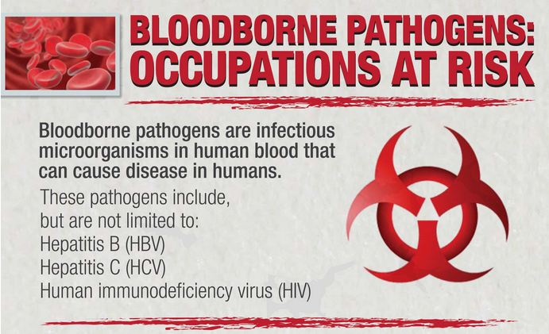
Department of Pathology and Genomic Medicine Laboratory Safety Orientation
Exposures
Link to policy tech IC40 Exposure control plan (http://hhvappdcsp01/dotNet/documents/?docid=38683 )
Infection control cell phone (713-441-1391)
After 4:00 pm please contact Infection Control at 713-404-7106 pager or 713-306-7848 cell)
During EHC hours
Employee goes directly to Clinic
After hours
Employee notifies (TIC, Chief Tech, MGMT, Director or Medical Director)
Infection Control notified, Employee goes to ED
Blood is collected and tested
Employee follows up with EHC next business day
Obtaining Source blood
During EHC hours; Clinic is responsible
After hours; Infection Control, Operations Admin or Nurse on floor collect blood
How to remain Confidential during after hours
Refuse ED draw; Report to EHC next business day

Slide 37
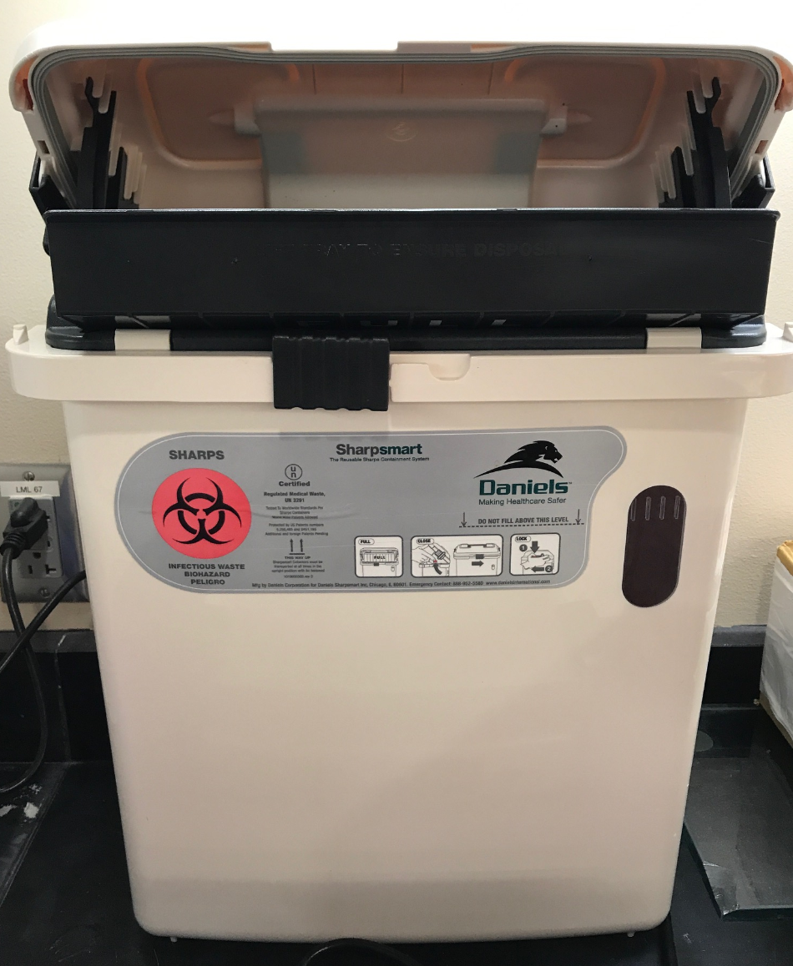
Department of Pathology and Genomic Medicine Laboratory Safety Orientation
Sharps
What is appropriate to discard in sharps containers?
All supplies with needles
Disposable scalpels
Glass slides
Broken glass tubes
Plastic pipette tips
Phlebotomy Sharps
64 Gallon
32 Gallon
Sharps containers are never to be overfilled
All lab sections are on a weekly replacement schedule but if many sharps containers are full:
Call dispatch at 713-441-4246 to request sharps container replacement
Small bench top sharps container

Slide 38
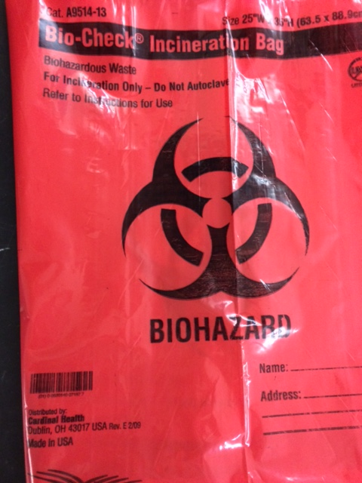
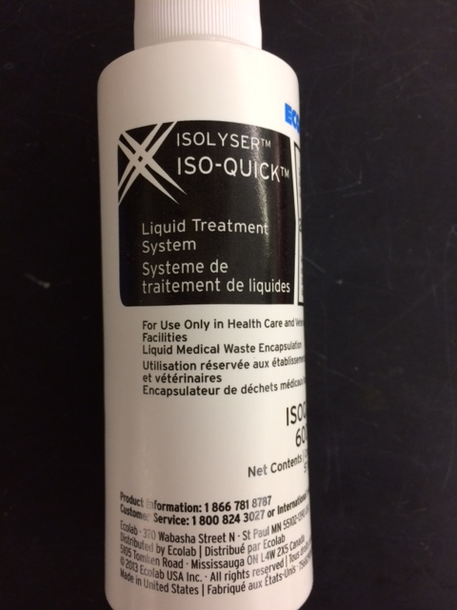
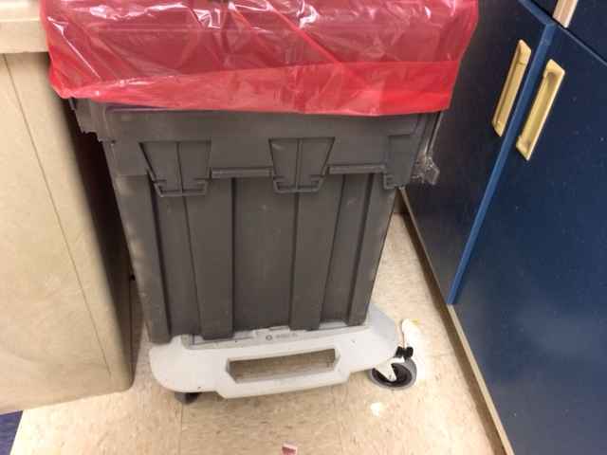
Department of Pathology and Genomic Medicine Laboratory Safety Orientation
Biohazard Bins
All Biohazardous containers must be properly labeled in accordance with HMH waste management procedures
Biohazard Bins
A. Place 2 red Bio-Check Incineration bags in a biohazard bin and
pour one bottle of the adsorbent material Isolyser Iso-Quick into the bin
B. Medical Waste that SHOULD go in Biohazard Bins:
All used gloves All PPE
Saturated bandages Blood-saturated items
Saturated gauze Visibly bloody plastic tubing, All specimens Closed disposable sharps containers
C. NEVER put the following items in the red incineration bags:
Medication Garbage
Loose sharps Radioactive waste
Batteries Hazardous & chemical waste Compressed gas cylinders Fixatives & preservatives
D. Never overfill the incineration bags. Only fill three quarters full.
*For specific workstations that discard heavy biohazardous waste,
the fill line will be adjusted to a lower level (2/3 or 1/2 full).
E. Tie off the top of Bio-Check Incineration bags when full.
F. Close the gray biohazard bin.
G. For the Core Lab, deliver the gray biohazard bin to room D214
H. For other labs, call dispatch at 713-441-4246 to pick up biohazard
bins.
I. Phone dispatch at 713-441-4246 to request more gray
biohazard bins or Bio-Check Incineration Bags.

Slide 39
Department of Pathology and Genomic Medicine Laboratory Safety Orientation
Emergency Eyewash and Safety showers
Emergency Eyewash and Shower Statements
Emergency Showers:
Upon installation, functionality of the safety showers is performed by a third party vendor and monitored by HMH Facilities Management Services (FMS). Signage and evaluation for necessity is conducted by Environmental Health and Safety (EHS) in collaboration with HMH FMS. Visual examination and activation of the plumbed systems are performed weekly by a third party vendor contracted by HMH FMS. Yearly maintenance and function verification are also performed either by HMH FMS or a third party vendor. Emergency showers are tested and maintained according to the ANSI Z358.1-2009 Standard. Records are maintained by HMH FMS.
Emergency Eyewashes:
Certification of flow, pressure, and temperature is performed during installation of the emergency eyewashes. Signage and evaluation for necessity is conducted by Environmental Health and Safety (EHS) in collaboration with HMH Facilities Management Services (FMS). Emergency eyewashes are tested and maintained according to the ANSI Z358.1-2009 Standard. Weekly function and maintenance tasks are performed and documented by each Department of Pathology and Genomic Medicine section. Yearly maintenance tasks are performed either by HMH FMS or a third party vendor contracted by HMH facilities. Yearly maintenance records are maintained by HMH FMS.

Slide 40
Department of Pathology and Genomic Medicine Laboratory Safety Orientation
Fire Safety: Code Red
Fire Extinguisher Classification
Steps for addressing a fire
Is there visible smoke or fire?
Activate (R-A-C-E) in (any order)
Rescue: Rescue anyone in immediate danger.
Alarm (Important! Both Steps must be completed to fully alarm throughout the facility):
1. Activate nearest fire pull station.
2. From a safe location call the Fire
Operator (Code Red):
713-790-3300
Contain: Close all doors.
Extinguish: Extinguish the fire, if possible, but DO NOT ENDANGER YOUSELF.
Burning Smell, but no smoke?
Notify Security at 713-441-9511

Slide 41
Department of Pathology and Genomic Medicine Laboratory Safety Orientation
Fire Safety
Know your evacuation routes and meeting points!

Slide 42
Department of Pathology and Genomic Medicine Laboratory Safety Orientation
Nearest fire pull station
Know where your nearest fire pull station is!

Slide 43
Department of Pathology and Genomic Medicine Laboratory Safety Orientation
Medical Gas Cylinders and Emergency oxygen shut off
Medical gas cylinders should be kept in an appropriately secured containment, upright, dry and in a clean condition.
Should the location of emergency oxygen shut off be identified and communicated to departmental staff?
In the event of an emergency, only trained staff within HMH can turn off the medical gases and only if it is safe to do so.

Slide 44
Department of Pathology and Genomic Medicine Laboratory Safety Orientation
Electrical Safety
Houston Methodist Hospital requires power strips that have a circuit breaker.
List of approved power strips.
Tripp-Lite PS-602-HG
Tripp-Lite PS-606-HG
Tripp-Lite PS-615-HG
Leviton 5300-HTS (surge protected)
Leviton 5300-H15 (surge protected)
Leviton 5300-HT2 (surge protected)
Extension cords shall not be substituted as permanent wiring.
Power strips cannot be daisy chained.

Slide 45
Department of Pathology and Genomic Medicine Laboratory Safety Orientation
Culture of Safety
Our mission is to establish a safe and health conscious working environment by providing leadership and encouragement to make safety and health a top priority.
Working together
The best way to prevent an accident.
STOP
SAFETY
STARTS
HERE

Slide 46
Department of Pathology and Genomic Medicine Laboratory Safety Orientation
Culture of Safety
What can we do?
Wear appropriate safety equipment
Communication makes us a stronger team
Participate in all safety training and drills
Share safety suggestions with your supervisor, manager or director
If you see something, say something

