Slide 1
Laboratory Medicine Safety Orientation Updates
Department of Pathology and Genomic Medicine
Created 5/27/2021

Slide 2
Department of Pathology and Genomic Medicine Laboratory Safety Orientation
This safety orientation will cover the following topics:
General, Hospital and Laboratory Safety
Fire & Equipment Safety
Chemical Safety
Blood-borne Pathogen Safety

Slide 3
Department of Pathology and Genomic Medicine Laboratory Safety Orientation
Safety Officers
Safety Representative | Department | Safety Representative | Department
Dorothy Akpan | Microbiology, Night | Vacant | Histology, Night
Cattareya Farrar | Core Lab, AM | Aurora Ramirez | Blood Donor Ctr. AM
Jona Garcia | Microbiology, PM | Erica Saunders | Histology, PM
Sanskruti Gaikaiwari | Core Lab, PM | Robert Scarlett | OPC
Aisha Mahmoud | CSR, PM | Ashley Siverly | Immunology, AM
Diann McAlpin | OPC | Trey Stevens | Blood Bank, AM
Umadevi Narra | Histology, AM | Kasondrah Stoops | Lab Admin.
Tessa Owen | Microbiology, AM | Jessica Varisco | Blood Admin. Coordinator
Duong Pham | Molecular DX, AM | Ivonne Vega | Cytology, AM
Audrey Ponce de Leon | Flow Cytometry, AM | Diedra Williams | HLA, AM

Slide 4
Department of Pathology and Genomic Medicine Laboratory Safety Orientation
GENERAL SAFETY

Slide 5
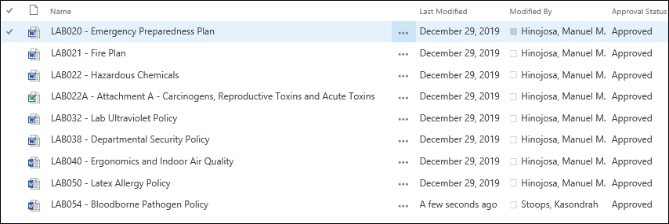
Department of Pathology and Genomic Medicine Laboratory Safety Orientation
Safety Standard Operating Procedures
Safety standard operating procedures to read
Sharepoint link: safety procedures

Slide 6
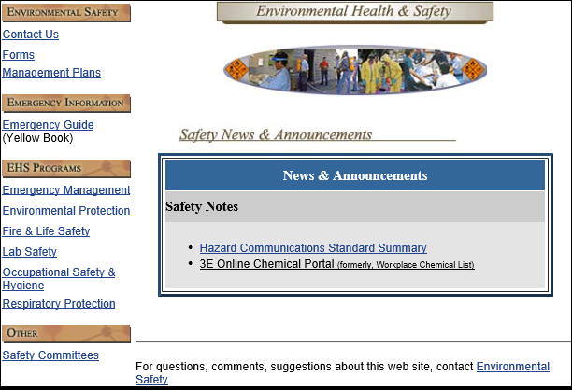
Department of Pathology and Genomic Medicine Laboratory Safety Orientation
HMH Environmental Health & Safety
Intranet link: http://www.tmh.tmc.edu/dept/Safety/home.htm
Site Includes:
Chemical Safety Plan
Biosafety Manual

Slide 7
Department of Pathology and Genomic Medicine Laboratory Safety Orientation
Emergency Procedures Guide: Also known as the “Yellow Book”
Link to access this guide on the intranet:
Emergency Yellow Book
Why is this book useful?
Useful as a reference for many different scenarios.
Eg. Your co-worker Mary is complaining of heart pain and suddenly falls. What do you do? Refer to the cardiac arrest section of the yellow book.
Location – refer to your specific safety representative.

Slide 8
Department of Pathology and Genomic Medicine Laboratory Safety Orientation
Emergency Disaster plan
Procedure: LAB020
Employee’s role in the event of a disaster
Lab section specific
Refer to your manager for your role in the event of a disaster.
What is Ride out versus Recovery?
Ride out team: According to each lab section’s staffing needs, this team comes prepared to stay for the duration of the incident or until released.
Recovery team: Those not on the ride out team come to relieve the recovery team.
Periodically call into Houston Methodist Employee Information line, 713-441-6733, for updates

Slide 9
Department of Pathology and Genomic Medicine Laboratory Safety Orientation
Life Safety
Decoration Safety
-Christmas tree are to be artificial and flame
resistant.
-No lit candles, open flames, or spark producing
devices are to be used as decorations.
-Electric lights or decorations are acceptable only
if they are labeled with a U.L. or F.M. approval.
-Do not install any decorations within 18 inches of
the ceiling.

Slide 10
Department of Pathology and Genomic Medicine Laboratory Safety Orientation
PERSONAL PROTECTIVE EQUIPMENT (PPE) & General Lab Safety

Slide 11
Department of Pathology and Genomic Medicine Laboratory Safety Orientation
Do not dispose of empty cups or food trash in lab work areas.
This is a HMH policy and best practice that eliminates the question of whether or not our team is following the no eating or drinking in the work area policy.
Lab coats or other personal protective equipment may not be worn outside of the laboratory.
Supplies must be stored at least 4” off the floor.
This is to allow adequate clearance for the floors underneath to be kept clean and free of pests.
4”

Slide 12
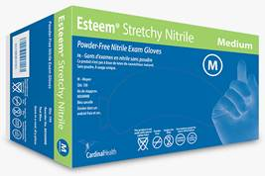
Department of Pathology and Genomic Medicine Laboratory Safety Orientation
Nitrile Gloves
Laboratory standardized nitrile gloves
Cardinal Esteem Tru-Blu Stretchy Nitrile gloves
Cardinal Esteem Stretchy Nitrile gloves
Latex gloves are not permitted per LAB 050
The certain sections of the anatomic pathology department use a longer cuff cardinal nitrile glove

Slide 13
Department of Pathology and Genomic Medicine Laboratory Safety Orientation
Disposing PPE
Disposing PPE
All disposable PPE (including but not limited to liquid impermeable lab coats, face shields, gloves) should be discarded in the biohazardous trash at all times.
Though PPE may not appear to be soiled, it is our policy to discard in the biohazardous trash to mitigate any risk of exposure.
Please do not discard lab coats, face shields or gloves in sharps containers.

Slide 14
Department of Pathology and Genomic Medicine Laboratory Safety Orientation
Infection Prevention
Why is it important to remove gloves before touching door handles?
To prevent the spread of infectious fluids or blood borne pathogens to colleagues, patients and visitors.
Eating, drinking, smoking, handling contact lenses, applying cosmetics and storing food for human use are not permitted in the laboratory work areas.

Slide 15
Department of Pathology and Genomic Medicine Laboratory Safety Orientation
REGULATORY

Slide 16
Department of Pathology and Genomic Medicine Laboratory Safety Orientation
Document Control
Why is document control important?
To ensure all procedures and posted documents are up to date and do not contribute to near misses, patient safety events or employee accidents.
All procedures and policies are in:
Sharepoint for laboratory specific procedures and policies.
Policy tech for all other hospital department procedures and policies.
Posted documents contain:
HMH document control sticker or
Six required DNV elements
Hospital name or logo
Department name
Document title
Creation date
Version number
Page numbers (if 2+ pages long)

Slide 17
Department of Pathology and Genomic Medicine Laboratory Safety Orientation
FIRE SAFETY

Slide 18
Department of Pathology and Genomic Medicine Laboratory Safety Orientation
Fire Safety: Code Red
Fire Extinguisher Classification
Steps for addressing a fire
Is there visible smoke or fire?
Activate (R-A-C-E) in (any order)
Rescue: Rescue anyone in immediate danger.
Alarm (Important! Both Steps must be completed to fully alarm throughout the facility):
1. Activate nearest fire pull station.
2. From a safe location call the Fire
Operator (Code Red):
713-790-3300
Contain: Close all doors.
Extinguish: Extinguish the fire, if possible, but DO NOT ENDANGER YOUSELF.
Burning Smell, but no smoke?
Notify Security at 713-441-9511

Slide 19
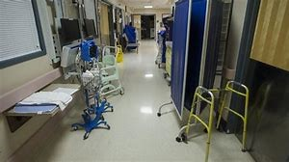
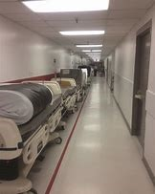
Department of Pathology and Genomic Medicine Laboratory Safety Orientation
Life Safety
Hallway Clearance & Corridor Etiquette
- There must be an unobstructed egress of at least 4 feet from one end of the area to the other.
- All equipment should be stored on one side of the hallway and mobile.
- Equipment or other objects cannot block life safety systems such as: fire extinguishers, pull stations, fire exits, fire doors or medical gas shut off valves.

Slide 20
Department of Pathology and Genomic Medicine Laboratory Safety Orientation
Medical Gas Cylinders and Emergency oxygen shut off
Medical gas cylinders should be kept in an appropriately secured containment, upright, dry and in a clean condition.
Should the location of emergency oxygen shut off be identified and communicated to departmental staff?
In the event of an emergency, only trained staff within HMH can turn off the medical gases and only if it is safe to do so.

Slide 21
Department of Pathology and Genomic Medicine Laboratory Safety Orientation - Contingent
EQUIPMENT SAFETY

Slide 22
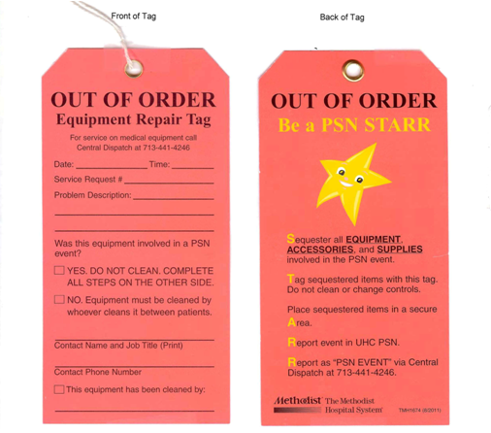
Department of Pathology and Genomic Medicine Laboratory Safety Orientation
PC/PS104 and HMLAB002
Equipment Problems
PSN STARR TAG
Biomed is responsible for the maintenance and repair of all medical equipment.
When there is a problem with medical equipment, biomed needs to be notified.
A service request can be made on the intranet under “Frequently Accessed Pages” or call 713-441-4246 Central Dispatch.

Slide 23
Department of Pathology and Genomic Medicine Laboratory Safety Orientation
PC/PS104 and HMLAB002
Equipment Problems
PSN STARR TAG
PSN STARR tag:
Date and time of the request
Service request number which will be provided by Central Dispatch or intranet request.
A description of the problem.
If the equipment was involved in a PSN.
Name, title and contact number of the person making the request.
Equipment has been cleaned and by whom.

Slide 24
Department of Pathology and Genomic Medicine Laboratory Safety Orientation
PC/PS104 and HMLAB002
Equipment Problems
PSN STARR TAG
If the equipment has been involved in a PSN event, the equipment should not be cleaned and none of the controls or settings should be changed. Notify supervisor of PSN event.

Slide 25
Department of Pathology and Genomic Medicine Laboratory Safety Orientation - Contingent
Emergency Eyewash and Safety showers
Emergency Eyewash and Shower Statements
Emergency Showers:
Upon installation, functionality of the safety showers is performed by a third party vendor and monitored by HMH Facilities Management Services (FMS). Signage and evaluation for necessity is conducted by Environmental Health and Safety (EHS) in collaboration with HMH FMS. Visual examination and activation of the plumbed systems are performed weekly by a third party vendor contracted by HMH FMS. Yearly maintenance and function verification are also performed either by HMH FMS or a third party vendor. Emergency showers are tested and maintained according to the ANSI Z358.1-2009 Standard. Records are maintained by HMH FMS.
Emergency Eyewashes:
Certification of flow, pressure, and temperature is performed during installation of the emergency eyewashes. Signage and evaluation for necessity is conducted by Environmental Health and Safety (EHS) in collaboration with HMH Facilities Management Services (FMS). Emergency eyewashes are tested and maintained according to the ANSI Z358.1-2009 Standard. Weekly function and maintenance tasks are performed and documented by each Department of Pathology and Genomic Medicine section. Yearly maintenance tasks are performed either by HMH FMS or a third party vendor contracted by HMH facilities. Yearly maintenance records are maintained by HMH FMS.

Slide 26
Department of Pathology and Genomic Medicine Laboratory Safety Orientation
CHEMICAL SAFETY

Slide 27
Department of Pathology and Genomic Medicine Laboratory Safety Orientation
Hazard Communication - 3E SDS Online SDS
What is 3E SDS Online?
Online chemical search portal
Where the workplace chemical list is located
How do I access 3E SDS Online or SDS sheets?
HM intranet home page frequently accessed pages menu
Call 1-800-451-8346.
All lab phones should have a sticker with this phone number.

Slide 28
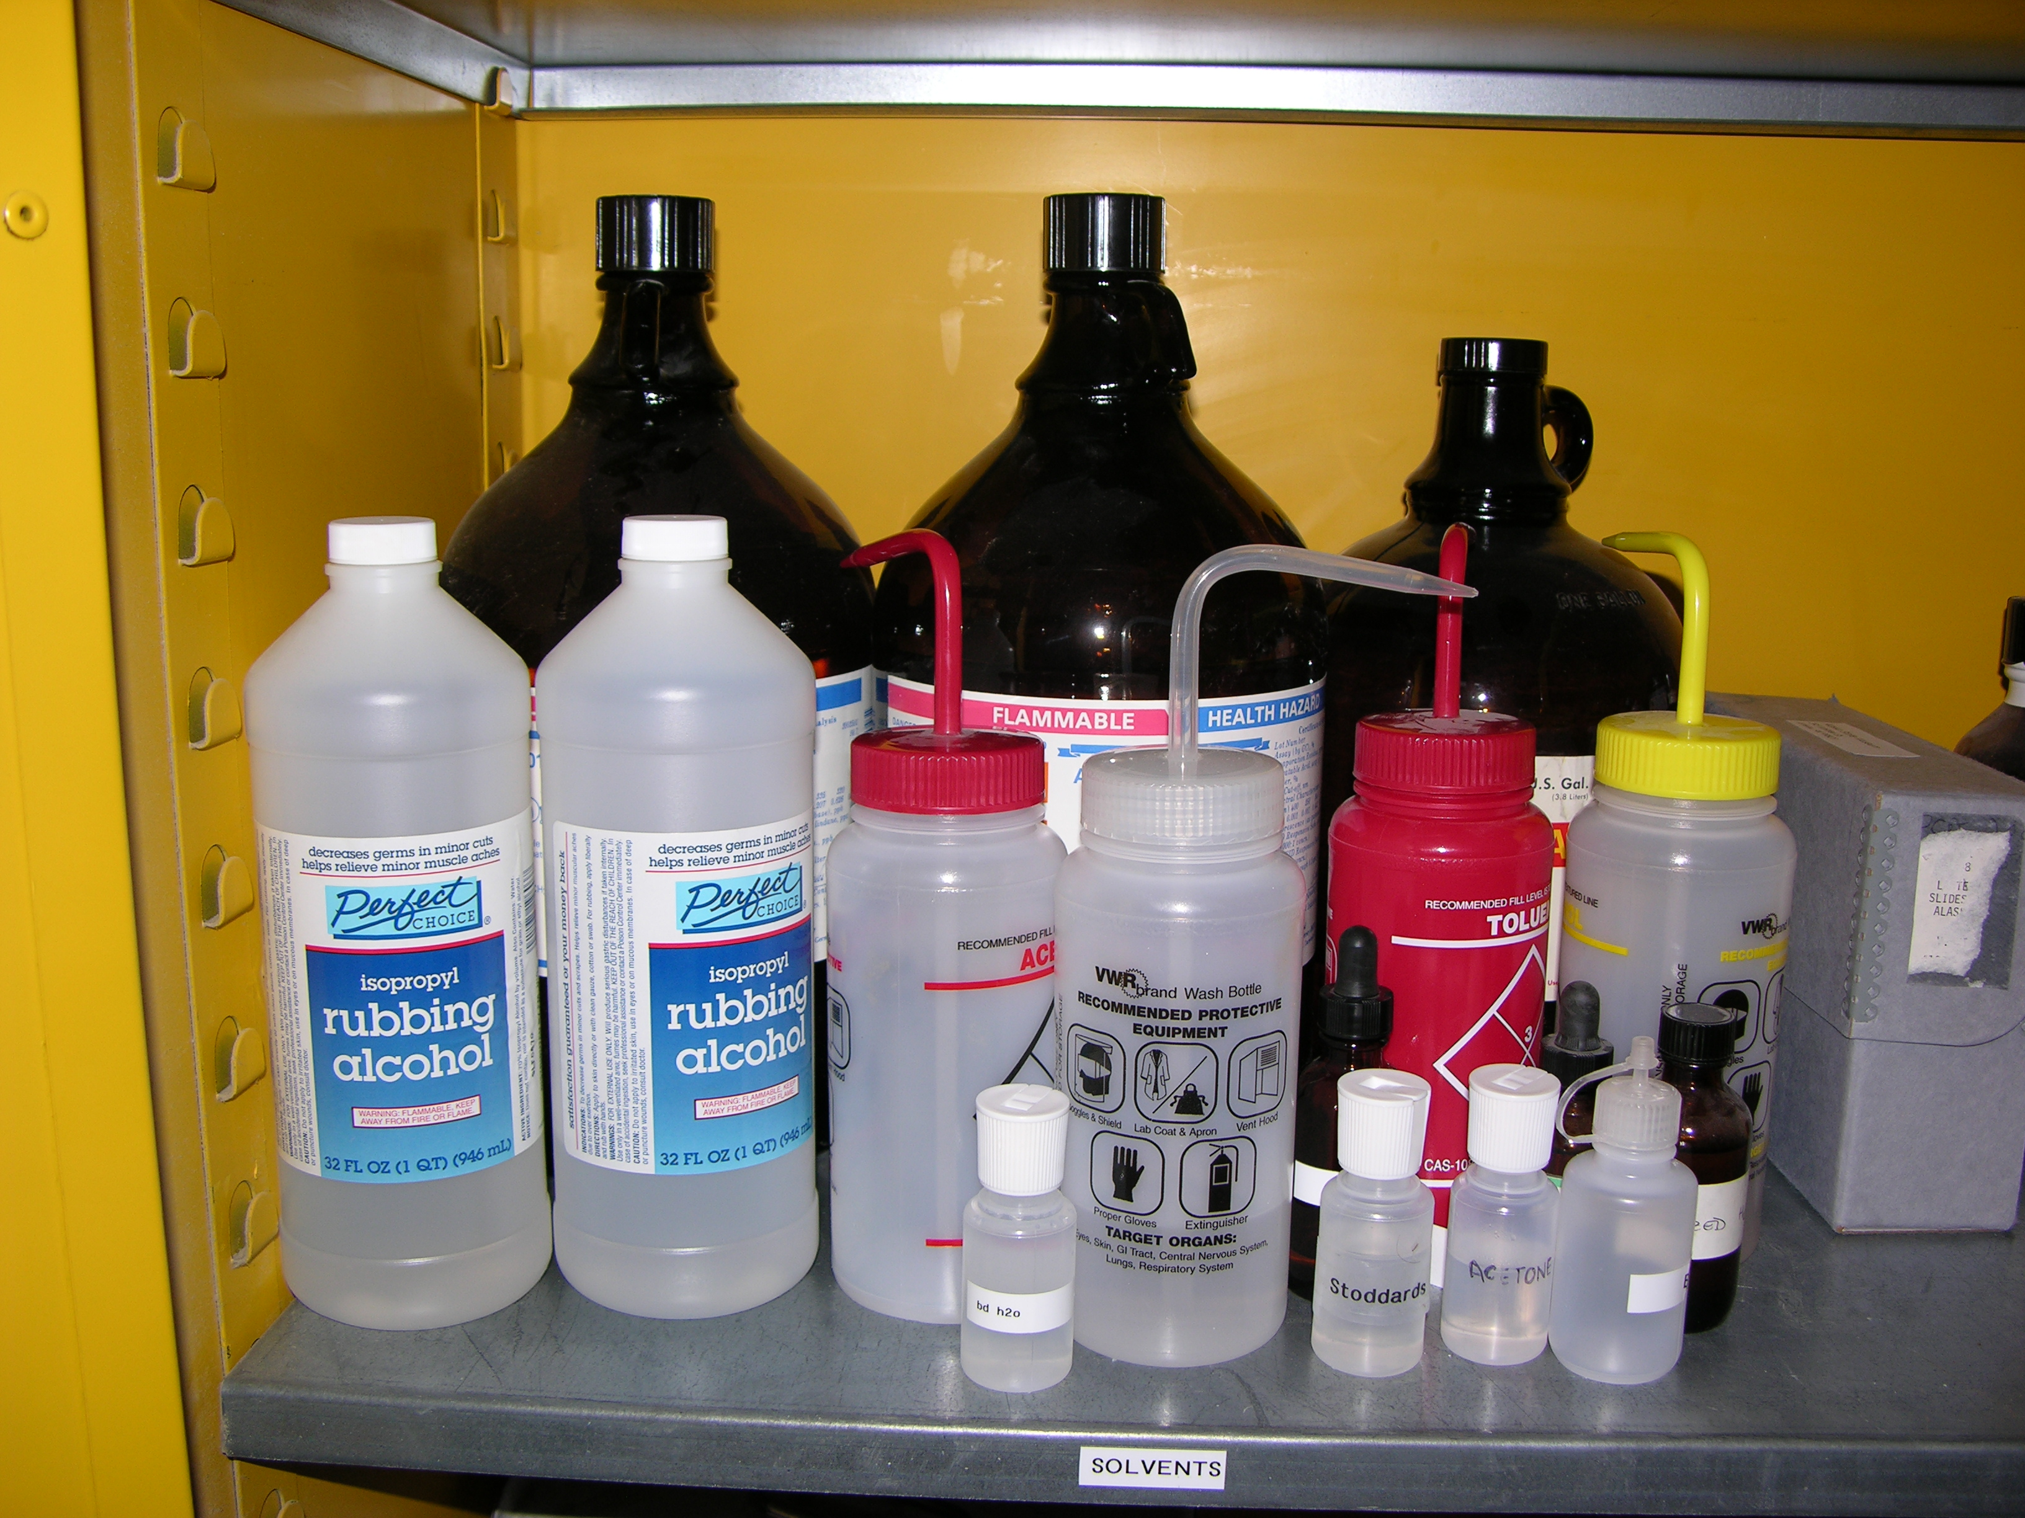
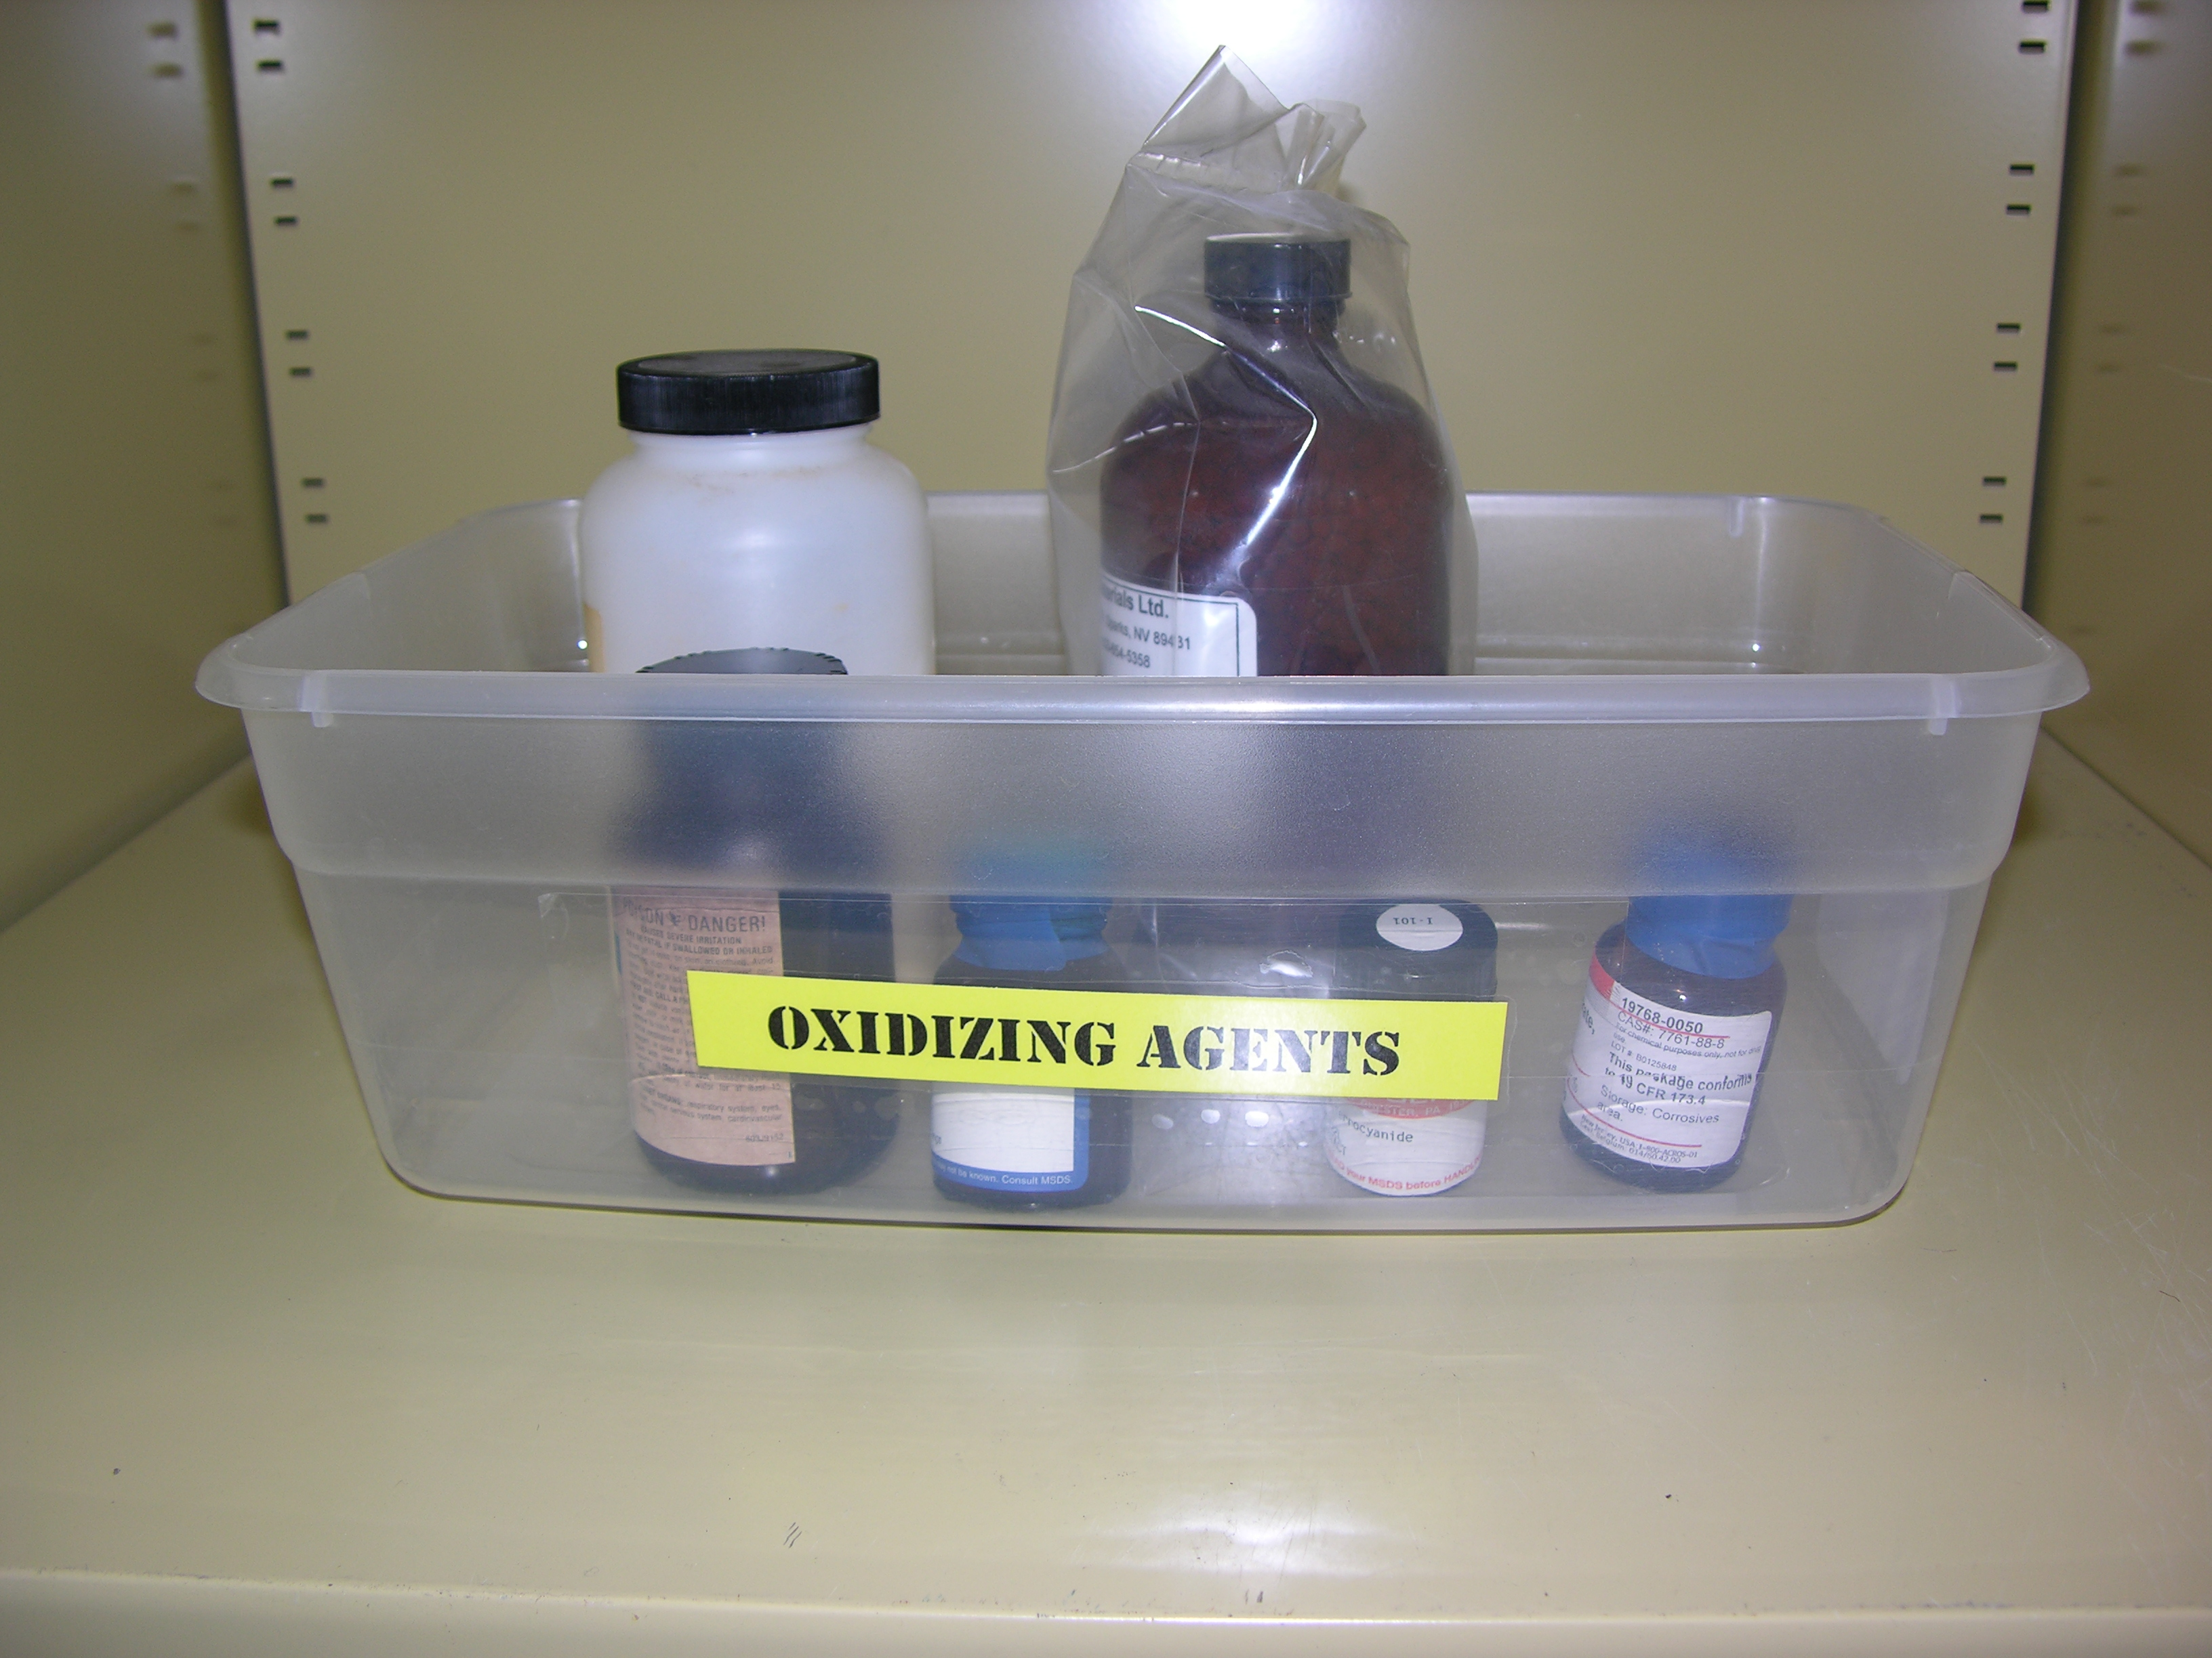
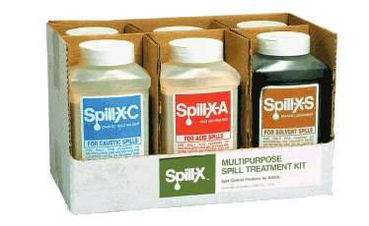
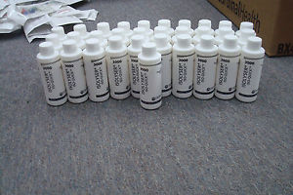
Department of Pathology and Genomic Medicine Laboratory Safety Orientation
Spills
Prevention
Prevention is the key to ensure a healthy and safe work environment. The following tips can help in prevention of spills.
Do not over fill the containers
Secure lid at all times
Chemicals are to be kept in the biohazard safety cabinet and never stored on the floor.
Hazardous chemicals outside of flammable or chemical cabinets must be stored in a secondary container.
Cleaning Up Spills
Contain and absorb small spills (10-20mL) with appropriate absorbent. Discard in red biohazard bag.
For large spills that you can’t clean yourself, isolate and notify the Call Center at 713.441.4246 or ext.14246
If exposed, flush area for at least 15 minutes and notify superiors immediately. Visit employee health clinic or ED.
Please refer to Yellow Book for any additional questions.

Slide 29
Department of Pathology and Genomic Medicine Laboratory Safety Orientation
Hazard Communication
Correct labeling of secondary containers:
Be written in English
Have the chemical name(s)
No abbreviations (ex EtOH)
No generalization (ex Piranha solution)
Give a brief description of hazards: flammable, corrosive, toxic, etc.
purpose of GHS labels

Slide 30
Department of Pathology and Genomic Medicine Laboratory Safety Orientation
Hazards Communication
Globally Harmonized System of classification and labeling of Chemicals (GHS)
Flammable, Toxic material, Toxic to environment, Corrosives
Manufacturers are required to put these labels on hazardous chemicals
If an aliquot greater than 50mL is created for any hazardous chemical, these GHS labels must be applied to the bottle and follow the laboratory procedure for labeling of reagents.
Information for each hazardous chemical can be found on the 3E Online on the hospital intranet page.
OSHA link: http://www.osha.gov/dsg/hazcom/index.html

Slide 31
Department of Pathology and Genomic Medicine Laboratory Safety Orientation
Proper use and handling of Liquid Nitrogen and Dry Ice
Dry Ice Safety
The use of insulated gloves, dry ice tongs or scoop, and safety goggles/glasses when handling dry ice is mandatory.
Store and use of all containers dry ice only in well-ventilated areas.
Do not use or store dry ice in confined areas, walk-in refrigerators, environmental chambers, or rooms without ventilation.
Why? A CO2 leak in such an area could cause an oxygen-deficient atmosphere.
Liquid Nitrogen (LN2) Safety
The use of appropriate gloves, shielding of all skin, and the use of a face shield or safety goggles when decanting or entering an open container of LN2 is mandatory.
Storage and use of all containers of LN2 only in well-ventilated areas.
Do not use or store LN2 in confined areas, walk-in refrigerators, environmental chambers, or rooms without ventilation.
Why? An LN2 leak in such an area could cause an oxygen-deficient atmosphere.

Slide 32
Department of Pathology and Genomic Medicine Laboratory Safety Orientation
BLOODBORNE PATHOGENS

Slide 33
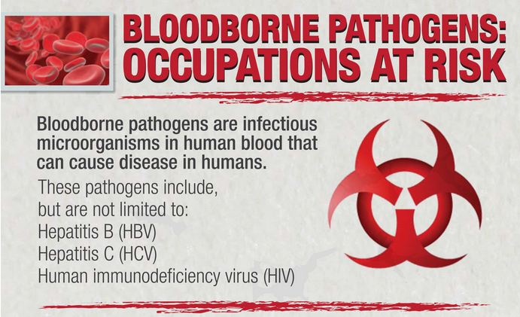
Department of Pathology and Genomic Medicine Laboratory Safety Orientation
Exposures
Link to policy tech IC40 Exposure control plan (PolicyTech )
Infection control cell phone (713-441-1391)
After 4:00 pm please contact Infection Control at 713-404-7106 pager or 713-306-7848 cell)
During EHC hours
Employee goes directly to Clinic
After hours
Employee notifies (TIC, Chief Tech, MGMT, Director or Medical Director)
Infection Control notified, Employee goes to ED
Blood is collected and tested
Employee follows up with EHC next business day
Obtaining Source blood
During EHC hours; Clinic is responsible
After hours; Infection Control, Operations Admin or Nurse on floor collect blood
How to remain Confidential during after hours
Refuse ED draw; Report to EHC next business day

Slide 34
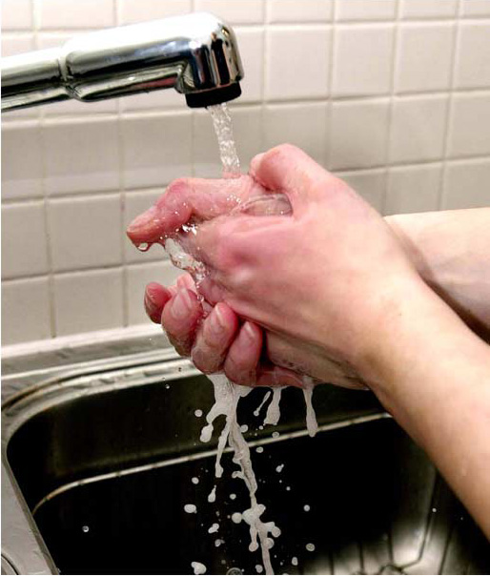
Department of Pathology and Genomic Medicine Laboratory Safety Orientation
Hand Washing & Hand Hygiene Policy
Why is hand washing important?
It is one of the most important steps in prevention of spreading pathogens to other surfaces in the hospital, hospital acquired infections and food contamination. Proper hand washing technique removes infectious organisms present on the hands.
Link to Hand Hygiene Policy

Slide 35
Department of Pathology and Genomic Medicine Laboratory Safety Orientation
Specimen Transport
Blood and other body fluid samples will be packaged in a sealable biohazard bag before being transported by hand or pneumatic tube system.
If there is a spill in the pneumatic system, refer to procedure LAB004.
Specimen acceptance criteria are outlined in LAB005 Policy and Procedure.

Slide 36
Department of Pathology and Genomic Medicine Laboratory Safety Orientation
WASTE MANAGEMENT

Slide 37
Department of Pathology and Genomic Medicine Laboratory Safety Orientation
Hazardous waste Removal – Glass clean up
When cleaning broken glass:
Always wear full PPE
Do NOT pick up by hand
Use broom and dust pan
Small broom and dust pan can always be found in each spill kit
Ensure product goes to appropriate waste container or pick-up is requested from EHS if saturated by chemical residue

