Slide 1
Anticoagulation & INR Testing
A Review

Slide 2
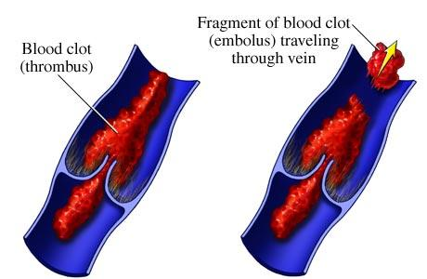
Embolus
A blood clot, air bubble, piece of fatty deposit, or other object which has been carried in the bloodstream to lodge in a vessel and cause an embolism.
Heart: Heart Attack
Lung: Pulmonary Embolism
Brain: Stroke

Slide 3
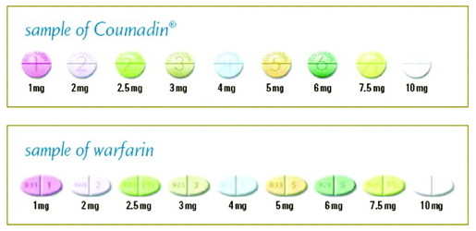
warfarin
Coumadin/Jantoven
Use:
prevention/treatment of thrombosis/embolism

Slide 4
Warfarin (Coumadin/Jantoven)
Water soluble and completely absorbed after oral administration.
Half life of 36-42 hours.
Strongly protein-bound, primarily to albumin.

Slide 5
Drug Use & Warfarin
Altered platelet function (ex. aspirin).
GI injury (ex. NSAID’s).
Altered Vitamin K synthesis in the GI tract (ex. antibiotics).
Alterations in warfarin metabolism (ex. Amiodarone).
Interference with vitamin K metabolism (ex. Acetaminophen).

Slide 6
Antibiotics & Warfarin
Often within the first three days of antibiotic use there is a risk of over-anticoagulation.
Amoxicillin, Clarithromycin, Norfloxacin, Trimethoprim-sulfamethoxazole may cause increased anticoagulation.

Slide 7
Aspirin & Warfarin
Risk of GI bleed is much higher in patient taking low dose aspirin and warfarin as compared to warfarin alone.

Slide 8
Food & Warfarin
Cranberry juice may cause elevated INR by affecting the metabolism of Coumadin.
Cranberry juice has salicylic acid which may increase the INR by displacing warfarin from the albumin sites.
Any foods high in vitamin K-dark green leafy vegetables and cashews can interfere with warfarin.

Slide 9
Alcohol & Warfarin
Acute alcohol ingestion decreases the metabolism of Coumadin and increases the PT/INR.
Chronic daily use of alcohol increases metabolism of warfarin and decreases the PT/INR.

Slide 10
CoaguChek XS from Roche

Slide 11
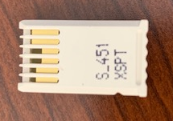
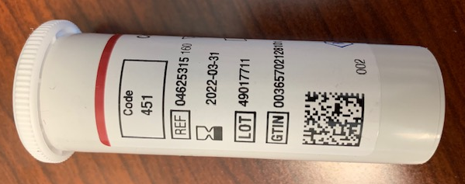
Proper use of CoaguChek XS Machine
Strips
Chip
Chip code and strip code must match.

Slide 12
Proper use of CoaguChek XS Machine
Strips can be stored and used until their expiration date.

Slide 13
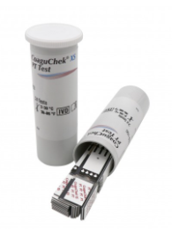
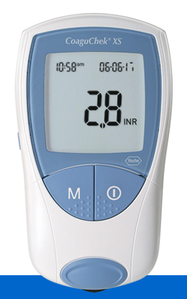
Proper use of CoaguChek XS Machine
Strips must be used within 10 minutes after removal from container for accuracy.
Container cap should be put back on tightly immediately after removing a test strip.
CoaguChek XS machine needs to be cleaned with alcohol prep pad 70% daily or if visibly soiled

Slide 14
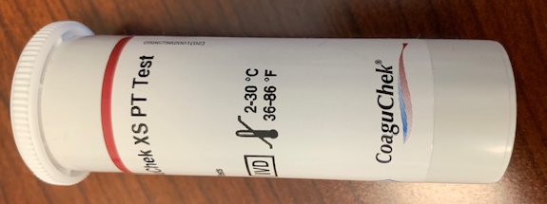
Proper use of CoaguChek XS Machine
Test strips & meter can only be used within certain temperatures.
65°-90°F (18°-32°C)
<85% noncondensing humidity

Slide 15
Critical INR Procedure
Procedure for abnormal results
1. The acceptable CoaguChek XS linearity range is 0.8 to 8.0.
2. Critical INR result >5 as established by Grand View Health Medical Staff Director
(0.8 – 2.8 if patient is taking heparin or low molecular weight heparin in conjunction with Warfarin)
3. If the result exceeds 5:
a) Follow target Coumadin parameter ranges and established Medical Practice guidelines with reference to bleeding.
b) An action must be taken to protect the patient, i.e.,
the patient is instructed to stop Coumadin for 24 hours (or more),
revisit is scheduled, and
INR rechecked.
c) Contact the physician per Medical Practice guidelines.

Slide 16
When not to use the CoaguChek XS.
With patients being treated with any direct thrombin inhibitors (Hirudin, Lepirudin, Bivalirudin, Argatroban and Dabigatran Etexilate).
With patients with a hematocrit range outside 25%-55% range.
With patients that have anti-phospholipid antibodies (APA’s) such as Lupus.

Slide 17
DOCUMENTATION OF RESULTS
The standards do not require a log sheet to be maintained for waived tests. The organization is required to be able to correlate the quality control results with the individual test results. Examples of typical correlated information would include the following:
client identifier
date of testing
test kit lot number
test result, QC lot numbers
QC results
testing personnel identifier
Logs are useful for compiling this information in one comprehensive document. Alternatively, the organization may choose to document this information in the client chart or utilize a combination of document sources to correlate the information. For example, an organization performing occult blood testing elects to document the date of testing, client result, QC result and testing personnel initials in the client chart. A separate inventory log is maintained to track the lot of reagents and test cards in use at the time of testing. Performance of initial QC for the lot, when required by the organization's policy, could also be documented on the inventory log prior to releasing the kit for general use.
https://www.jointcommission.org/standards/standard-faqs/laboratory/waived-testing-wt/000001721/

Slide 18
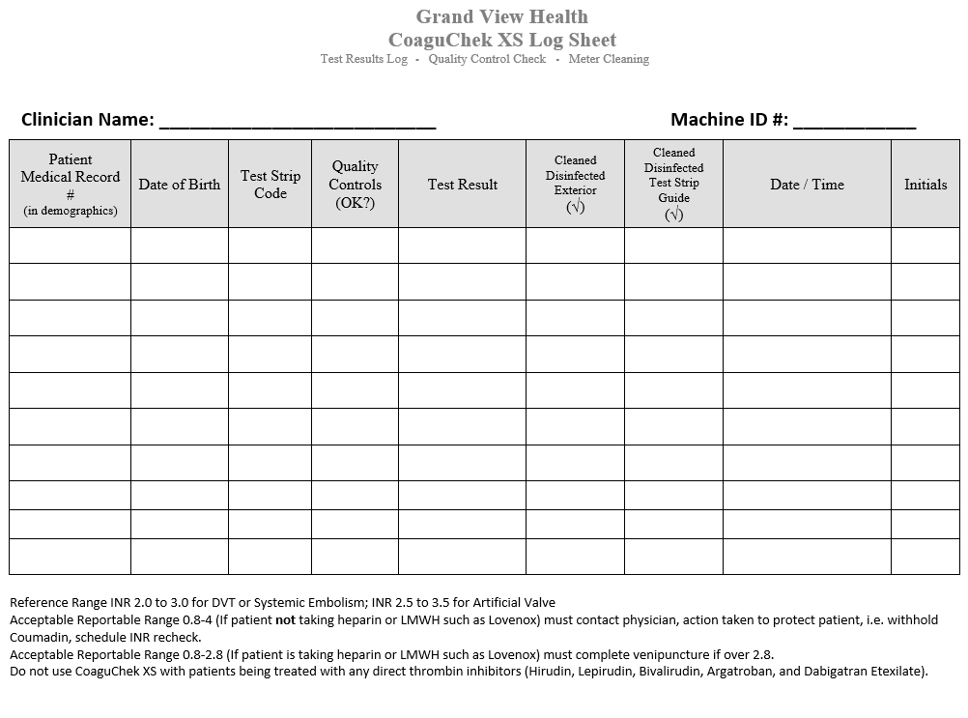
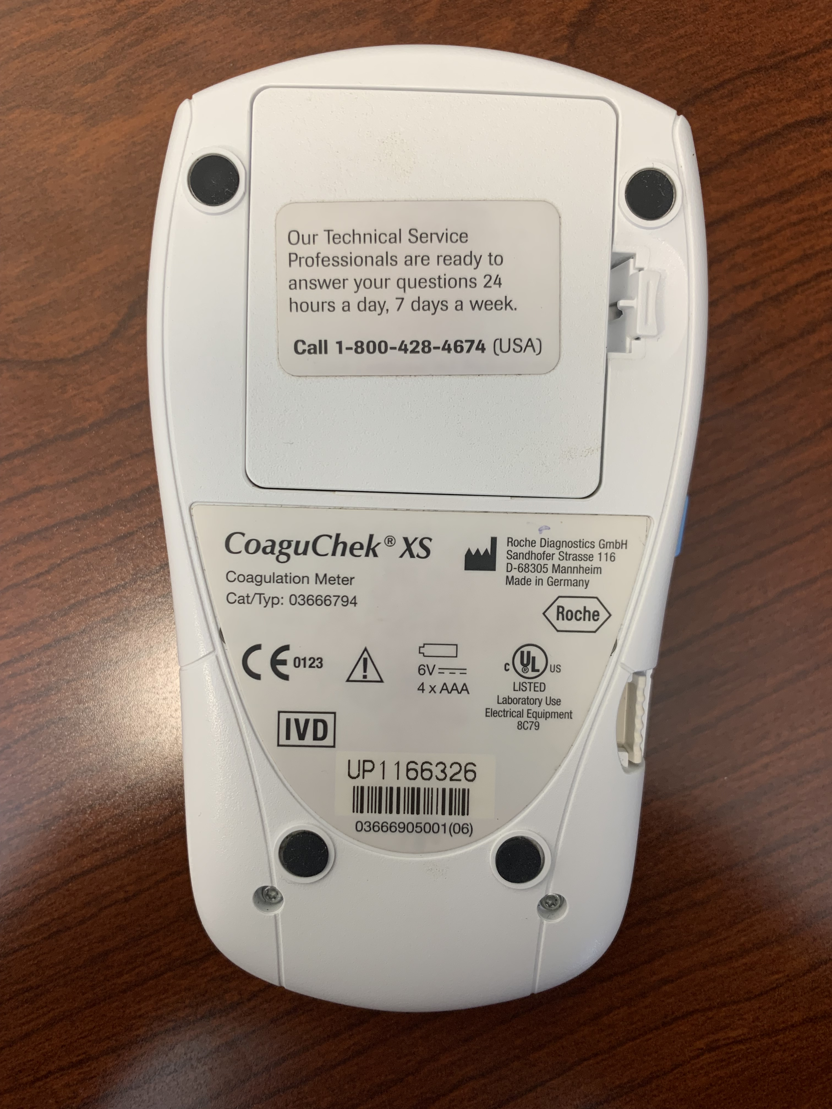
Documentation QC and Cleaning
Log Sheet
CoaguChek XS

Slide 19
Documentation
According to The Joint Commission, the following sentence must be in all charts of patients that have us complete INR for them.
REFERENCE RANGE INR 2.0 TO 3.0 FOR DVT OR SYSTEMIC EMBOLISM; INR 2.5 TO 3.5 FOR ARTIFICIAL VALVE.
Pathways – Orders Interventions Narrative Note

Slide 20
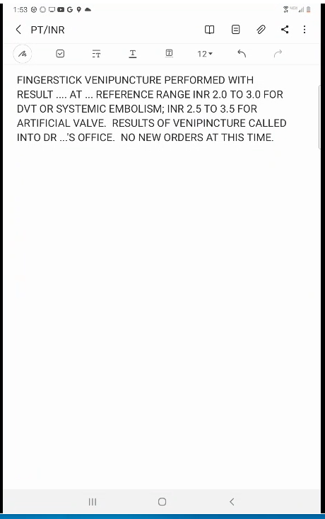
Documentation
Use of a template insures that proper documentation is completed and the required sentence is in the chart.

Slide 21
Grand View Health Responsibility
There is a delicate balance between too much and not enough anticoagulation. It is our responsibility to instruct our patients on signs and symptoms of over-anticoagulation to report.

Slide 22
Questions?
Please review the CoaguChek XS system User Manual or the CoaguChek test strip package insert or contact POCT 215-453-4317

Slide 23
Thank You!

