Slide 1
Anticoagulation & INR Testing
A Review

Slide 2
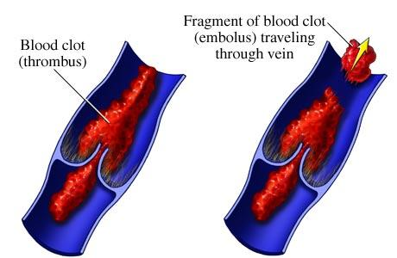
Embolus
A blood clot, air bubble, piece of fatty deposit, or other object which has been carried in the bloodstream to lodge in a vessel and cause an embolism.
Heart: Heart Attack
Lung: Pulmonary Embolism
Brain: Stroke

Slide 3
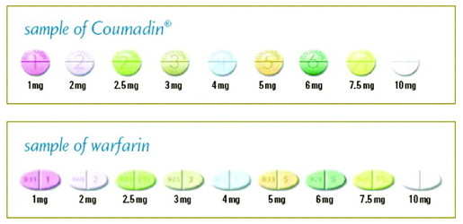
warfarin
Coumadin/Jantoven
Use:
prevention/treatment of thrombosis/embolism

Slide 4
Warfarin (Coumadin/Jantoven)
Water soluble and completely absorbed after oral administration.
Half life of 36-42 hours.
Strongly protein-bound, primarily to albumin.

Slide 5
Drug Use & Warfarin
Altered platelet function (ex. aspirin).
GI injury (ex. NSAID’s).
Altered Vitamin K synthesis in the GI tract (ex. antibiotics).
Alterations in warfarin metabolism (ex. Amiodarone).
Interference with vitamin K metabolism (ex. Acetaminophen).

Slide 6
Antibiotics & Warfarin
Often within the first three days of antibiotic use there is a risk of over-anticoagulation.
Amoxicillin, Clarithromycin, Norfloxacin, Trimethoprim-sulfamethoxazole may cause increased anticoagulation.

Slide 7
Aspirin & Warfarin
Risk of GI bleed is much higher in patient taking low dose aspirin and warfarin as compared to warfarin alone.

Slide 8
Food & Warfarin
Cranberry juice may cause elevated INR by affecting the metabolism of Coumadin.
Cranberry juice has salicylic acid which may increase the INR by displacing warfarin from the albumin sites.
Any foods high in vitamin K-dark green leafy vegetables and cashews can interfere with warfarin.

Slide 9
Alcohol & Warfarin
Acute alcohol ingestion decreases the metabolism of Coumadin and increases the PT/INR.
Chronic daily use of alcohol increases metabolism of warfarin and decreases the PT/INR.

Slide 10
CoaguChek XS from Roche

Slide 11
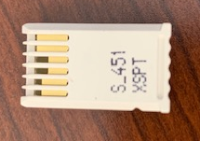
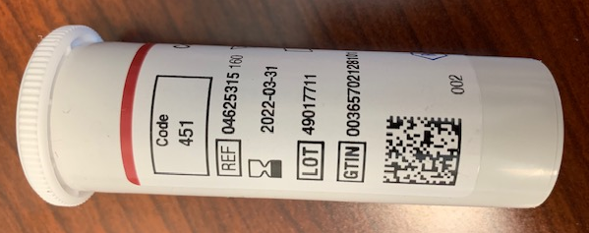
Proper use of CoaguChek XS Machine
Strips
Chip
Chip code and strip code must match.

Slide 12
Proper use of CoaguChek XS Machine
Strips can be stored and used until their expiration date.

Slide 13
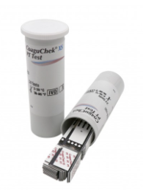
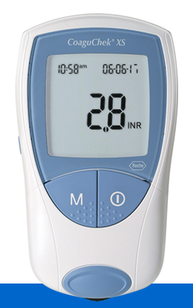
Proper use of CoaguChek XS Machine
Strips must be used within 10 minutes after removal from container for accuracy.
Container cap should be put back on tightly immediately after removing a test strip.
CoaguChek XS machine needs to be cleaned with alcohol prep pad 70% or higher after each use.

Slide 14
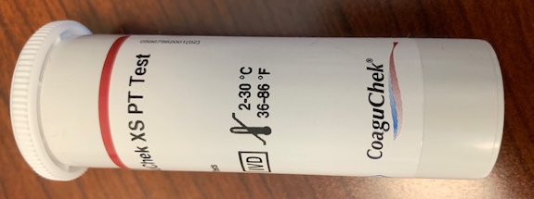
Proper use of CoaguChek XS Machine
Test strips can only be used within certain temperatures.
Take strips and CoaguChek XS machine in your home after work.

Slide 15
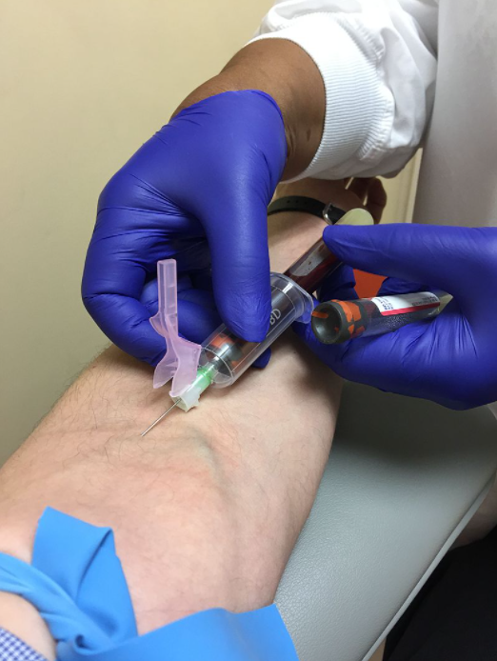
When to perform venipuncture.
Acceptable Reportable Range: 0.8 - 4 (if patient not taking Lovenox).
Must complete venipuncture if over 4.0.
Acceptable Reportable Range: 0.8 – 2.8 (if patient taking Lovenox).
Must complete venipuncture if over 2.8.
Must call physician to get an order if wanting to run a STAT INR.

Slide 16
Critical INR Procedure
If a patient has an INR above 5.0 they must have a revisit the next day.
Documentation in the chart should detail the outcome of laboratory testing, correspondence with the physician and follow up.

Slide 17
When not to use the CoaguChek XS.
With patients being treated with any direct thrombin inhibitors (Hirudin, Lepirudin, Bivalirudin, Argatroban and Dabigatran Etexilate).
With patients with a hematocrit range outside 25%-55% range.
With patients that have anti-phospholipid antibodies (APA’s) such as Lupus.

Slide 18
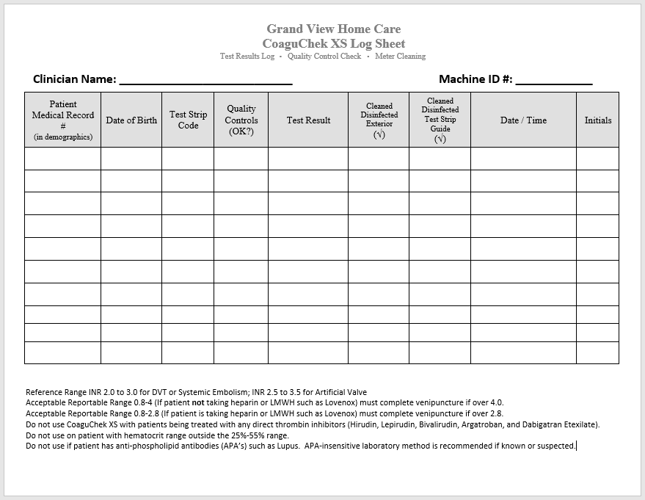
Log Sheet
Required by Joint Commission to maintain the last two years of logs to keep CLIA (Clinical Laboratory Improvement Amendments) license.
All results on log sheet must correspond with log results in CoaguChek XS machine.
CoaguChek XS machine stores the last 300 readings with the most recent one first.
Use date and time on CoaguChek XS machine for log sheet.

Slide 19
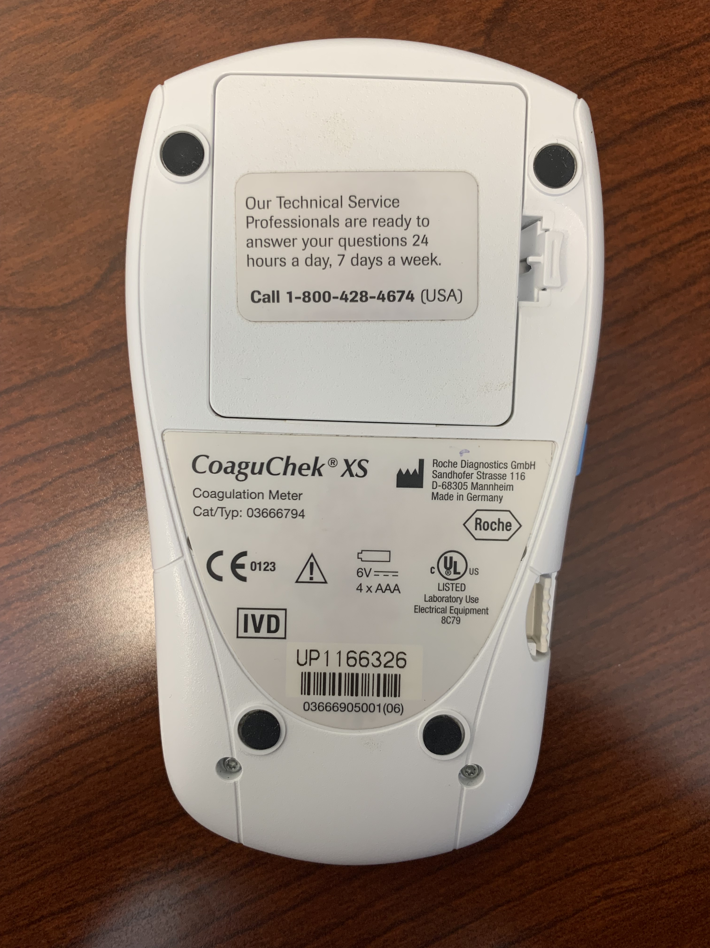
Documentation
Log Sheet
CoaguChek XS

Slide 20
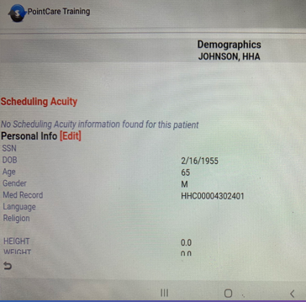
Documentation
Log Sheet
Medical Record Number

Slide 21
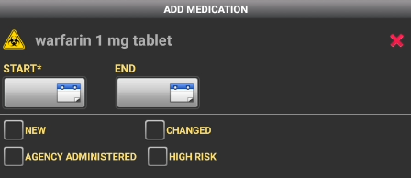
Documentation
When inputting medications into a patient chart, the only documented high risk medications for home care are…
Insulin
Oral Hypoglycemic
Coumadin/warfarin
IV Narcotics

Slide 22
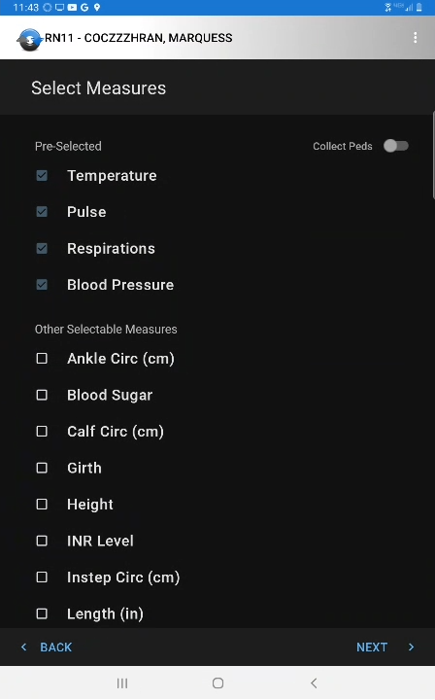
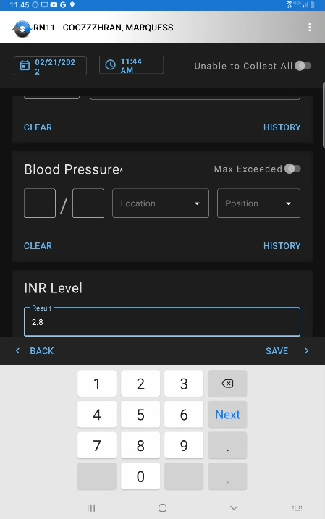
Documentation
INR can be documented in Vital Signs.

Slide 23
Documentation
According to The Joint Commission, the following sentence must be in all charts of patients that have us complete INR for them.
REFERENCE RANGE INR 2.0 TO 3.0 FOR DVT OR SYSTEMIC EMBOLISM; INR 2.5 TO 3.5 FOR ARTIFICIAL VALVE.
Pathways – Orders Interventions Narrative Note

Slide 24
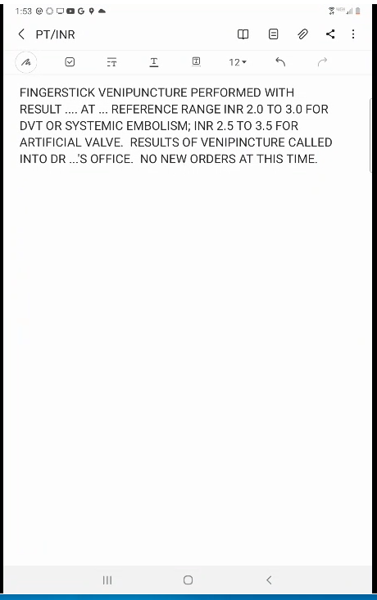
Documentation
Use of a template insures that proper documentation is completed and the required sentence is in the chart.

Slide 25
Grand View Home Care Responsibility
There is a delicate balance between too much and not enough anticoagulation. It is our responsibility to instruct our patients on signs and symptoms of over-anticoagulation to report.

Slide 26
Questions?

Slide 27
Thank You!

