Slide 1
True Metrix pro blood glucose meter

Slide 2
Intended use
The TRUE METRIX® PRO Blood Glucose Monitoring System is intended for the quantitative determination of glucose in human whole blood taken from the fingertip or forearm (capillary) or from the vein (venous). The system is not to be used for neonates. The system is intended for multiple-patient use in professional healthcare settings.

Slide 3
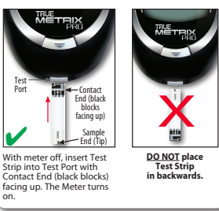
Meter and test strips

Slide 4
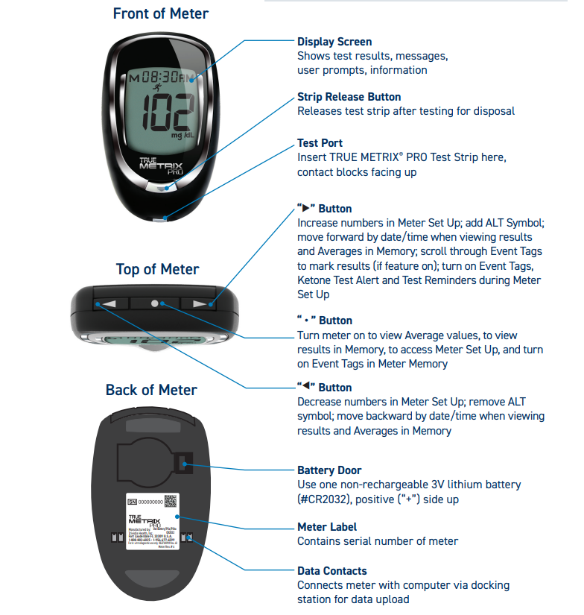

Slide 5
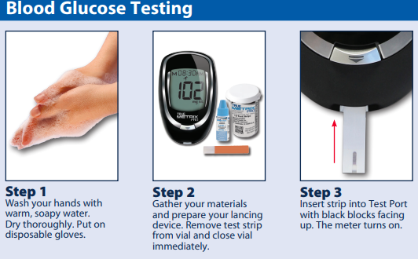
Blood glucose testing
Training video: https://www.youtube.com/watch?v=uNsdBxNCAJY

Slide 6
Meter, Control Solution & strip care
Store the system in carrying case to protect from liquids, dust and dirt.
Keep in a dry place at room temperature (40-86ºF) at 10-80% (non-condensing)relative humidity area.
Meter reads blood glucose levels from 20-600 mg/dL. If test result <20, “LO” appears; if test result reads “Hi”, result is >600 mg/dL. Always repeat test to confirm LO/HI results.
Meter turns off after 2 minutes of nonuse. 3V Lithium battery required; must be discarded as hazardous waste.
Control Solution:
• Write date opened on control solution label. Discard if either 3 months after first opening or date printed next to EXP on bottle label has passed, whichever comes first. • After use, wipe bottle tip clean and recap tightly. • Discard any control solution bottles that appear cracked or leaking. • Store at temperatures between 36°F-86°F. DO NOT FREEZE.
Control Strips: Do not use test strips 4 months past written opened date or EXP date printed on vial
• Store test strips in original vial only. Do not transfer old test strips to new vial or store test strips outside of vial. • Write date opened on test strip vial. Discard vial and unused test strips if either the open vial expiration date (see test strip Instructions for Use) or the date printed next to EXP on vial label has passed, whichever comes first. Use of test strips past expiration dates may give incorrect results. • Discard any test strip vials that appear cracked or broken. • Close vial immediately after removing test strip. Store in a dry place at room temperature (40°F-86°F ) at 10%-80% relative humidity. DO NOT FREEZE. • Do not reuse test strip. • Do not bend, cut or alter test strips in any way.

Slide 7
To Clean and Disinfect the Meter
Wash hands thoroughly with soap and water. Wear a clean pair of gloves.
2. Make sure meter is off and a test strip is not inserted.
With ONLY PDI Super Sani Cloth Wipes (EPA* reg. no. 9480-4), rub the entire outside of the meter using 3
circular wiping motions with moderate pressure on the front, back, left side, right side, top and bottom
of the meter. Repeat as needed until all surfaces are visibly clean. Discard used wipes.
3. Using fresh wipes, make sure that all outside surfaces of the meter remain wet for 2 minutes. Make
sure that no liquids enter the Test Port or any other opening in the meter.
4. Let meter air dry thoroughly before using to test.
5. Verify that the system is working properly by performing an Automatic Self-Test.
Note: Other disinfectants have not been tested. The effect of other disinfectants used interchangeably
has not been tested with the meter. Use of disinfectants other than Super Sani Cloth Wipes
may damage meter. Note: Super Sani Cloth Wipes have been tested on the meter for a total of 10,950 cleaning and
disinfecting cycles, which is equal to cleaning and disinfecting the meter 10 times per day for
a 3-year period. The expected life span of the meter is 3 years.

Slide 8
Control Test
Use ONLY TRUE METRIX® Control Solution to check the performance of
the system. It is important to perform control tests with more than one level
of control solution to assure that the system is working properly and
testing technique is good. Three levels of TRUE METRIX® Control Solution (Levels 1-3) are available.
Call 1-800-803-6025 for assistance in obtaining different levels of control solution.
Control Test(s) should be performed:
• Before using the system for the first time.
• For practice to ensure that testing technique
is good.
• When opening a new vial of test strips.
• If results seem unusually high or low based on the
patient’s condition.
• If test strip vial has been left open or exposed to
extreme heat, cold or humidity.
• Whenever a check on the performance of the system
is needed.
• If meter damage is suspected (meter was dropped,
crushed, wet, etc.).
Ranges printed on the test strip vial label are for Control Test results only and are not to
be used for management of patient’s blood glucose.
DO NOT drink control solution.

Slide 9
Helpful links
Training video
Quick reference guide
Owner’s manual

Slide 10
Helpful links
Training video: https://www.youtube.com/watch?v=uNsdBxNCAJY
Owner’s manual:
https://www.trividiahealth.com/wp-content/uploads/2024/01/RE4TVHP03-TRUE-METRIX-PRO-Owners-Booklet_012224.pdf
Quick reference guide:
https://www.trividiahealth.com/wp-content/uploads/2024/04/RE4TVHP08-TRUE-METRIX-PRO-QRC_040524.pdf
Notes:
Identical to previous slide but with links spelled out (this slide hidden)

