Slide 1
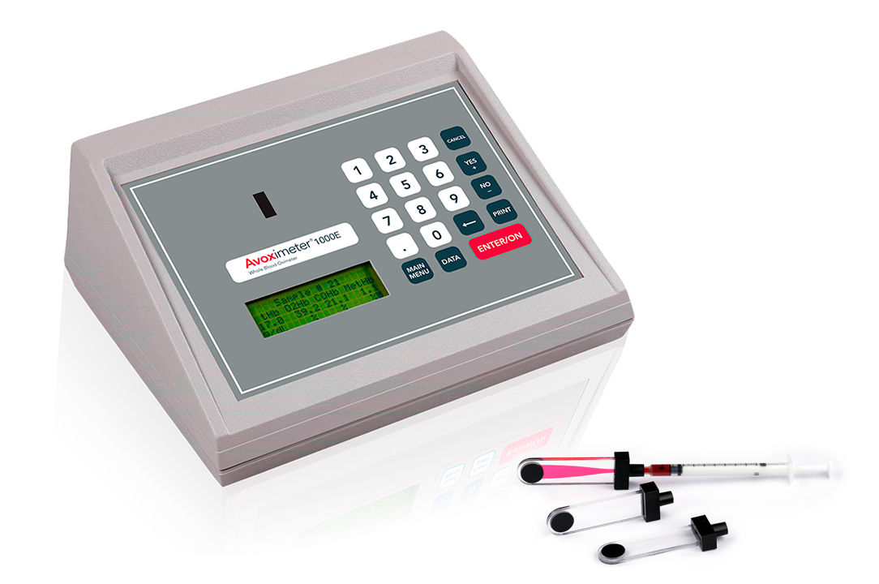
AVOX 1000E
Whole blood oximetry
Tutorial
Policy Manager #3700

Slide 2
Intended Use:
The AVOXimeter 1000E is a battery-operated bedside whole blood oximeter that performs individual point-of-care measurements of oxyhemoglobin saturation (%Hb02) and total hemoglobin concentration [THb] on lithium/sodium or heparin or EDTA anticoagulated whole blood samples. Oxygen content [02] of the blood sample is automatically calculated from the %Hb02 and THb measurements.

Slide 3
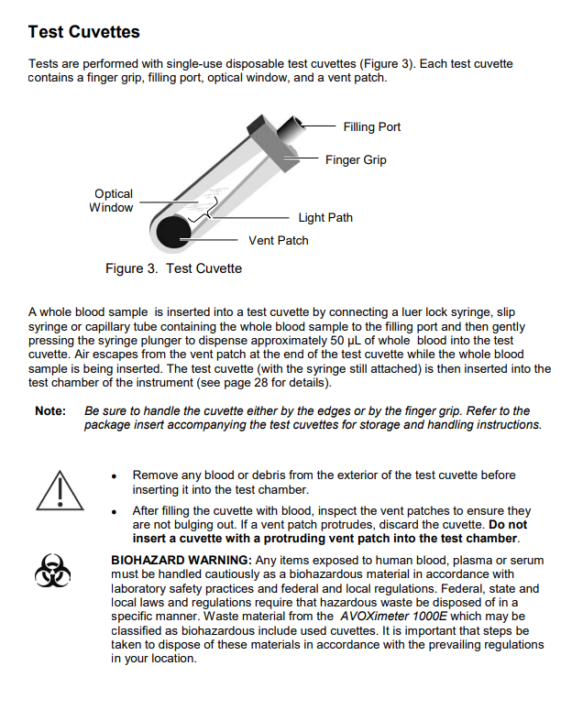

Slide 4
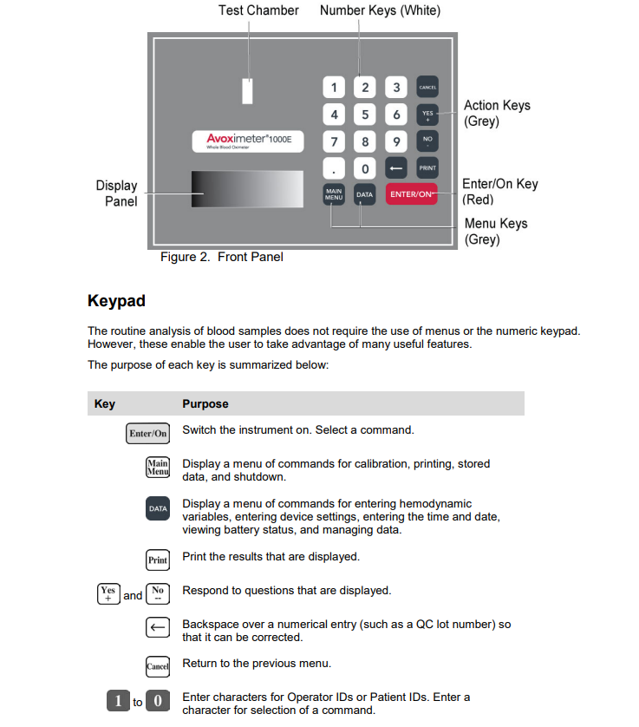

Slide 5
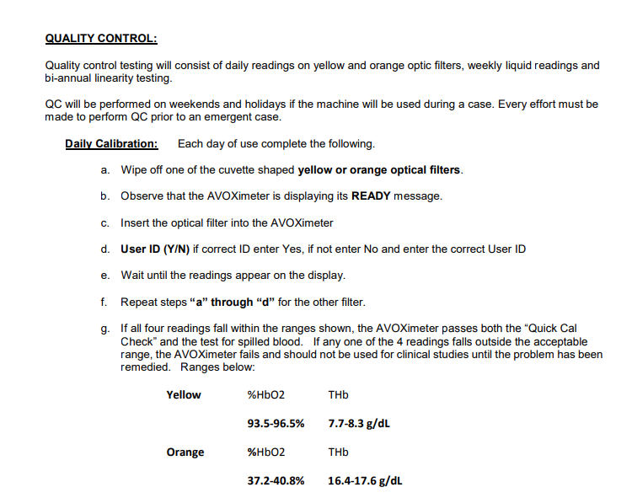
EQC

Slide 6
Patient Specimen testing using the AVOX1000e
- From Ready Screen - Prepare cuvette - Insert cuvette with rough vent patch to the left - Verify correct operator ID, change, if necessary, enter - If prompted, label site yes, choose site and subsite - Enter Patient ID, enter last 7 digits of V number, drop leading zeros (e.g. V00009380240 is entered as 9380240), correct ID yes - Record results

Slide 7
Sample Collection
Collect freshly-drawn whole blood samples in a heparin- or EDTA-anticoagulated syringe.
Do not use samples that contain excessive volumes of anticoagulant or are diluted with saline.
Note: Refer to CLSI document H18-A3, entitled “Procedures for the Handling and
Processing of Blood Specimens – Approved Guideline, Third Edition” for additional
information on sample collection
Sample Preparation
1. If the sample was not infused into the cuvette immediately after blood draw, mix
the whole blood sample by rolling the syringe between the palms of your hands.
2. Connect a syringe containing the sample to an unused cuvette. Hold the cuvette
by means of the finger grip on the black cap (see next slide).
3. Firmly holding the syringe and cuvette at a 45° angle, fill the cuvette by
gently pressing the syringe plunger.
CAUTION: Never force sample into the cuvette. If a cuvette does not fill
easily, discard it and use a new one.
4. Fill cuvette until the sample fills the cuvette to the opposite end. Do not continue
to fill the cuvette and cause the vent patch to bulge.

Slide 8
5. Verify that the light path area is free of bubbles.
6. Remove any sample from the exterior of the cuvette before placing the cuvette
(with syringe still attached) into the test chamber.

Slide 9
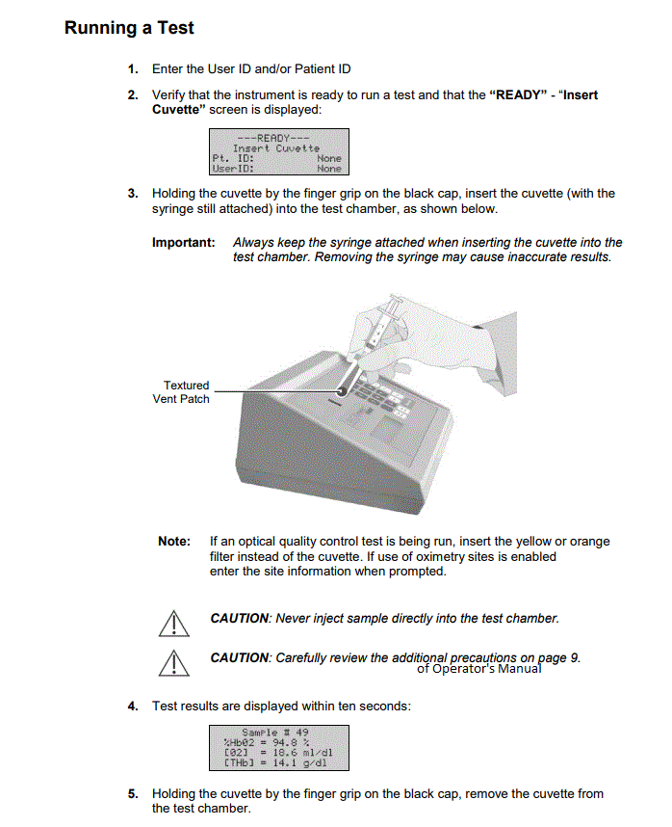

Slide 10
References:
Policy Manager #3700 Whole Blood Oximetry located on The Insider
AVOX 1000E Whole Blood Oximeter Operator’s Manual
copy located on Lab shared drive avoximeter_1000e.pdf
Reviewed 5/2024 DMK/POC

