Slide 1
Blood Glucose Monitoring Nova StatStrip®

Slide 2
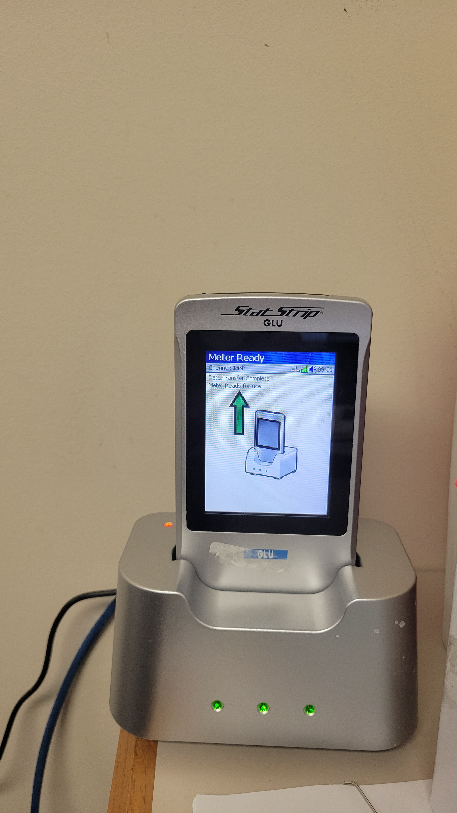
Bedside Glucose Monitor
Wireless unit- place on dock to
download results and to charge unit
Quality controls must be completed
Q24 hours
QC vials expire 90 days after opening
(date and initial)
Glucose test strips expire 180 days after
opening (date and initial)
Results below 10 mg/dL will display “LO”
Results above 600 mg/dL will display ”HIGH”

Slide 3
Monitor
The Monitor is a touch screen
Staff log in by entering 5-digit employee number
Choose patient test or QC depending
Follow instructions in the blue bar at the top of the screen. Verify lot number and patient ID.
When not in use the meter must be placed in the docking stations to successfully transmit the data and to charge the meter

Slide 4
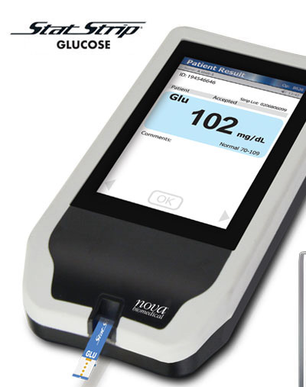
patient testing
Log in only under your own employee ID
As per FDA regulations, fingerstick glucose determinations are not to be performed on patients having cold fingers or poor circulation. Consult nurse for further instruction.
Best practice is to clean the skin with alcohol pad before piercing the skin, wiping away the first drop of blood, and using the second drop of blood for the test
For results “LO” (<10) or “HIGH” (>600), repeat testing.
Clean & Disinfect the meter; redock

Slide 5
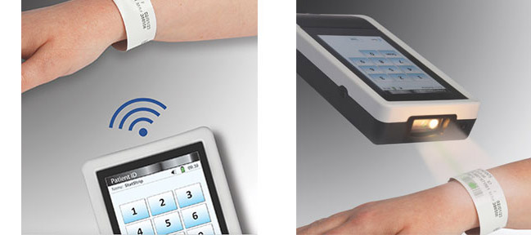
Unregistered patient or wristband doesn’t scan
Enter the patient’s V# beginning with the 9 if wristband does not scan
Complete form and send to the Lab to be documented in patient’s chart for compliance.
If patient does not have a wristband or they are not registered (visitor, employee), follow instructions on form, using a generic ID # and send the completed form (patient name, operator, time etc.) to the Lab so information can be deleted appropriately from the system.

