Slide 1
Blood Glucose Monitoring StatStrip Xpress2 Glucose Meter ®

Slide 2
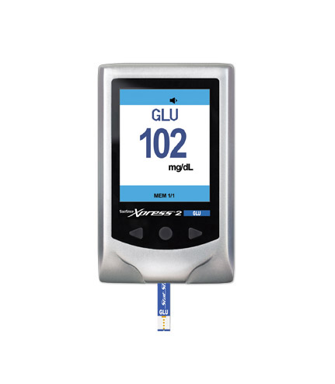
POC Glucose Monitor
Battery Information:2 AA batteries
Quality controls must be completed
Daily when meter in use
QC vials expire 90 days after opening
(date and initial)
Glucose test strips expire 180 days after
opening (date and initial)
Results below 10 mg/dL will display “LO”
Results above 600 mg/dL will display ”HIGH”

Slide 3
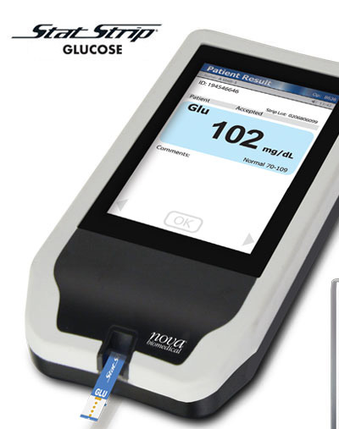
patient testing
As per FDA regulations, fingerstick glucose determinations are not to be performed on patients having cold fingers or poor circulation. Consult nurse for further instruction.
Best practice is to clean the skin with alcohol pad before piercing the skin, wiping away the first drop of blood, and using the second drop of blood for the test
For results “LO” (<10) or “HIGH” (>600), repeat testing.
Clean & Disinfect the meter

Slide 4
