Slide 1

Gem Hemochron 100 ACT-LR
Tutorial

Slide 2
Intended Use:
The Gem Hemochron 100 ACT-LR ( Low Range Activated Clotting Time ) test is a quantitative assay for monitoring anticoagulation with low to moderate unfractionated heparin doses in fresh whole blood samples.

Slide 3
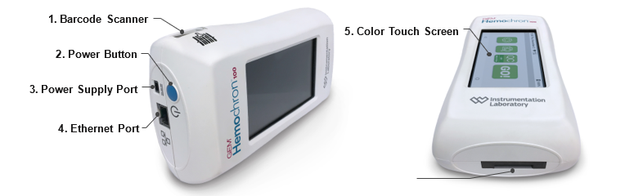
Hemochron 100 Components

Slide 4

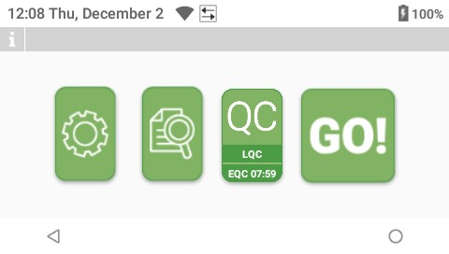



Hemochron 100 Home Screen Icons
Settings
View Test results
Back
Home

Slide 5
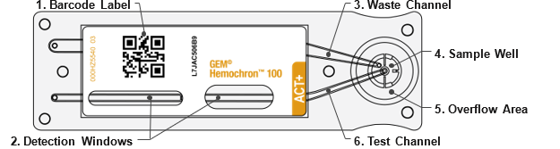
Hemochron 100 Test Cartridge

Slide 6
Hemochron 100 Verifying EQC
  - If screen is dark tap to activate.
  - EQC is required every 8 hours.
  ( it is automatically run every 8 hours )
  View time remaining on QC icon.
  - EQC takes 5 minutes to run
  - If time remaining is less than 3 hours
  initiate EQC.

Slide 7
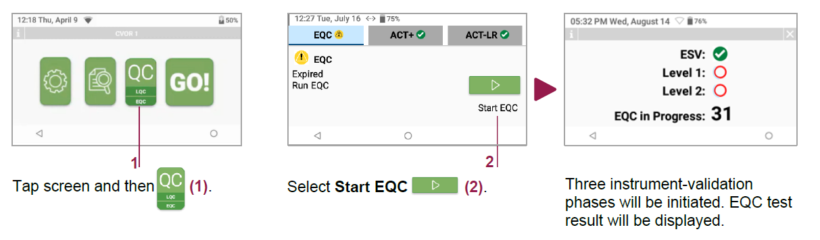
Hemochron 100 Running EQC

Slide 8
Hemochron 100 Running EQC

Slide 9
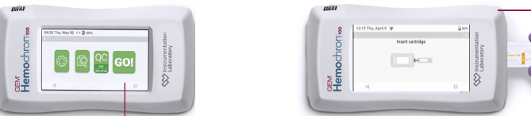
Hemochron 100 Running Patient Specimen

Slide 10
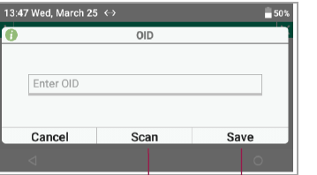
Hemochron 100 Running Patient Specimen

Slide 11
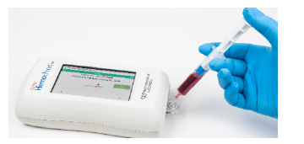
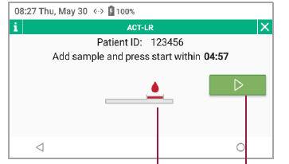
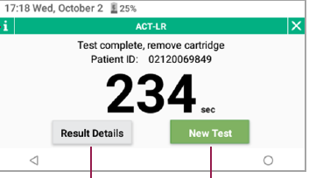
Hemochron 100 Running Patient Specimen

Slide 12
Hemochron 100 Notes to Remember - Specimen Collection
Collect fresh whole blood samples for coagulation testing in accordance with institutional procedures and the Clinical and Laboratory Standards Institute (CLSI) guideline POCT14‑A ensuring sufficient dead space volume of blood is removed prior to specimen collection, when applicable.
Collect blood specimens in a manner that prevents contamination with tissue thromboplastin, indwelling intravenous (IV) solutions, or alcohol cleansing solution. Discard samples that are not properly collected or contain visible clots or debris.

Slide 13
Hemochron 100 Notes To Remember – Loading the Cartridge
Keep the instrument on a horizontal and stable surface.
Operators must not prepare the patient sample until the instrument prompts them to apply the sample to the test cartridge. If the patient sample is prepared too early, premature clotting will cause erroneous test results.
- Collect a minimum of 0.2 ml of fresh whole blood using a non-reactive plastic syringe without additive.
- Mix sample well and discard one drop before dispensing on cartridge.
- Dispense 1-2 drops of blood in center of sample well on cartridge

Slide 14
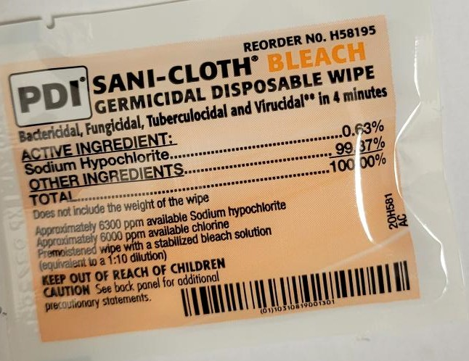

Hemochron 100 Notes to Remember – Data Transmission and Maintenance
- Hemochron 100 is WiFi capable
- Following procedure Hemochron 100 must be returned to Specimen Storage room with reconnection of Power source ( with white triangle Up)
- Results are transmitted to the EMR through middleware.
- Wipe down instrument after each procedure or when visibly soiled.
Using PDI Sani-Cloth Bleach Germicidal Disposable Wipe.

