Slide 1
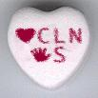
Aerosol Transmissible Disease
Annemarie Flood RN BSN CIC

Slide 2
Airborne Transmission

Slide 3
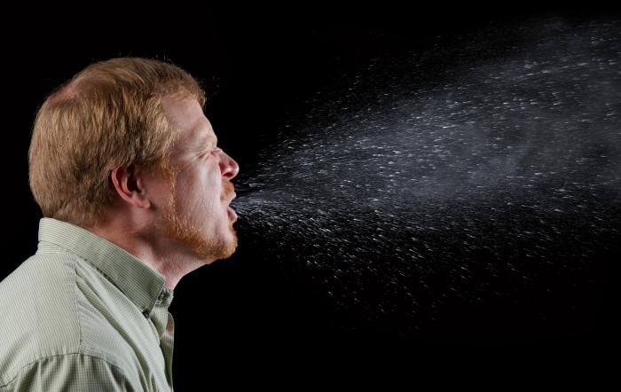
Droplet Transmission

Slide 4
Tuberculosis
Latent vs. Disease
a bad cough that lasts 3 weeks or longer
pain in the chest
coughing up blood or sputum
weakness or fatigue
weight loss
no appetite
chills
fever
sweating at night

Slide 5
Tuberculosis Incidence
One third of the world’s population is infected with TB.
In 2012, nearly 9 million people around the world became sick with TB disease.
There were around 1.3 million TB-related deaths worldwide.
TB is a leading killer of people who are HIV infected
In 2013, a total of 9,588 new tuberculosis (TB) cases were reported in the United States
There were 2170 cases of TB in California in 2013

Slide 6
Measles
Fever, followed by a cough, runny nose, and conjunctivitis (pink eye).
A rash starts on the face and upper neck, spreads down the back and trunk, then extends to the arms and hands, as well as the legs and feet. After about 5 days, the rash fades the same order in which it appeared.
measles can lead to pneumonia
it can also cause lifelong brain damage, deafness, and even death.
one to three out of 1,000 children in the U.S. who get measles will die
Before the measles vaccination program started in 1963, about 3 to 4 million people got measles each year in the US
48,000 people were hospitalized, 1,000 suffered brain damage or became deaf,
450 died because of measles

Slide 7
Recent Measles Outbreaks
Out of 129 nationwide cases so far this year, 58 are in California. Ten of those are in Los Angeles County, and 22 are in Orange County.
Last year in California, there was a 15-percent increase in the number of parents opting out of immunizations. In Orange County, health officials report a 30-percent increase.
Notes:
California was associated with out of country travel by an non immunized child.

Slide 8
Varicella ( Chicken Pox)
High fever
Tiredness
Loss of appetite
Headache
The rash usually appears first on the head, chest, and back then spreads to the rest of the body. The lesions are usually most concentrated on the chest and back

Slide 9
Chicken Pox Incidence
4362 cases in 2013
2646 as of 5/4/14
Vaccine became available in 1995
Before the vaccine, about 4 million people would get chickenpox each year in the United States. Also, about 10,600 people were hospitalized and 100 to 150 died each year as a result of chickenpox.

Slide 10
Mumps
Swollen, painful salivary glands on one or both sides of face (parotitis)
Fever
Headache
Weakness and fatigue
Loss of appetite
Pain while chewing or swallowing
Can cause encephalitis, orchitis( 37% post pubertal) , miscarriage in first trimester
Notes:
Mumps is usually a mild viral disease.
However, serious complications, such as inflammation of the brain (encephalitis) can occur rarely. Prior to mumps vaccine, mumps encephalitis was the leading cause of viral encephalitis in the United States,
Serious side effects of mumps are more common among adults than children.
Among males, mumps can lead to, a testicular inflammation that causes pain, swelling, nausea, vomiting and fever. ( 37% of post pubertal males)
Among some women with mumps, inflammation of the ovaries or breasts can occur
An increase in miscarriages has been found among women who develop mumps during the first trimester of pregnancy.

Slide 11
Recent Mumps Outbreaks
January 1 to May 2, 2014, 464 people in the United States have been reported to have mumps.
Outbreaks in at least two U.S. universities have contributed to these cases in Ohio and New York

Slide 12
Rubella
Symptoms that to of flu. Fever, sore throat , body aches, swollen glands 1-5 days before rash appears.
Rash on the face which spreads to the trunk and limbs and usually fades after three days
Infection in the first trimester of pregnancy will develop congenital rubella syndrome (CRS), resulting in heart defects, cataracts, mental retardation, and deafness.
Notes:
In 1964-1965, before rubella immunization was used routinely in the U.S., there was an epidemic of rubella that resulted in an estimated 20,000 infants born with CRS, with 2,100 neonatal deaths and 11,250 miscarriages. Of the 20,000 infants born with CRS, 11,600 were deaf, 3,580 were blind, and 1,800 were mentally retarded.
Less red rash Due to the widespread use of rubella vaccine, only six CRS cases were provisionally reported in the U.S. in 2000. Because many developing countries do not include rubella in the childhood immunization schedule, many of these cases occurred in foreign-born adults. Since 1996, greater than 50 percent of the reported rubella cases have been among adults. Since 1999, there have been 40 pregnant women infected with rubella.

Slide 13
Rubella Out Breaks
Rubella has not been detected in the US since 2009
In 1964-1965, before rubella immunization was used routinely in the U.S., there was an epidemic of rubella that resulted in an estimated 20,000 infants born with CRS, with 2,100 neonatal deaths and 11,250 miscarriages. Of the 20,000 infants born with CRS, 11,600 were deaf, 3,580 were blind, and 1,800 were mentally retarded

Slide 14
Pertussis (Whooping Cough)
Serious illness, particularly for babies and young children. More than 50% of babies with reported cases of pertussis must be hospitalized. Coughing can be so severe that it is hard for babies to eat, drink or breathe.
Babies may bleed behind the eyes and in the brain from coughing.
The most common complication is bacterial pneumonia. About 1 child in 10 with pertussis also gets pneumonia, and about 1 in every 50 will have convulsions.
Brain damage occurs in 1 out of every 250 children who get pertussis.
Pertussis causes about 10-20 deaths each year in the United States.

Slide 15
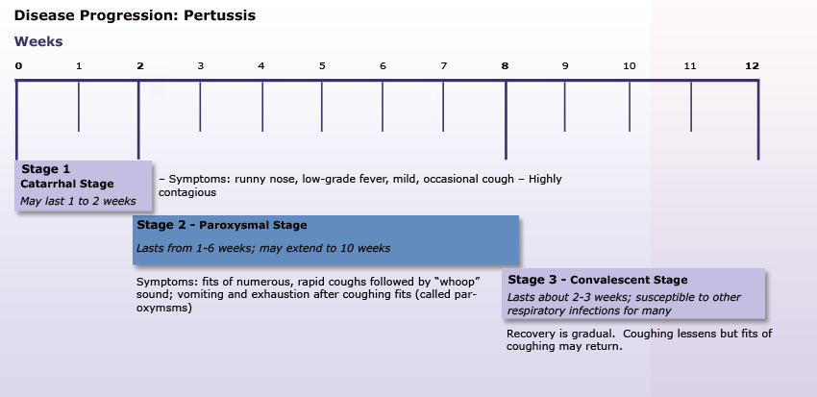

Slide 16
Pertussis Outbreaks
Over 9,000 cases of pertussis were reported in California during 2010, the most in over 60 years, including 10 infant deaths. Pertussis continues to circulate throughout California and the rest of the world
From January 1-April 14, 2014, 4,838 cases of pertussis have been reported to CDC by 48 states and Washington, D.C.; This represents a 24% increase compared with the same time period in 2013.

Slide 17
Neisseria Meningitis
Sudden onset of fever, headache, and stiff neck. There are often additional symptoms, such as Nausea, Vomiting, Photophobia (increased sensitivity to light)
Altered mental status (confusion)
The symptoms of meningococcal meningitis can appear quickly or over several days. Typically they develop within 3-7 days after exposure

Slide 18
Meningococcal Septicemia
Bacteria enter the bloodstream and multiply, damaging the walls of the blood vessels and causing bleeding into the skin and organs.
Symptoms may include:
Fatigue, Vomiting
Cold hands and feet, Cold chills
Severe aches or pain in the muscles, joints, chest or abdomen (belly)
Rapid breathing
Diarrhea
In the later stages, a dark purple rash

Slide 19
Meningococcal Outbreaks
Two U.S. Universities are experiencing unrelated outbreaks of serogroup B meningococcal disease.
Princeton University
University of California, Santa Barbara
The department of public health has confirmed a total of eight cases of invasive meningococcal disease (IMD) in Los Angeles county so far this year, including four cases reported among men who have sex with men (MSM), of which three men who were HIV-positive.

Slide 20
Influenza
Fever* or feeling feverish/chills
Cough
Sore throat
Runny or stuffy nose
Muscle or body aches
Headaches
Fatigue (tiredness)
Some people may have vomiting and diarrhea, though this is more common in children than adults.

Slide 21
Why Do We Need a New Shot Each Year?
Notes:
Influenza A viruses are divided into subtypes based on two proteins on the surface of the virus: the hemagglutinin (H) and the neuraminidase (N). There are 18 different hemagglutinin subtypes and 11 different neuraminidase subtypes.

Slide 22
So What Can We do?

Slide 23
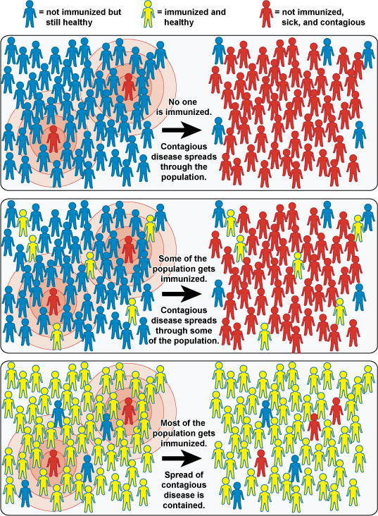

Slide 24
Respiratory Hygiene and Cough Etiquette

Slide 25
Any Questions?

