Slide 1
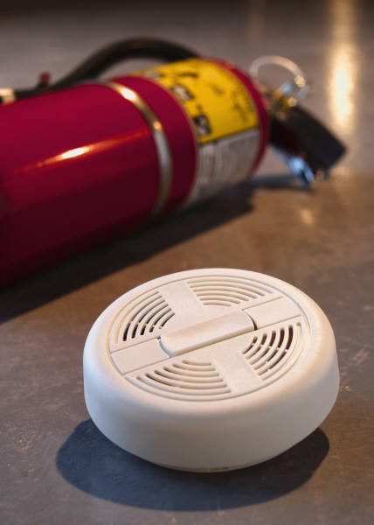
ISO FUNdamentals
October 2013
Excellence in Patient Care through Standardization
Preventive Action
ISO 9001: 2008
(International Organization for Standardization)
IMPLEMENTING ISO 9001
When a process does not meet patient needs, or is not working as intended, or when we are not providing consistently excellent service, a gap is acknowledged and we work to fix it. Verde Valley Medical Center’s improvement processes empower staff to address current and potential problems.
A KEY TOOL: THE PREVENTIVE ACTION PROCESS
The preventive action policy and procedure helps provide a way to avert a potential problem. Initiating this process helps prevent adverse events before they occur to avoid future issues. Talk to your director if you identify any potential opportunities to prevent errors or harm to patients or staff.
WHAT CAN YOU DO TO HELP PREVENT POTENTIAL PROBLEMS?
Use MIDAS to report events that occur in your department or unit. Identify the cause of the event when you can.
As part of this reporting, be sure to report “Good Catches”. These “Good Catches” help us improve care for patients and prevent future risk to patients or employees.
Provide the best patient experience possible! Work with your director to address patient complaints while the patient is still in the hospital. Help us exceed patient expectations!
Follow evidence-based practice and standardized approaches to ensure high quality care on core measures and patient safety initiatives. For example, help prevent patient falls through hourly rounding.
Follow policies and procedures to ensure a safe environment of care, emergency preparedness, and occupational health & safety.
WHAT DOES VVMC DO TO HELP PREVENT POTENTIAL PROBLEMS?
There is a Preventive Action Policy. (HOSP 900.08)
Across the organization, department managers review various reports to identify trends or opportunities to improve. For example, directors review event reports, patient complaints or grievances, or quality indicators such as infection rates.
Non-clinical reviews occur as well, such as preventive maintenance, information security issues, and environment of care concerns.
We also keep an eye on what’s happening outside VVMC, such as medication safety
alerts or sentinel event alerts.
3 C’s of ISO: Consistency, Customer (Patient) Focus, and Continual Improvement

