Slide 1
Leading at the
SPEED OF TRUST
Franklin Covey

Slide 2
High cost low trust
What is Trust? I could give you a dictionary definition but you know it when you feel it. Trust happens when leaders are transparent, candid, and keep their word. It’s that Simple. – Jack Welch, former CEO, General Electric

Slide 3
3 BIG IDEAS
Trust is an economic driver, not merely a social virtue.
http://shar.es/1Woq5d
One of the easiest ways to explain that is if you have low trust, you might be able to coordinate. If you have a little bit more trust, you can cooperate. But to collaborate requires a level of trust where you feel safe to be transparent internally and externally — with your employees, your stakeholders, and your customers. To enjoy that kind of exchange requires a high level of trust. – Stephen Covey

Slide 4
Trust Continued…
2. Trust is the #1 competency of leadership needed today.
The first job of a leader is to inspire trust. The second job is to extend it. So the whole idea of leadership is the ability to extend trust to others and do it in a smart way.
Trust is a learnable competency.
You can increase Trust, create it, grow it, and establish it on purpose.

Slide 5
Lab Example of Trust in Action
Recently the Lab demonstrated a good example of trust. Diane and Terrill were the techs and Sherry was the Lab Assistant. Three emergency surgeries came up which pulled Diane away into blood bank leaving Terrill to cover all other departments. Sherry was processing and drawing patients. Because we had a structure in place built on trust that had been delegated by management Sherry was able to call in Mary Ann.
This showed trust in leaders to have a schedule in play to have an “on call person” who is competent to come in and jump in on any situation.
Trust in the techs and lab assistants to handle a situation as such with the proper training.
This is different from Low Trust that could result in a patients life which is immeasurable or a lawsuit.
* WE TRUST UNTIL WE HAVE BEEN GIVEN REASON NOT TO TRUST*

Slide 6
Walls
Building Trust Breaking Down Walls
http://shar.es/1W392S

Slide 7
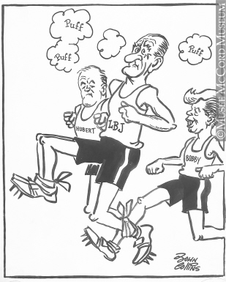
Team building exercise

